Slide 1
Primer Notes

Slide 2
Testing
our definition: “anything that proves that a requirement is satisfied”
a way of ensuring that we get expected results
Code quality check is also sort of a test
Quality Assurance: guaranteeing quality is maintained; processes that go into making sure that a certain standard is met for the client

Slide 3
Testing Pyramid
User Acceptance Test (UAT): Tests conduct by an actual human; usually it tests to see if it meets the requirement in a way that could be deemed as acceptable to the average user
Ex: a product owner using the developed application and giving feedback on whether or not it is satisfactory; Alpha and Beta testing
System Test: ensuring that the whole app works as a whole; E2E
Selenium, Protractor, Postman
Integration Test: testing multiple units together
Ex: testing a repository method by transacting on the db
Unit Test: A method test; testing the smallest possible unit
Increase in cost (less frequent)
Increase in Frequency (faster,cheaper)

Slide 4
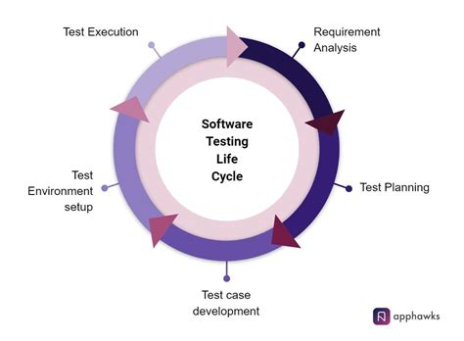
Testing Lifecycle
Iterative process of analyzing requirements and developing/executing testing regime
Logical problem-solving process

Slide 5
Functional Testing
Doing testing where you provide a set of inputs and verify against a set of outputs
Testing to see if the feature work as intended
Are there test that are non-functional?
Performance testing: Load testing, etc.
Security

Slide 6
TDD
Test Driven Development
Development philosophy that prioritizes developing tests prior to implementing functionality
Acceptance vs Developer TDD
Ex: analyze requirements -> Write Method signiature -> write Junit test case -> write implementation for method -> code until it passes

Slide 7
Test Strategy Document
A static document that sets standards for testing standards and activities
Doesn’t get changed often; sets precedence for application
Test Strategy is DIFFERENT from the Test plan document
Test Strategy is more high level and more static
Usually created by product manager; illustrates what the expectations are form the product manager
https://www.guru99.com/how-to-create-test-strategy-document.html

Slide 8
Test Plan Document
Defines scope objective approach emphasis on a software testing approach effort
It tells you per project what you are going to do for testing/what is in your scope
It is project specific and dynamic (can be changed at any time)
Usually made by test lead or manager
https://www.guru99.com/test-plan-for-project.html

Slide 9
Test Case Document
Outlines all of the specific test cases for all user stories
Useful for the RTM
You don’t have to go into code base to have knowledge of what tests are exiting and if they pass or not, etc.
https://www.guru99.com/download-sample-test-case-template-with-explanation-of-important-fields.html

Slide 10
RTM
Requirements Traceability Matrix outlines all test cases and compares them to the desired requirements
It marks if they have passed or failed their test
Single location where you can show that you succeeded at your job as tester
https://www.guru99.com/traceability-matrix.html

Slide 11
Controllers
….
Dispatcher
controller
service
…
@Get(“/”)

Slide 12
Method chaining with promises
fetch() <- returns a promise
.then(…) <- promise
.then(…) <- promise
-----
mockMvc.perform(…) <- Result actions
.andExpect(check for criterion 1) <- result actions
.andExpect(check for criterion 2) <- result actions

