Slide 1
Logic Programming with clara-rules
Concisely express logical relationships in a way that does not require thinking about the execution model of the machine, while maintaining the expressivity of full programming languages. The resulting code clarity and tooling that this allows should enhance developer productivity.
SQL also has some of these traits – they are of proven value.
http://www.clara-rules.org/docs/approach/

Slide 2
Secondary goals
Efficiently process large amounts of data (in some cases gigabytes of data broken down into hundreds or thousands of categories) across thousands of rules. This has been more extensively optimized on the JVM than in CLJS.
Support the application of updates on arbitrary parts of input datasets with low latency suitable for user-facing applications.
  This is particularly difficult when writing custom code for each set of logic.

Slide 3
Non-goals
Be an all-encompassing development environment. Instead, Clara should easily integrate with standard Clojure code and libraries, as well as with other JVM languages. It should be testable, managed in source control, etc.
Eliminate the need for developers. While Clara could be a useful component in the backend of systems targeted at other groups of users, the library itself is intended for use by developers. When necessary one can readily use arbitrary Clojure code in Clara rules, subject to requirements of statelessness and immutability.

Slide 4
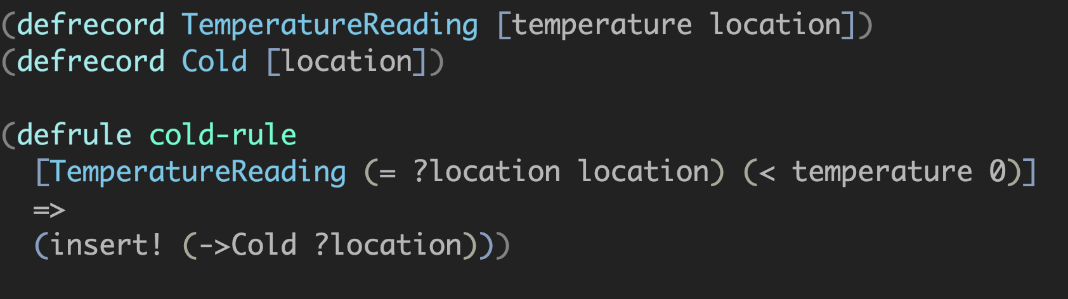
Simple example: For each TemperatureReading fact with temperature < 0, let there be a Cold fact with the same location as the TemperatureReading in the session.
When there is a TemperatureReading fact matching the LHS (left-hand side) the RHS (right-hand side) is executed and a Cold fact is added to the session. This Cold fact could then in turn trigger other rules. If the TemperatureReading fact is removed, then the Cold fact it caused to be inserted is removed as well, along with facts it caused to be inserted. This is called truth maintenance.

Slide 5
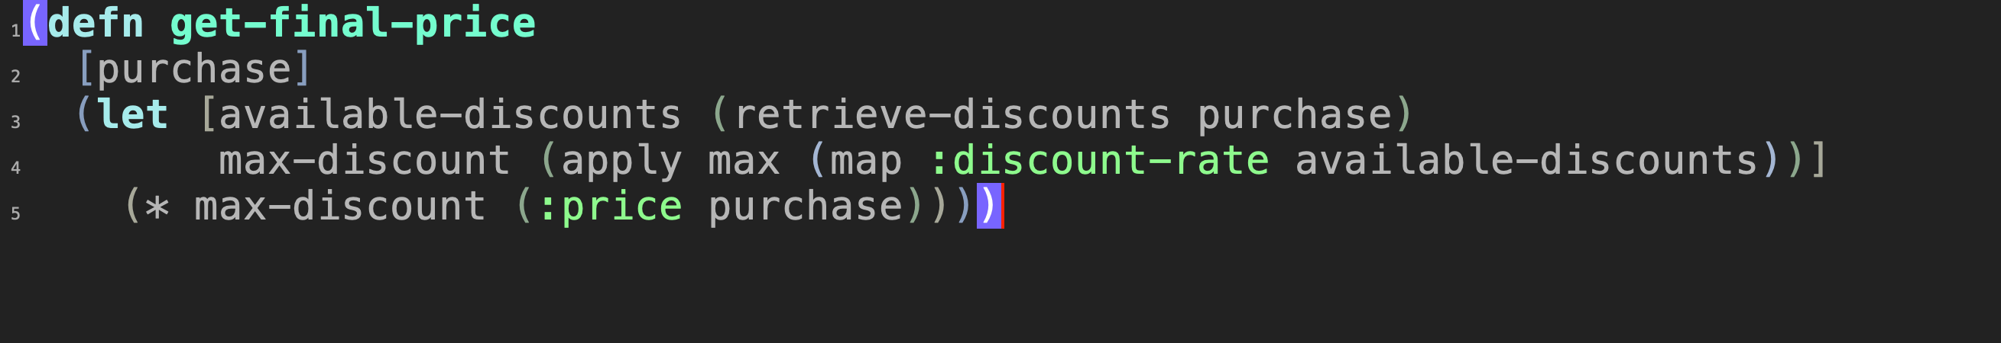
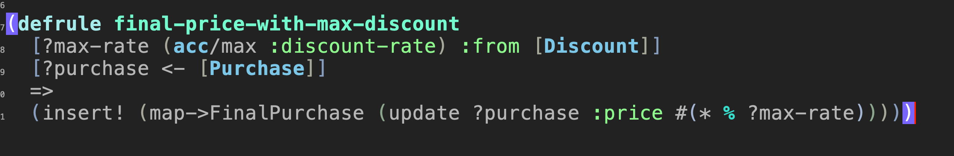
Evolution of functions vs rules
Functional and rules style:
This doesn't look too complicated in either case.

Slide 6
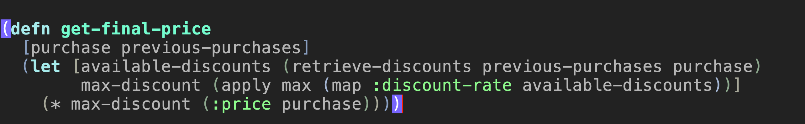
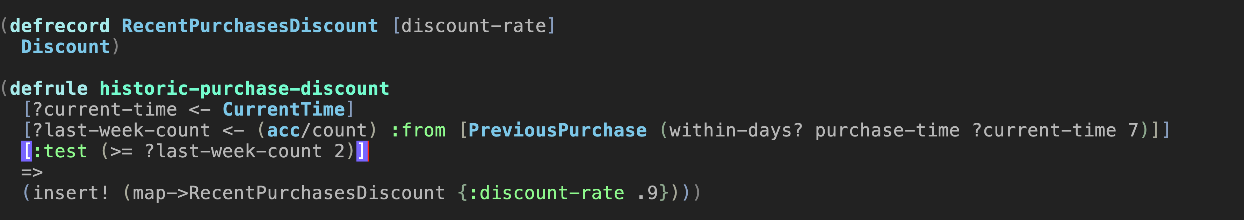
In the rules-based version note that the final price rule didn't change.
Now suppose we add a discount for customers with 2 purchases in the last week.

Slide 7
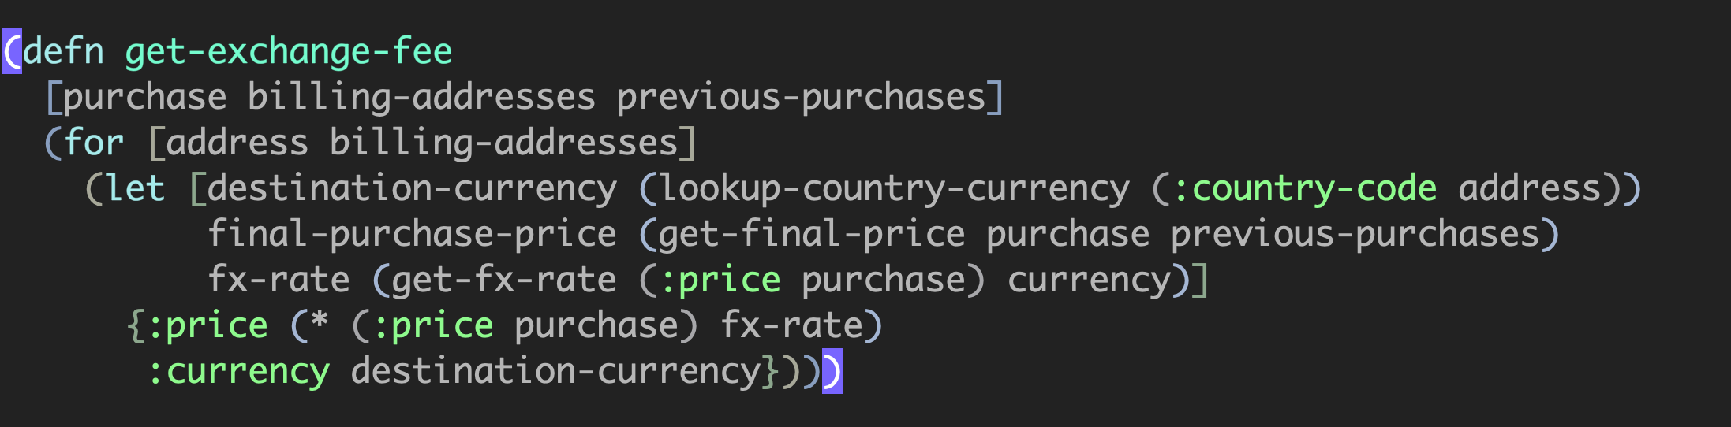
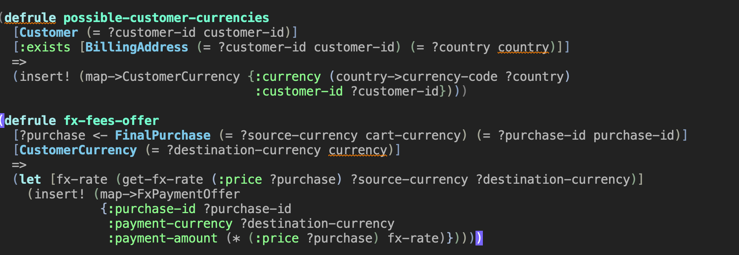
Now suppose that we need to calculate foreign exchange fees. Note that the functional version is concerned with previous purchases. In the rules if we wanted different logic for selecting destination currencies we could readily do this.

Slide 8
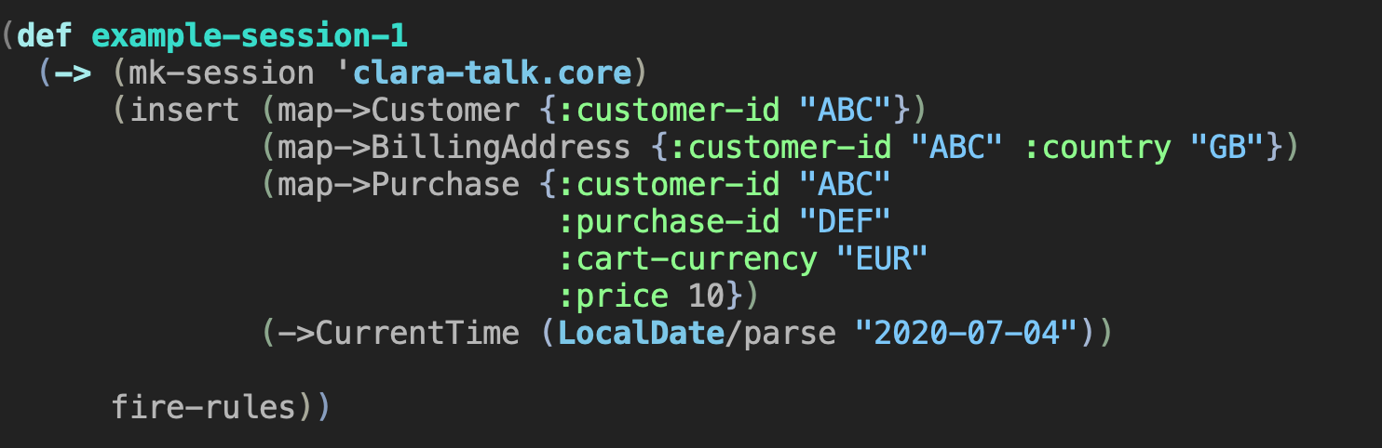
Example code at https://github.com/WilliamParker/london-clojurians-clara-talk/blob/master/src/clara_talk/core.clj
There weren't any discounts available, so Clara simply applied the logic for foreign exchange to the original purchase price.

Slide 9
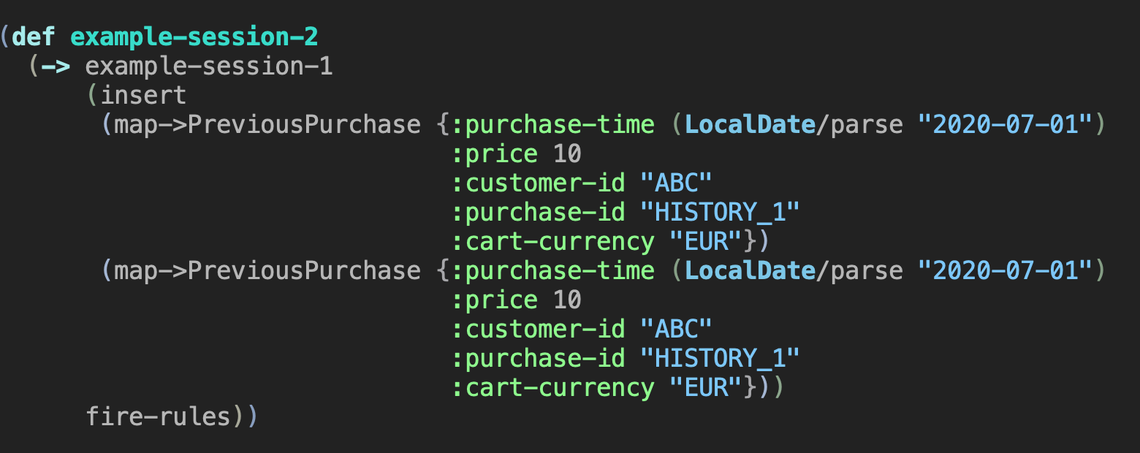
We inserted previous purchases; Clara determined from the rules that they should create a discount, reducing the purchase price, and then reducing the amount paid after conversion.
Now we insert previous purchases meeting the criteria for a discount to be added.

Slide 10
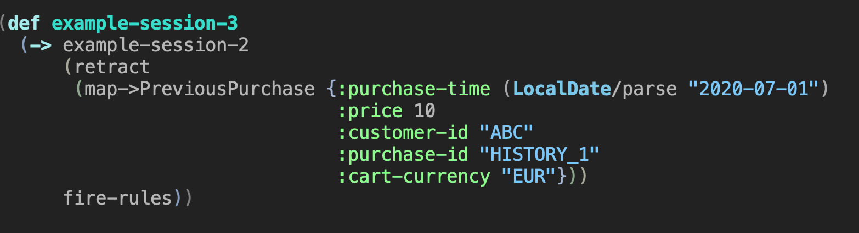
Now suppose that we discover that one of the previous purchases was incorrectly recorded and remove it.
Now we're back to the original price, without any discount.
Note that these sessions are immutable; inserting and retracting facts returns a new session.

Slide 11
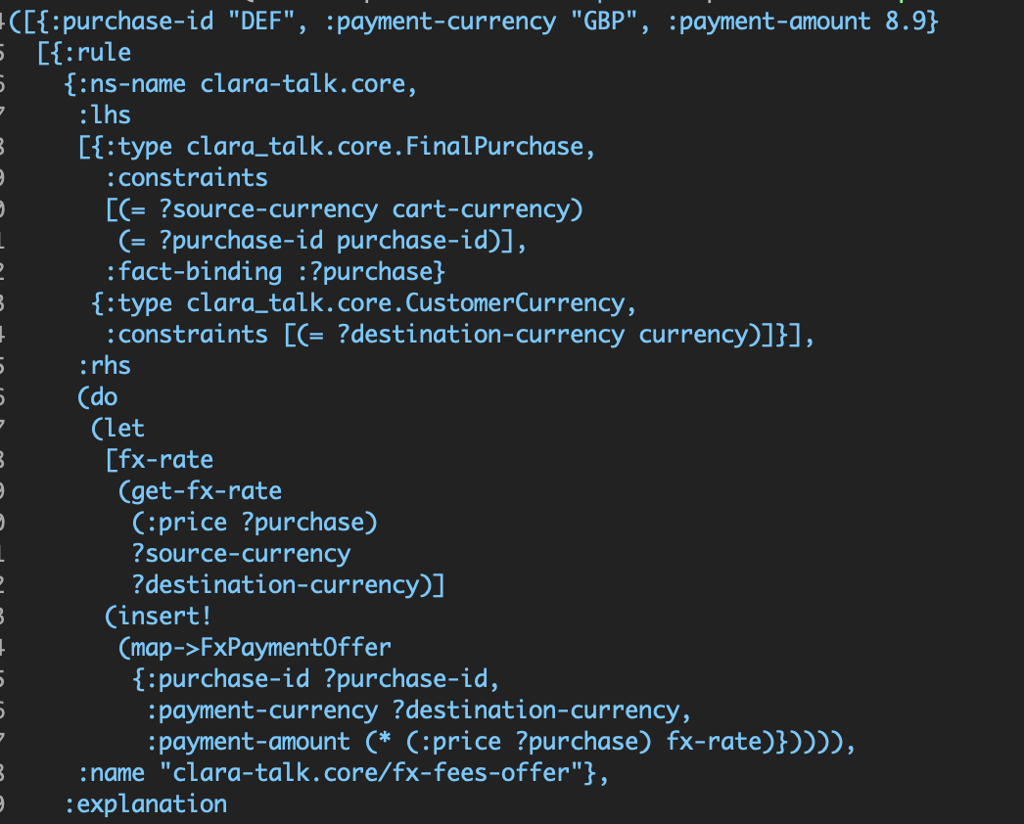
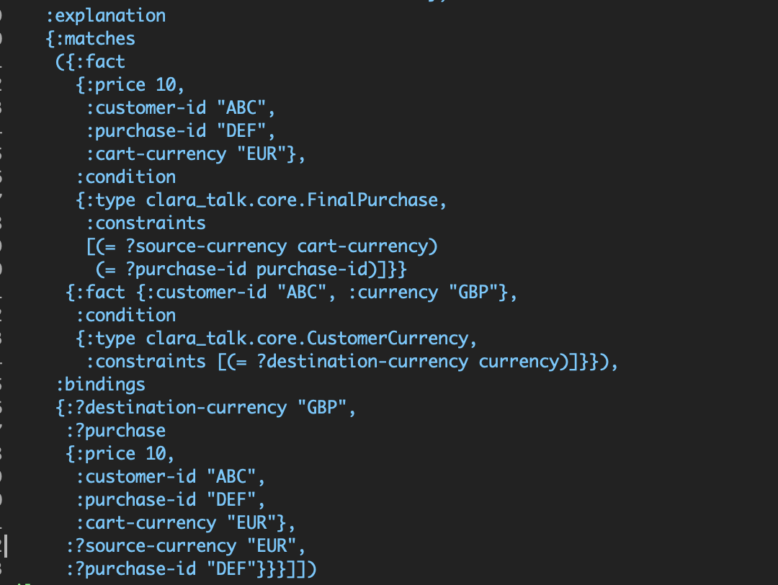
Note: the result below is split from left to right to fit the dimensions needed here
We can inspect the session to see why a fact was inserted, what facts a given rule inserted, etc. This can support both debugging and tooling.

Slide 12
Rete algorithm
Clara is a forward-chaining rules engine that broadly uses the Rete algorithm.
Sources on the Rete algorithm:
  Production Matching for Large Learning Systems, by Robert Doorenbos (PhD thesis, freely available online)
    This is a good source, but is from 1995; some of the optimisations described there are less necessary with modern computers and not implemented in Clara.
    Wikipedia

Slide 13
Forward-chaining characteristics
Given input facts, Clara will derive all possible knowledge from those facts immediately upon fire-rules being called. It does not wait on a query being executed, for example. In fact query results are precomputed; calling query simply looks them up.

Slide 14
Performance characteristics
Rules that perform joins can perform poorly if they need to join large numbers of facts. This is unavoidably an O(mn) problem in the worst case.
  In order to mitigate this one can use hash-based joins to limit the size of each set of facts being joined; this is explained further in the docs.
Clara requires that all facts be stored in memory.
Clara supports salience, which allows the user to specify rule execution order. It is encouraged to use this to optimize performance rather than for correctness when possible.

Slide 15
Other topics
Clara supports serialization of sessions; the user is required to provide an serializer for the facts in the session.
Users can write their own accumulators for reasoning over collections of facts; note the max condition in the examples for an example of an accumulator condition.
Defrule and defquery generate Clojure data structures that Clara compiles into sessions. It is possible to supply these data structures to Clara directly, allowing its use as a compilation target for other DSLs.

Slide 16
Questions?
http://www.clara-rules.org/
#clara in the Clojurians slack
Mailing list https://groups.google.com/g/clara-rules
  The Slack channel is more active currently
It is useful to know what is causing problems or confusion, as these things may become targets for bugfixes, error handling improvements, or documentation improvements.

