Slide 1
MLB Salary & Performance Data
Team Red Sox

Slide 2

Explore Relationship re: MLB Team Salaries and Team Wins
Background: Goal of each team in Major League Baseball is to win as many games as possible out of a 162 game season.
Hypothesis: Teams that spend more money on players’ salaries win more games.
Data Exploration & Cleanup Methodology: - Create a subset for American League Teams (2000-2015) using the Salaries.csv and Teams.csv datasets.
- The salary data was standardized by determining the mean league salary spend for each year, and then calculating how many standard deviations each team's total salaries were away from that mean.
- Looked at Boston Red Sox Team data over time re: wins and salary with respect to other Teams to cross check & verify data.

Slide 3
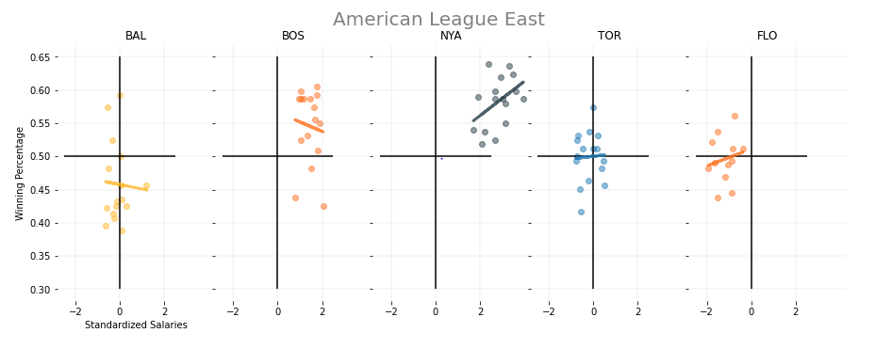

American League Salaries and Team Wins (2000-2015) : Observations & Findings:
Scatter plot of standardized salary for each Team in the American League East against their win/loss percentage for the years 2000 – 2015 show that Teams that spend the most, frequently win the most.
NOTE: 1. Each dot in the chart below represents annual season data for each AL Team explored.
2. The colored line in each chart represents the regression/best fit showing the overall trend for each AL team. 2. Each dot represents annual season data for each AL Team.

Slide 4
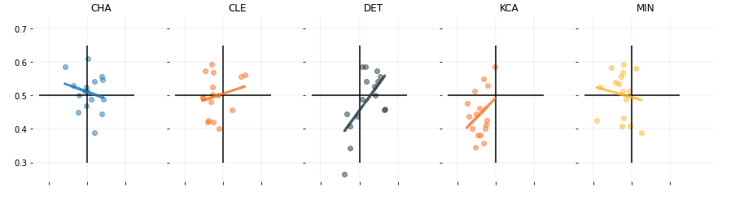
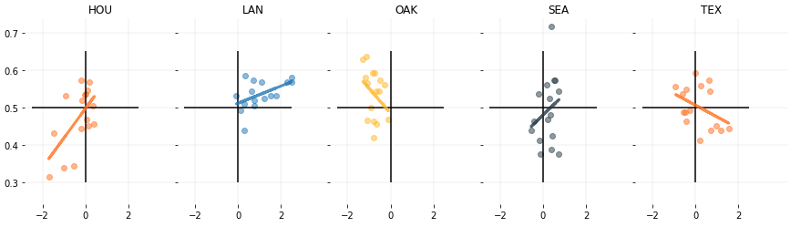
American League Salaries and Team Wins (2000-2015) : Observations & Findings:
American League Central
American League West

Slide 5

MLB AL Salaries and Team Wins: Summary Findings
Better players may be more costlier.
Teams may need to spend more money on high performance players to win more games.
General trend exists re: higher salaries lead to a higher Team winning percentage. - i.e. Strong correlation exists for the New York Yankees and Boston Red Sox.
Some teams including the Toronto Blue Jays and the Minnesota Twins appear to show fairly flat results regardless of total salary... More can be explored by looking at the specific performance metrics of these Teams to identify any additional trends in further reviews.

