Slide 1
Load Balancer 만들기

Slide 2
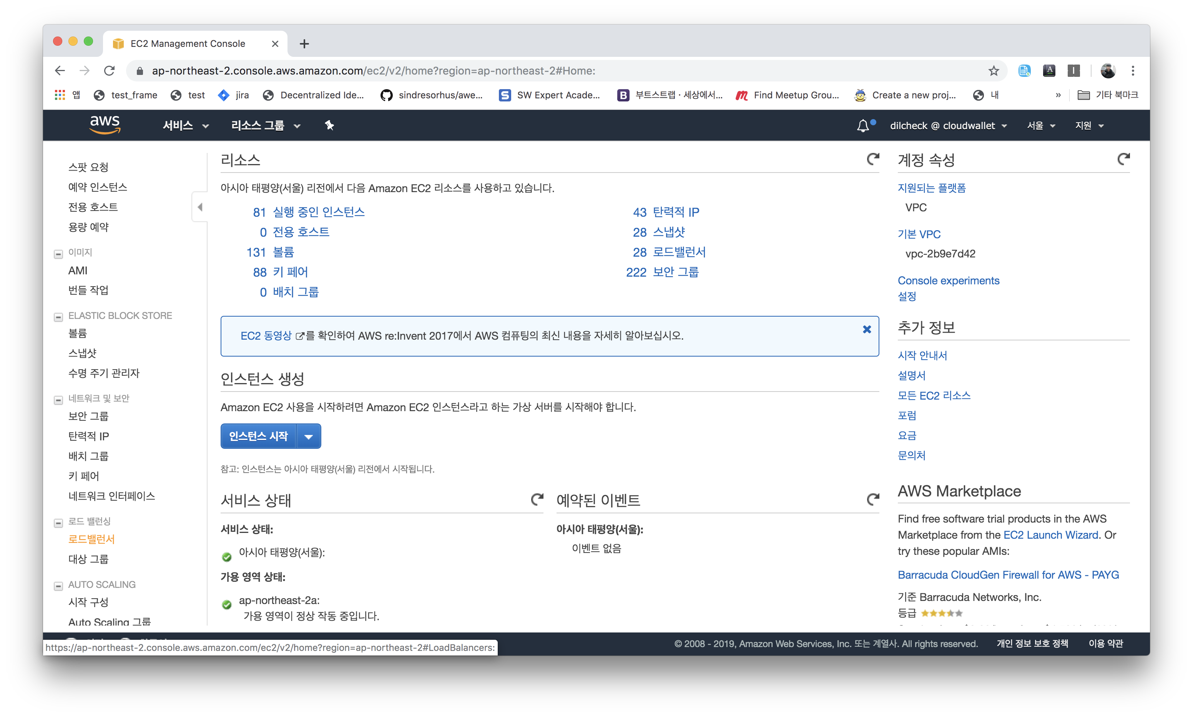

Slide 3
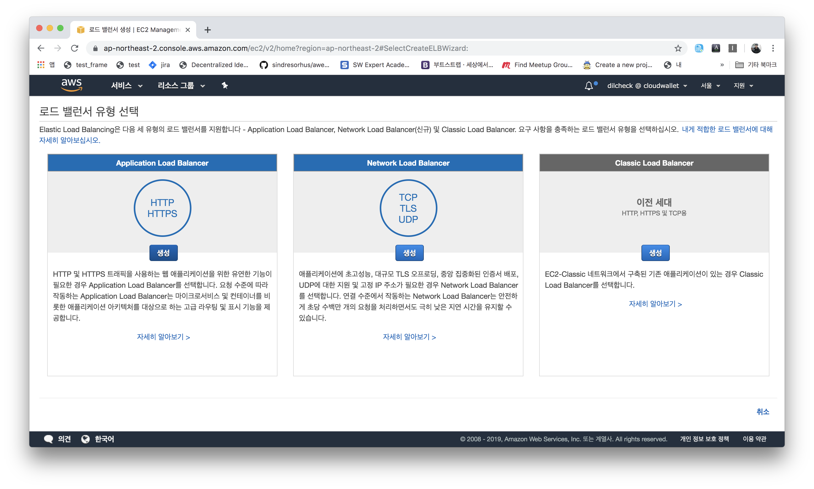

Slide 4
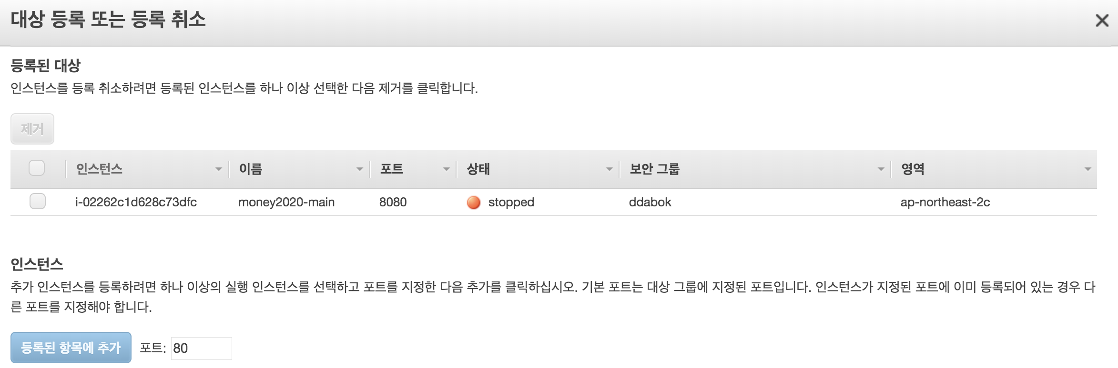

Slide 5
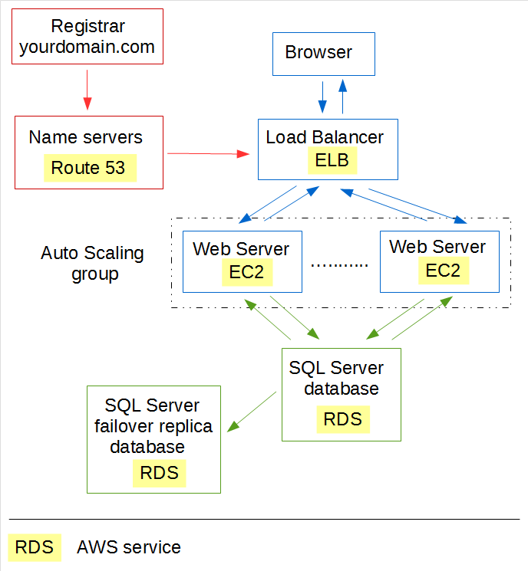
구조

Slide 6
구현 구조
15.164.166.91:8080
Target
group
13.209.26.89:8081
54.180.150.98:8081

Slide 7
상세 구조
ELB
Server1
Controller
Client
Service
Domain
Server2
Target
group

Slide 8
Least Connection
모드
{"code":"OK","contents":"server1"}
{"code":"OK","contents":"server2"}
{"code":"OK","contents":"server1"}
{"code":"OK","contents":"server2"}
{"code":"OK","contents":"server1"}
{"code":"OK","contents":"server2"}
{"code":"OK","contents":"server1"}
{"code":"OK","contents":"server2"}
{"code":"OK","contents":"server1"}
Round Robin
Tps 333
{"code":"OK","contents":"server2"}
{"code":"OK","contents":"server2"}
{"code":"OK","contents":"server1"}
{"code":"OK","contents":"server2"}
{"code":"OK","contents":"server2"}
{"code":"OK","contents":"server2"}
{"code":"OK","contents":"server1"}
{"code":"OK","contents":"server2"}
{"code":"OK","contents":"server2"}
Tps 333

Slide 9
Least Connection http://15.164.166.91:8080/?mode=leastConnection
테스트
Round Robin http://15.164.166.91:8080/?mode=roundRobin

