Slide 1
LEO to GEO Low Thrust Transfer
As of 11/28/22

Slide 2
 | Initial Orbit | Final Orbit
Eccentricity | 0 | 0.0004970447067339205
Inclination | 0 | 0.1009871403899396
Orbital Radius | 7000 km | 42166.95599935504
Longitude | 0 | -92.02989532184473
Fuel Mass | 1000 kg | 679.5798552011545
Elapsed days 10 days
Dry Mass 850 kg

Slide 3
Solution
The optimized solution file is called ThrustProfileGEO_100_Solution (in repo)
Final orbit constraints
Eccentricity
Target 0
Value 0.0004970447067339205
Inclination
Target 0
Value 0.1009871403899396
Orbital Radius
Target 42164
Value 42166.95599935504
Longitude
Target -93.6465
Value -92.02989532184473
Elapsed days 10 days
Initial Fuel Mass 1000 kg
Final Fuel Mass
679.5798552011545 kg
Dry Mass 850 kg
Thrust bounds of -15 to 15 newtons in xyz directions (max mag of 26 N)
Magnitude not held constant

Slide 4
Keplerian Elements
Initial Keplerian elements
Semimajor axis = 7000 km
Eccentricity of 0 , Inclination of 0
Right Assentation of Ascending node 0
Argument of Periapsis 0, True Anomaly 0
Final Keplerian elements
Semimajor axis = 42146.26754914655 km
Eccentricity of 0.0004970447067339205 , Inclination of 0.1009871403899396
Right Assentation of Ascending node 249.5518187700747
Argument of Periapsis 218.5159368094261,
True Anomaly 189.0342099316114

Slide 5
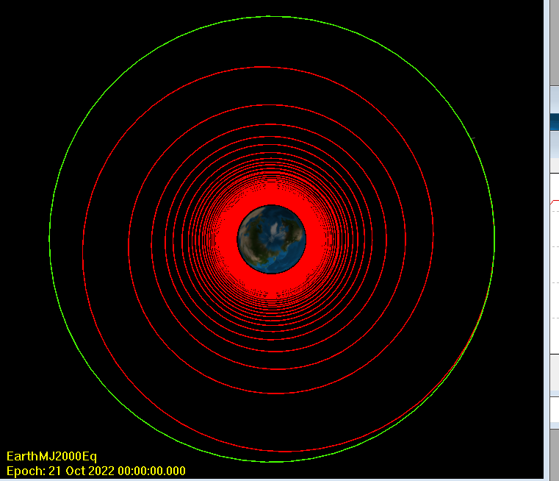
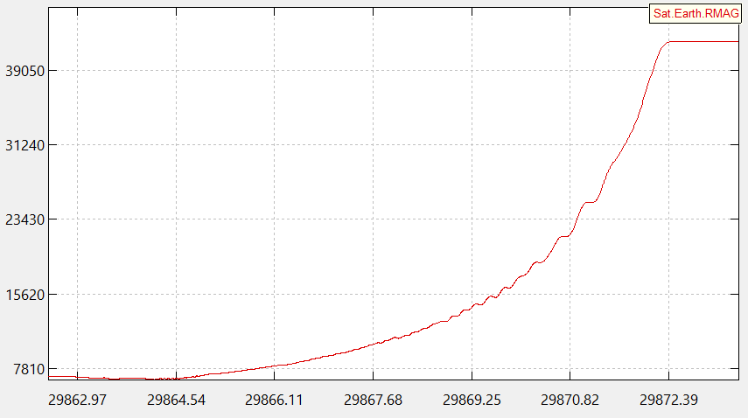
Orbital Transfer and Spacecraft radius over Time

Slide 6
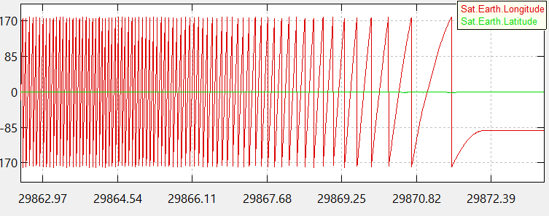
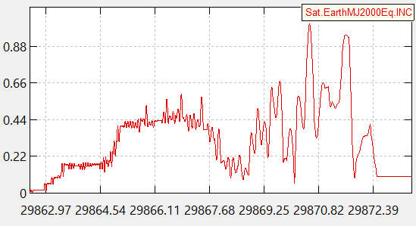
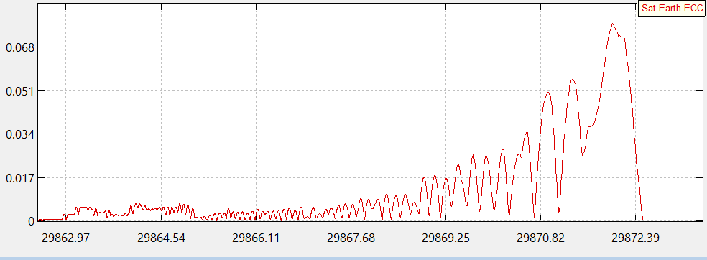
Longitude, Eccentricity, and Inclination constraints over Time

