Slide 1
Reducing Bias in AI Unmanned Aerial Vehicles - Showcase
William Sottoriva (24505063), Dylan Huynh (24504870), Jerry Liu (24560409), Justin Ngo (24506622), Robert Shishoian (24506659)

Slide 2
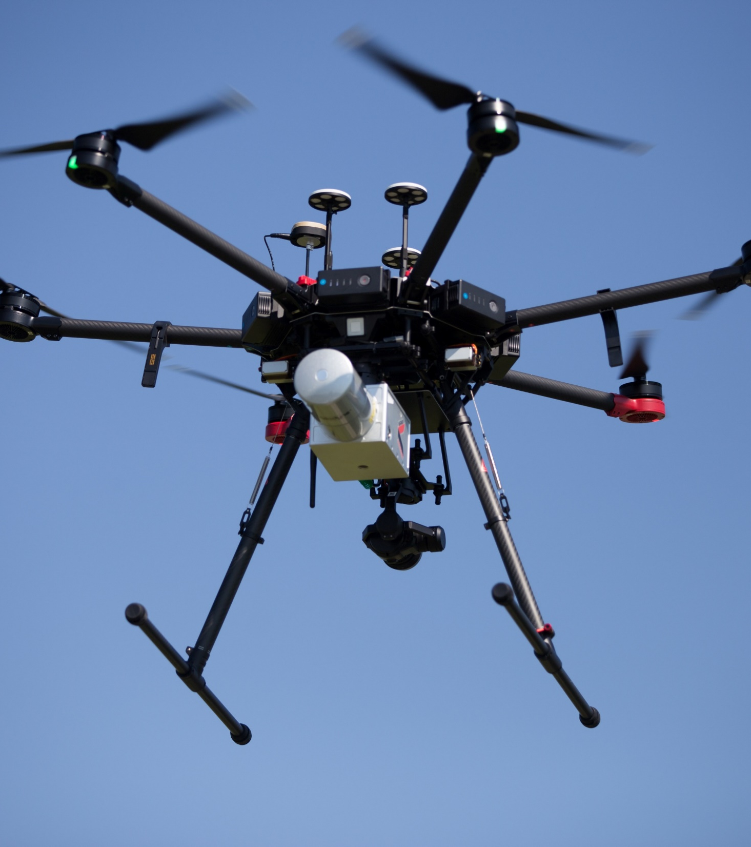
Background and Context
UAVs are used for surveillance and identification
Shift from remote control to AI autonomous control.
This has highlighted AI bias issues such as highlighted papers (Hsu H.-J., & Chen, K.-T., 2015) (Min, A., 2023).
Use of UAVs is on the rise → Market to double by 2026 (Kärkkäinen, K., & Joo, J. 2019)
34% higher inaccuracy for minorities (Hsu H.-J., & Chen, K.-T., 2015) → Ethical concerns
Caused by unbalanced training data

Slide 3
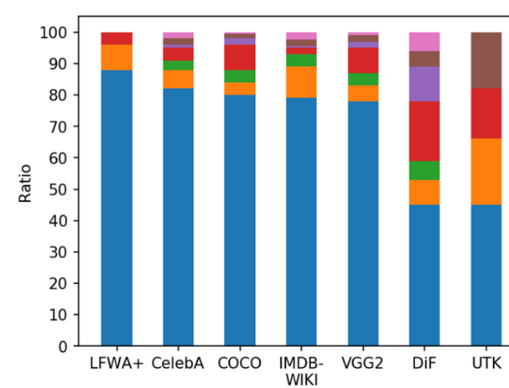
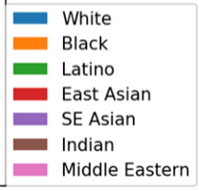
Dataset Race Distribution

Slide 4

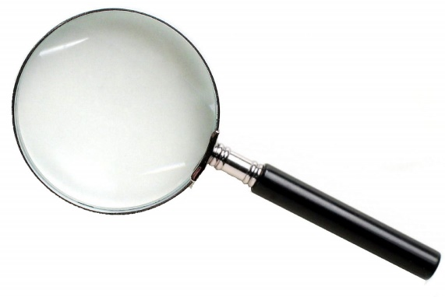
Research Question
"How can we reduce and quantify the impact of biased training data to improve accuracy for UAV identification systems”

Slide 5
Significance and Potential Impact
High significance due to emerging prevalence of the technology
Increase awareness of bias and ethical issues in UAVs
Reduce bias in real world UAV facial detection [5]
Surveillance
Conflicts

Slide 6


Aims and Objectives
Aims:
Reduce bias from training data
~5% Disparity in accuracy between groups
Quantify bias from training data
Objectives:
Create augmented unbiased dataset
Train models on both datasets
Run comparative study

Slide 7
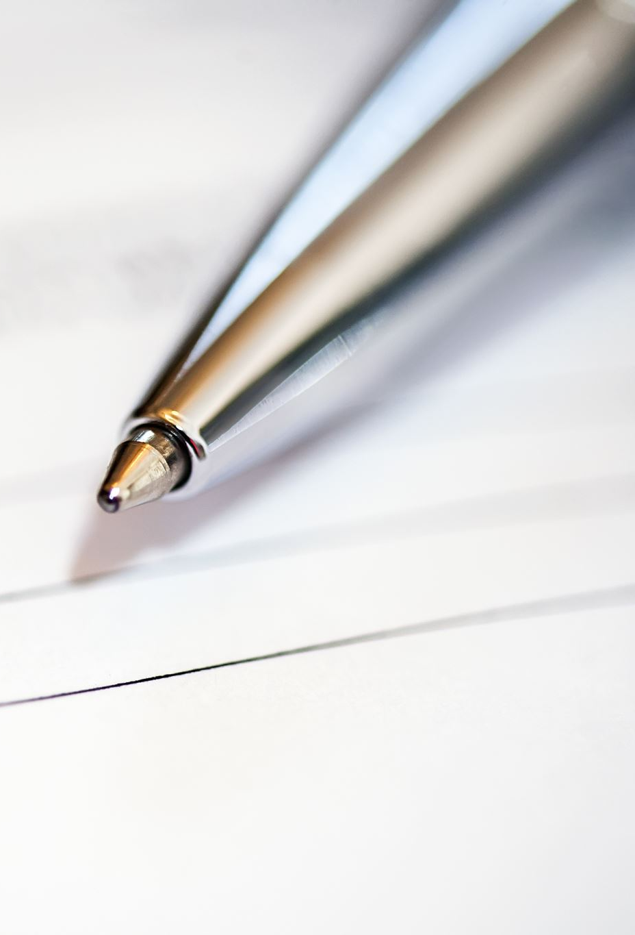
Summary of Literature Review
Highly respected and relevant papers agree upon the following findings (Kärkkäinen, K., & Jo, J, 2019)(Rindermann, M., Fysh, M. C., Sage, S. S. K., Douglas, K., & Tummon, H. M. (2017)(Robinson, J. P. 2024):
Bias has major impact on accuracy
The quality of the footage proves to be a limitation for facial recognition
Bias can arise from unbalanced datasets or negligent model development
Possible further entrenchment of systemic racism
Underrepresentation of marginalised groups in historical photos

Slide 8
Research Gaps
Strategies to reduce bias in machine learning (ML) training data
Techniques to limit impact of bias on ML models
Rules and regulations for UAV ethical concerns
These gaps will be addressed through improved datasets and models.

Slide 9
Research Outcomes
Insights into fairness, accuracy and inclusivity
Advance datasets
Advance algorithms
Influence policy recommendations
Improve reliability

Slide 10
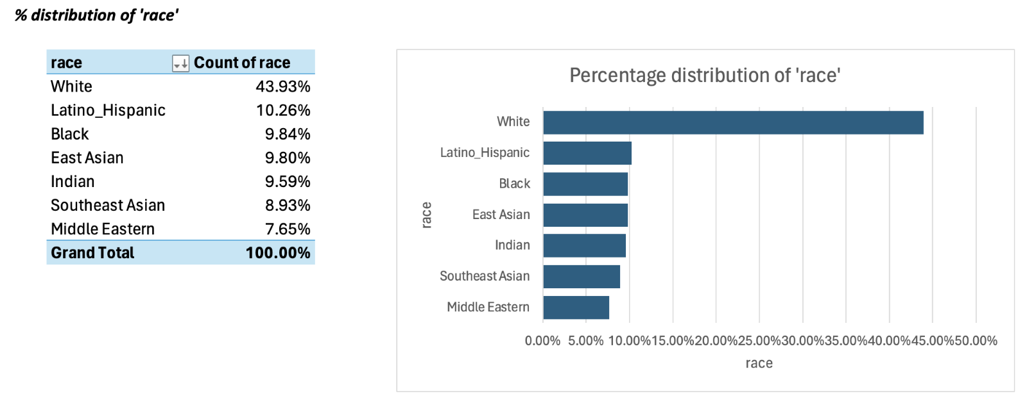
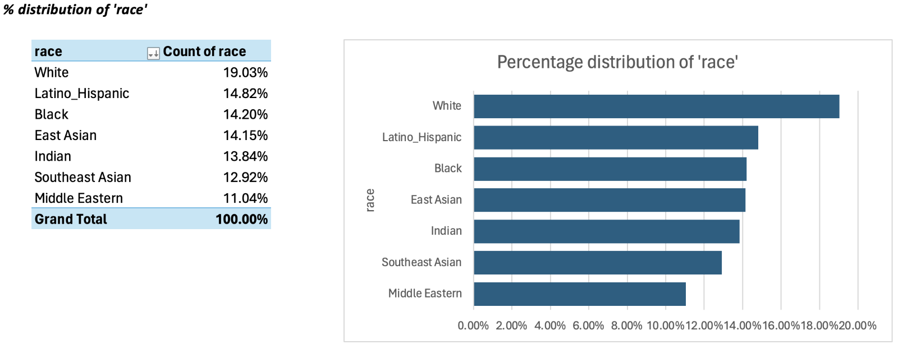
Methodology
Before:
Approach 1:
Augment biased FairFace dataset to reduce bias
Dataset augmentation
Quantify accuracy improvement and impact of bias in training data on ResNet-34 CNN.
Train CNN on both datasets and compare race-based accuracies.
Experiment with various algorithmic parameters
After:

Slide 11
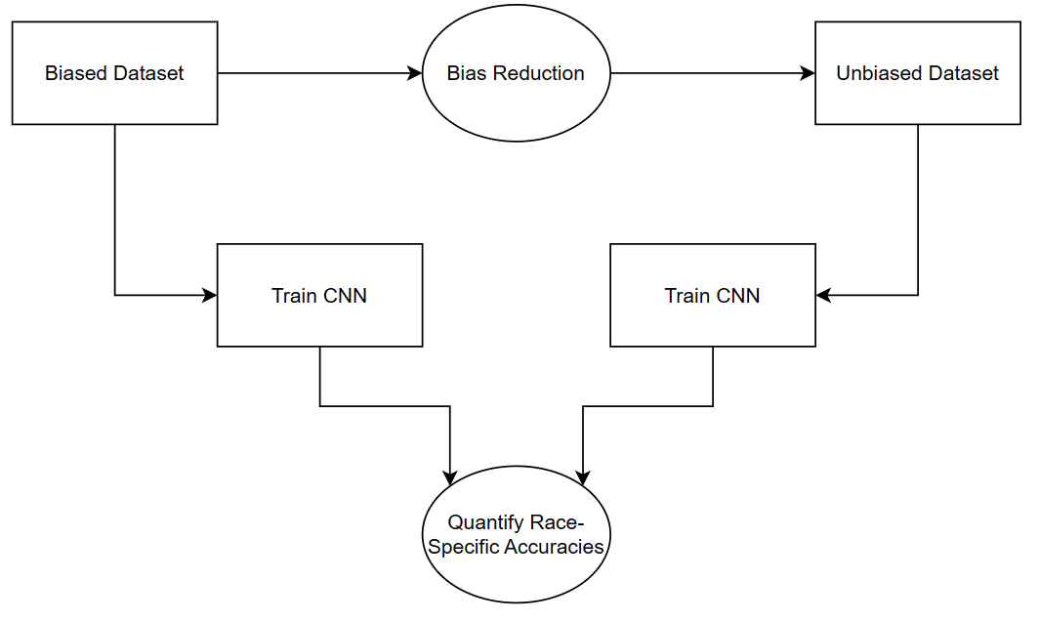
Methodology

Slide 12
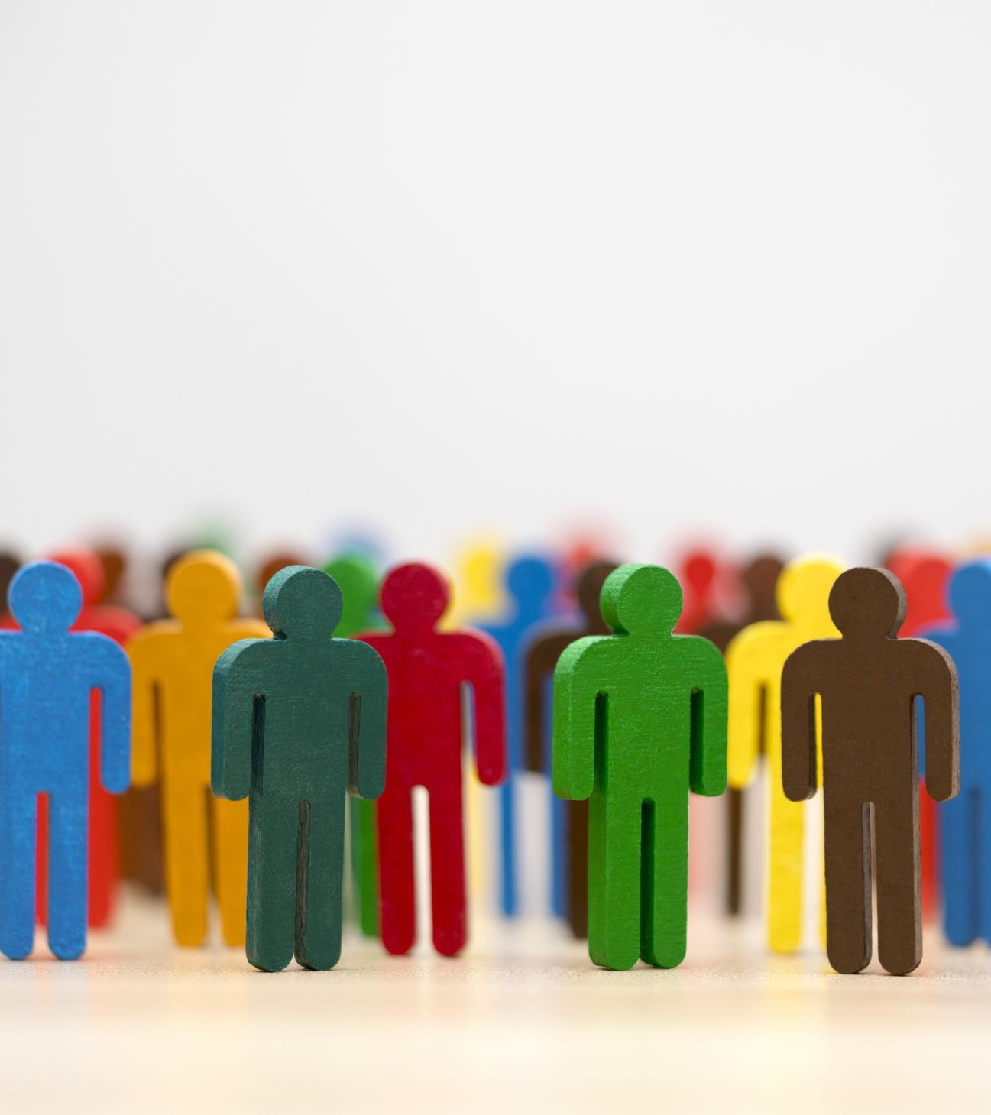
Ethical Considerations
Consent of individual
Privacy of data
Fair treatment of individuals.
Transparent of limitations and potential biases in the research

Slide 13
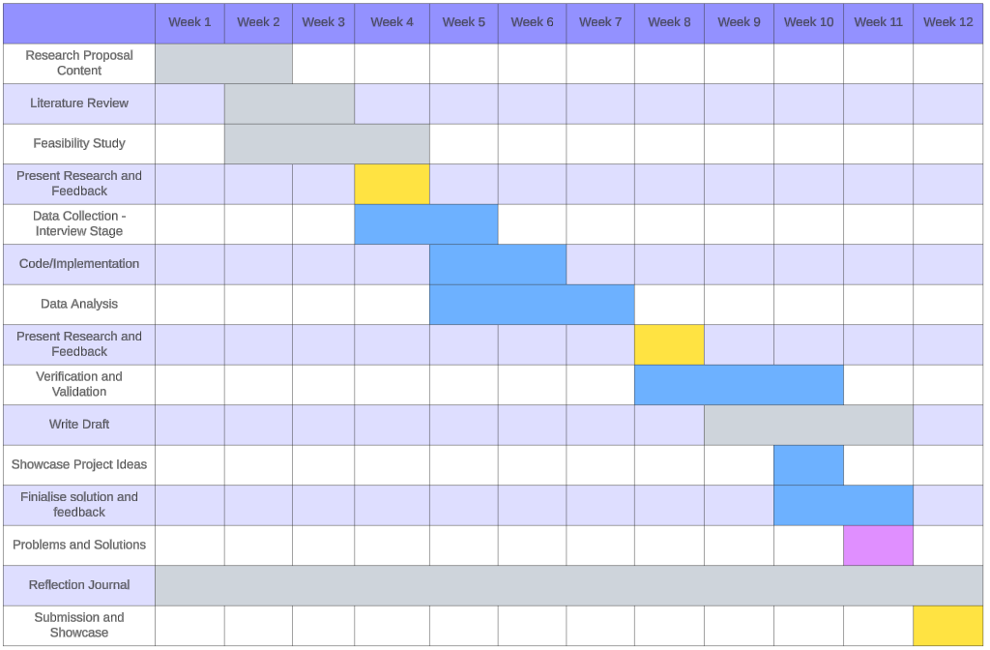
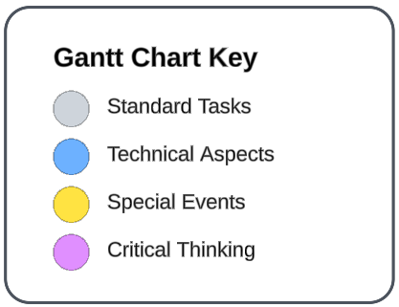
Timeline

Slide 14
Research Costs
Cost of Conducting the Research
Time: 12 Weeks
Resources: Powerful GPU Compute
Training Data: ~$200 to purchase existing datasets
Research: ~$100 to purchase existing research papers for evaluation
Resources
Personnel
Jerry – Plant
Rob – Specialist
Justin – Team worker, Sharper
Dylan – Monitor Evaluator
William – Coordinator, Completer Finisher
Equipment
RTX 307 GPU, 12700k CPU, 32GB RAM, 5TB NVME Storage
Interviews: ~$500 to compensate interviewees

Slide 15

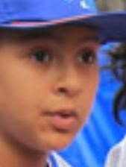
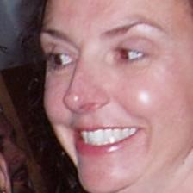
Data Understanding
Data quality check
Accuracy, completeness, consistency, reliability
Data exploration
Data visualisation

Slide 16
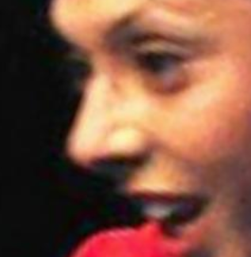
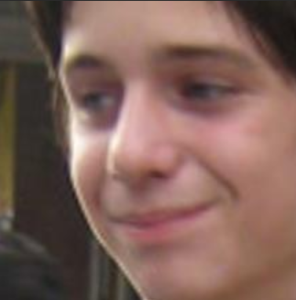

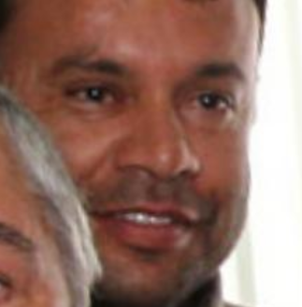
Dataset Examples
Image
Class | 20-29, Female, White | 10-19, Male, White | 30-39, Female, East Asian | 40-49, Male, Latino_Hispanic

Slide 17
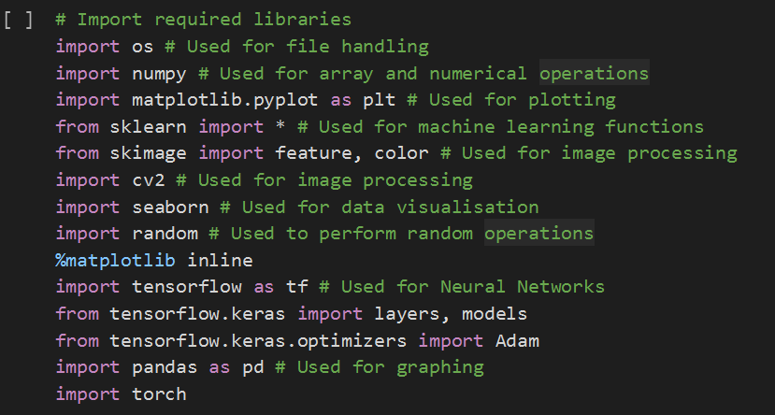
Implementation
Library importing:

Slide 18

Implementation
Drive mounting:

Slide 19
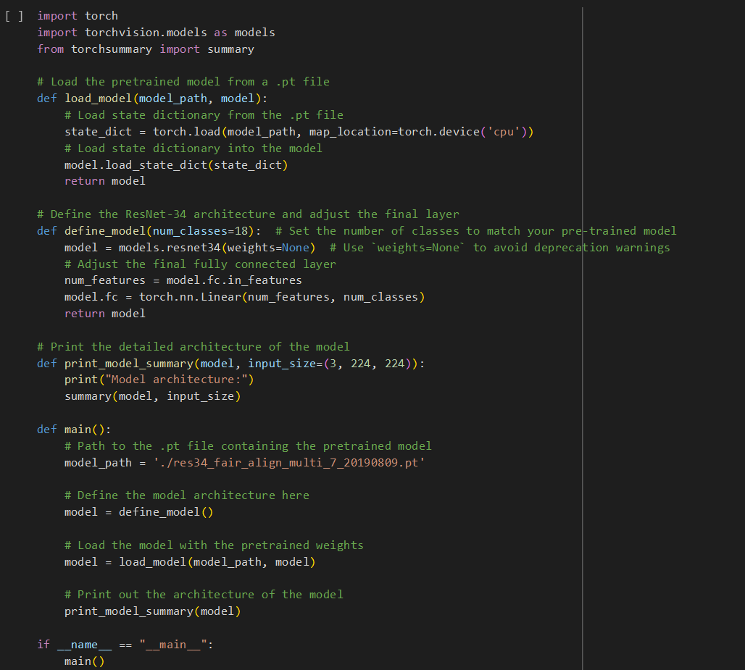
Implementation: Approach 1
Model Reverse Engineering:

Slide 20
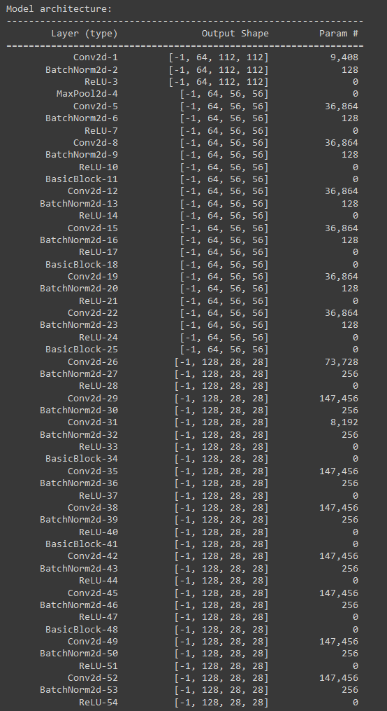
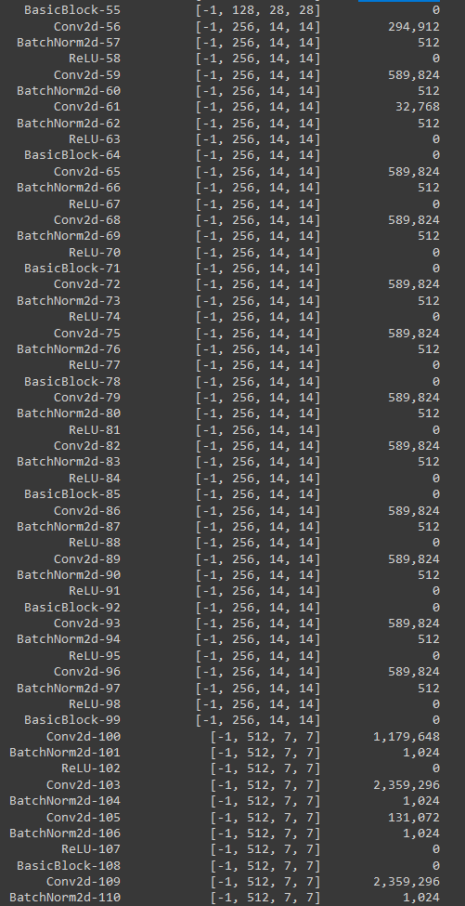
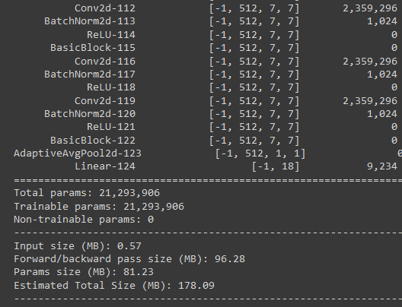
Model
Architecture:
Res34

Slide 21
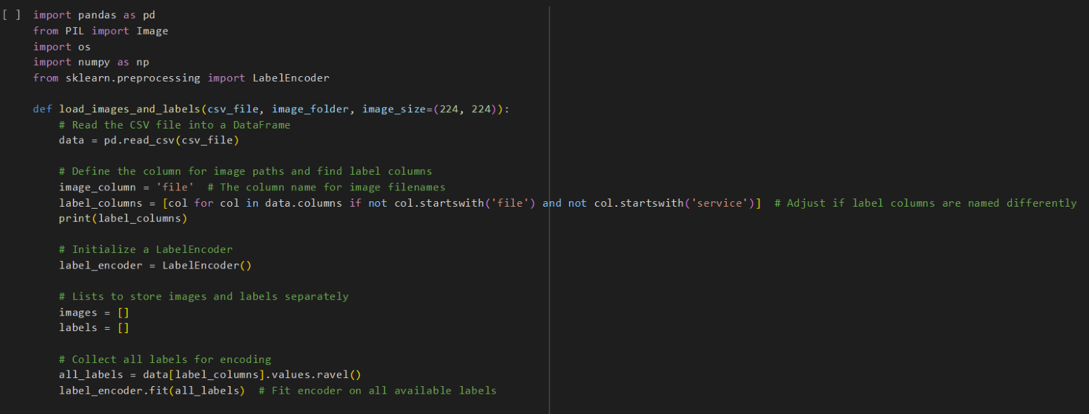
Implementation
Read in data and encode labels:

Slide 22
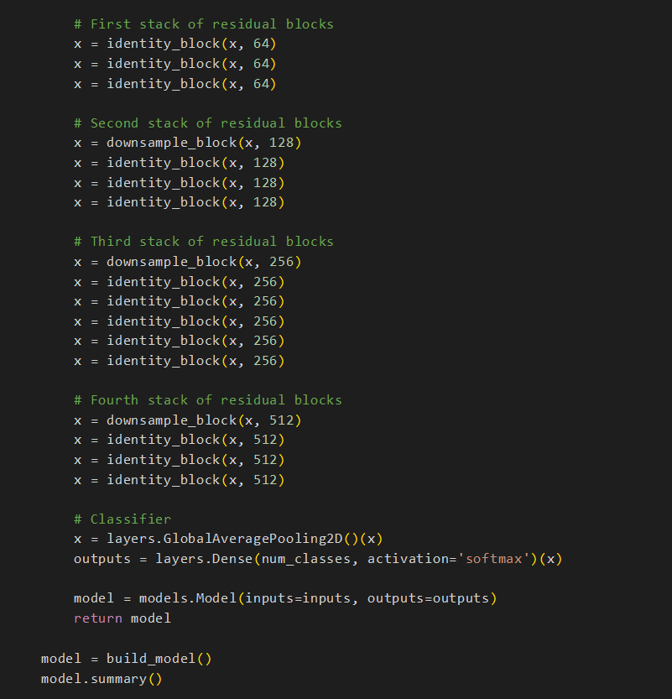
Implementation
Define CNN model:

Slide 23
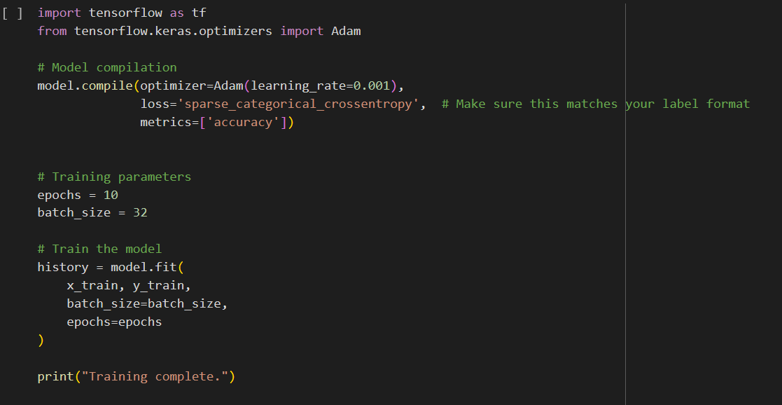
Implementation
Model training:

Slide 24
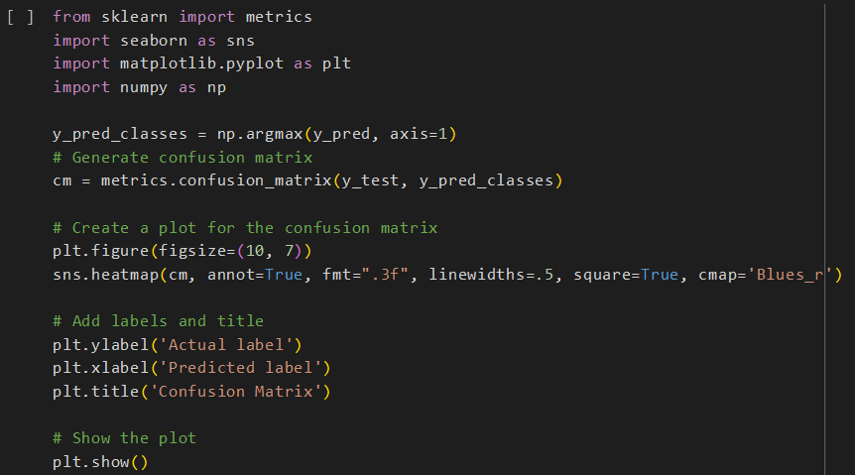
Implementation
Model evaluation:

Slide 25
Results
Accuracy Measures:
Dataset | Accuracy (Test)
Biased | 75.01%
Unbiased | 93.99%

Slide 26
Results Verification and Validation
Experiment | Person | Results (Test)
Unbiased (ADAM, LR 0.001, Epochs 40, Batch 32) | William, Dylan, Rob, Justin, Jerry | Acc: 0.94
Biased (ADAM, LR 0.001, Epochs 10, Batch 32) | William, Dylan, Rob, Justin, Jerry | Acc: 0.75
Biased (ADAM, LR 0.01, Epochs 10, Batch 320) | William | Acc: 0.61
Biased (ADAM, LR 0.001, Epochs 10, Batch 32, Removed 2nd Conv Layer) | Dylan | Acc: 0.68
Biased (ADAM, LR 0.005, Epochs 10, Batch 160, Removed 2nd Conv Layer) | Rob | Acc: 0.65
Biased (ADAM, LR 0.01, Epochs 10, Batch 320) | Justin | Acc: 0.62
Biased (ADAM, LR 0.005, Epochs 10, Batch 160) | Jerry | Acc: 0.70

Slide 27
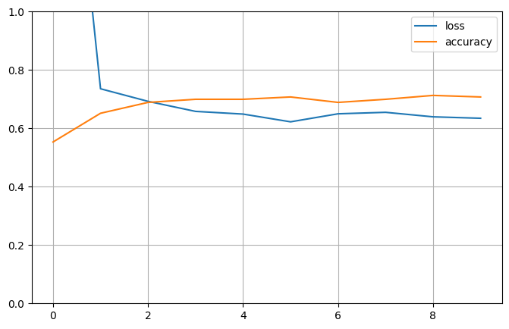
Results - Training Plots
Biased

Slide 28
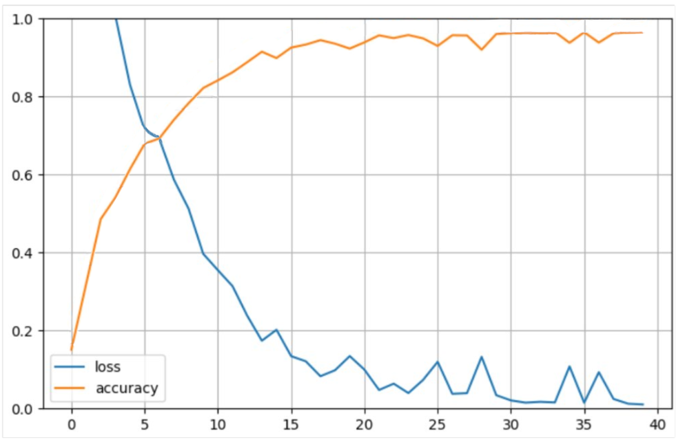
Results - Training Plots
Unbiased

Slide 29

Findings
25% improvement by reducing bias
Valid findings
Hyper parameter settings and comparative study
White individuals are favoured
Slight bias towards men over women
Higher bias = higher standard deviation in accuracy
40 Epochs required on unbiased dataset
Difficulty for single models to handle multiple races

Slide 30

Limitations and Improvements
Explore algorithmic solutions such as data augmentation
Explore image quality impacts on bias
Photo quality and diversity
Use an individual identification model and dataset
Train on dedicated GPU
Fully remove bias
Improve accuracy metrics

Slide 31

Team Collaboration
Effective communication and collaboration through:
Google Colab
Google Drive
Discord
Daily updates
Weekly meetings
Class collaboration

Slide 32
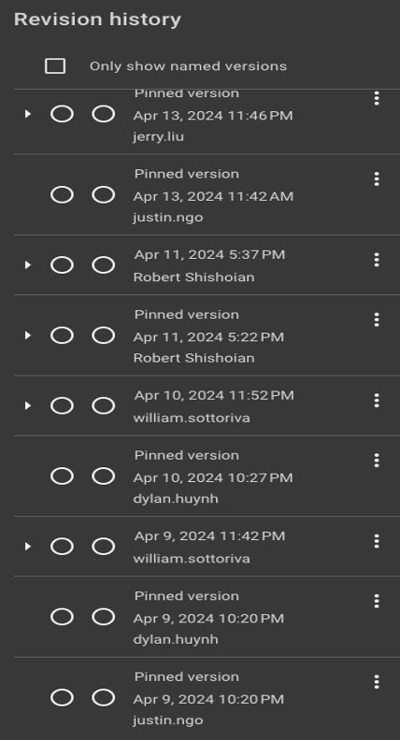
Team Contributions
Equal contribution
Effective delegation which
Maximised efficiency
Optimised for individual strengths
Equal delegation of documentation and presentation
William Sottoriva | Model Development and Training
Justin Ngo | Dataset Augmentation
Robert Shishoian | Model Development and Training
Dylan Huynh | Model Evaluation
Jerry Liu | In-line Documentation

Slide 33
Conclusion
Successful solution was developed
25% improvement by reducing bias
Algorithmic techniques and identity centric models should be explored

Slide 34
References
Bindemann, M., Fysh, M. C., Sage, S. S. K., Douglas, K., & Tummon, H. M. (2017). Person identification from aerial footage by a remote-controlled drone. Scientific Reports, 7(1). https://doi.org/10.1038/s41598-017-14026-3​
Hsu, H.-J., & Chen, K.-T. (2015). Face Recognition on Drones. Proceedings of the First Workshop on Micro Aerial Vehicle Networks, Systems, and Applications for Civilian Use. https://doi.org/10.1145/2750675.2750679​
Kärkkäinen, K., & Joo, J. (2019, August 13). FairFace: Face Attribute Dataset for Balanced Race, Gender, and Age. ArXiv.org. https://doi.org/10.48550/arXiv.1908.04913
Leslie, D. (2020). Understanding Bias in Facial Recognition Technologies. The Alan Turing Institute. https://doi.org/10.5281/zenodo.4050457​
MDPI. (2023). Power Sources for Unmanned Aerial Vehicles: A State-of-the-Art. Applied Sciences, 13(21), 11932. https://doi.org/10.3390/app132111932 ​
Min, A. (2023). Artificial Intelligence and Bias: Challenges, Implications, and Remedies. ResearchGate. Retrieved from https://www.researchgate.net/publication/374493754_Artifical_Intelligence_and_Bias_Challenges_Implications_and_Remedies​
Robinson, J. P. (2024, February 13). visionjo/facerec-bias-bfw. GitHub. https://github.com/visionjo/facerec-bias-bfw
Schroff, F., Kalenichenko, D., & Philbin, J. (2015). FaceNet: A unified embedding for face recognition and clustering. 2015 IEEE Conference on Computer Vision and Pattern Recognition (CVPR). https://doi.org/10.1109/cvpr.2015.7298682
Wiegand, T., Pimentel, M. A. F., Rutterford, N. A., Vollmer, S. J., & Roberts, D. J. (2023). An adversarial training framework for mitigating algorithmic biases in clinical machine learning. npj Digital Medicine, 6, 8. https://doi.org/10.1038/s41746-023-00805-y​
Zewe, A. (2022, February 21). Can machine-learning models overcome biased datasets? MIT News. Retrieved from https://news.mit.edu/2022/machine-learning-biased-data-0221​

Slide 35


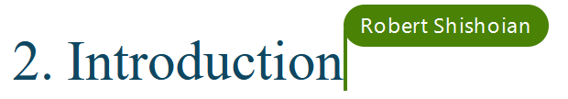




Appendix
Appendix 1: Justin’s Contribution
Appendix 2: Dylan’s Contribution
Appendix 3: Robert’s Contribution
Appendix 4: Jerry’s Contribution
Appendix 5: William’s Contribution

Slide 36
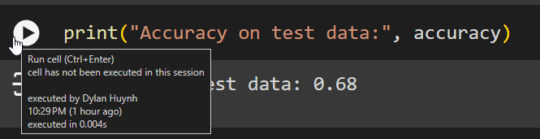
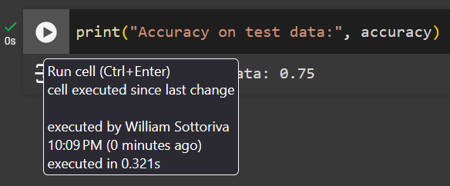
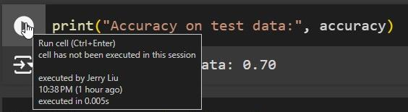
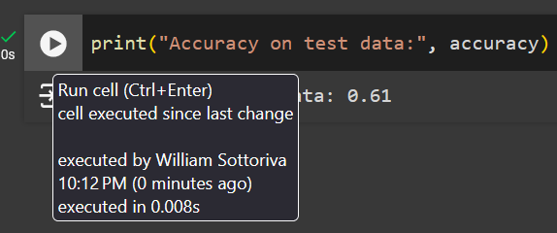
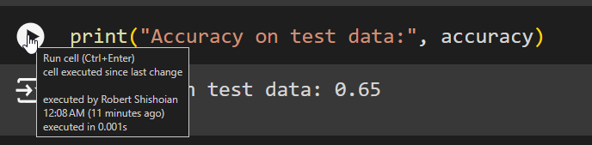
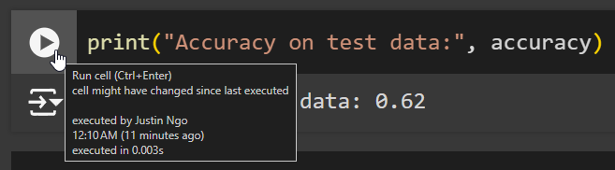
Appendix
Appendix 6: Code
https://drive.google.com/file/d/1eZKTy9vjPyLa3hTJMYL78XDapVuDFq4k/view?usp=drive_lin
Appendix 7: Experimental Validation

