Slide 1
Modeling of Multi-room Heating
Jane Wu, Anda Liang

Slide 2
Problem Description
Consider a house with 4 rooms that is heated by a central heating system and each room has a vent.
The temperature in each room is controlled
The heat from heater, if there vent is open
The temperature of the adjacent rooms
Outside temperature.
At any given time, only two of the rooms have their vents open.

Slide 3
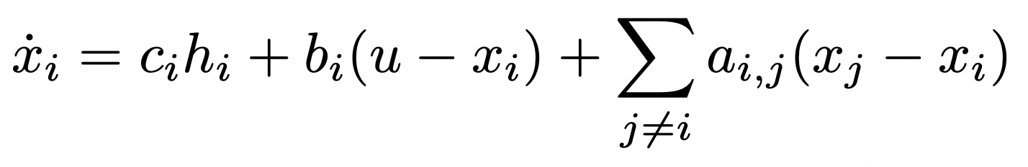
Problem Description
Dynamics of room temperature given by following formula
x - temperature of each room, i = 1,2,3,4 for room 1,2,3,4
u - outside temperature
a,b,c being constant that defines how heat from heater, other rooms, and outside transfers to current room
h - vent status {0, 1} = {closed, open}

Slide 4
Problem Description
Goal:
Create a controller (thermostat) keeps the temperature of the rooms in a reasonable range by opening/closing vents in the rooms accordingly.
Safety Requirement:
All rooms have temperature not above or below proposed thresholds.
No more than 2 vents are on at the same time

Slide 5
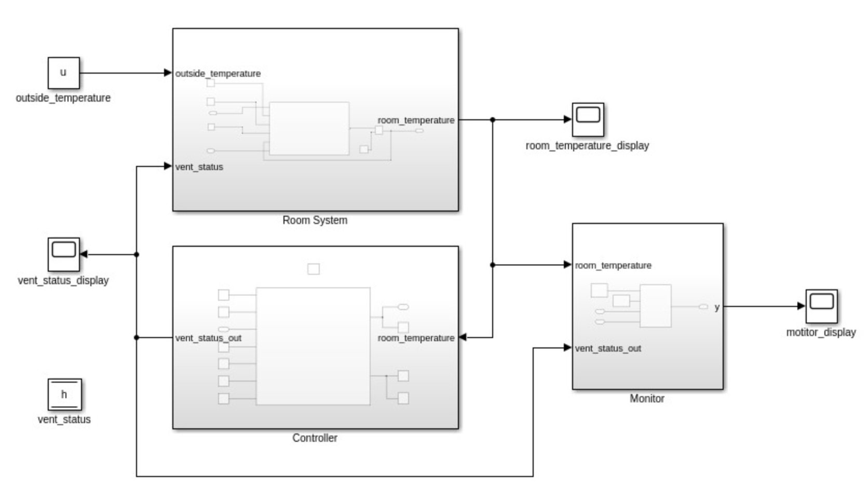
Overall Design

Slide 6
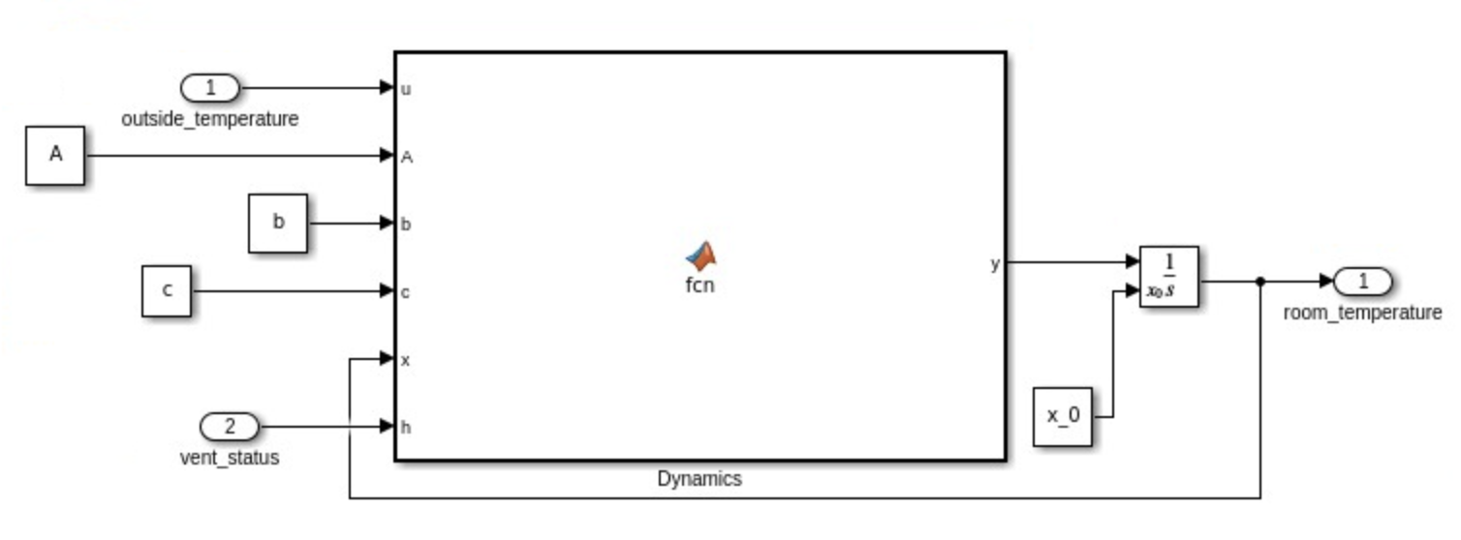
Overall Design - Room System
Input: Output: Constant:
Outside Temperature - Current Temperature - A, b, c
Vent Status (open/close)

Slide 7
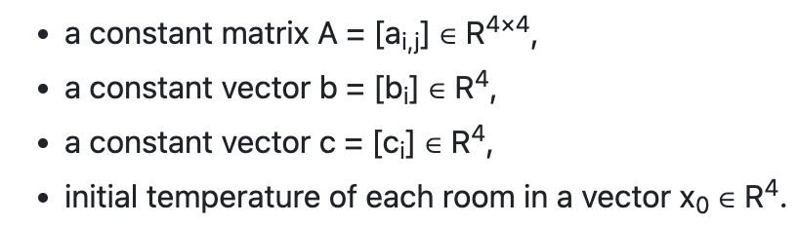
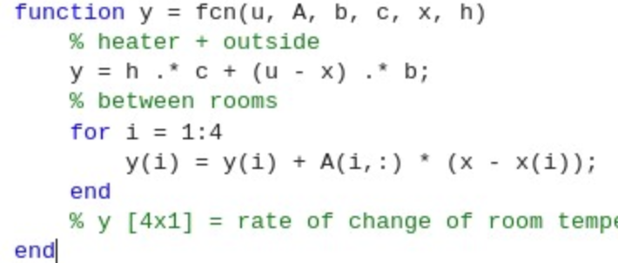
Room Dynamics
Between room
From outside
From Heater

Slide 8
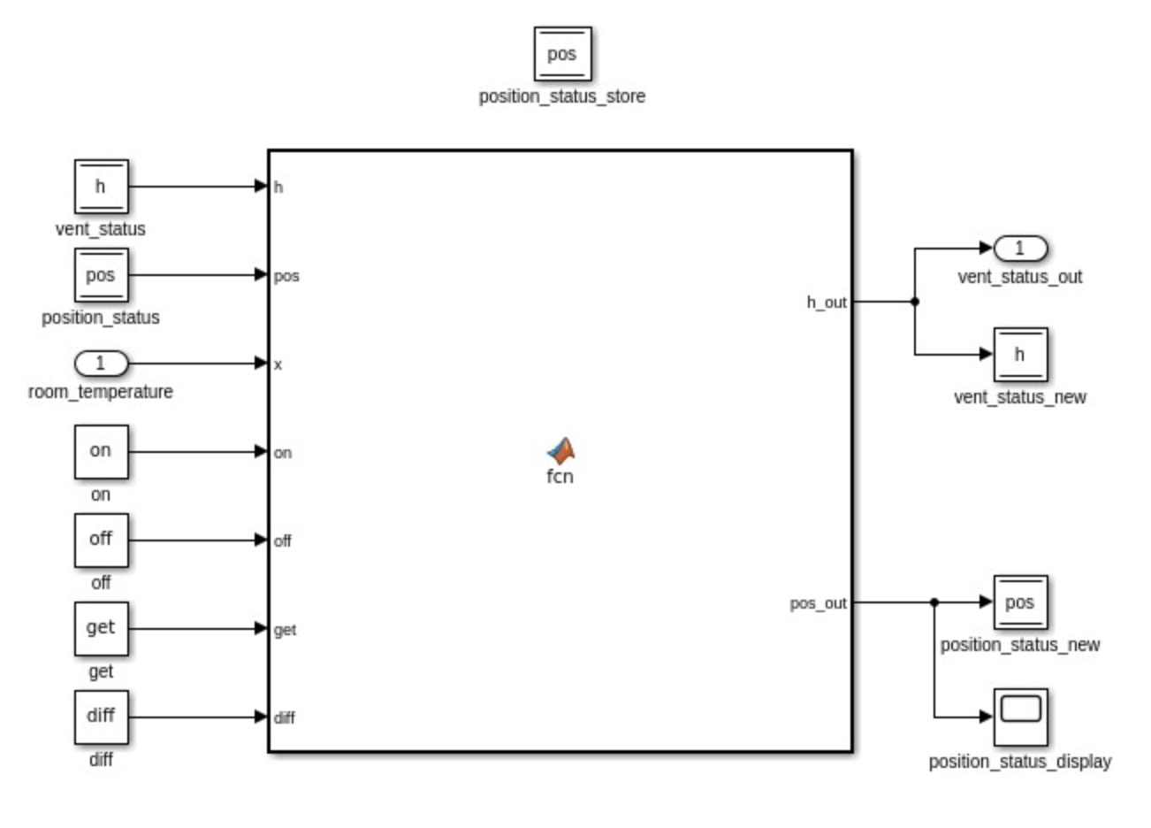
Overall Design - Controller
Input:
Room Temperature
Output:
Vent Status
Constants:
On, Off, Get, Diff

Slide 9
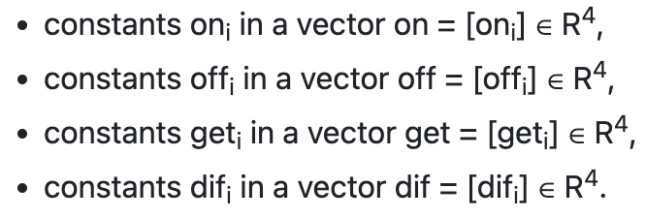
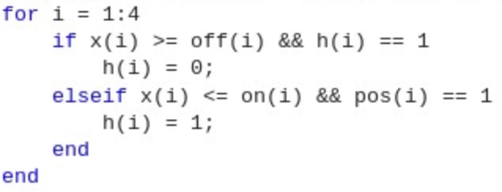
Determine Vent Open/Closed

Slide 10
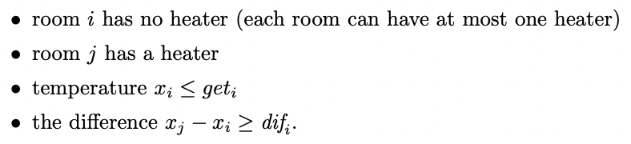
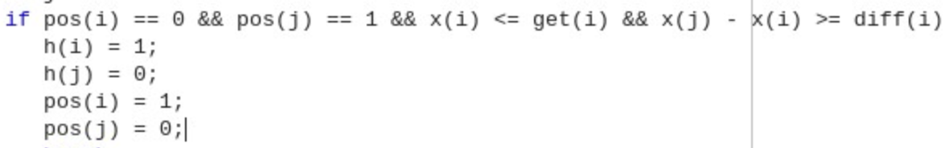
Determine Vent Opening across rooms

Slide 11
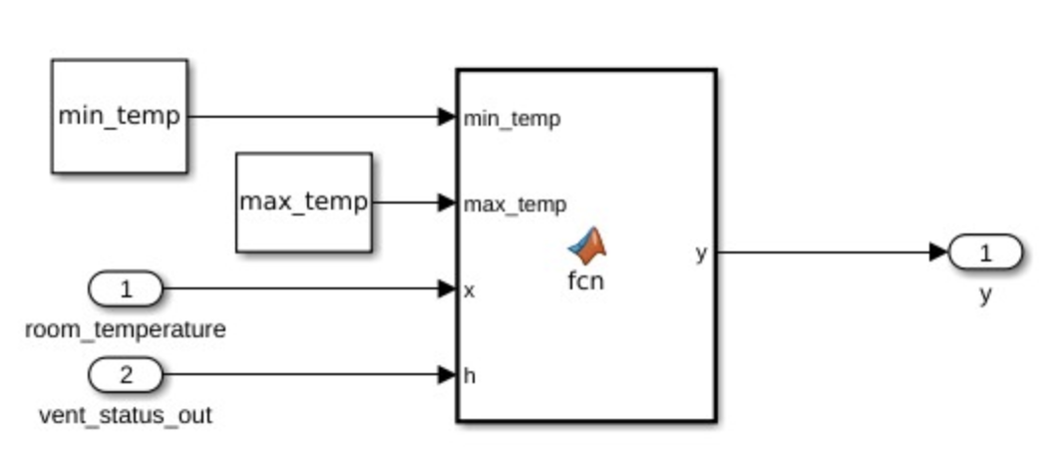
Overall Design - Monitor
Input:
Room Temperature
Vent Status
Output:
Safe / Not Safe (0 / 1)
Constants:
Temperature thresholds

Slide 12
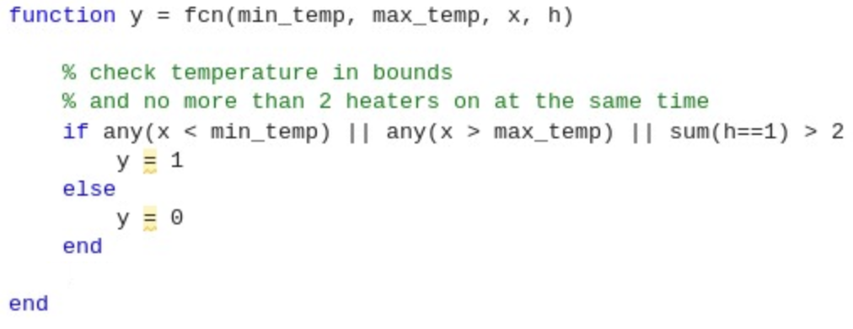
Safety Checks
Temperature is within reasonable range
Controller does not ask for more than 2 vents to be open at the same time as that is not possible

Slide 13
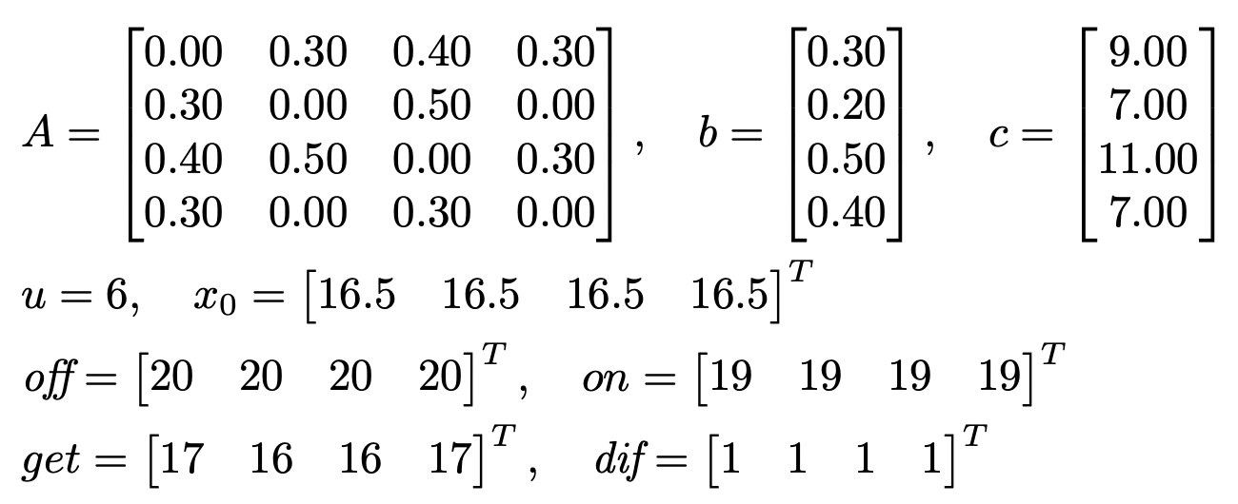
Simulation - time: 10.0
All Vents are off initially
Goal: Control temperature in rooms between 15 & 20 degrees Celsius

Slide 14
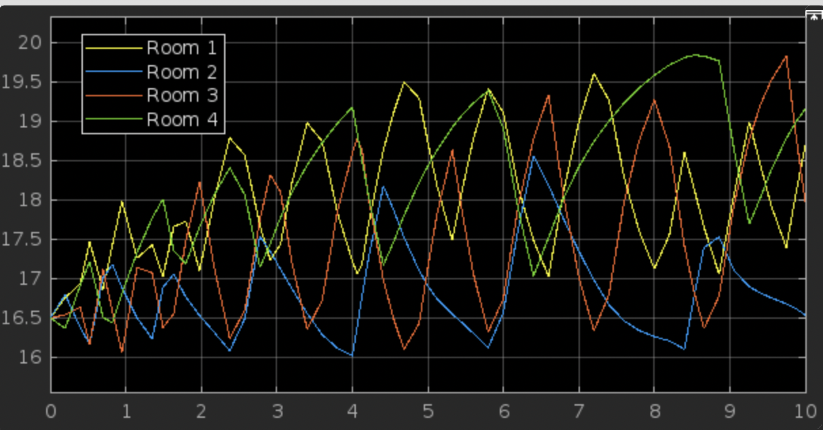
Room Temperature Plot

Slide 15
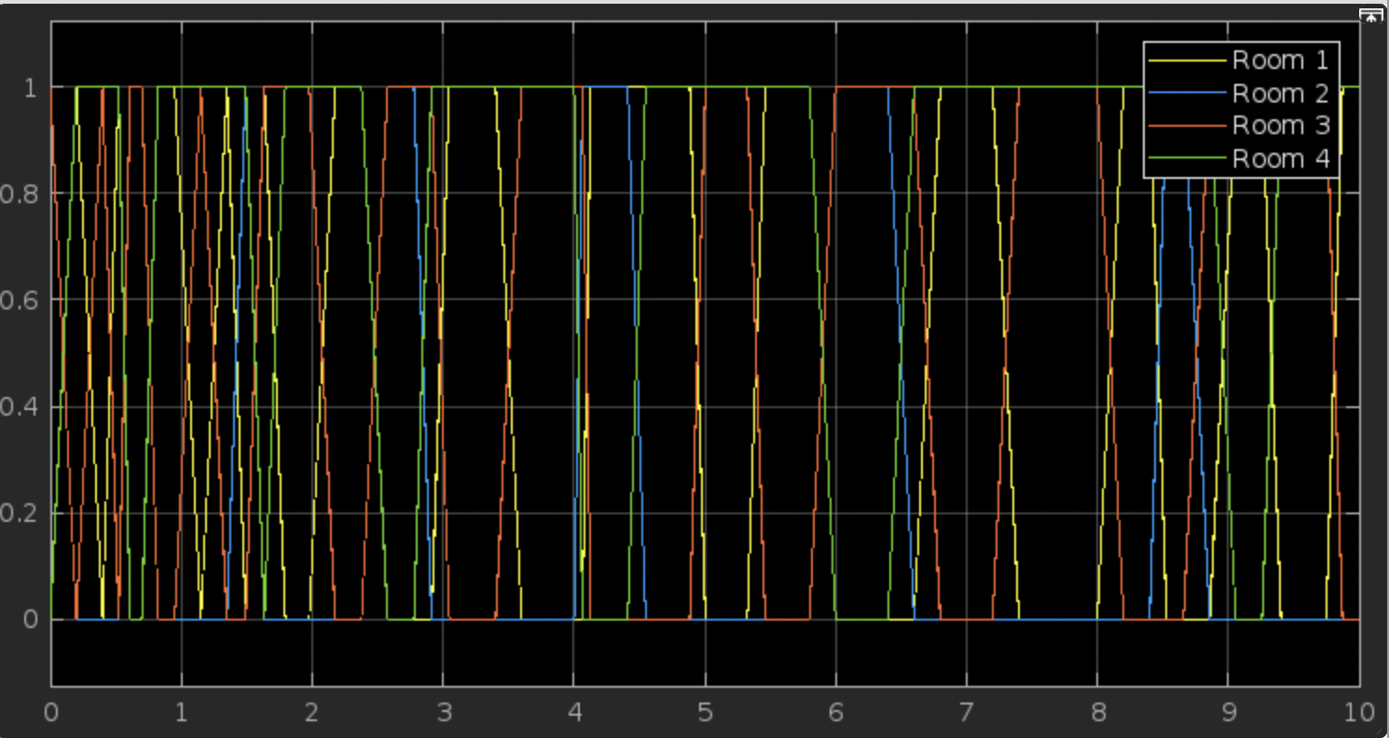
Vent Status Plot

Slide 16
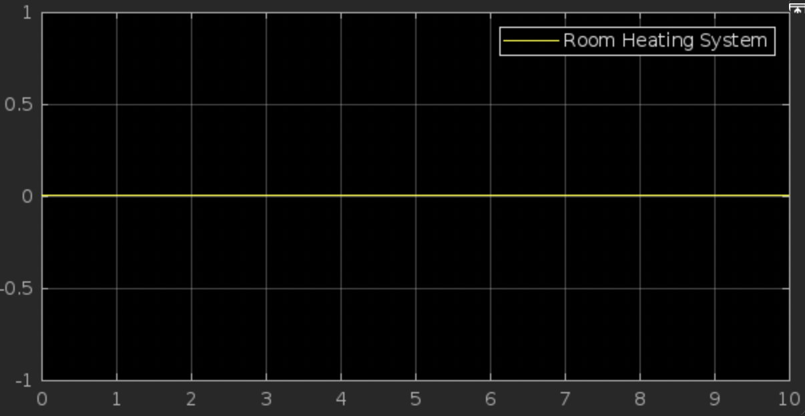
Safety Monitor Plot

Slide 17
Thank you

