Slide 1
Big Data

Slide 2














Technologies
Notes:
Tech is fun!

Slide 3
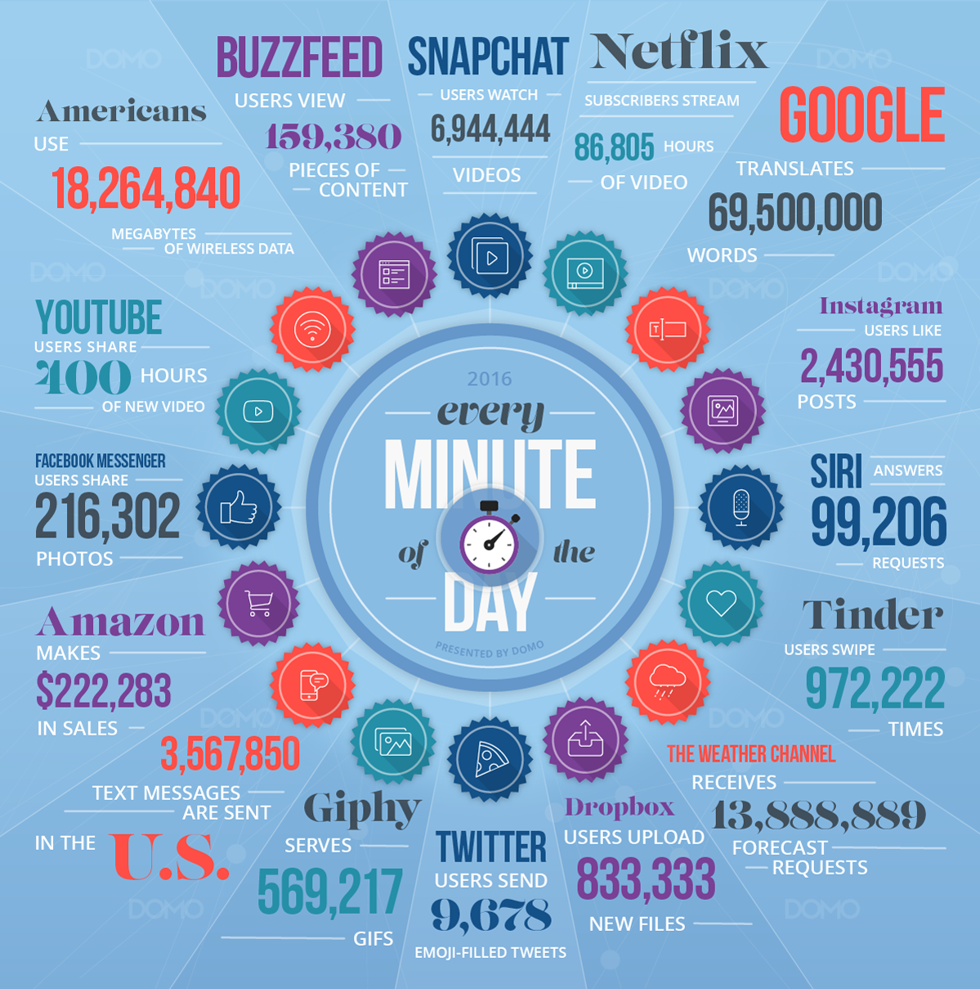
Big Data
The Four V’s
Volume
Variety
Velocity
Value
Challenges
Storage
Processing
Fault Tolerance
Notes:
Big Data is the capability to manage a huge volume of different types of data, at the right speed, and within the right time frame to allow real-time analysis and reaction.
In other words Big Data can be associated with The four V’s. The four V’s are volume, variety, velocity, and value.
Volume is the amount of data,
Variety is the different types of data weather it be structured or unstructured
Velocity the speed of incoming data, and
Value being the worth of the data to the company.
Statistics
You’ll notice these statistics are pretty big. This leads to the challenges of handling big data. The challenges are
the mass volume of data or Storage,
the computation of the data or Processing, and
the mitigation of data loss or Fault Tolerance. The Storage challenge is solved through the Hadoop Distributed File System (HDFS).
The Processing challenge is solved via the MapReduce framework.
The fault tolerance challenge is solved through Replication Strategies.
Over the course of this demonstration we will give a brief overview of these solutions.

Slide 4
What is it?
Storage Layer
Resource Management Layer
Processing Layer
Abstraction Layer
Hive
Pig
MapReduce
Spark
MapReduce
YARN
HDFS
HDFS
Hadoop 1.x
Hadoop 2.x

Slide 5
HDFS
HDFS Daemons
Namenode
Datanode
HDFS HA
Standby namenode
Namenode
Datanode
Datanode
Datanode

Slide 6
MapReduce
Processing Challenge
Data Locality
Map Phase
Reduce Phase
Input
Splitting
Mapping
Shuffling
Reducing
Result
cat 1
dog 1
dog 1
0 cat, dog, dog
4 dog, cat, cat
cat, dog, dog
dog (1,1,1)
dog, 3
cat 3
dog 3
dog, cat, cat
dog 1
cat 1
cat 1
cat (1,1,1)
cat, 3

Slide 7
YARN
Resource Manager
Application Manager
Scheduler
Node Manager
Client
Datanode
App Master
Node Manager
Namenode
Resource Manager
App Manager
Scheduler
Notes:
The Daemons are Resource Manager and Node

Slide 8
Hive
Warehouse Framework
HiveQL
Industry well known
Fast initial load

Slide 9
Pig
Capable of handling semi-structured data (JSON, XML)
Schema-on-read
PigLatin
Grunt shell

Slide 10
Spark
MapReduce Alternative
In memory processing
Resilient Distributed Dataset
RDDs
Multiple times faster
APIs in Java, Scala, Python

