Slide 1
CureOsis
Raising Awareness about Tuberculosis through Mobile Technology

Slide 2
Who We are
We are Cure-Tech Systems, we specialize in the building mobile and application. We specifically enjoy creating solutions for Non-Profit organization
Team Members
Kgotso Bogatsu
William Tandwe
Mpho Mosotho
Mthandazo Towani
Phendulo Nedzingahe
Mninikhaya Kagiso Mavundla

Slide 3
Our Goal
In a time where a huge part of our population has access to cellular devices we seek to further raise awareness of the dangers and solutions available to someone with Tuberculosis.
The TB incidence rate is the proportion of new TB cases per 100,000 population over a year. In South Africa the national TB incidence rate reached its peak in 2009 at 832 per 100,000, and has since declined.
We seek to further help this steady decline of incidences

Slide 4
How We thought about it
We tackled this issue by thorough planning and creativity
Firstly, We Developed a Mobile application for our primary users
Secondly, We developed a website that hosts administrative access for health officials, such as doctors & nurses, to update statistics an information

Slide 5
Mobile App Requirements
No. | Sub-System | Name | Requirements | No.
1.1 | Login | Sign Up | User Enters their personal details into the application and their personal password and clicks enter | 1.1
1.2 |  | Sign In | User enters their required | 1.2
1.3 |  | Change Password | Allow user to change their password on the system | 1.3
1.4 |  | Log out | User clicks the Log Out button, system prompts user to click ‘okay’ if certain of decision | 1.4
2.1 | Info Access | Tuberculosis Information | System Displays all relevant information regarding Tuberculosis and allows User the choice of viewing different Tabs of information | 2.1
2.2 |  | Medication Information | System Displays all relevant information corresponding to Tuberculosis recovery and links the appropriate Government institution that dispenses these medications | 2.2
3.1 | Contact List | Add new Contact | User Chooses to add a new contact | 3.1
3.2 |  | Delete Contact | User chooses to delete a cont | 3.2
3.3 |  | Edit Contact | User edits the details of the contact list | 3.3

Slide 6
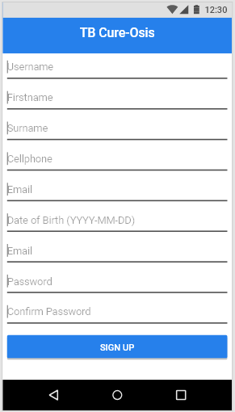
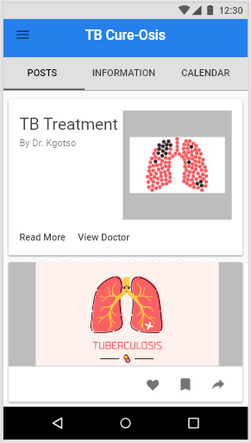
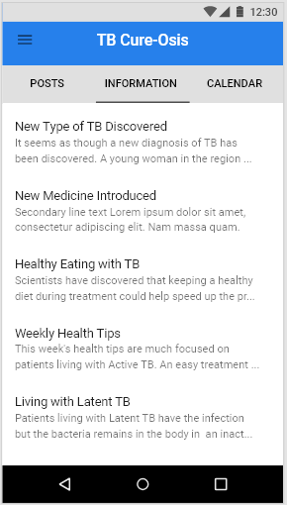
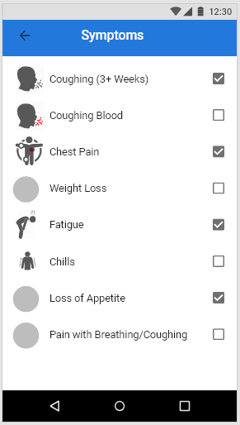
Mobile App Screen Designs
Sign Up
Home
Information
Symptoms

Slide 7
API Requirements
No. | Sub-System | Name | Requirements
4.1 | User Maintenance | Health Official Sign -in | Authorized Health Official enters their required username and password on the Administration website and clicks enter
4.2 |  | Edit TB Info | Authorized Health Official, once signed in, clicks the edit button, the system then prompts the user to chose whether they want to edit information on the following, either TB or medication. Authorized Health Official clicks the TB button allowing the user to edit specific TB information
4.3 |  | Edit Medication Information | Authorized Health Official, once signed in, clicks the edit button, the system then prompts the user to chose whether they want to edit information on the following, either TB or medication. Authorized Health Official clicks the ‘Med’ button allowing the user to edit specific Medication information
4.4 |  | Add New Information | Authorized Health Official click the ‘add’ tab button allowing the user to add new information
4.5 |  | Delete | Authorized Health Official click the ‘delete’ tab button allowing the user to select pre-existing information and delete it

Slide 8
Administrative Back-End Requirements
No. | Sub-System | Name | Requirements
5.1 | System Administration | Log In | System Administrator
5.2 |  | Add New Official
5.3 |  | Delete Health Official Details
5.2 |  | Edit Health Official Permissions | System Administrator logs into the system website and edits the health officials’ permissions and details
5.3 |  | Edit Doctor Details | System Administrator logs into the system website and edits the Doctor clinic location and contact details
5.4 |  | Edit Government Medical Institutions | System Administrator logs into the system website and edits the Government Medical Institutions location and contact details

Slide 9
Administrative Back-End Requirements
No. | Sub-System | Name | Requirements
6.1 | Backup & Restore | Back-up | System administrator clicks the ‘back-up’ button displayed on the website, the system prompts the user to answer the following message ‘Are You Sure?’ the system then acknowledges the users input and begins to make a back-up copy of all the relevant information
6.2 |  | Restore | System administrator is clicking the ‘Restore’ button displayed on the website, the system prompts the user to answer the following message ‘Are You Sure?’. The user then clicks ‘Yes’.the system then acknowledges the users input and begins to make restores from a copy of all the relevant information

Slide 10

Thank You
We as the Development appreciate your time.

