Slide 1

Copywriting
Kaetlin & Sabina

Slide 2
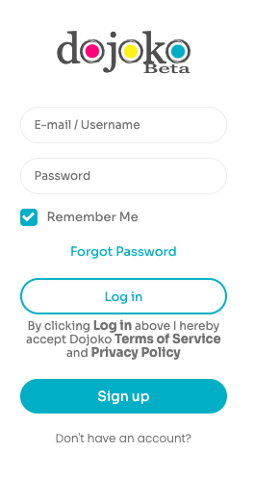
Landing page
Suggestions:
Remove text about Terms of Service and Privacy Policy under login button
Put “Don’t have an account?” above the sign up button, and make it non-clickable, just text.
GV
GV

Slide 3
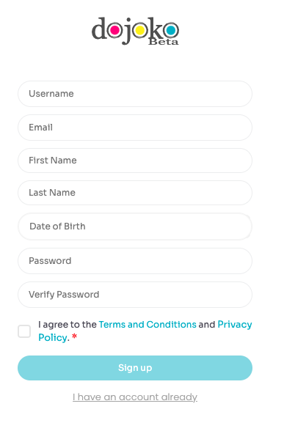
Sign-up page
Current Copy | Action | Suggested Copy
I have an account already | change to | I already have an account
GV

Slide 4
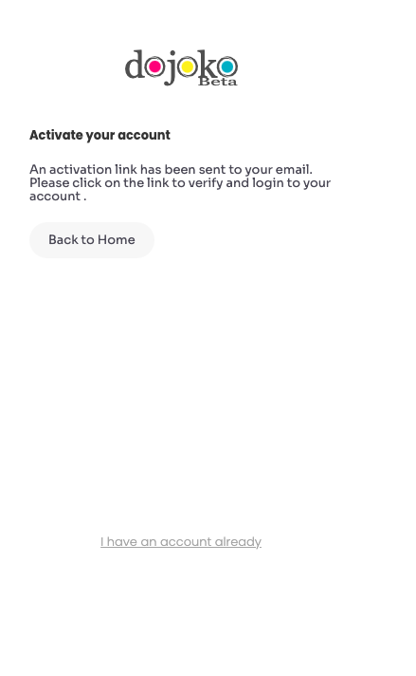
Page after signing up
Current Copy | Action | Suggested Copy
An activation link has been sent to your email. Please click on the link to verify and login to your account. | change to | Almost done… We’ve sent an activation link to your email. Please click on it to complete the sign-up process!
I have an account already | remove | -
Back to Home | Change | Back to Login
GV
GV
GV

Slide 5
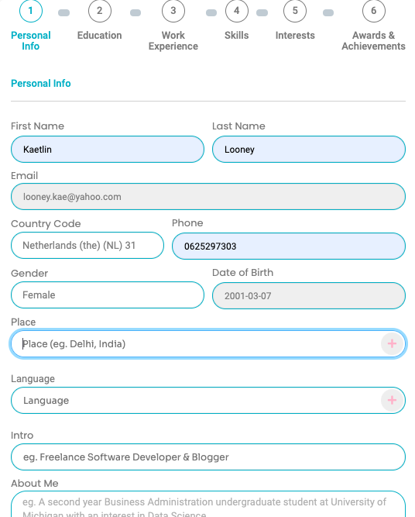
Personal information
Current Copy | Action | Suggested Copy
Place | Change to | Current Location Previous Locations
Language | Change to | Languages
GV
GV

Slide 6
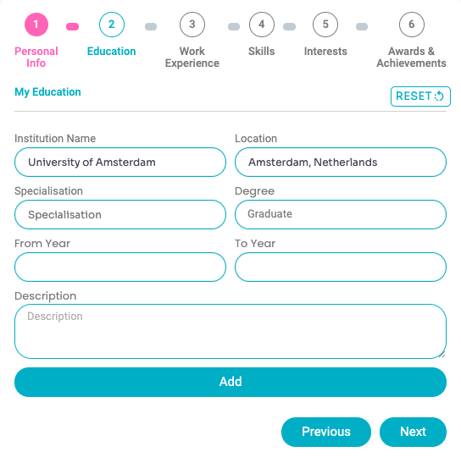
Education
Current Copy | Action | Suggested Copy
From year | Change to | Start date
To year | Change to | End date
Specialisation | change to | Program
GV
GV
GV

Slide 7
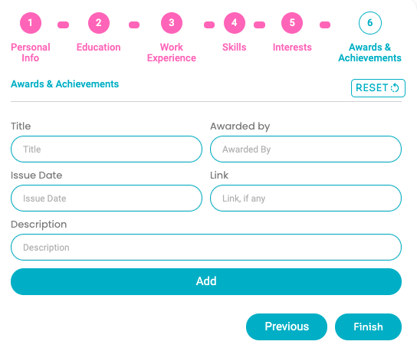
Awards & Achievements
Current Copy | Action | Suggested Copy
Awarded by | Change to | Institution
GV

Slide 8
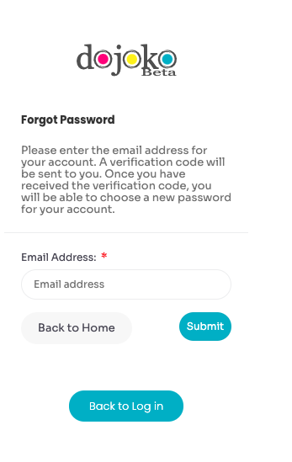
Forgot Password page
Current Copy | Action | Suggested Copy
Forgot Password | change to | Forgot your password? No worries!
Please enter the email address for your account. A verification code will be sent to you. Once you have received the verification code, you will be able to choose a new password for your account. | change to | Just enter your email address below and we’ll send you instructions on how to reset your password.
Buttons belows | Change | Back to Login (where Submit is) Change Back to Home to Back to Submit
GV
GV
GV

Slide 9
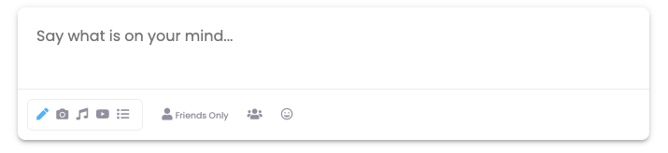
Page | Current Copy | Action | Suggested Copy
Homepage | Say what is on your mind... | Change to | What’s new, FIRSTNAME?
GV

Slide 10
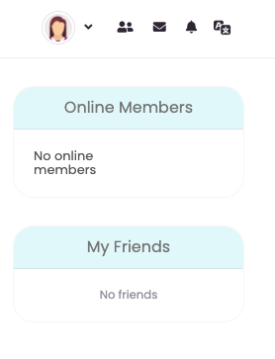
Home page
Current Copy | Action | Suggested Copy
Online Members | Change to | Online Dojoko members
No online members | change to | No online Dojoko members
My Friends | Change to | My connects
No friends | Change to | No connects Build connections here (hyperlinked to Network module)
GV
GV
GV
GV

Slide 11
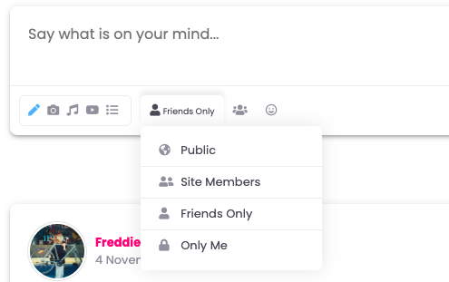
Place | Current | Action | Our suggestion
Home | Site Members | change to | Dojoko members
 | Friends only | change to | Connects only
GV
GV

Slide 12
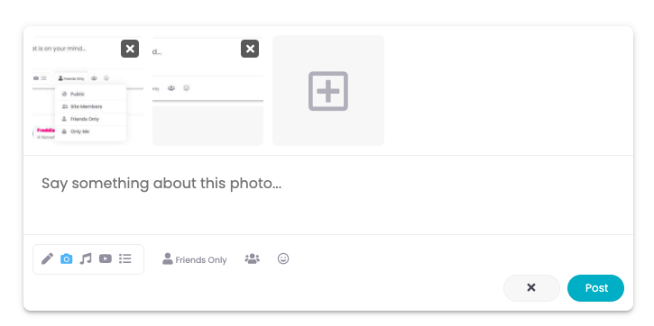
Place | Current Copy | Action | Copy suggestion
Home | Say something about this photo... | change to | Add text...
GV

Slide 13
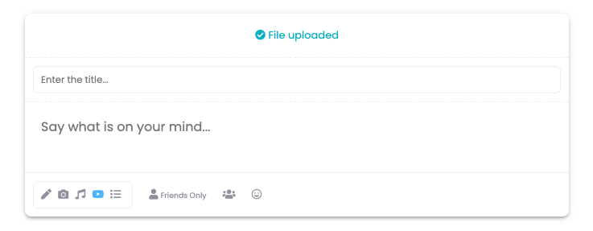
Place | Current Copy | Action | Copy suggestion
Home > post video | Say what is on your mind... | change to | Add text…
GV
Note: post button is missing!

Slide 14
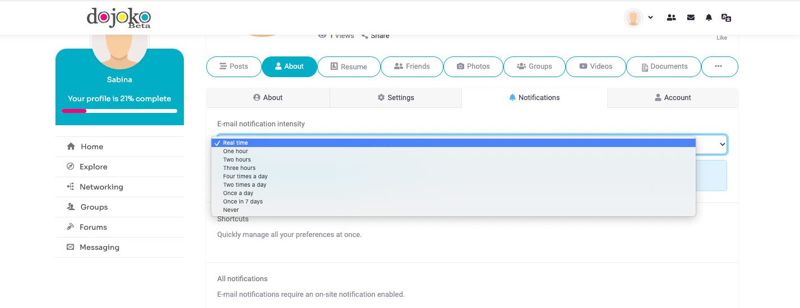
Place | Current | Action | Our suggestion
My profile > About > Notifications | One hour | change to | Every hour
 | Two hours | change to | Every two hours
 | Three hours | change to | Every three hours
GV
GV
GV

Slide 15
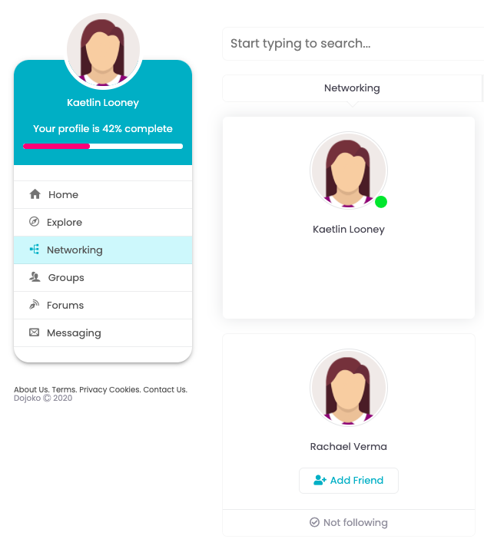
Networking
Place | Current | Action | Our suggestion
Home > Networking | Networking | Change to | Network
Home > Networking | Add friend | Change to | Connect
Home > networking | Not following | Change to | Not connected
GV
GV
GV

Slide 16
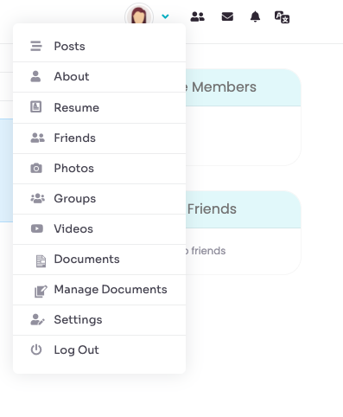
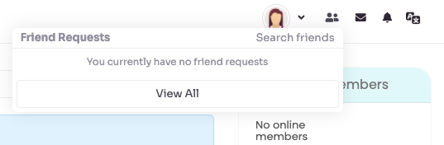
Pop-up
Place | Current | Action | Our suggestion
Home > profile pop-up | Friends | Change to | My Connects
Home > connects pop-up | Friend requests | Change to | You currently have no connection requests
Home > connects pop-up | Search friends | Change to | Search for Connects
GV
GV
GV

Slide 17
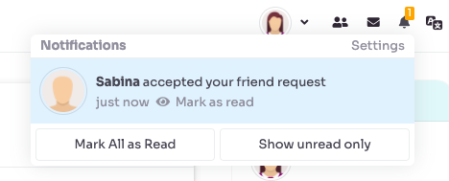
Pop-up
Place | Current | Action | Our suggestion
Home > profile pop-up | Friends request | Change to | Sabina accepted your connection request
GV

Slide 18
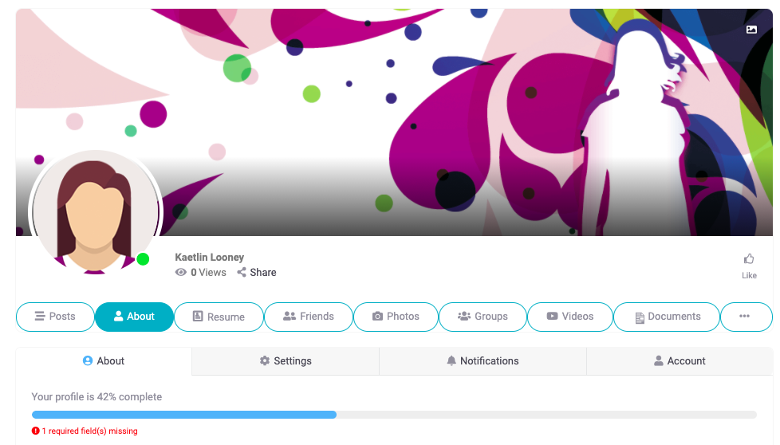
Pop-up
Place | Current | Action | Our suggestion
About > country | Site members | Change to | Dojoko members
GV

Slide 19
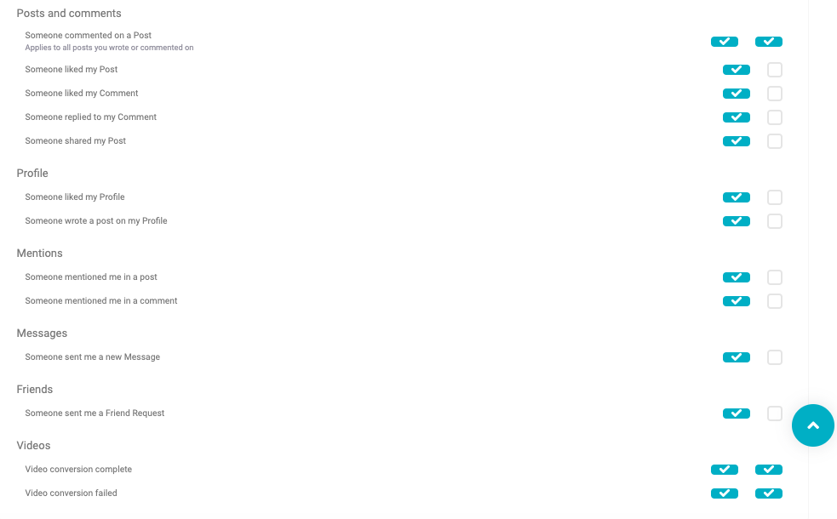
Place | Current | Action | Our suggestion
My profile > About > notifications |  |  | Make all letters except the first in the phrase lower case. Example: Someone commented on a post (NOT Post)
GV

Slide 20
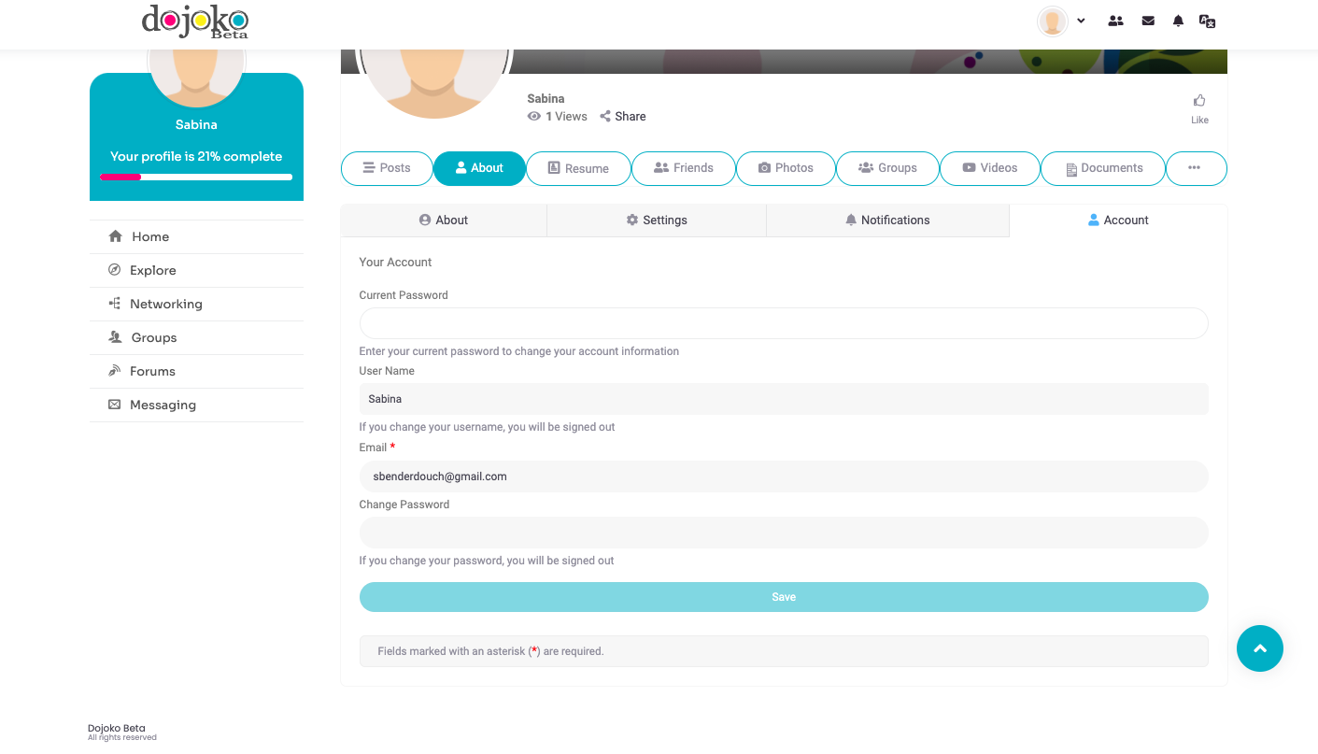
Put “Your Account” in bold
More spacing between all the boxes, right now they are too close together and it’s not clear
GV
GV

Slide 21
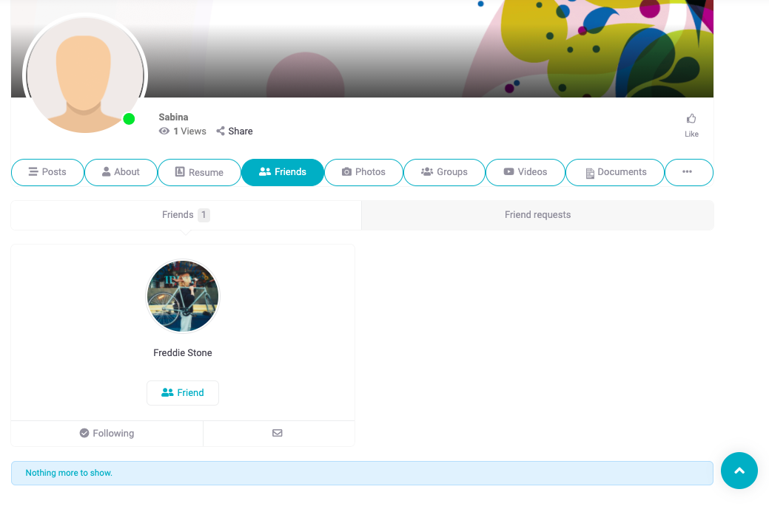
Suggestion: remove “nothing more to show”, just leave it blank instead
GV

Slide 22
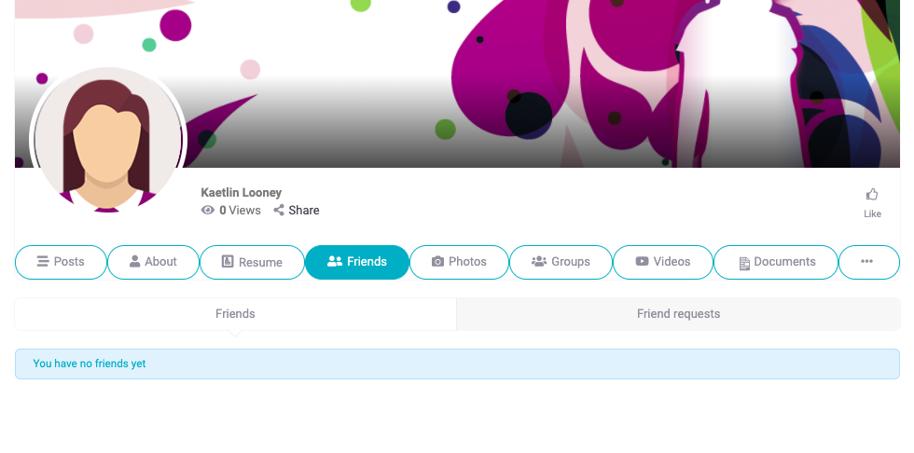
Pop-up
Place | Current | Action | Our suggestion
Friends | Friends | Change to | My Connects
Friends | Friend requests | Change to | Connection requests
GV
GV

Slide 23
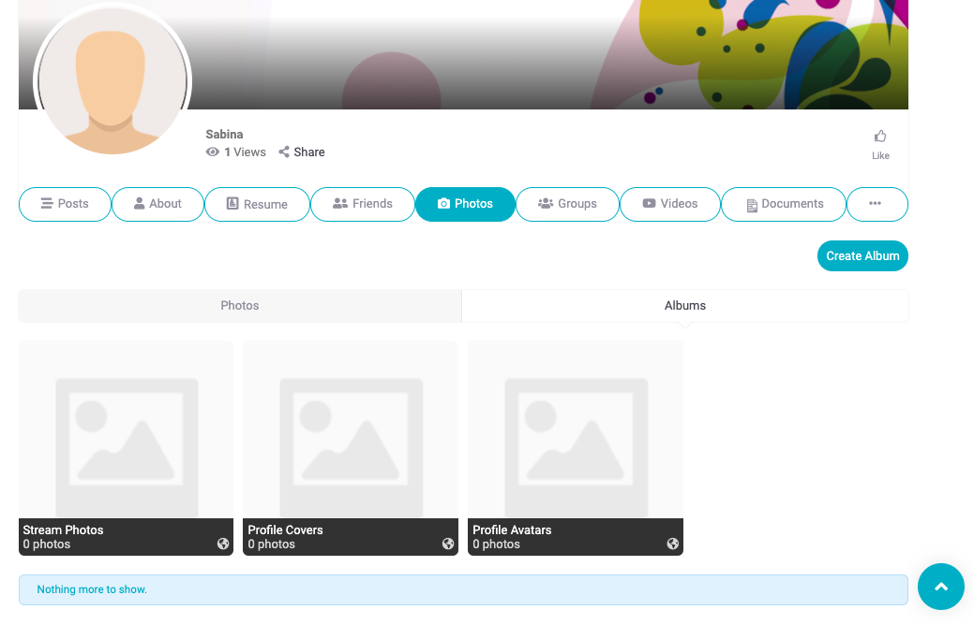
Place | Current Copy | Action | Copy suggestion
My profile > Photos | “Nothing more to show” | REMOVE | -
 | Profile Avatars | change to | Profile Pictures
GV
GV

Slide 24
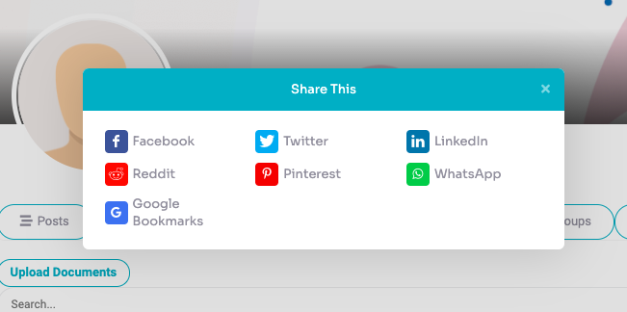
Place | Current Copy | Action | Copy suggestion
My profile > Share button | Share This | change to | Share on
GV

Slide 25
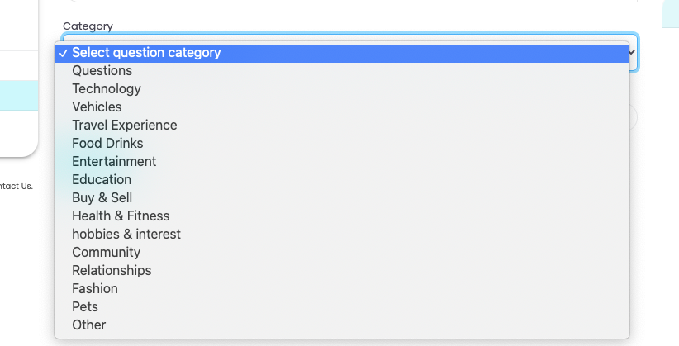
Place | Current Copy | Action | Copy suggestion
Forums > Ask | hobbies & interest | change to | Hobbies & Interests
 | Food Drinks | change to | Food & Drinks
 | Travel Experience | Change to | Travel & Adventure
GV
GV
GV

Slide 26
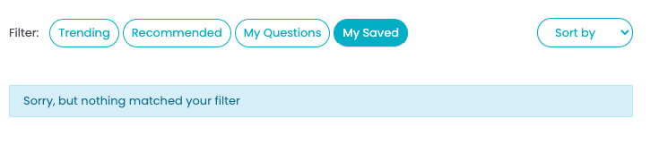
Place | Current Copy | Action | Copy suggestion
Forums > Saved Questions & Saved answers | Sorry, but nothing matched your filter | change to | You don’t have any saved questions yet.
GV

Slide 27
Place | Current Copy | Action | Copy suggestion
Messaging | Search by content, or user | change to | Search by content or user
GV

Slide 28
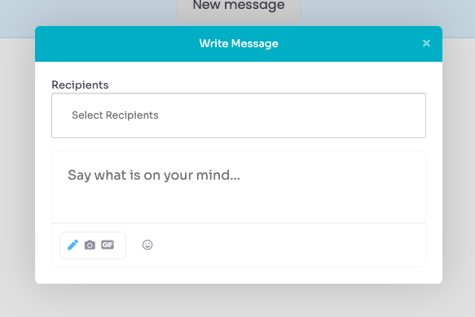
Place | Current Copy | Action | Copy suggestion
Messaging > New message | Say what’s on your mind... | change to | Write a message…
GV

Slide 29
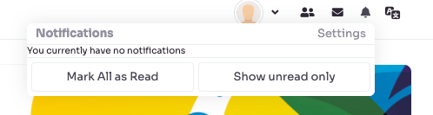
Place | Current Copy | Action | Copy suggestion
Notifications (Bell icon) | Mark All as Read | change to | Mark all as read
GV

Slide 30
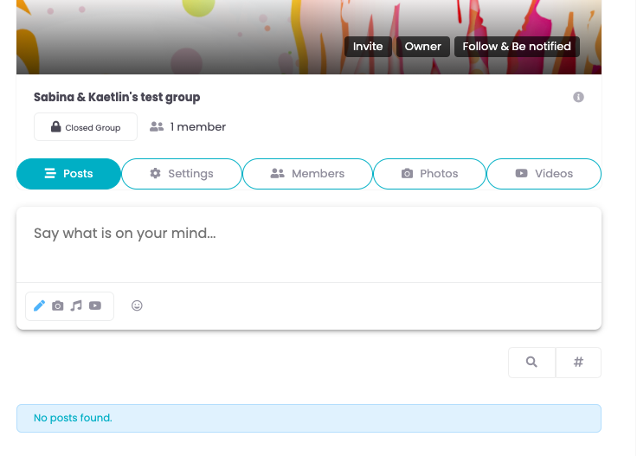
Place | Current Copy | Action | Copy suggestion
In a group | Say what is on your mind... | change to | What’s new, FIRSTNAME?
GV

Slide 31
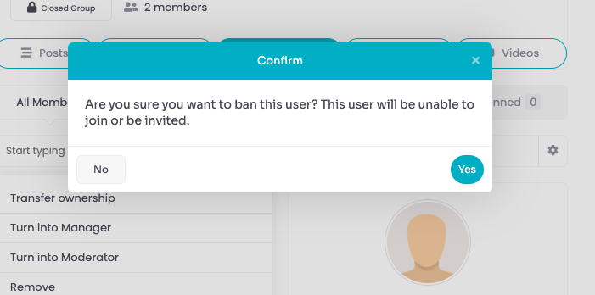
Place | Current Copy | Action | Copy suggestion
Within a group > All members > Manage > Ban | Are you sure you want to ban this user? This user will be unable to join or be invited. | Change to | Are you sure you want to ban this user? This user can no longer join or be invited. Make all No/cancel pink and same sized boxes
GV
GV

Slide 32
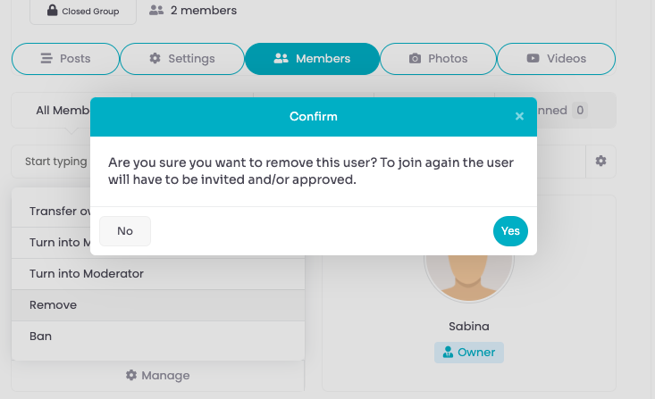
Place | Current Copy | Action | Copy suggestion
Within a group > All members > Manage > Remove | Are you sure you want to remove this user? To join again the user will have to be invited and/or approved. | Change to | Are you sure you want to remove this user? To join again the user must be re-invited and approved. Make all No/cancel pink and same sized boxes
GV

Slide 33
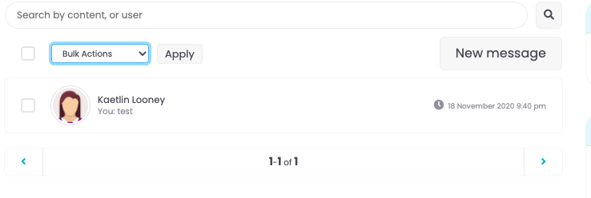
Place | Current Copy | Action | Copy suggestion
Messaging | Bulk Actions | change to | Select action:
GV

Slide 34
Our general suggestion: remove “Nothing more to show.” bar from everywhere
GV

