Slide 1
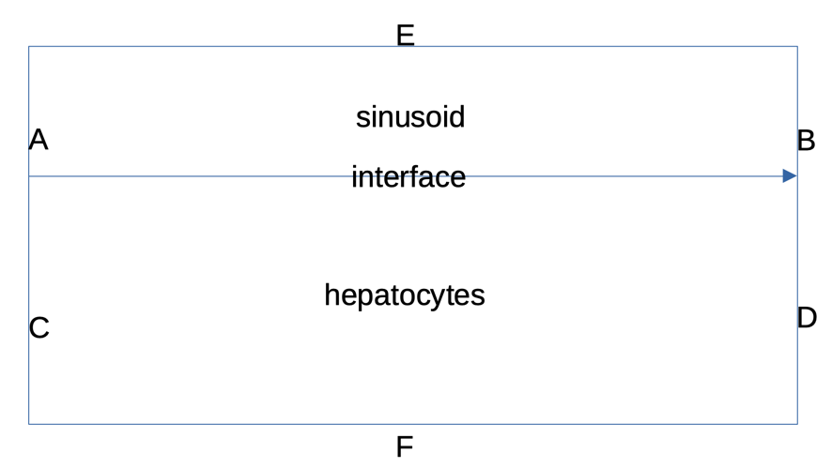
Sinusoid: diffusion+advection
Hepatocyte: diffusion+reaction(Michaelis-Menten)
Interface: equal flux
A: fixed value, 65mmHg
B: advection only (diffusion ignored)
C/D/F: zero flux
E: symmetry (same as zero flux)

Slide 2
Numerical scheme
Diffusion: Crank-Nicolson method
(always stable)
Advection: Upwind method
(stable when courant number )
time step= 1.5-2 millisecond,
space step= 1 micrometer
Each iteration takes 0.08-0.09 second
converges within minutes
$\frac{Δt∗velocity}{Δx}<1$

Slide 3
key constants
sinusoid blood flow velocity: 0.3-0.65 mm/sec
oxygen diffusion coefficient in sinusoid: 1.62 X 10(-5) cm2/sec (2 in water)
oxygen diffusion coefficient in hepatocyte: 1.4 (no data, I assume a smaller value)
oxygen concentration:
PP: 60-70 mmHg= 10-12% aåtmospheric pressure
PV:25-35 mmHg= 3-5% (target)
diameter of hepatocyte rescaled, 25-30 micro m
diameter of sinusoid rescaled, 10-15 micro m
length of sinusoid rescaled, 275 micro m
Oxygen consumption parameters: not important, to be replaced by mitochondria model

Slide 4
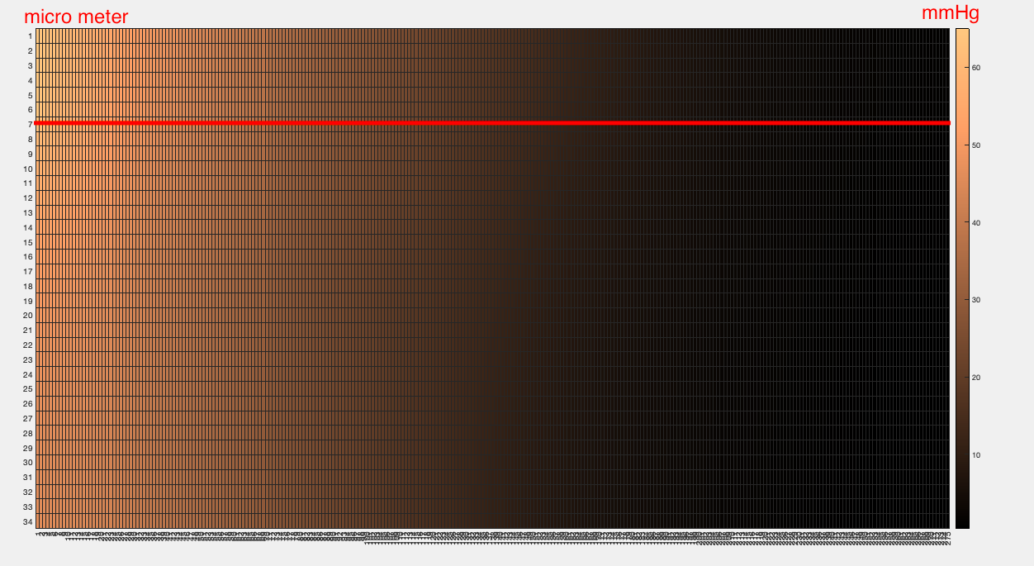

Slide 5
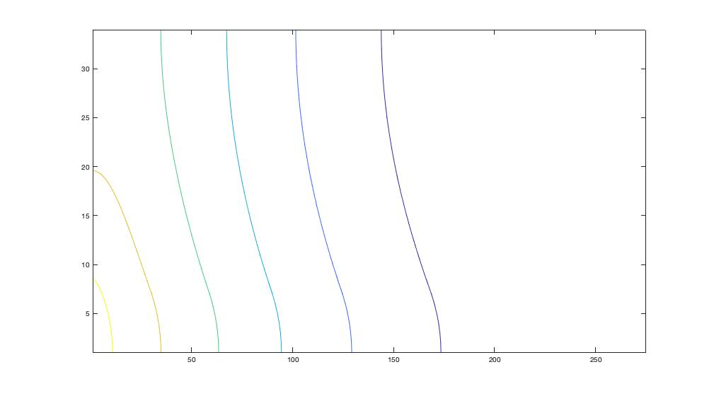
Contour plot: vertically

Slide 6
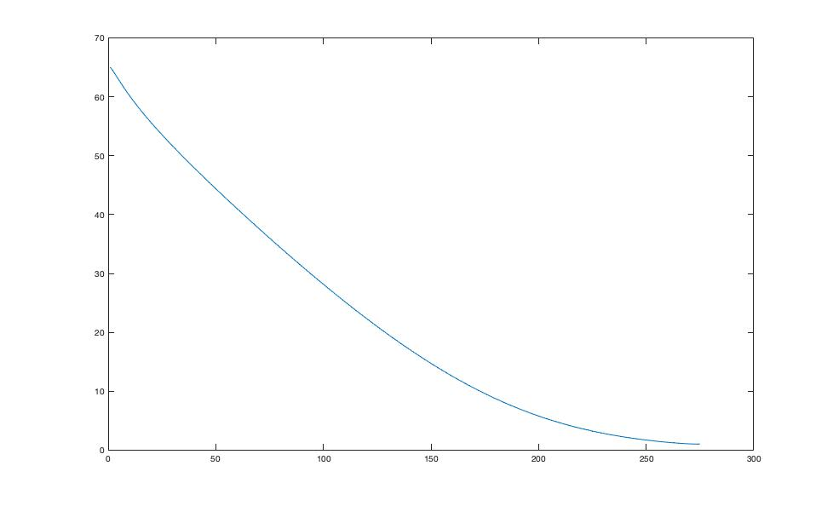
Centre of sinusoid: horizontal

Slide 7
Challenge
The oxygen concentration at PV too low, miss the target
Real parameters used here, but oxygen in hemeglobin ignored
Solution:
1. to compensate: increase blood flow velocity, decrease diffusion coefficient ( I have tried, kinda works) not feasible
2. add the interaction between plasma and hemeglobin oxygen
(Hill equation, but might mess up the numerical simulation)
3. raise oxygen concentration at the inlet

