Slide 1
Impact of drugs on oxygen consumption by liver cells
13th Jan meeting
William Xu

Slide 2
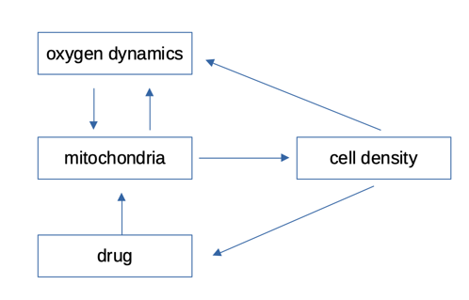
Overall structure

Slide 3
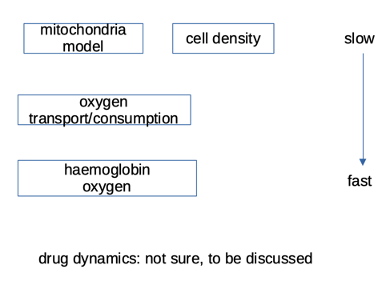
Multiple temporal scales

Slide 4
oxygen dynamics
Model updated:
1. haemoglobin oxygen modelled
(equation solving: Newton method, fast)
2. from 2D geometry to 3D symmetric geometry
3. space step and time step increased
(to 2 micrometers, 0.0045 seconds)

Slide 5
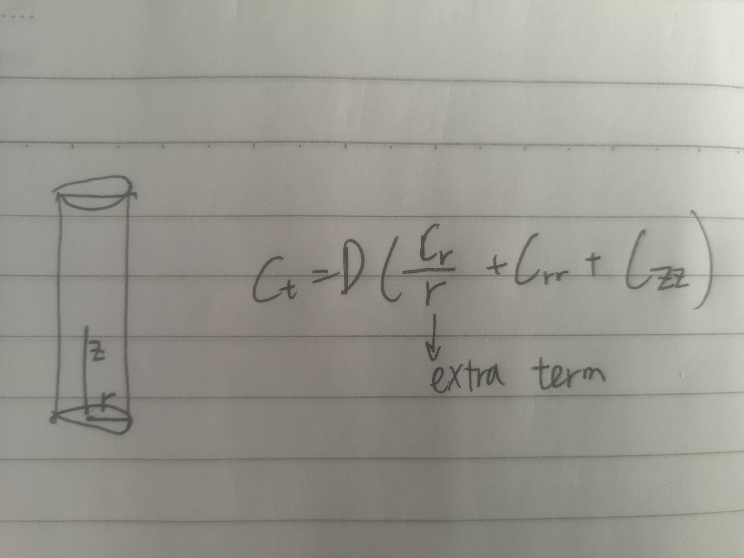

Slide 6
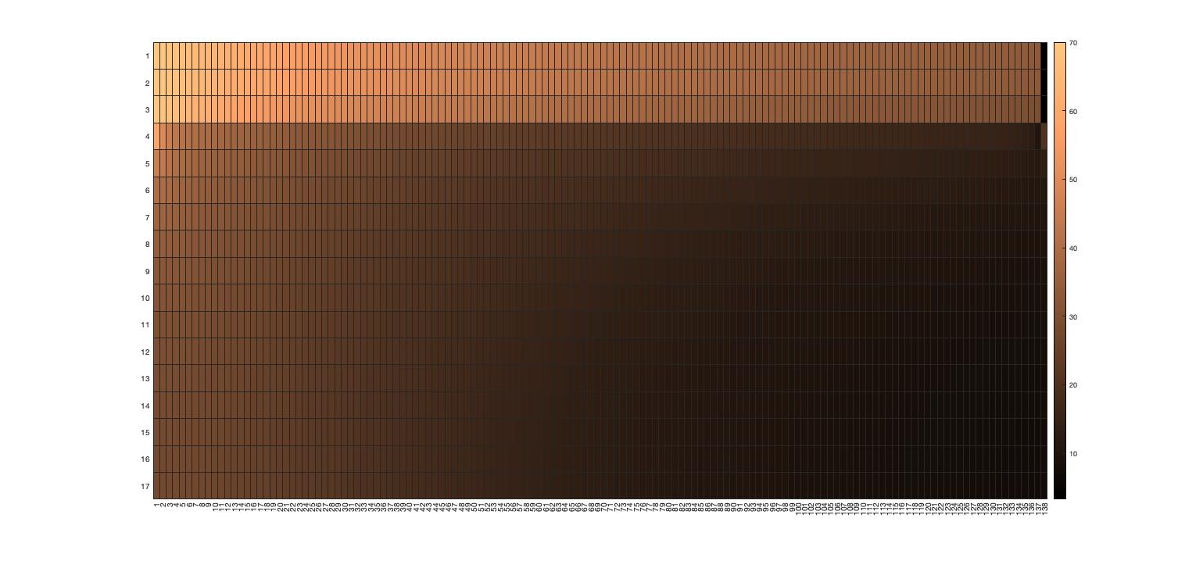

Slide 7
Output interpretation
Sinusoid exit: ~ 30 mmHg
Periportal (PP) hepatocytes: 45-25 mmHg
Perivenous (PV) hepatocytes: 15-7 mmHg
Results in the physiological range. Satisfactory.
Faster execution

Slide 8
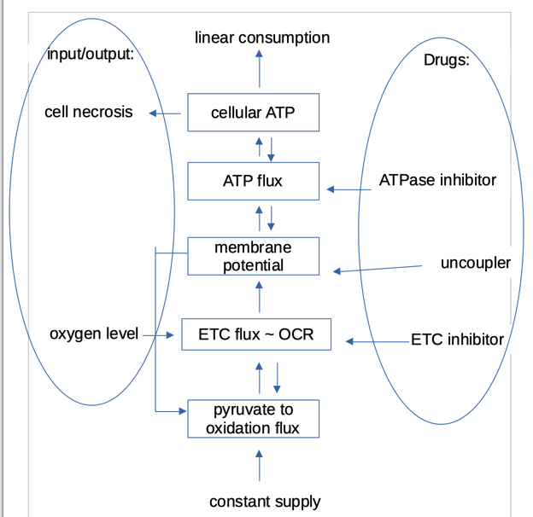
Mitochondria model
Simplified version of Yang 2015 paper
Input: oxygen level affects OCR by Michaelis-Menten, and OCR ~ ETC flux
Output: cellular ATP level affects necrosis (TBD)
Parameters: fitted using data and plots from Yang 2015 (drug doses, cellular ATP, membrane potential, OCR, ECAR)
Customisable parameters. Data from other drugs can be used to fit the parameters and determine their roles.
Methods: MATLAB ODE15s solver, fminsearch optimiser

Slide 9
Cell density
Base: logistic model. Data: liver regeneration time after surgery?
Necrosis: determined by cellular ATP level. Help needed.
Apoptosis: incorporated into logistic model or affected by mitochondria/oxygen? Help needed

Slide 10
Drug Model
Pharmacokinetics data?
Metabolism by hepatocyte: P450?
Transport across membrane: extra parameter?
Drug diffusion

Slide 11
Thank you!
After the remaining issues sorted, I expect to finish the model construction within one week
codes, data, PowerPoints uploaded on Github
github.com/WilliamXXu/liver_model

