Slide 1
Impact of drugs on oxygen consumption by liver cells
William Xingze Xu
Supervised by Dr Giovanni Di Veroli, Dr Aydar Uatay
(AstraZeneca)

Slide 2
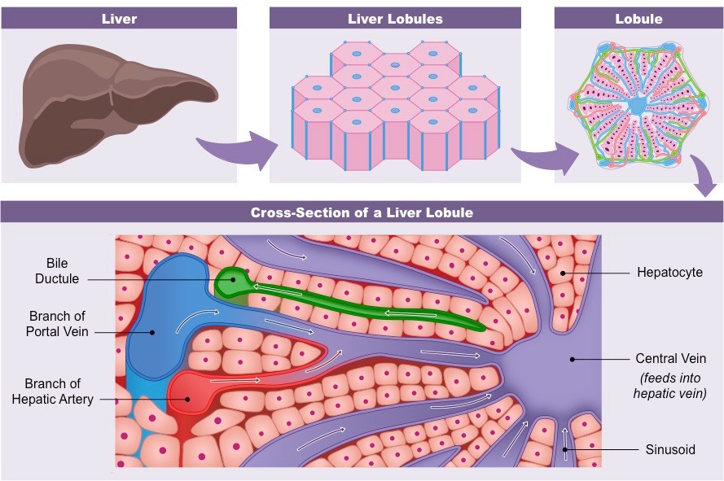
Motivation
Drug-induced liver injury (DILI) screening
To guide/complement organ-on-chip experiments
Data interpretation

Slide 3
Ideas
  Quantitative systems pharmacology
  Computational fluid dynamics
  Simplify the biology, but need to capture liver zonation
  Model each process and link them together
Cell death
Oxygen
mitochondria
ATP
drug

Slide 4
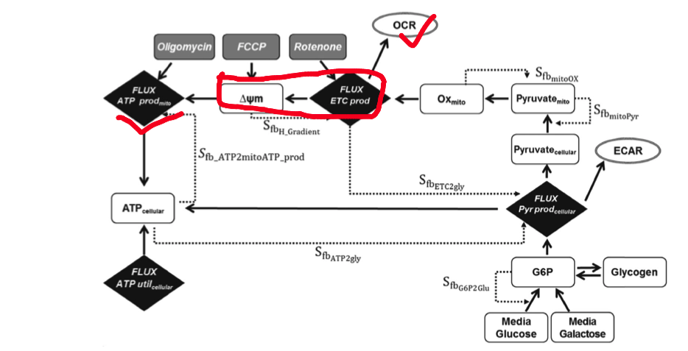
Mitochondria
Yang 2015

Slide 5

Methods
Continuous, mechanistic, multi-scale
Differential equations (advection-diffusion-consumption)
Lots of them.
Numerical simulations in MATLAB
User-friendly and flexible framework
Leedale 2019

