Slide 1
Advanced Artificial Intelligence
Project: Image classification using deep learning

Slide 2
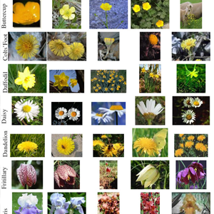
Introduction
Datasets
This datasets consists of 102 flower categories. The flowers chosen to be flower commonly occuring in the United Kingdom. Each class consists of between 40 and 258 images. The details of the categories and the number of images for each class can be found on this category statistics page.
The images have large scale, pose and light variations. In addition, there are categories that have large variations within the category and several very similar categories. The dataset is visualized using isomap with shape and colour features.
Link：
https://www.robots.ox.ac.uk/~vgg/data/flowers/102/102flowers.tgz
https://www.robots.ox.ac.uk/~vgg/data/flowers/102/imagelabels.mat

Slide 3
Experimental environment
Pytorch
You can choose Jupyter notebook or Pycharm as IDE.

Slide 4
Files to be submitted
Trained network model file, including model and weights (pth format).
model&weights_studentname_studentId.pth
The project source code
code_studentname_studentId.py
Experimental Report
report_studentname_studentId.doc
the report should Include following contents：
The data processing method, the principle of model design, and the method of adjusting the parameters
Figure of network model structure
Figures for the accuracy curves and loss curves
classification accuracy
Zip these three files into a folder named studentname_studentid, and submit the zipped folder.

Slide 5
Note
Final score is based on classification accuracy of the model on the test dataset and quality of the experimental report.
No plagiarism.
Designing a new network model is encouraged.
Your project should be submitted to the following email address feiziang123@163.com by Jan. 24th , 2021
Late submission leads to “fail” for the project.

