Slide 1
Decision Trees: Classification
Bhavana Vadlamani, Zach Fallon, Burton Milnor, and Andrew Kiriakedes

Slide 2
AGENDA
Decision Tree Review
Generic Example
Classification Trees
Advantages vs. Disadvantages of Decision Trees
Measures: Error rate, Gini Index, Information gain
Entropy
Measuring Information
Introduction to R-Part
Example in R
In Class Exercise
Decision Tree vs. Linear Models
Real World Applications
Questions

Slide 3
Recap
Since the 1980’s, Decision Trees have been the most widely deployed machine-learning based data mining model builder.
Intuitive to understand and easy to explain, however, do not always deliver best performance
Supervised Learning Methodologies (Classification & Regression)
Key Components: Root Node, Internal (split) Node, Terminal (leaf) Node

Slide 4
RECAP
Associated with each Internal Node will be a decision made or question asked that determines which branch to follow.
The leaf nodes contain the "decisions" or "predictions”.
Probabilities are typically recorded for each leaf node of the decision tree to indicate the strength of the decision we derive from the model.

Slide 5
RECAP
Dilemma: infinite possible trees vs. impossible to enumerate and test each one
Solution: use the observations/training subset to search the space of possible trees to find a "good" model in a reasonable amount of time.

Slide 6



Will Burton Jump?

Slide 7




Day | Temp | Precipitation | Wind | Jump?
1 | Hot | Yes | Low | Yes
2 | Hot | No | Low | Yes
3 | Cold | No | Low | No
4 | Cold | No | High | No
5 | Hot | Yes | High | No
6 | Cold | Yes | High | No
7 | Hot | Yes | Low | Yes
8 | Cold | Yes | Low | No
9 | Cold | No | Low | Yes
10 | Hot | No | Low | Yes
11 | Hot | No | High | No
12 | Hot | Yes | Low | Yes
13 | Hot | Yes | Low | ?
Data
Root Node
Was it Hot?
Internal (split) Node
yes
no
Precipitation?
Precipitation?
Pure/ Zero Entropy
yes
no
yes
no
Wind Level High?
Wind Level High?
No
Wind Level High?
yes
no
yes
no
$$\frac{0}{2}$$
yes
no
No
Yes
No
Yes
No
Yes
$$\frac{0}{1}$$
$$\frac{3}{3}$$
$$\frac{0}{1}$$
$$\frac{2}{2}$$
$$\frac{0}{1}$$
$$\frac{1}{2}$$
YES!
Terminal (leaves) Node
Notes:
Information gain split at Temp? internal nodes – we will cover that later.
Not a complete tree – cold/low would be branched one layer deeper unless a constraint was added.
new data point 13 would not guarantee that the same would result would happen given the exact same parameters, because the splits could happen differently with a new data point.
Pure = max or min entropy. We will get to that later.

Slide 8
Classification trees
Classification Trees predict a qualitative response rather than quantitative
Pruning the tree: Simplify the tree by pruning peripheral branches to avoid overfitting
We need to measure how good a particular partition of the dataset is.
Measures for classification and regression trees differ
Regression: Recursive binary splitting with RSS
Classification : Recursive binary splitting with the following measures
Classification error rate
Gini Index
Entropy/Information Gain

Slide 9
ADVANTAGES VS. DISADVANTAGES
Advantages:
Easy to explain
Mimics human decision-making
Displayed graphically & easily interpretable even by non-experts
Can handle qualitative predictors without creating dummy variables
Disadvantages:
Predictive accuracy as compared to regression/ other classification approaches
Caveat: we can improve predictive accuracy via methods such as bagging, random forests & boosting we will explore next week.

Slide 10


Measures: Classification error rate
As we plan to assign an observation in a given region to the most commonly occurring class of training observations in that region, the classification error rate is :
The faction of training observations in that region that DO NOT belong to the most common class
Here ${\hat{P}}_{mk}$ represents the proportion of training observations in the m^{th} region from the k^{th} class.
Bottom-line: this measure is not sufficiently sensitive for tree-growing but is preferred if prediction accuracy of final pruned tree is the goal

Slide 11
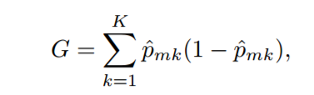

MEASURES: gINI INDEX
Defined by:
A measure of the total variance across the K classes. Since the Gini index takes on a small value if the ${\hat{P}}_{mk}$’s are close to zero or one it is known as a measure of node purity.
Small value of the Gini Index indicates that a node contains predominantly observations from a single class

Slide 12
Entropy
For classification trees, we will use an information gain measure for deciding between alternative splits.
The concept comes from information theory and uses the concept of entropy from physics (i.e., the concept of the amount of disorder in a system).
Entropy is often used as a measure of how evenly energy (or some analogous property) is distributed in a system. The more even the distribution, the higher the entropy.
Notes:
Add excel (Entropy vs. Gini )

Slide 13
Entropy
For us, the concept of disorder relates to how "mixed" our dataset is with respect to the values of the target variable.
If the dataset contains only observations that all have the same value for the target variable, then there is no disorder - i.e., no entropy or zero entropy.
If the two values of the target variable are equally distributed across the observations, then the dataset contains the maximum amount of disorder.
We identify this maximum amount of entropy as 1.
Thus datasets containing different mixtures of the values of the target variable will have a measure of entropy between 0 and 1.

Slide 14
Entropy
We interpret a measure of 0 (i.e., an entropy of 0) as indicating that we need no further information in order to classify a specific observation within the dataset - all observations belong to the same class.
Conversely, a measure of 1 suggests we need the maximal amount of extra information in order to classify our observations into one of the two available classes.

Slide 15
Entropy
If the split between the observations is not 50/50 but perhaps 75/25, then we need less extra information in order to classify our observations - the dataset already contains some information about which way the classification is going to go.
Like entropy, our measure of "required information" is thus between 0 and 1.

Slide 16
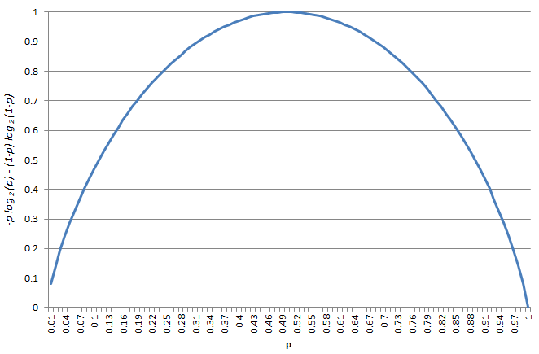
Measures: Information gain
If we plot this function, we obtain the following
The point of maximum entropy occurs when the observations are equally distributed across the values of the target variable. For a binary target, as here, this occurs when p = 0:5.
The point of minimum entropy occurs when the observations have the same value of the target variable. For a binary target, as here, this occurs when p = 0 or 1.

Slide 17

Measures: Information gain
The formula we use to capture the entropy of a dataset, or equivalently, the information needed to classify an observation, is:
where $ρ$is the proportion of observations in the dataset with one or the other value (perhaps RainTomorrow = Yes)
Here, less is better since it means the dataset has less entropy (less disorder, therefore requiring less information to classify an observation).
$$info\left(D\right)=−p\log_{2}\left(p\right)−(1−p)\log_{2}\left(1−p\right)$$

Slide 18
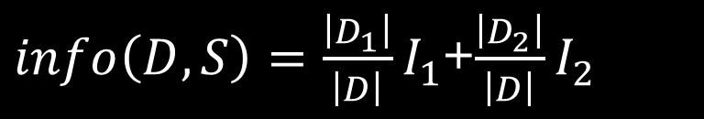
Measures: Information Gain
This then provides a mechanism for measuring the information content of a particular split, and so provides a means to choose the "best" split from among the very many possible splits.
Each potential split results in a binary partition of the training dataset. We will call these D₁ and D₂. We note that D = D₁ U D₂.
If we let the entropy of these two datasets be I₁ and I₂, then we can add them, weighting by the size of the two subsets created by a particular split S to obtain a measure of the combined entropy:
$info\left(D,S\right)=\frac{\left|D_{1}\right|}{\left|D\right|}I_{1}$+$\frac{\left|D_{2}\right|}{\left|D\right|}I_{2}$
Notes:
Note: Slides 11-15 need to be edited.

Slide 19
Measures: Information Gain
Comparing this with the original information, or entropy, we get a measure of the gain in information obtained by using the particular split S:
This can then be calculated for each of the possible splits. The split that provides the greatest gain in information (and equivalently the greatest reduction in entropy) is the split we choose.
$$gain\left(D,S\right)=info\left(D\right)−info\left(D,S\right)$$

Slide 20
R PART INTRO
R-part: short for Recursive Partitioning
CART : Gini Index
Analyzing Output
Tuning Parameters

Slide 21
IN-CLASS LAB EXAMPLE

Slide 22
IN-CLASS LAB EXERCISE

Slide 23
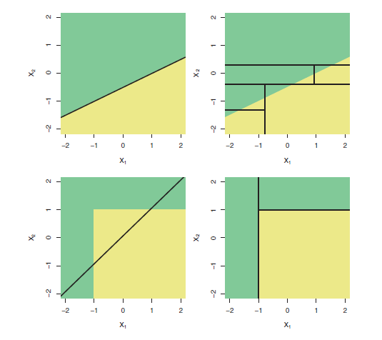
DECISION TREE MODEL VS. LINEAR MODEL
Which model is better?
Depends on problem at hand.
If relationship between features & response are well approximated by a linear model then an approach such as linear regression will work well because it will exploit this linear structure
If instead there is a highly complex and non-linear relationship then decision trees may work better.
Remember: relative performance can be assessed by estimating test error using either cross-validation or validation set approach
However prediction using trees may be preferred simply for ease of interpretability and visualization.

Slide 24
REAL WORLD APPLICATIONS
Astronomy:
Filter noise from Hubble Space Telescope images
Biomedical Engineering: Identify features to can be used in implantable devices
Manufacturing & Production:
Process optimization in electrochemical machining
Schedule printed circuit board assembly lines
Uncover flaws in a Boeing manufacturing process
Quality control
Medicine: Disease diagnosis
Molecular Biology: Human Genome project
Analyzing amino acid sequences
Identify and predict genes in DNA sequences
Object Recognition: Recognizing three dimensional objects and for high level vision
Text Processing: Text classification
Video Games: X-Box Kinect

Slide 25
QUESTIONS…☺

