Slide 1
Hierarchical Clustering
Arshan Tarapore
Eric Hensley
Curt Commander
Arel Murphy

Slide 2
Agenda
Review of Interpreting a Dendrogram
Different ways to visualize a Dendrogram
Hierarchical Clustering Algorithm
Dissimilarity Measures
Different Dissimilarities for Different Data Types
Linkage Types
Shortcomings of different Linkage types
How dissimilarity and linkage changes a dendrogram
Lab
Practical Issues/Warnings about Hierarchical Clustering

Slide 3
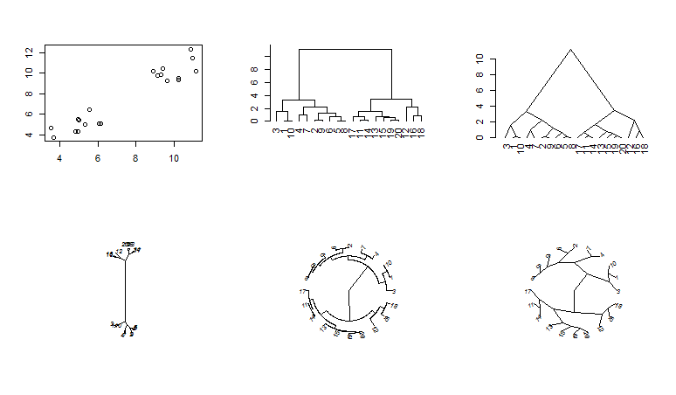
Review
Visualization of Hierarchical Clusters

Slide 4
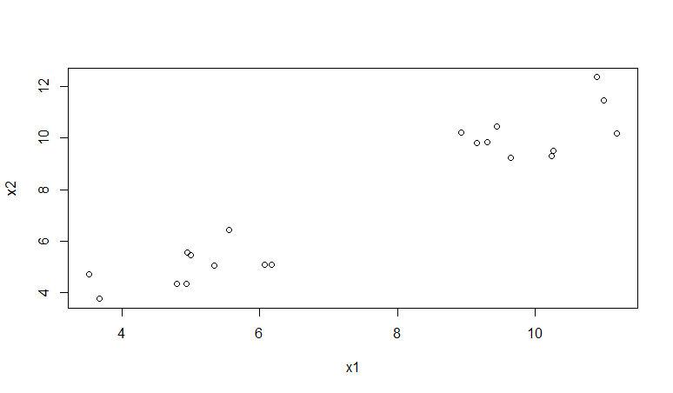
Scatterplots

Slide 5
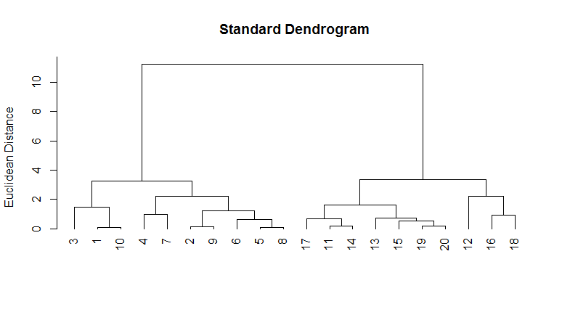
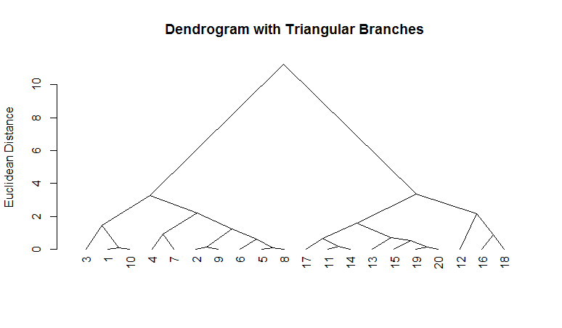
Plotting Dendrograms

Slide 6
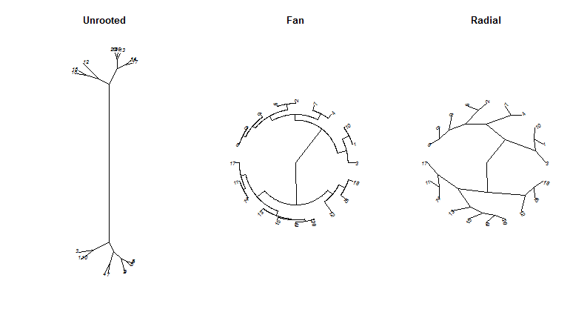
Phylogenetic Trees

Slide 7
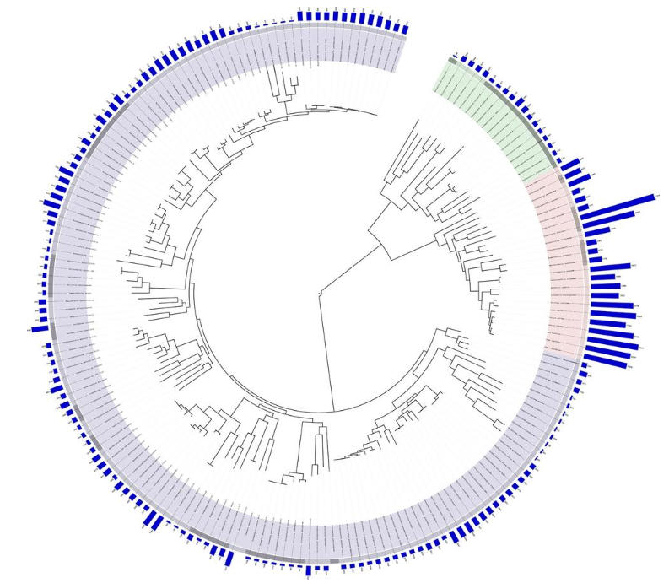
Tree of Life
Distance based on RNA sequencing
Radial layout conserves space
http://itol.embl.de/itol.cgi

Slide 8
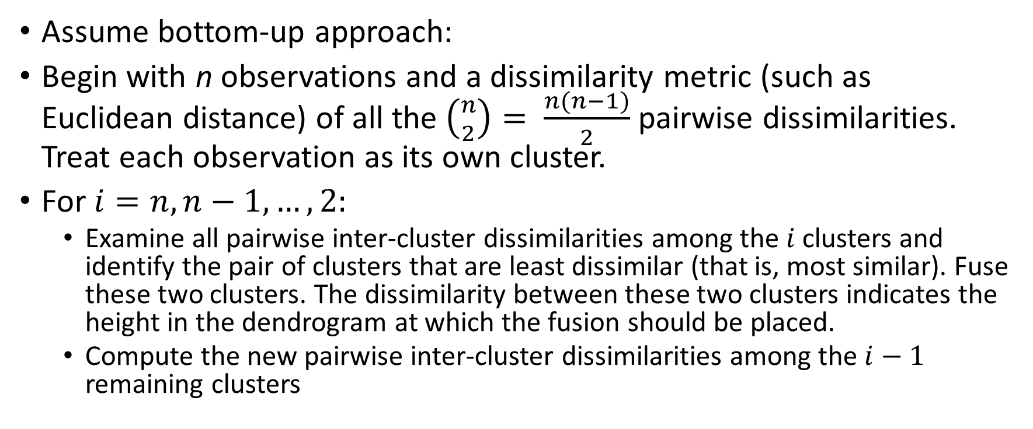
Hierarchical Clustering Algorithm
Assume bottom-up approach:
Begin with n observations and a dissimilarity metric (such as Euclidean distance) of all the $\left({n \atop 2}\right)= \frac{n(n−1)}{2}$ pairwise dissimilarities. Treat each observation as its own cluster.
For $i=n, n−1, …, 2:$
Examine all pairwise inter-cluster dissimilarities among the $i$clusters and identify the pair of clusters that are least dissimilar (that is, most similar). Fuse these two clusters. The dissimilarity between these two clusters indicates the height in the dendrogram at which the fusion should be placed.
Compute the new pairwise inter-cluster dissimilarities among the $i−1$ remaining clusters
Source: ISLR

Slide 9
Similarity and Dissimilarity Between Observations
"Distance" measures the dissimilarity between two data observations, say a = (a₁; a₂; : : : ; a_{n}) and b = (b₁; b₂; : : : ; b_{n}).
A distance measure should satisfy the following requirements:
d(a; b) >= 0 distance is non-negative
d(a; a) = 0 distance to itself is 0
d(a; b) = d(b; a) distance is symmetric
d(a; b) <= d(a; c)+d(c; b) triangular inequality

Slide 10

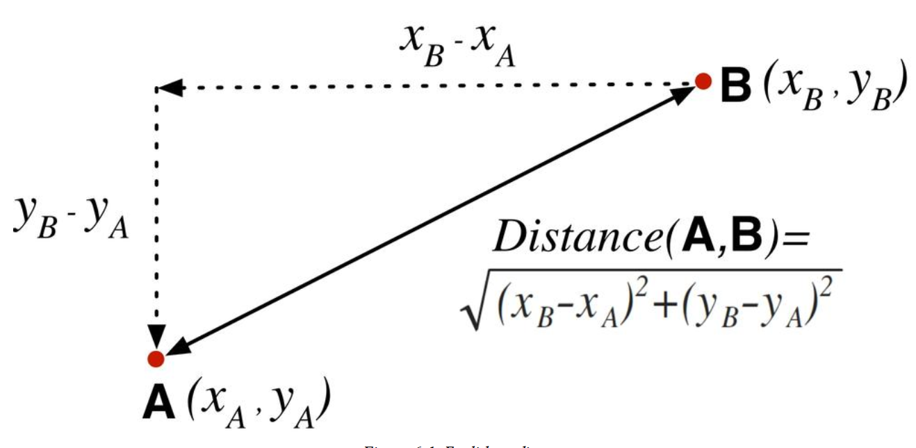
Minkowski Distance
A general measure of distance:
If q = 2, d is the Euclidean distance.

Slide 11
Minkowski Distance
A general measure of distance:
If q = 2, d is the Euclidean distance.
If q = 1, d is the Manhattan distance.
A variation is the weighted distance (variables have different perceived importance):

Slide 12
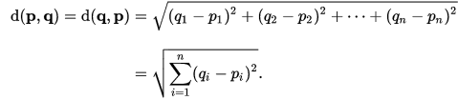
Euclidean Distance
If p = (p₁, p₂,..., p_{n}) and q = (q₁, q₂,..., q_{n}) are two points in Euclidean n-space, then the distance (d) from p to q, or from q to p is given by:
Source: https://en.wikipedia.org/wiki/Euclidean_distance

Slide 13

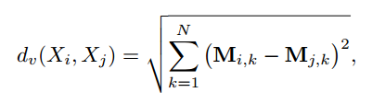
Correlation-Based Distance
Distance functions that take correlation as an input
Example (Gu and Wang, 2010):
Most common correlation-based distance indicates the strength of linear correlation between X_{i} and X_{j}:
Distance measure considering two rows M_{i,k} and M_{j,k} for samples Xi and Xj , and we define the distance as:
where N is the number of samples. Then compute d_{v}(X_{i} , X_{j} ) for all pairs of samples and normalize them to [0, 1] for our use.
Source: http://www3.nd.edu/~cwang11/research/isvc10-hcc.pdf; A Study of Hierarchical Correlation Clustering for Scientific Volume Data
Notes:
Linear correlation: When Xi and Xj are perfectly correlated (regardless of the sign), then ds(Xi , Xj ) gets its minimum of 0. If Xi and Xj have no linear correlation, then ds(Xi , Xj ) gets its maximum of 1.

Slide 14
Types of Data in Cluster Analysis
A distance measure works well for numeric variables, but what about other types of variables?
Variables types include:
Numeric variables
Binary variables
Categorical, ordinal, and ratio variables
Text
Variables of mixed types

Slide 15
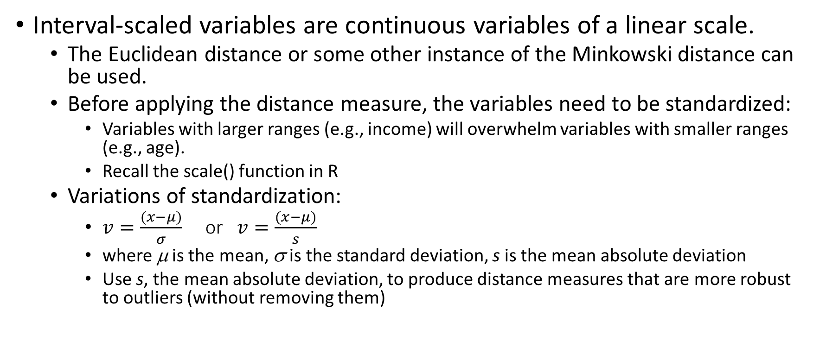
Interval-Scaled Data
Interval-scaled variables are continuous variables of a linear scale.
The Euclidean distance or some other instance of the Minkowski distance can be used.
Before applying the distance measure, the variables need to be standardized:
Variables with larger ranges (e.g., income) will overwhelm variables with smaller ranges (e.g., age).
Recall the scale() function in R
Variations of standardization:
$v=\frac{(x−μ)}{σ}$ or $v=\frac{(x−μ)}{s}$
where μ is the mean, σ is the standard deviation, s is the mean absolute deviation
Use s, the mean absolute deviation, to produce distance measures that are more robust to outliers (without removing them)
Notes:
The mean absolute deviation of a set of data is the average distance between each data value and the mean.

Slide 16
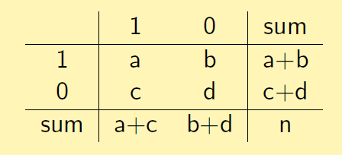


Binary Variables
Binary variables have just two possible values (say 0 and 1).
We consider as a group all of the binary variables and count for observation x_{i} and x_{j} the number of times they both have 0, 1, or (0; 1) or (1; 0) to build a contingency table:
Simple matching coefficient (symmetric variable):
Jaccard coefficient (asymmetric: use when 1 is more important - e.g. diseases):

Slide 17
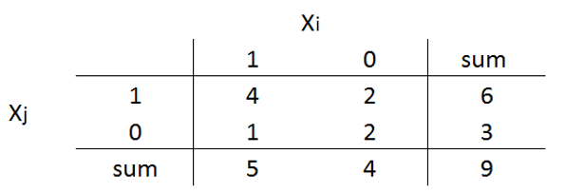
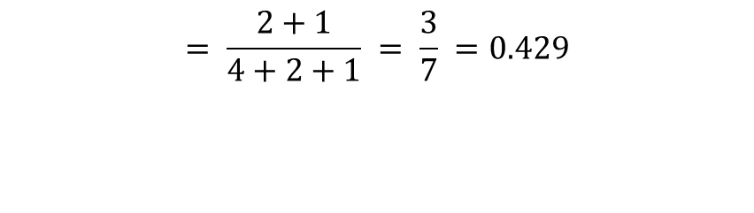
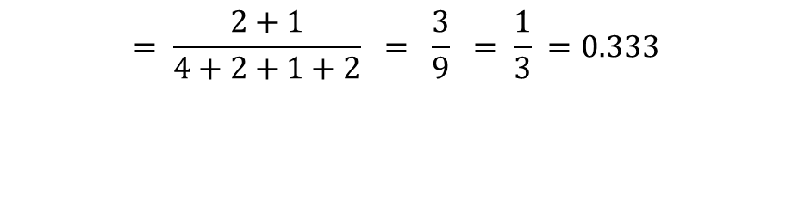

Binary Variable Example
a a b c d a b d a
$$x_{i}=\left[\begin{matrix}1 & 1 & 0\end{matrix} \begin{matrix}1 & 0 & 1\end{matrix} \begin{matrix}0 & 0 & 1\end{matrix}\right]$$
$$x_{j}=\left[\begin{matrix}1 & 1 & 1\end{matrix} \begin{matrix}0 & 0 & 1\end{matrix} \begin{matrix}1 & 0 & 1\end{matrix}\right]$$
Simple Coefficient:
$$= \frac{2+1}{4+2+1+2} = \frac{3}{9} = \frac{1}{3} =0.333$$
Jaccard Coefficient:
$$= \frac{2+1}{4+2+1} = \frac{3}{7} =0.429$$

Slide 18

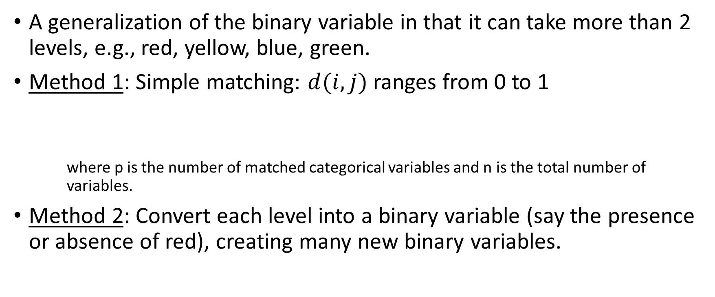
Categorical Variables
A generalization of the binary variable in that it can take more than 2 levels, e.g., red, yellow, blue, green.
Method 1: Simple matching: $d(i,j)$ ranges from 0 to 1
where p is the number of matched categorical variables and n is the total number of variables.
Method 2: Convert each level into a binary variable (say the presence or absence of red), creating many new binary variables.

Slide 19
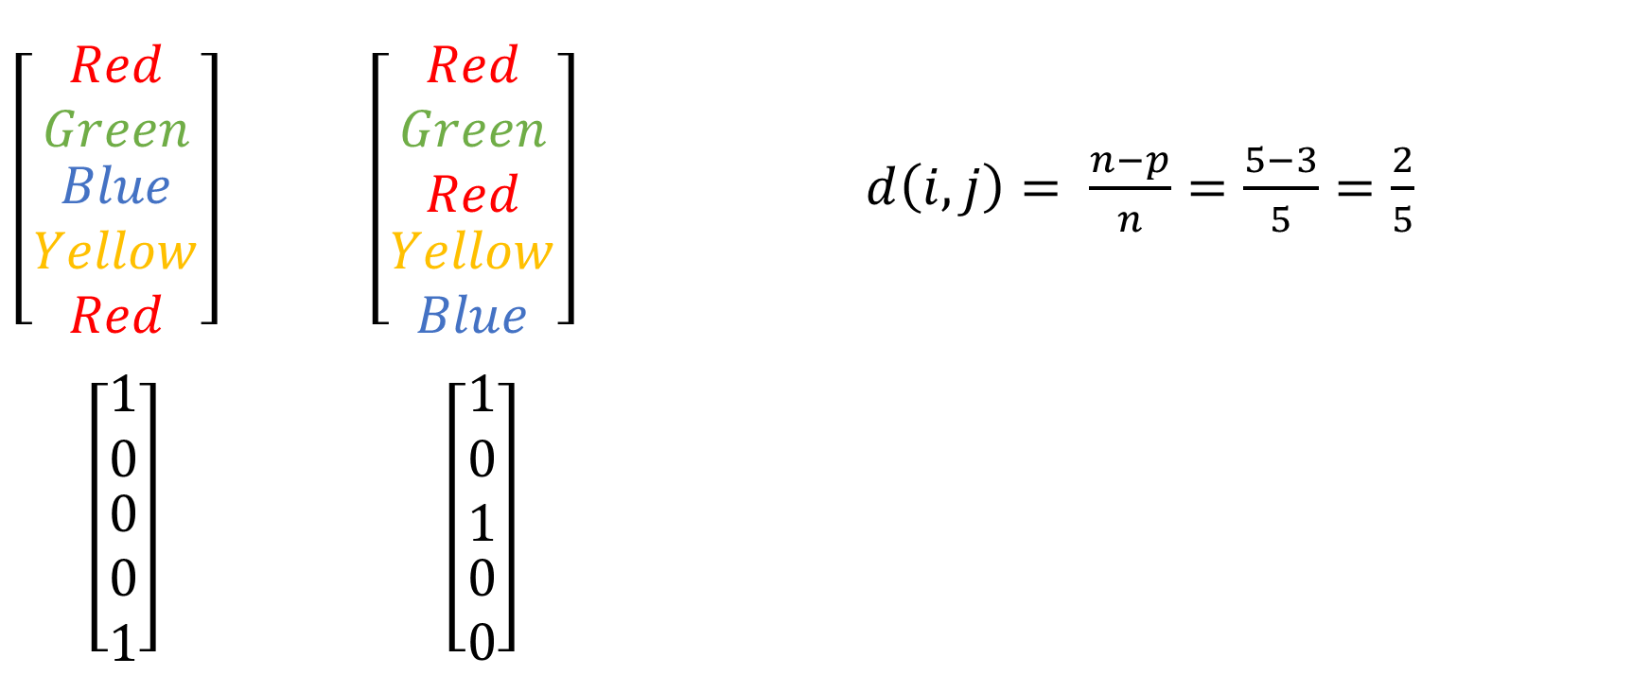
Simple Matching Example
A:
B:
$\left[\begin{matrix}Red \\ Green \\ \begin{aligned}Blue \\ Yellow \\ Red\end{aligned}\end{matrix}\right]$ $\left[\begin{matrix}\begin{aligned}Red \\ Green \\ Red\end{aligned} \\ Yellow \\ Blue\end{matrix}\right]$ $d\left(i,j\right)= \frac{n−p}{n}=\frac{5−3}{5}=\frac{2}{5}$
$\left[\begin{matrix}1 \\ 0 \\ \begin{aligned}0 \\ 0 \\ 1\end{aligned}\end{matrix}\right]$ $\left[\begin{matrix}\begin{aligned}1 \\ 0 \\ 1\end{aligned} \\ 0 \\ 0\end{matrix}\right]$

Slide 20
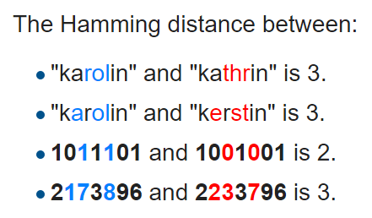
Text Data
Hamming Distance:
The number of positions at which corresponding symbols are different
Requires equal length strings
Source: https://en.wikipedia.org/wiki/Hamming_distance

Slide 21
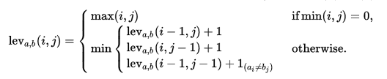

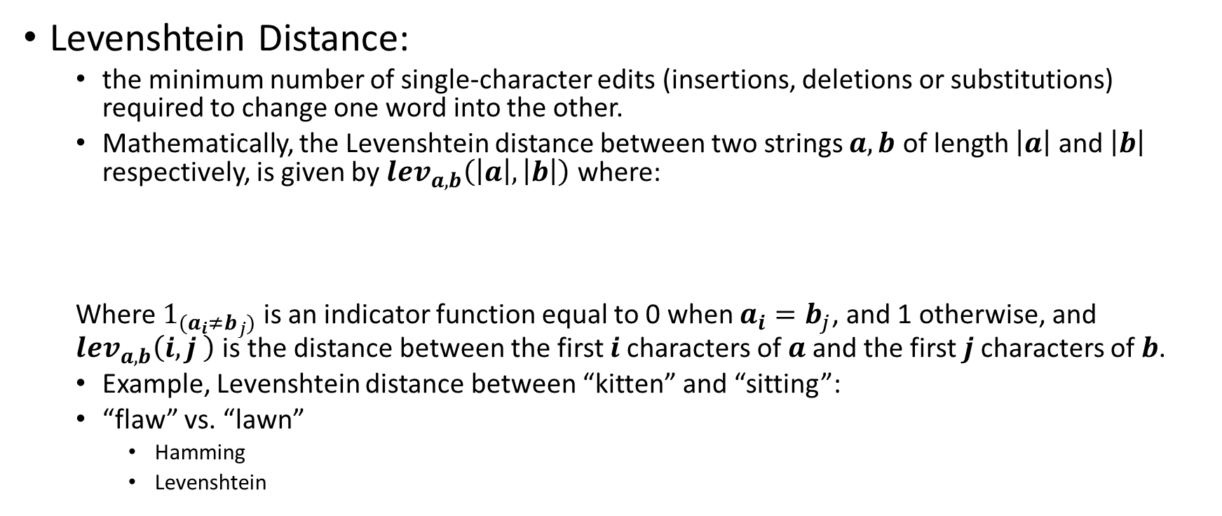
Text Data
Levenshtein Distance:
the minimum number of single-character edits (insertions, deletions or substitutions) required to change one word into the other.
Mathematically, the Levenshtein distance between two strings $a,b$ of length $\left|a\right|$ and $\left|b\right|$ respectively, is given by ${lev}_{a,b}\left(\left|a\right|,\left|b\right|\right)$ where:
Where $1_{(a_{i}≠b_{j})}$ is an indicator function equal to 0 when $a_{i}=b_{j}$, and 1 otherwise, and ${lev}_{a,b}\left(i,j \right)$ is the distance between the first $i$characters of$a$ and the first$j$ characters of $b$.
Example, Levenshtein distance between “kitten” and “sitting”:
“flaw” vs. “lawn”
Hamming
Levenshtein
Source: https://en.wikipedia.org/wiki/Levenshtein_distance
Notes:
Note that the first element in the minimum corresponds to deletion (from a to b), the second to insertion and the third to match or mismatch, depending on whether the respective symbols are the same. d(kitten,sitting) = 3
Flaw v. lawn h = 4 l = 2

Slide 22
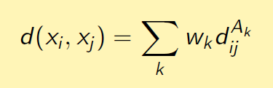

Datasets of Mixed Types
A dataset may contain all types of variables: numerical, binary, categorical, text.
The normal procedure to combine different distances is to:
Standardize all distances
Use a weighted formula to combine them, where the weights are used to express the relative importance of the variables:
where w_{k} is the weight of variable A_{k} , and is the dissimilarity of the i_{th} observation and the j_{th} observation on variable A_{k} .
Here, all are standardized.

Slide 23
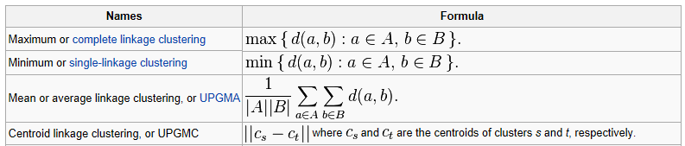
Linkage Functions
Linkage: A method for finding distance between clusters
The following linkage functions are common: where d is the chosen distance metric.
Other linkage criteria include:
The decrease in variance for the cluster being merged
at each step find the pair of clusters that leads to minimum increase in total within-cluster variance after merging. (Ward's criterion)
The probability that candidate clusters spawn from the same distribution function (V-linkage).
Source: https://en.wikipedia.org/wiki/Hierarchical_clustering
Notes:
Upgmc STANDS FOR Unweighted Pair-Group Method using Centroids

Slide 24
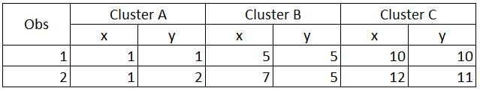
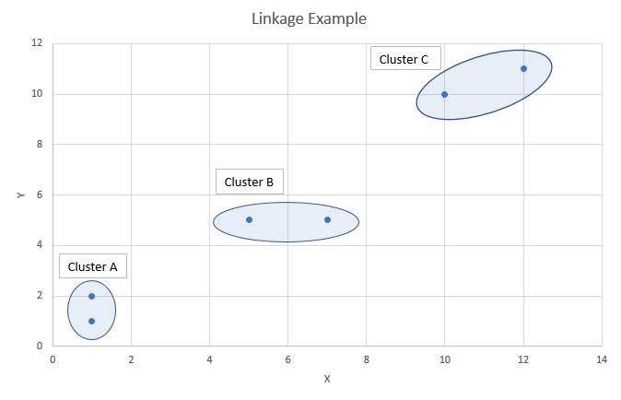
Linkage Example

Slide 25
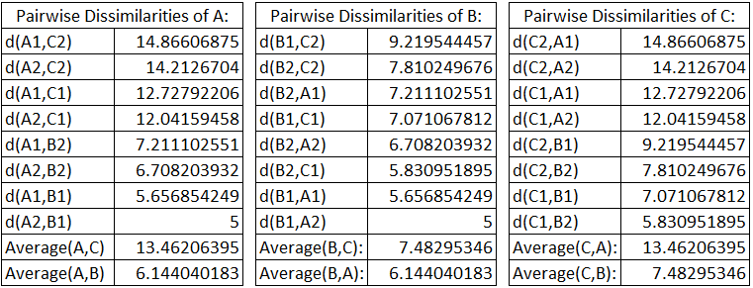
Linkage Example
Euclidean Distance:

Slide 26
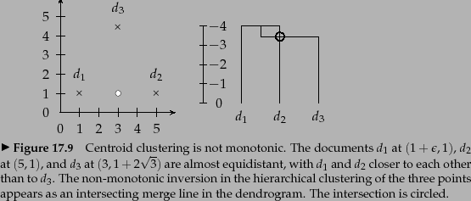
Shortcomings of Non-Monotonic Linkages
Centroid Linkage is most common
Can lead to inversions in dendrogram:
An Inversion is where two clusters are fused at a height below either of the individual clusters in the dendrogram.
Source: https://nlp.stanford.edu/IR-book/html/htmledition/centroid-clustering-1.html

Slide 27
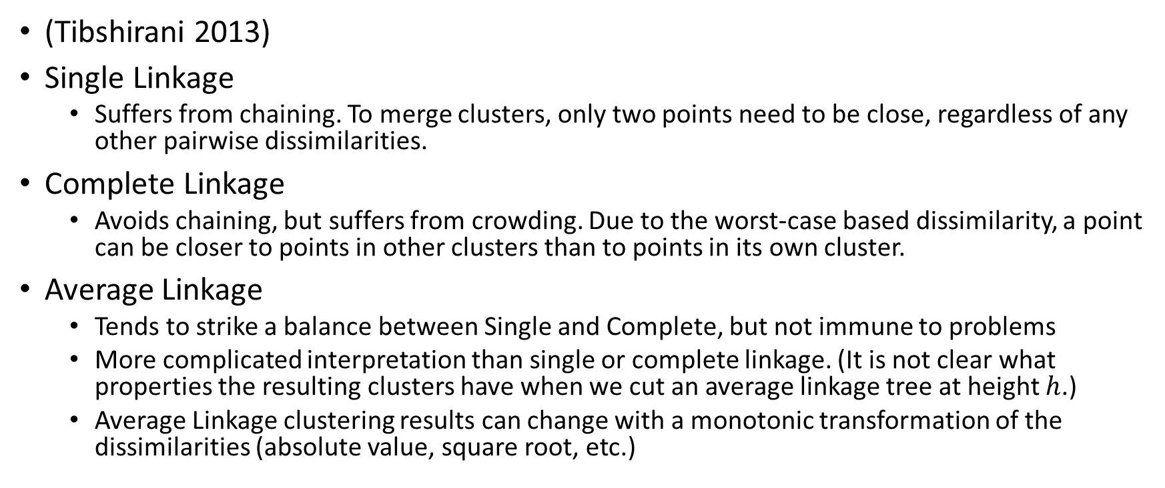
Shortcomings of Monotonic Linkage Types
(Tibshirani 2013)
Single Linkage
Suffers from chaining. To merge clusters, only two points need to be close, regardless of any other pairwise dissimilarities.
Complete Linkage
Avoids chaining, but suffers from crowding. Due to the worst-case based dissimilarity, a point can be closer to points in other clusters than to points in its own cluster.
Average Linkage
Tends to strike a balance between Single and Complete, but not immune to problems
More complicated interpretation than single or complete linkage. (It is not clear what properties the resulting clusters have when we cut an average linkage tree at height $h$.)
Average Linkage clustering results can change with a monotonic transformation of the dissimilarities (absolute value, square root, etc.)
Source: http://www.stat.cmu.edu/~ryantibs/datamining/lectures/05-clus2-marked.pdf

Slide 28
A note on Scaling:
No different than before:
Case-by-case matter, helpful when you have:
Variables measured in different units
Variables on different orders of magnitude
Interval-Scaled Data
Unnecessary when you have:
Variables measured in the same units, on similar orders of magnitude

Slide 29
R to accompany dissimilarity/linkage
Very straightforward to switch dissimilarity measures and linkage types
data.dist <- dist(data, method = “________”)
euclidean, canberra, manhattan, …^
OR
data.dist <- corDist(data, method = “_________”)
pearson, spearman, kandall, cosine, ….^
dendrogram <- hclust(data.dist, method = “_______”)
complete, average, single, centroid, ….^
Plot(dendrogram)

Slide 30
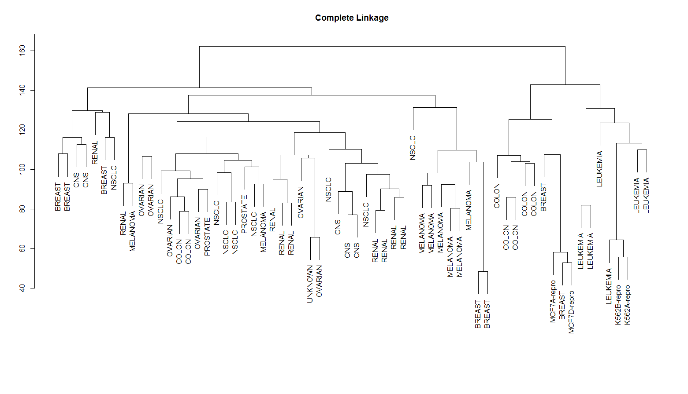
(Linkage): type = “complete”

Slide 31
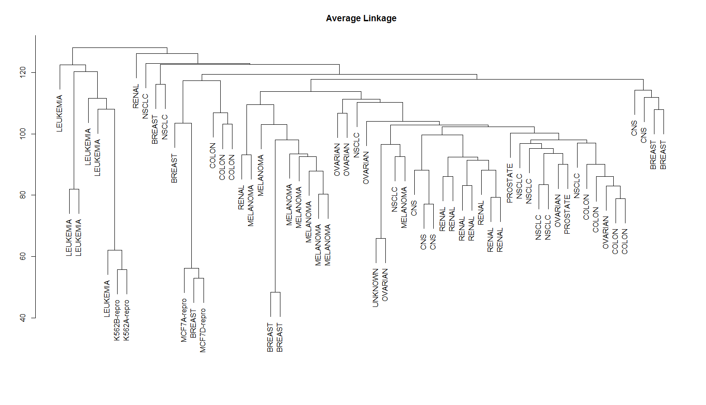
(Linkage): type = “average”

Slide 32
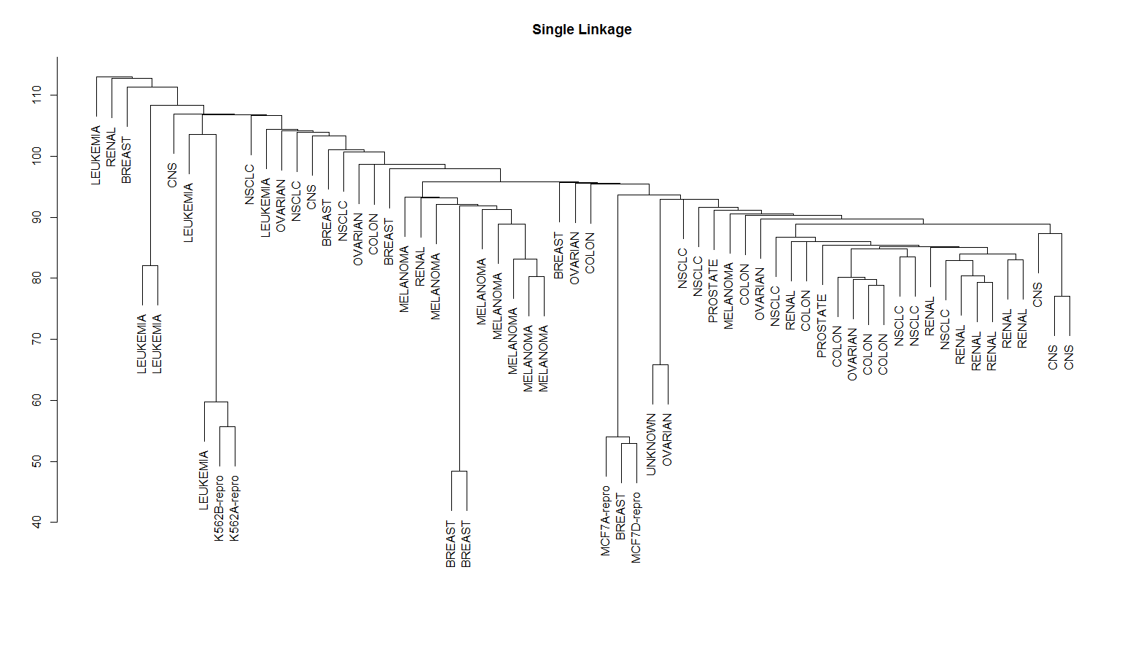
(Linkage): type = “single”

Slide 33
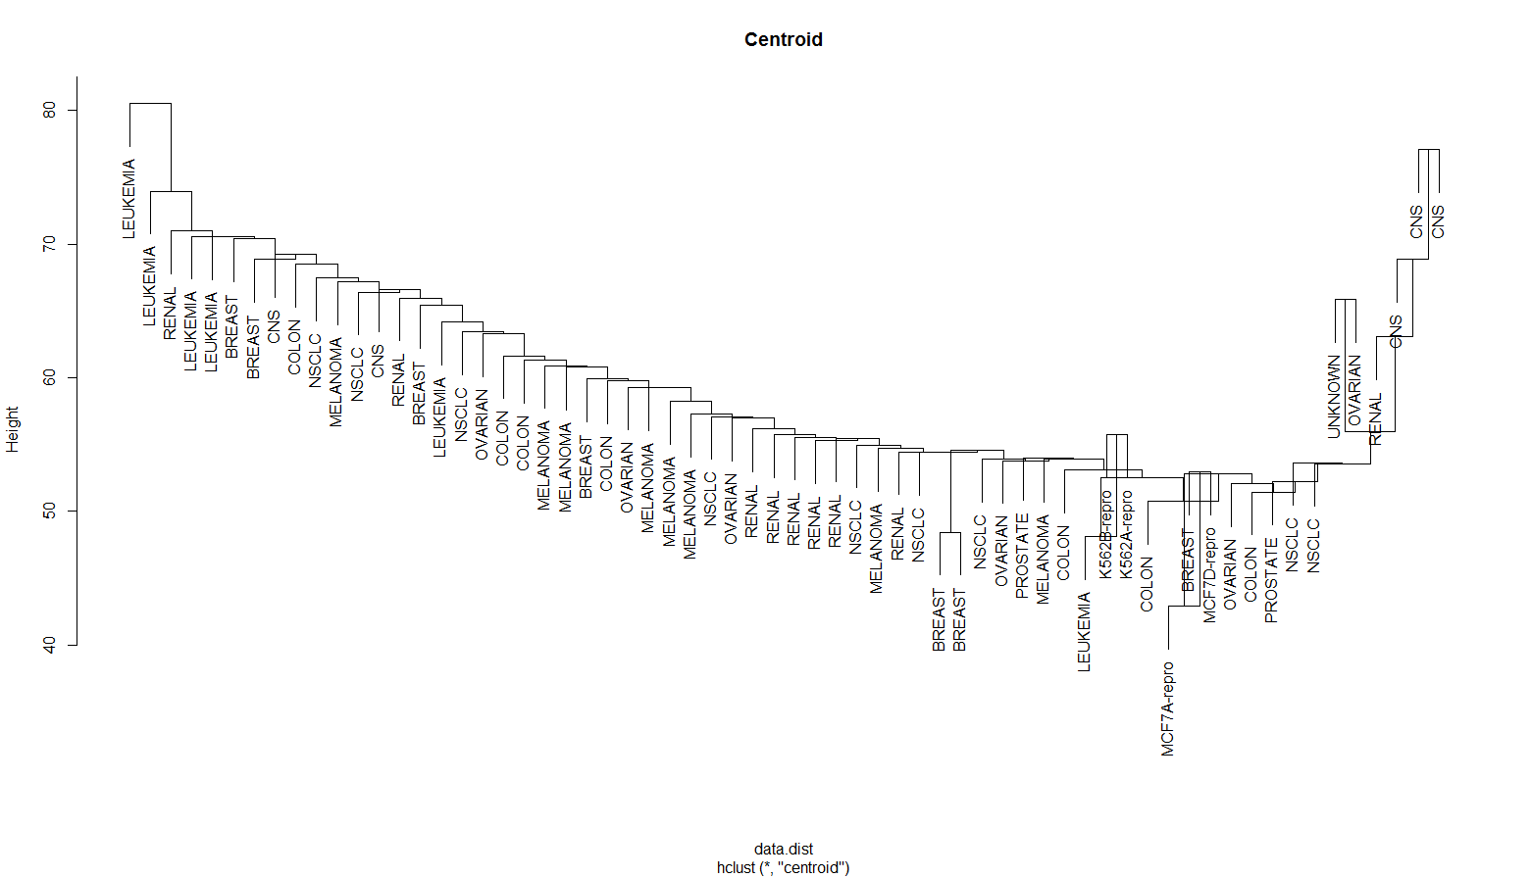
(Linkage): type = “centroid”

Slide 34
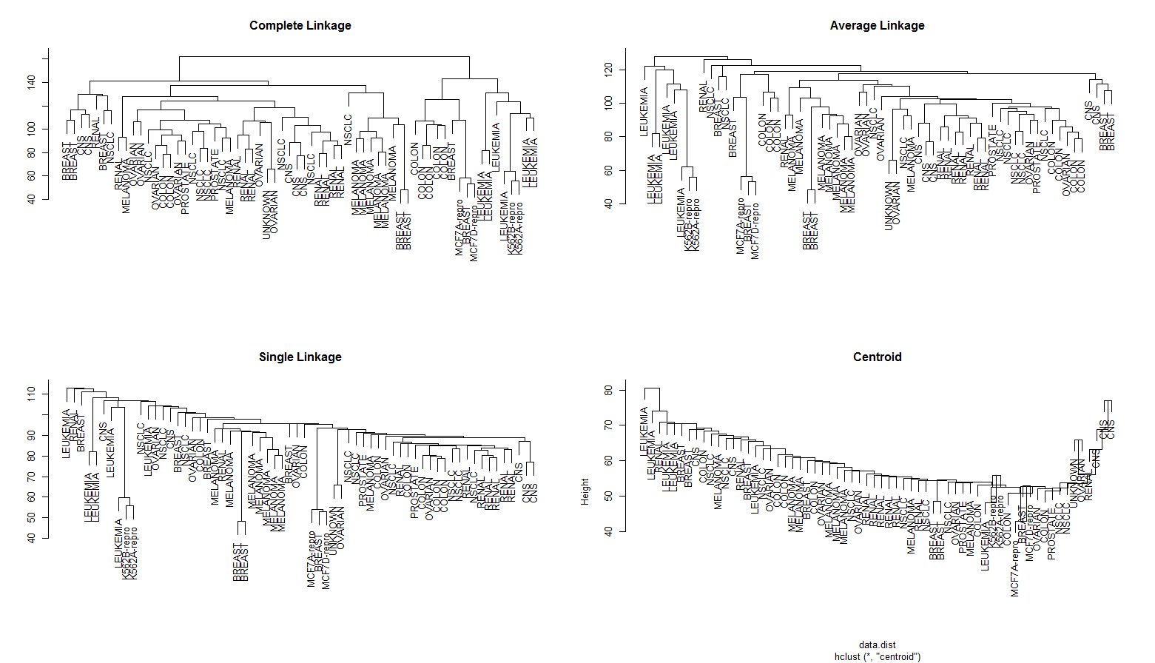
Different linkage methods

Slide 35
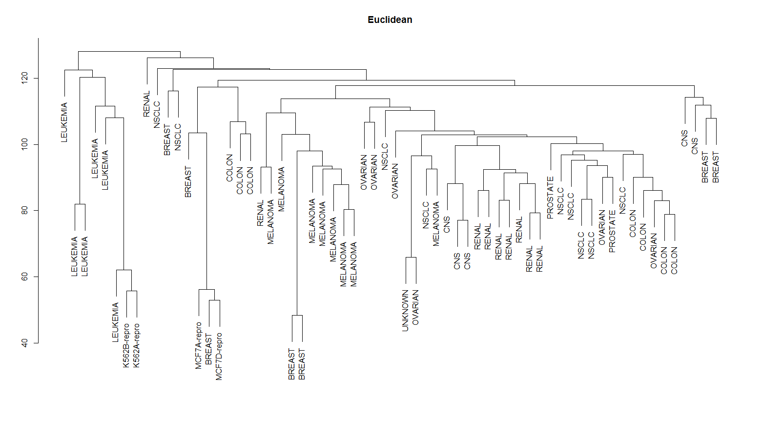
(Dissimilarity measure): type = “euclidean”

Slide 36
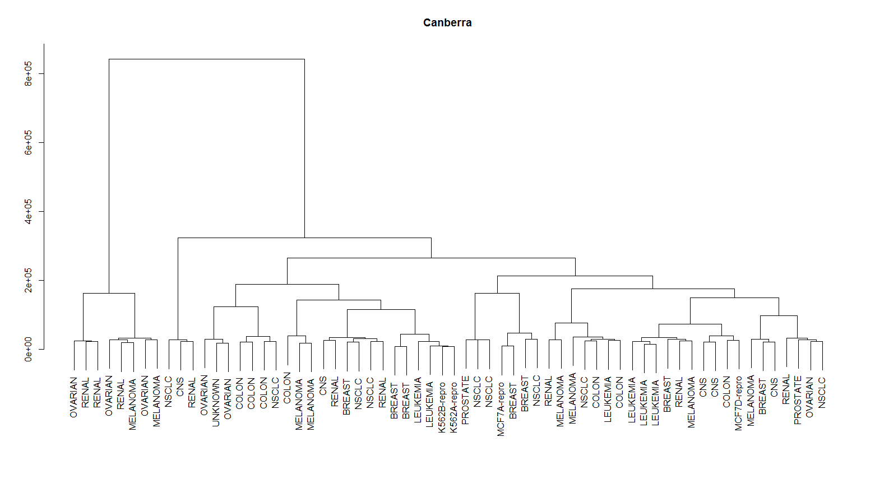
(Dissimilarity measure): type = “canberra”

Slide 37
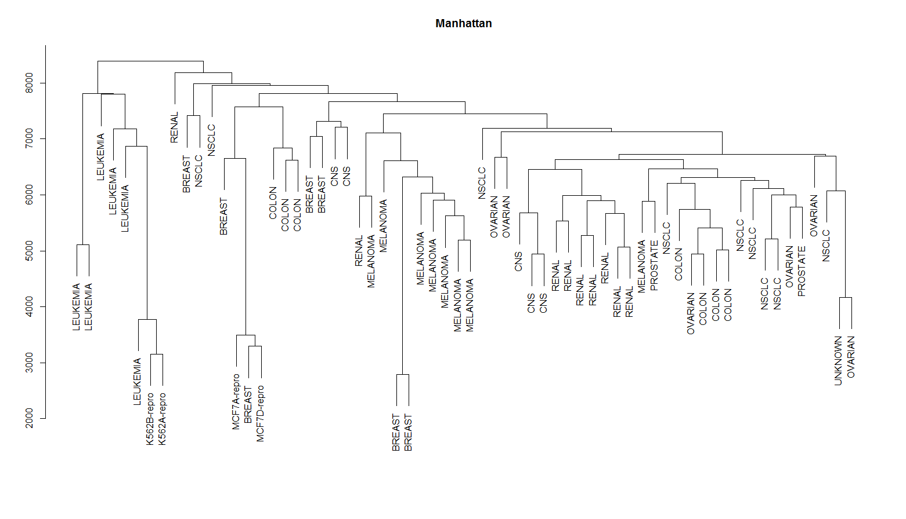
(Dissimilarity measure): type = “manhattan”

Slide 38
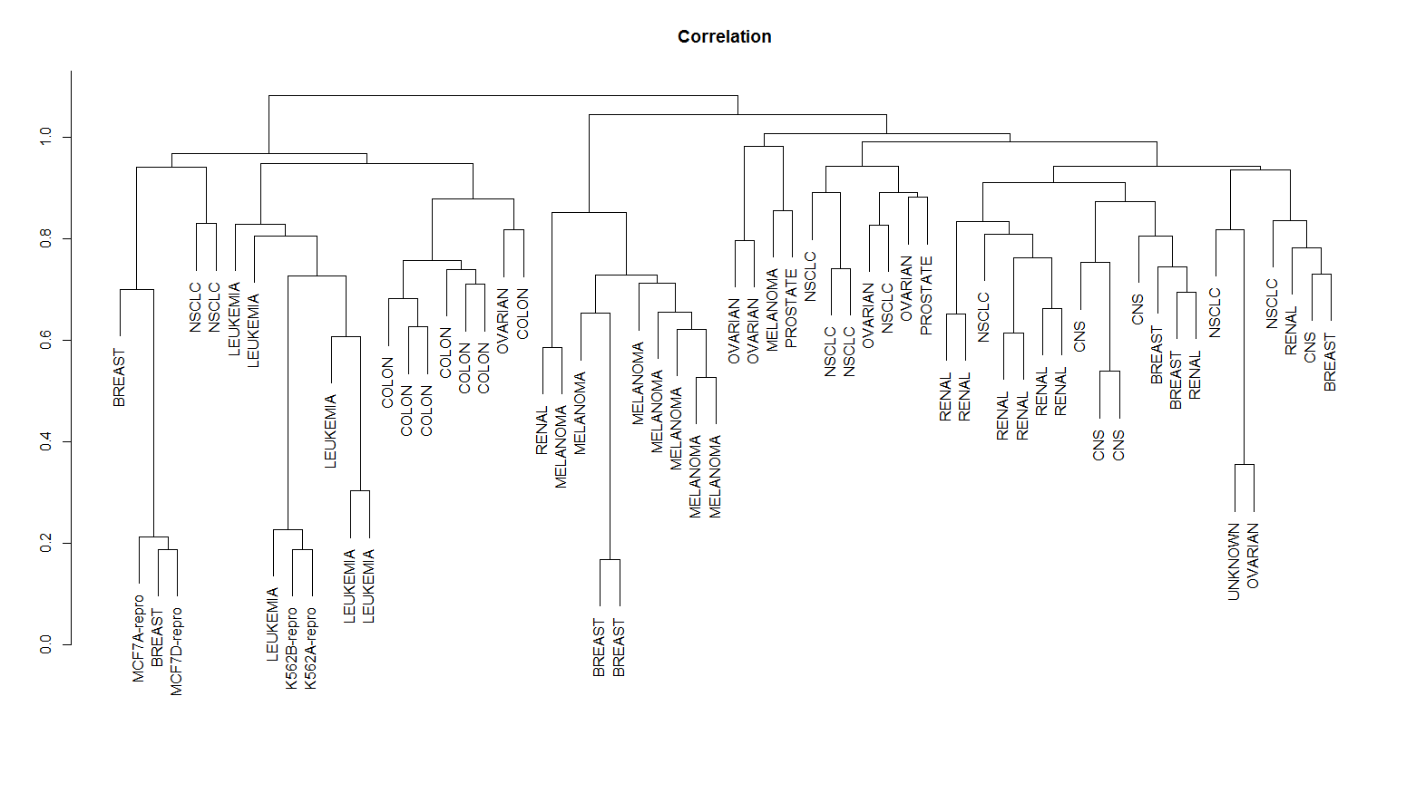
(Dissimilarity measure): type = “correlation”

Slide 39
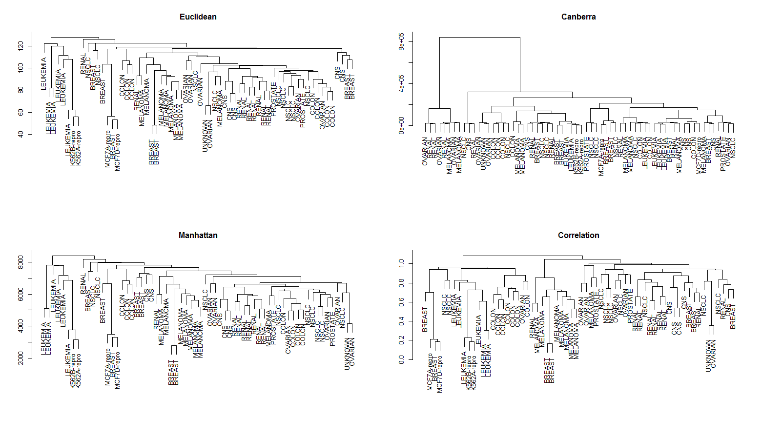
Different dissimilarity measures

Slide 40
LAB

Slide 41
Practical Issues in Clustering
“Small Decisions, Big Consequences”
Scale?
Which dissimilarity metric was used?
Which linkage was used?
Where was the dendrogram cut (i.e. how many clusters were used)?
Each decision above has a significant impact on the resultant clusters
Essentially, there is no one right answer. Any solution that produces an interesting result should be considered.
Play around with parameters to find consistent patterns and take the most useful/interpretable solutions.

Slide 42
Warnings about Hierarchical Clustering
Clustering models tend to not be robust to perturbation
If N observations are clustered once, then clustered again having removed a random subset n from N, it is likely that the clusters from the two models will be significantly different
In Hierarchical Clustering we force all observations into clusters, when maybe one observation truly does represent a subgroup by itself
This is exploratory analysis; nothing is being predicted
This is the starting point for hypothesis development

