Slide 1
Intro to git and Github
Andrew Leeth

Slide 2
Version Control System
A system that records changes to a file or set of files over time so that you can recall specific versions later

Slide 3





Version Control Problems
v3
v2

Slide 4
Version Control Problems
v3
Conflict!
v2
Data Overwritten!
Disorder!
v4
v4

Slide 5

Version control system for tracking changes in computer files and coordinating work on those files among multiple people
Software development
Created by Linus Torvalds in 2005 for development of the Linux kernel

Slide 6


Git repository hosting service
Similar to Source Forge or Google Code
Collaborative and social
Centralized server

Slide 7
Popular public repos:
Apollo Guidance Computer (AGC)
Bootstrap, Ruby on Rails, D3, jQuery
Homebrew
Flask
…

Slide 8
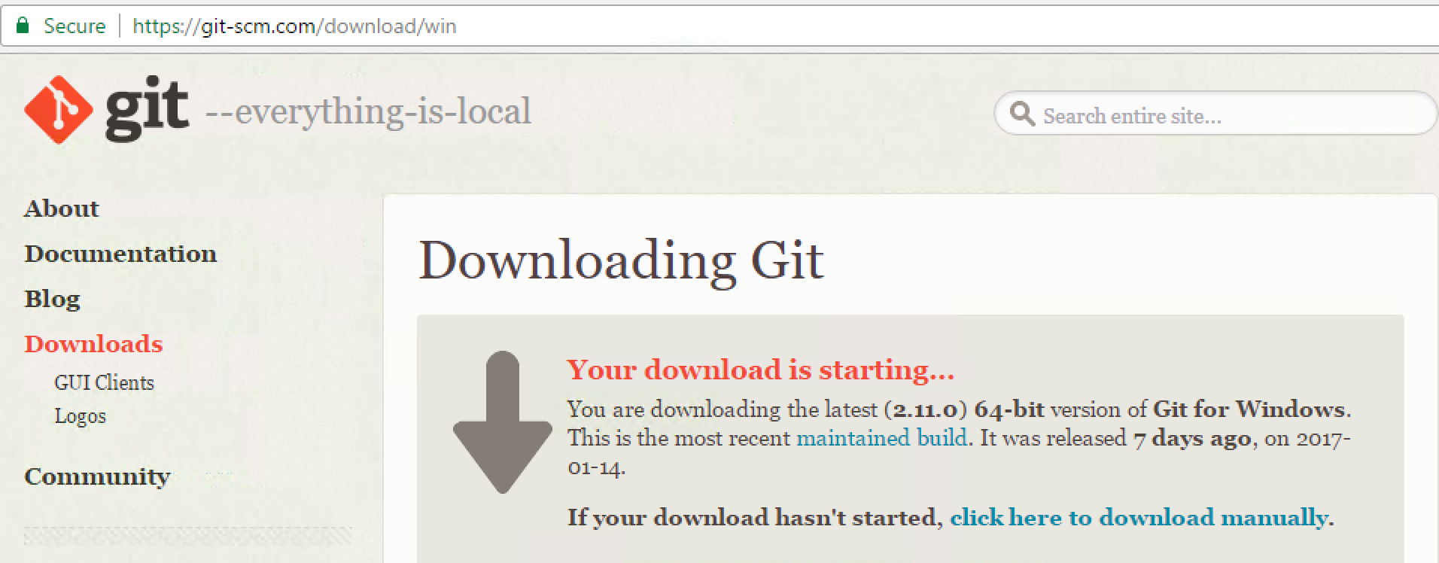
Install git

Slide 9
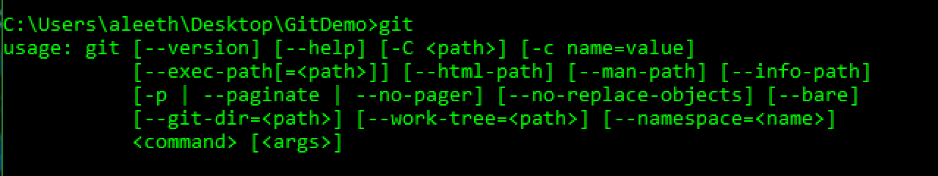
Install git (cont.)
Run Installer
Default settings
Test install with git command

Slide 10
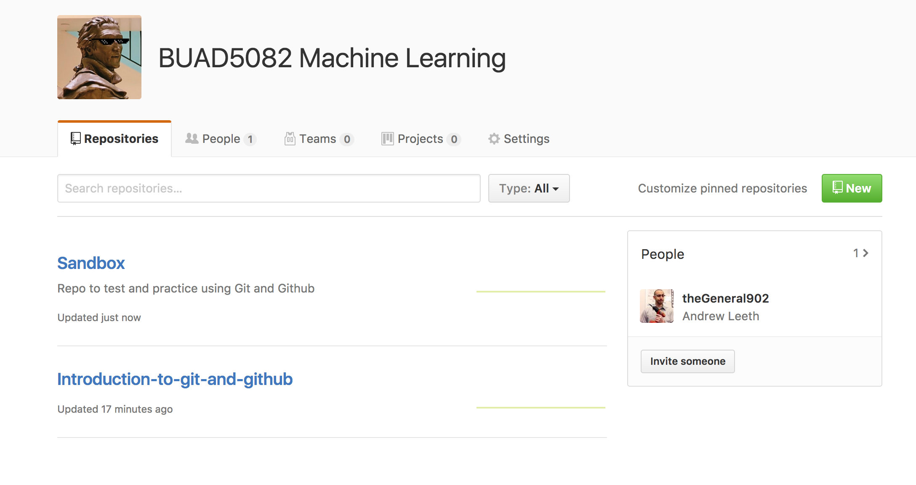
http://bit.ly/BUAD5082

Slide 11
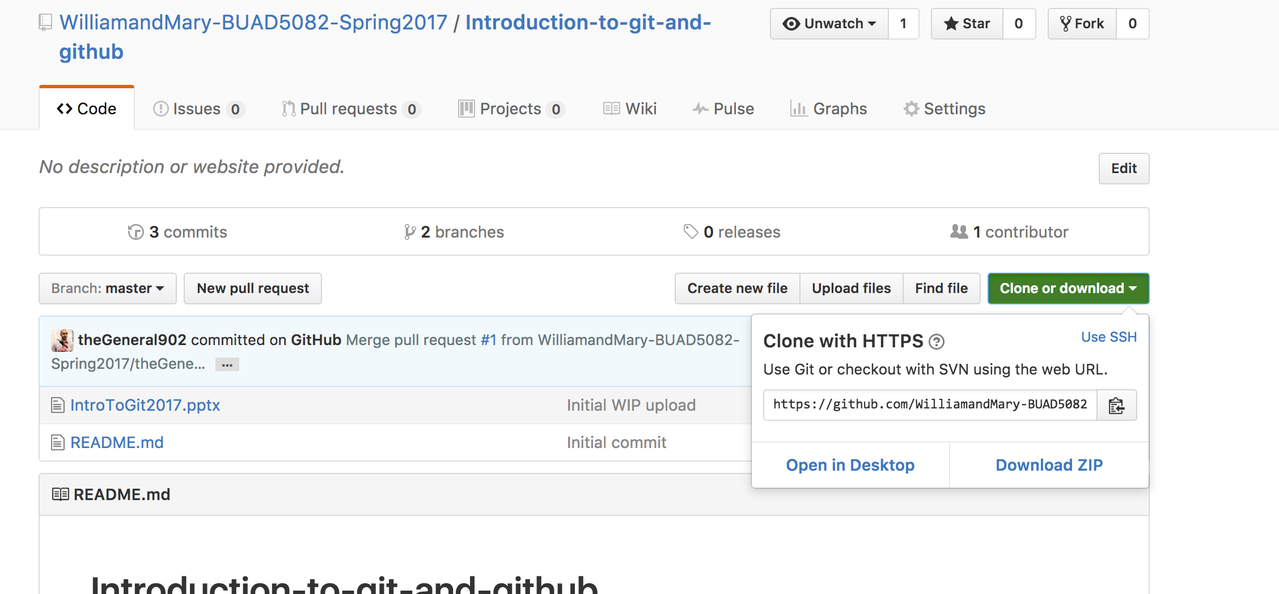
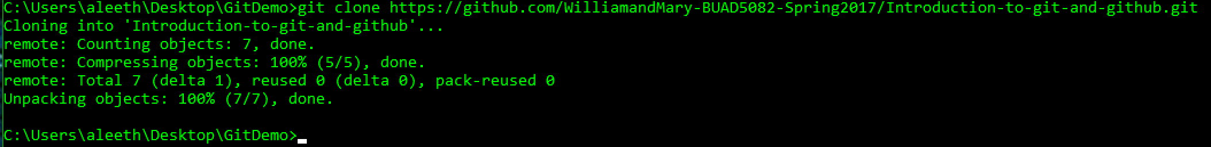
Clone Class Repo
git clone {Repo URL}

Slide 12
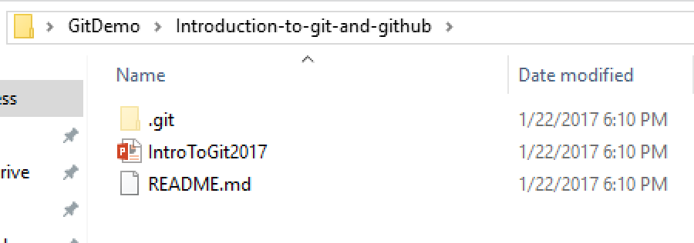
Clone Class Repo

Slide 13
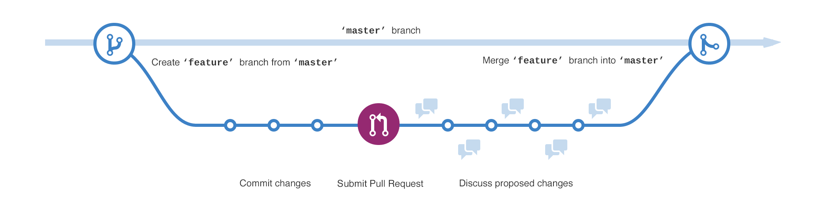
Branching

Slide 14
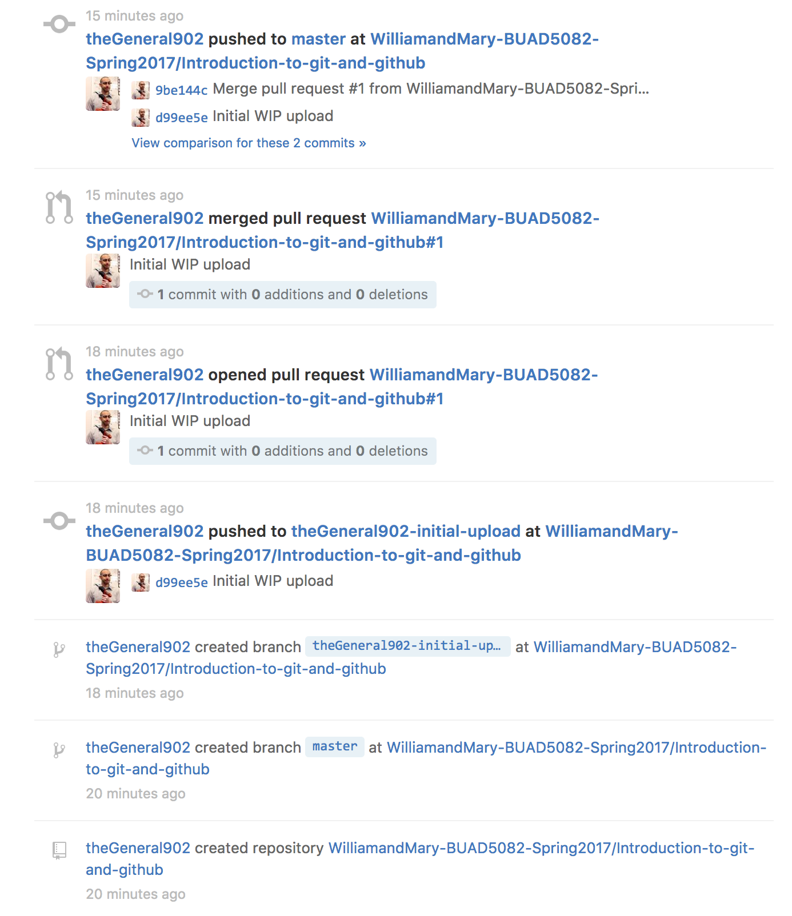
Create Repo

Slide 15
Create master Branch

Slide 16
Create New Branch

Slide 17
Push (upload) files and commits

Slide 18
Pull Request

Slide 19
Merge master Branch

Slide 20
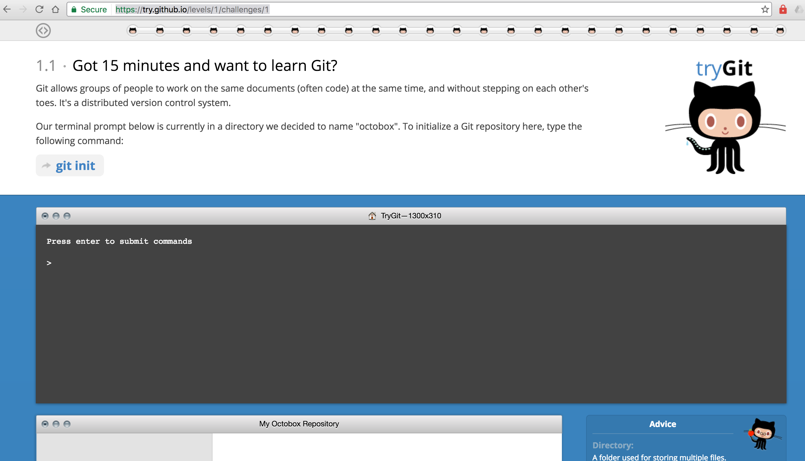
Additional Resources
https://try.github.io/levels/1/challenges/1

Slide 21
Additional Resources
https://git-scm.com/book/en/v2
https://services.github.com/on-demand/downloads/github-git-cheat-sheet.pdf

Slide 22

Thank you

