Slide 1
Face-Mask-Detection
Group 1
1. Junjun Hu (Student ID: 1264029)
2. Zhijie Shen(Student ID: 1263245)
3. Junzhe Ban (Student ID: 1247596)
4. Zhiyuan Sun(Student ID: 1251936)

Slide 2
Catalog
Introduction
Environment
Data Analyze
Model Training
Model Test
Code Reference
Conclusion
Interactive section

Slide 3

Introduction
Mask recognition technology has received widespread attention in the fields of public safety and medicine in recent years.
The Convolutional Neural Network-based mask recognition system uses computer vision technology to automatically identify and distinguish between people wearing masks and those not wearing masks by training image classification models.

Slide 4
ENVIRONMENT
Package Version
-------------------- -----------
Tensorflow 1.15.2
Keras 2.3.1
Imutils 0.5.3
Numpy 1.18.2
opencv-python 4.2.0.*
Matplotlib 3.2.1
Scipy 1.4.1
h5py 2.10.0
Keras 2.3.1
Keras-Applications 1.0.8
Pillow 9.5.0
scikit-learn 0.22.2
tensorflow 1.15.2
tensorflow-estimator 1.15.1
Keras-Preprocessing 1.1.2
matplotlib 3.2.1
numpy 1.18.2
Package Version
-------------------- -----------
protobuf 3.20.3
pyparsing 3.1.4
python-dateutil 2.9.0.post0
PyYAML 6.0.1
scipy 1.4.1
setuptools 47.1.0
six 1.16.0
tensorboard 1.15.0
termcolor 2.3.0
threadpoolctl 3.1.0
typing_extensions 4.7.1
Werkzeug 2.2.3
Markdown 3.4.4
MarkupSafe 2.1.5
Package Version
-------------------- -----------
opencv-python 4.2.0.34
opt-einsum 3.3.0
pip 24.0
kiwisolver 1.4.5

Slide 5
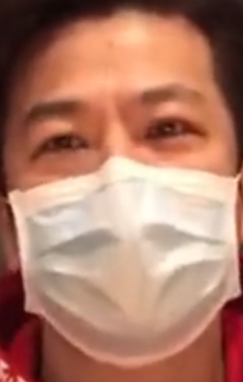
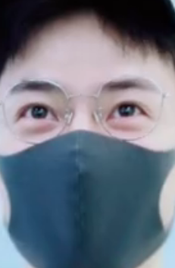
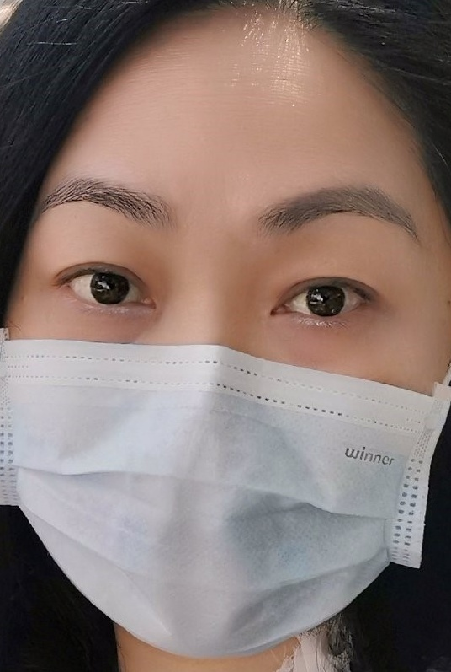
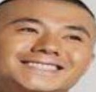
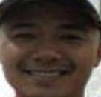
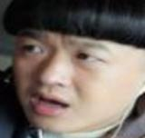
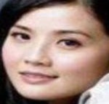
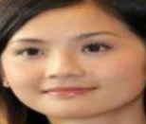
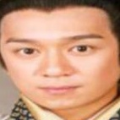
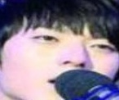
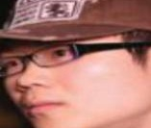
DATASET
Data Categories : The data source contains two different categories of data, ["with_mask", "without_mask"].
The training and test datasets are divided into 80% training set and 20% test set.
There are 1,915 masked images and 1,918 unmasked images.

Slide 6
DATA ANALYZE
Read the image path: construct the path of each image through os.path.join.
Resize the image: Resize images to 224 pixels to unify the size and format of all images.
Convert to array format: convert the image to array format for deep learning model processing.
Label encoding: Use LabelBinarizer to binarize the labels,
with_mask labels are encoded as [1, 0]
without_mask labels are encoded as [0, 1]

Slide 7
Model Training
This model is based on TensorFlow and Keras, and uses MobileNetV2 as the basic model for feature extraction. It is suitable for lightweight deep learning tasks.
MobileNetV2 basic model
Delete the original fully connected layer to build a custom classification on it.
The input tensor is Input(shape=(224, 224, 3)), which is suitable for image .
Custom classification
Average pooling layer: AveragePooling2D(pool_size=(7, 7)) pools the feature map to reduce the data dimension.
Flattening layer: Flattens the pooled feature map into a one-dimensional vector.
Fully connected layer: Add a fully connected layer with 128 units and use the ReLU activation function.
Dropout layer: Dropout (0.5), randomly drops neurons with a probability of 50% to prevent overfitting.
Output layer: Contains 2 units, used to output the probability of wearing a mask and not wearing a mask, using the Softmax activation function.

Slide 8


What is MobileNetV2 ？
The core formula of MobileNetV2 is as follows:
Inverted Residual Block
$$y = x + F(x)$$
Among them, x is the input feature, and F(x) is the feature transformation through depth convolution and point-by-point convolution.
The key to MobileNetV2 is the the Inverted Residual structure and the Linear Bottleneck.
In each reverse residual block, the input feature dimension is expanded to a larger dimension through pointwise convolution, and then spatial features are extracted through depthwise convolution.
Conv1x1 is a point-wise convolution.
DW 3x3 is a 3x3 depthwise convolution.

Slide 9
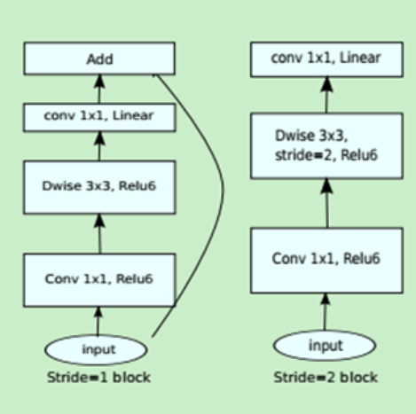
What is MobileNetV2 ？
Linear Bottleneck:
Remove the ReLU activation from the output of the reverse residual block to maintain feature diversity, especially for feature representation in low-dimensional space:
y=x+F(x)(if dimensions match)
If the dimensions of the input and output are inconsistent, the output is directly 𝑦=𝐹(𝑥). The design of this structure reduces the amount of calculation and the number of parameters, and is very suitable for use in resource-limited environments such as mobile devices.

Slide 10
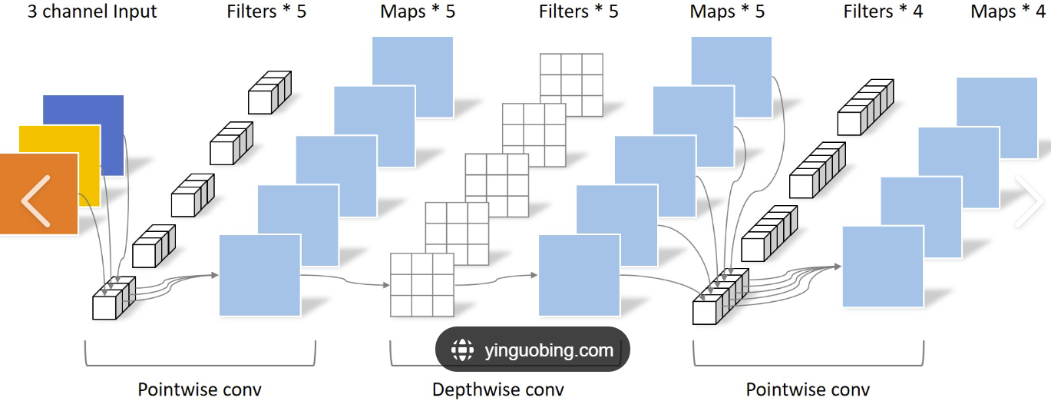
What is MobileNetV2 ？

Slide 11
What is MobileNetV2 ？
Advantages and Disadvantages of MobileNetV2
advantage:
The amount of parameters and calculations are significantly reduced.
Can run on low-power devices and is suitable for real-time applications.
Supports adjusting network width and input resolution to flexibly adapt to different computing resources and performance requirements.
disadvantage:
On tasks with extremely high accuracy requirements, it may not be comparable to larger models MobileNetV2 is designed as a general feature extraction network. If there are more complex scene requirements, additional optimization and fine-tuning may be required.

Slide 12
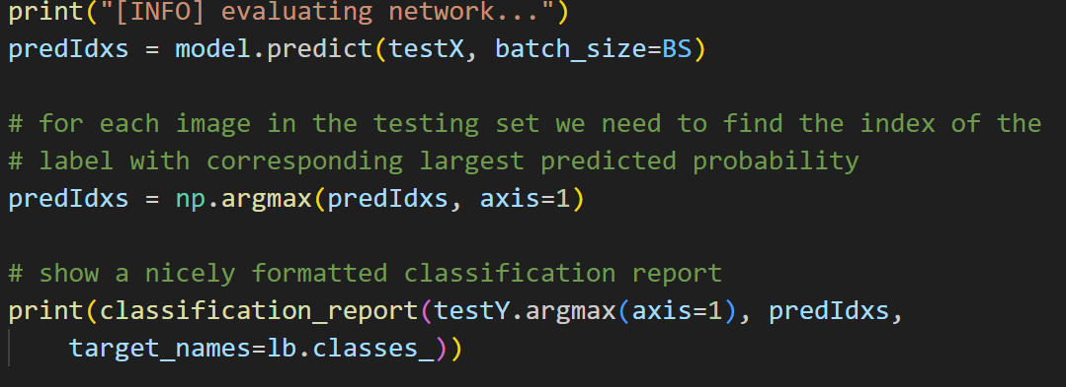
Model TEST
Find the class with the highest probability from the predicted probabilities for each image.
Convert the true labels from one-hot encoding format to integer labels for comparison with the predicted labels.
Compare the predicted labels with the true labels to generate a classification report.

Slide 13
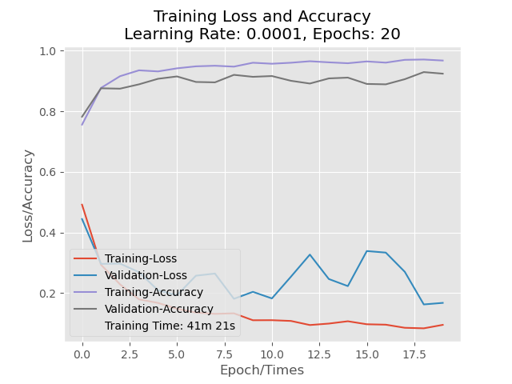
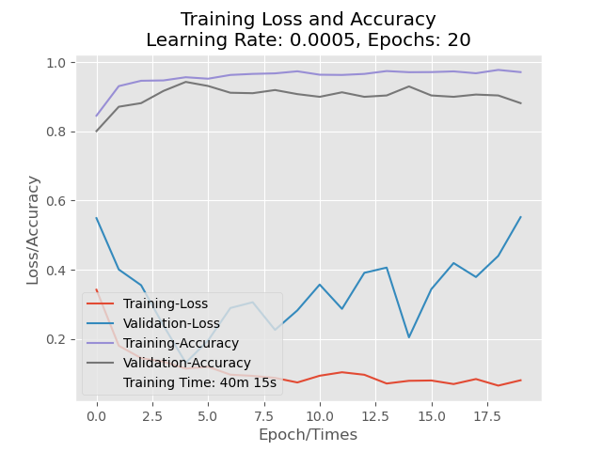
Model data comparison
We can clearly find that the model is in an underfitting state when the learning rate is 0.0005.

Slide 14
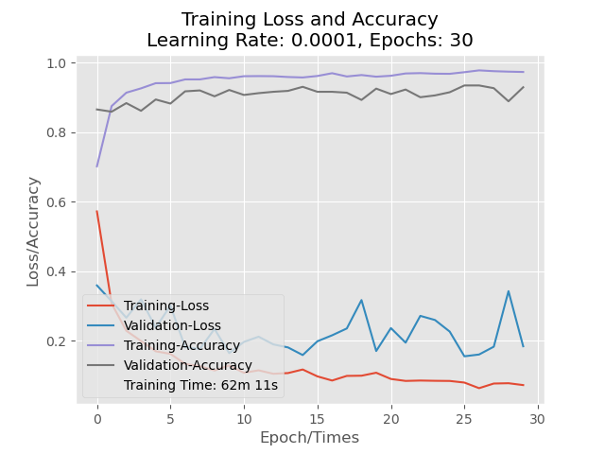
Model data comparison
Since we have added many commands to prevent overfitting, such as dropout, even more rounds of training will not lead to overfitting.

Slide 15
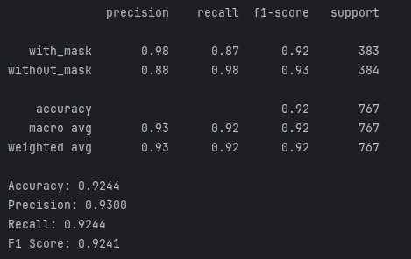
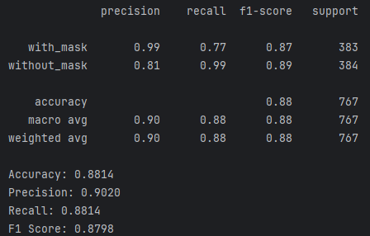
Model data comparison
LR=0.0001 EPOCHS=20 DROPOUT=0.5
LR=0.0005 EPOCHS=20 DROPOUT=0.6

Slide 16
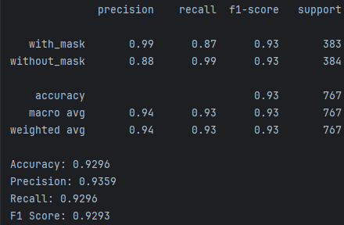
Model data comparison
LR=0.0001 EPOCHS=20 DROPOUT=0.5
LR=0.0001 EPOCHS=30 DROPOUT=0.5

Slide 17
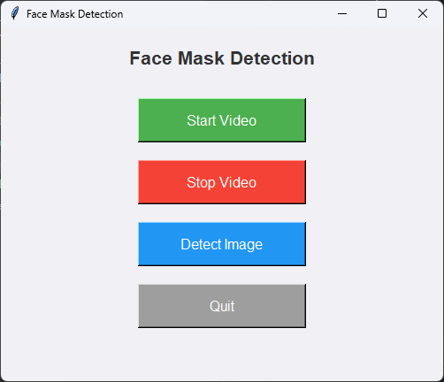
Code reference
In order to implement the mask detection better and more intuitively, we introduced some codes from public data that we are not familiar with but are very helpful for real-time monitoring.
The part of the code that extracts faces greatly facilitates our real-time monitoring

Slide 18
Model TEST Key Parameters
Data augmentation include:
rotation_range=20: random rotation angle range is 20 degrees.
zoom_range=0.15: random zoom range is 15%.
width_shift_range=0.2 and height_shift_range=0.2: random horizontal and vertical translation of 20%.
shear_range=0.15: shear strength is 15%.
horizontal_flip=True: random horizontal flip of the image.
fill_mode="nearest": fill mode, use the nearest pixels to fill the blank areas generated by rotation or translation.

Slide 19
Code reference
Extract faces:
Use OpenCV's cv2 method to convert the image.
Use faceNet to extraction or recognition on images.
“FaceNet is a deep learning model for face recognition, verification, and clustering proposed by the Google research team in 2015.”
Filter low-confidence faces:
Test the detection results and select the detection boxes with confidence greater than 0.5.
Process face images:
The detected face area is cropped and resized to 224x224, converted to RGB channel order, and preprocessed into the format required by the model.

Slide 20
Conclusion
Training of mask detection model
MobileNetV2 as the base model, which is a lightweight convolutional neural network (CNN).
Add a custom fully connected layer (FC layer) as output for classification.
ImageDataGenerator It is a class in Keras for image data augmentation for data augmentation to improve the generalization ability of the model.
Compile the model with binary cross entropy loss function and Adam optimizer, and train the model with training data.
After training, evaluate the performance of the model on the test set, and output indicators such as precision, recall, and F1 score through classification report.
Mask detection application (code borrowed from public sources)
This is an application based on Tkinter graphical interface, which uses OpenCV and deep learning models to detect faces in camera video streams or static images and predict whether ware masks or not.
OpenCV is a DNN module to load pre-trained face detection models for real-time detection of face positions in images.

Slide 21
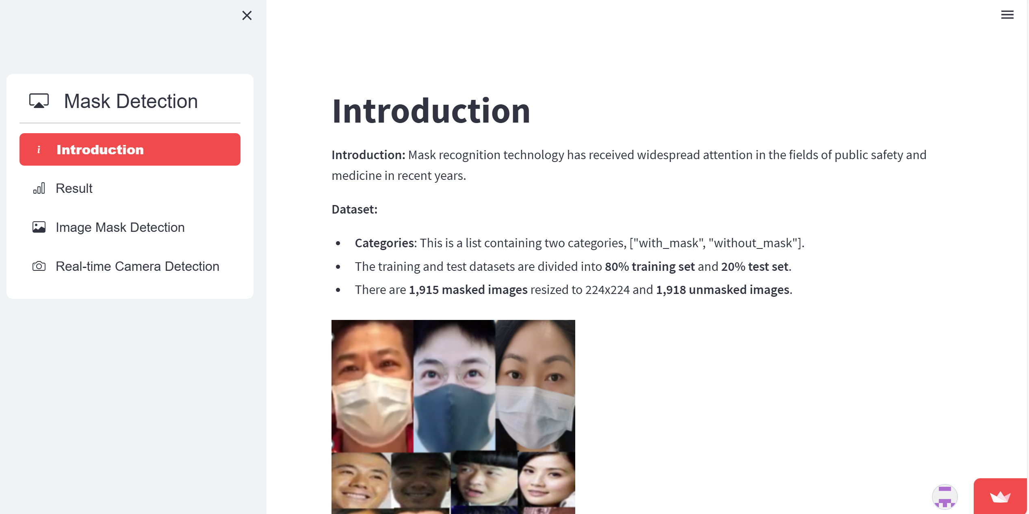
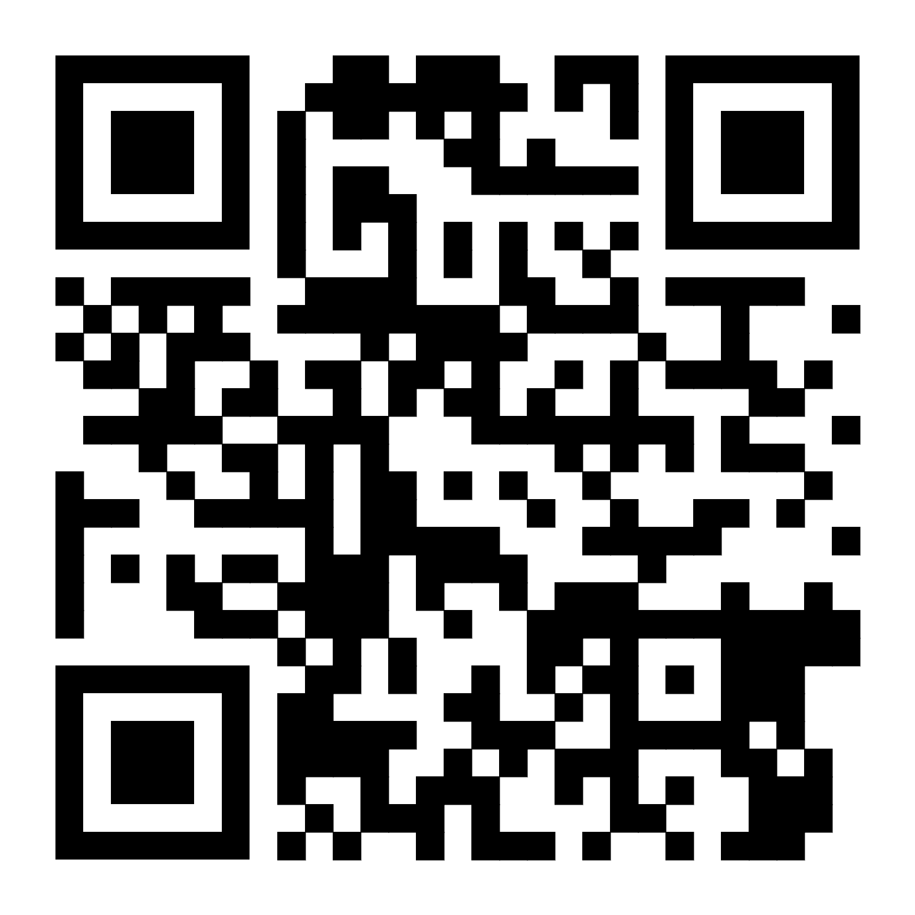
Interactive section

Slide 22
Collaboration and Division of Work
Junzhe Ban: ppt prensentation coding
Zhijie Shen: final report ppt production coding
Zhiyuan Sun: finish readme train and test the model ppt production Data acquisition and processing
Junjun Hu: proposal ppt production Video recording of implementation results Building a website

Slide 23
REFERENCE
Leamsaard, J., Charoensook, S. N., & Yammen, S. (2021, September). The automatic creation of literature abstracts | IBM Journals & Magazine | IEEE Xplore. https://ieeexplore.ieee.org/abstract/document/5392672
Sandler, M., Howard, A., Zhu, M., Zhmoginov, A., & Chen, L. C. (2018). Mobilenetv2: Inverted residuals and linear bottlenecks. In Proceedings of the IEEE conference on computer vision and pattern recognition (pp. 4510-4520).
Ieamsaard, J., Charoensook, S. N., & Yammen, S. (2021, March). Deep learning-based face mask detection using yolov5. In 2021 9th International Electrical Engineering Congress (iEECON) (pp. 428-431). IEEE.
Das, A., Ansari, M. W., & Basak, R. (2020, December). Covid-19 face mask detection using TensorFlow, Keras and OpenCV. In 2020 IEEE 17th India council international conference (INDICON) (pp. 1-5). IEEE.
Kathein, D., Hernandez, B., & Medeiros, H. (2024). Multi-Camera Multi-Person Association using Transformer-Based Dense Pixel Correspondence Estimation and Detection-Based Masking. arXiv preprint arXiv:2408.09295.

Slide 24
Thank you

