Slide 1
Diagnostic Classification Using LASSO and LDA
Exploring Variable Selection and Predictive Performance with Cross-Validation and Threshold Analysis
William Jones-Warner

Slide 2
Project Summary
In this analysis, we applied LASSO regression for variable selection and Linear Discriminant Analysis (LDA) for classification to identify key predictive features from a high-dimensional diagnostic dataset. We employed repeated train/test splits with posterior prediction tracking to estimate model uncertainty and assess the stability of selected features. We further conducted a threshold-based sensitivity analysis to explore the diagnostic trade-off between sensitivity and specificity across different probability cutoffs.
This approach is particularly useful for diagnostic methods that yield continuous outcomes, such as biomarker assays or serological tests, where there is no obvious single threshold to distinguish positive from negative cases. Rather than relying on arbitrary cutoffs, this framework allows for data-driven threshold selection based on the desired balance between sensitivity and specificity, which is crucial for optimizing diagnostic performance in clinical or field settings.

Slide 3
Sample ‘Dummy’ dataset
Dataset Summary
Total Observations: 1,000 individuals
Outcome Variable (Y):
500 Positive (Y = 1)
500 Negative (Y = 0)
Predictors:
300 continuous variables (P1 to P300)
Simulated to represent potential diagnostic markers or features
No strong prior assumption of which predictors are relevant

Slide 4
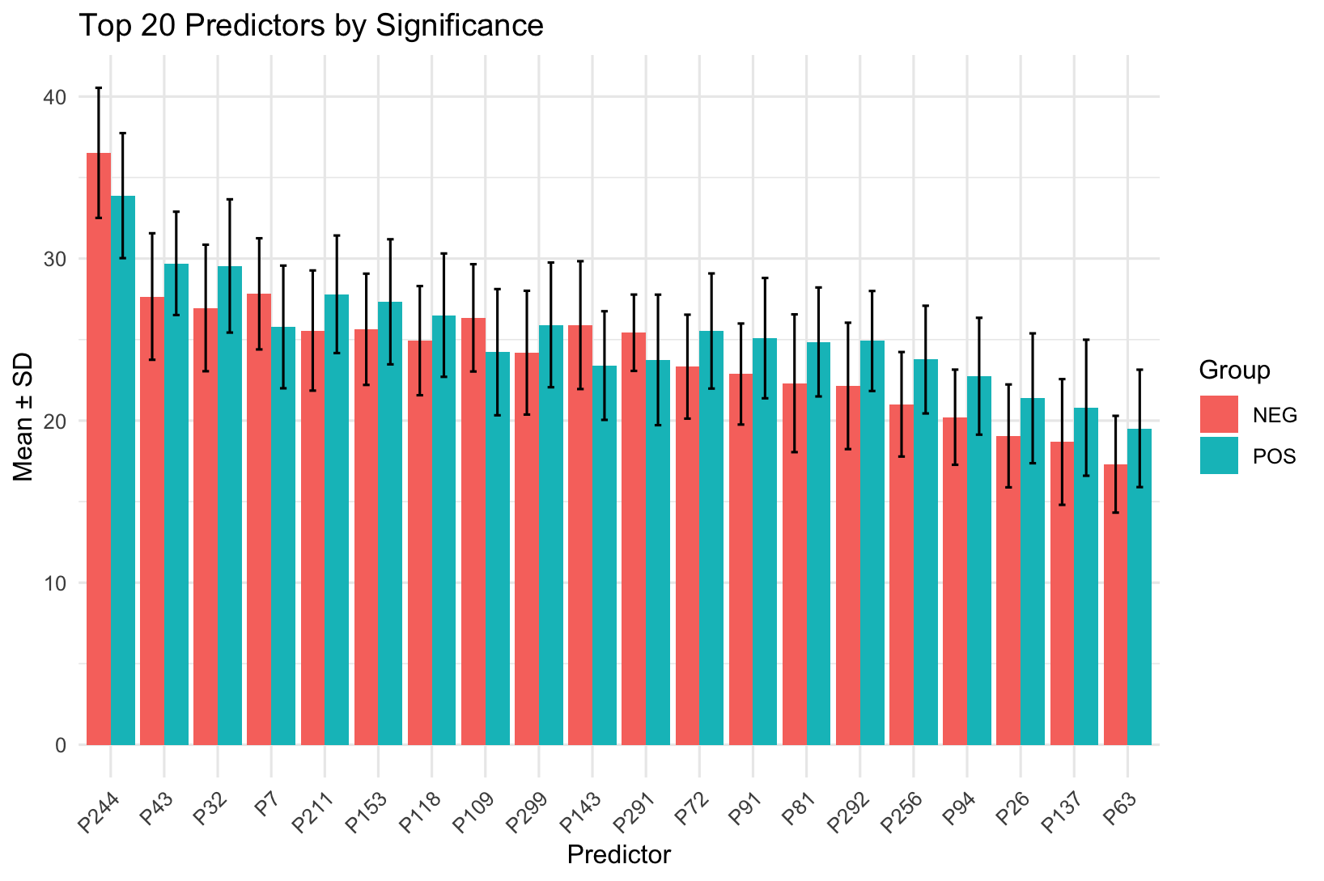
Top 20 Most Significant Predictors Differentiating Positive and Negative Cases
Bar plot showing the mean values (± standard deviation) of the top 20 predictors with the lowest p-values from two-sample t-tests comparing positive and negative cases. Predictors are ordered by overall mean difference. Bars are grouped and color-coded by diagnostic group (POS = positive, NEG = negative). Error bars represent one standard deviation from the group mean.

Slide 5
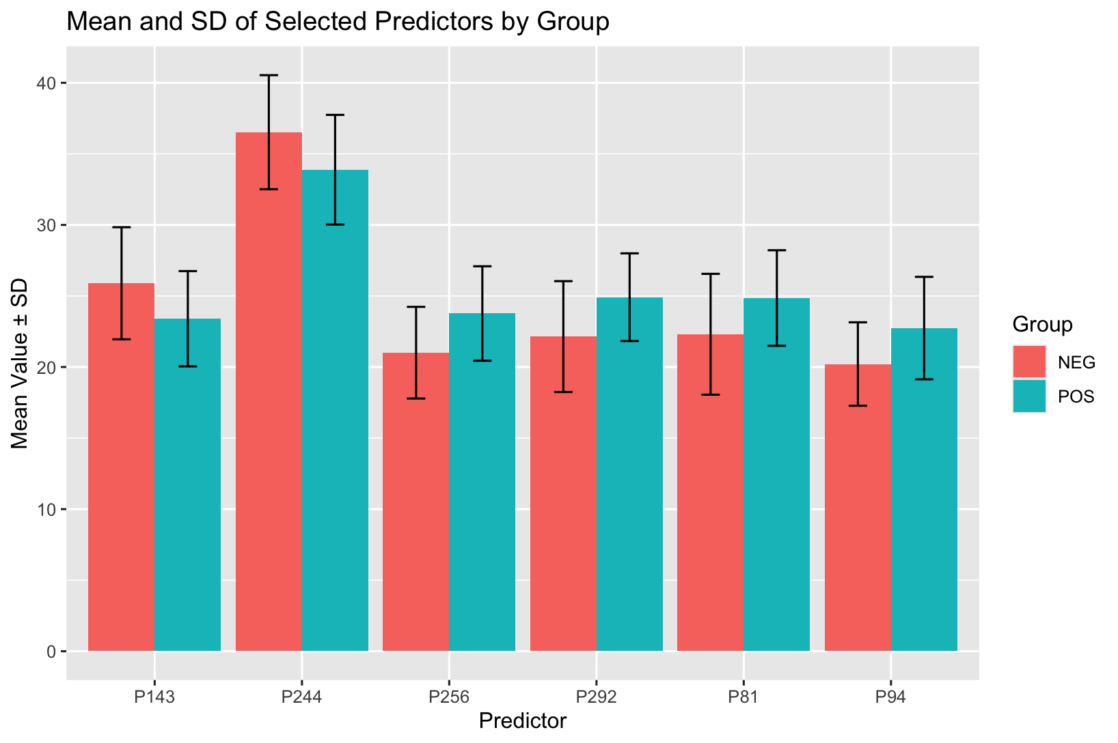
Mean and Standard Deviation of LASSO-Selected Predictors by Diagnostic Group
Bar plot displaying the mean values (± standard deviation) of predictors selected through LASSO regression, stratified by diagnostic group (POS = positive, NEG = negative). Each predictor shown was chosen for its contribution to classification performance in the LASSO model. Bars are grouped by diagnostic class, with error bars representing one standard deviation from the group mean.

Slide 6
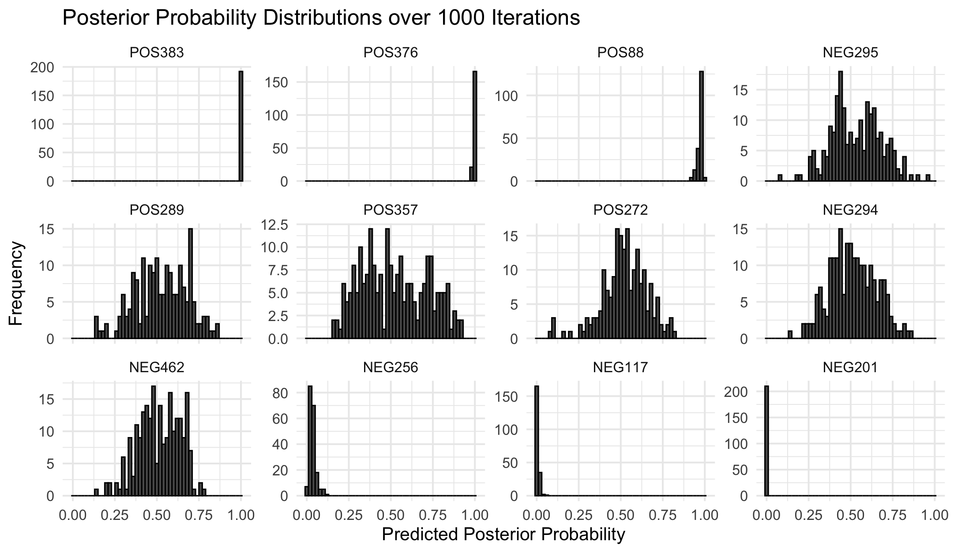
Posterior Probability Distributions over 1000 Iterations for Selected Samples
Faceted histograms displaying the distribution of predicted posterior probabilities for selected individual samples across 1000 train/test iterations. Each panel represents one unique sample (ID), with predictions derived from LDA models using LASSO-selected features. This visualization highlights the variability and uncertainty in classification probabilities for each sample across the iterations of train/test integrations.

Slide 7
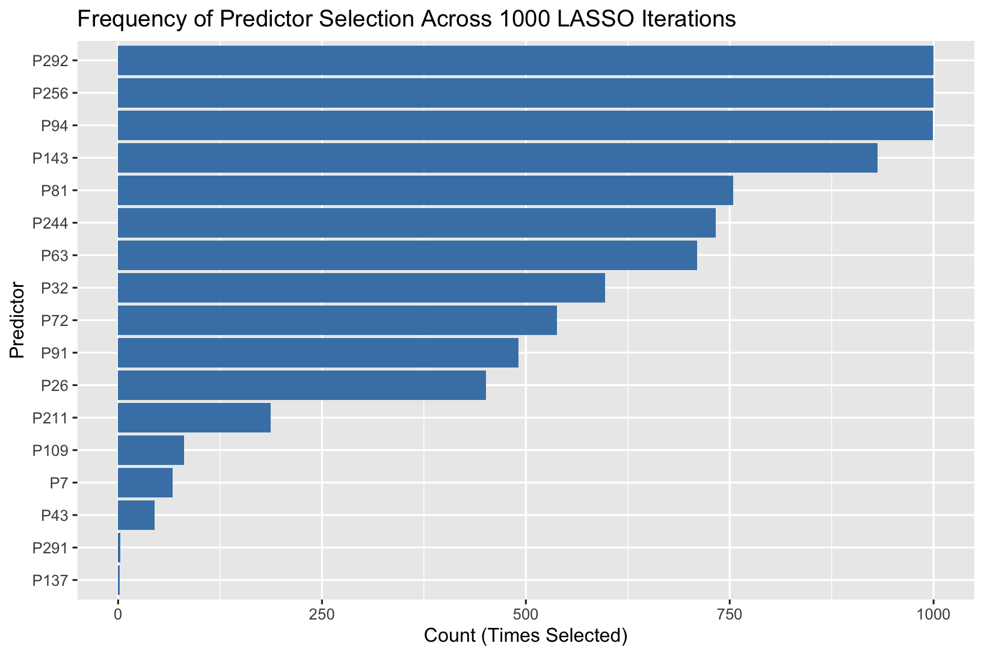
Frequency of Predictor Selection Across 1000 LASSO Iterations
Horizontal bar plot showing how frequently each predictor was selected across 1000 iterations of LASSO regression during repeated 80:20 train/test splits. Predictors are ordered by selection count, indicating their relative importance and stability as diagnostic features.

Slide 8
Select the Top 6 most Frequent Predictors to Utilise LDA on Whole Population.
P256 P292 P94 P143 P81 P244
Here we settle on 6 predictors that are the same to the initial LASSO regression results.

Slide 9
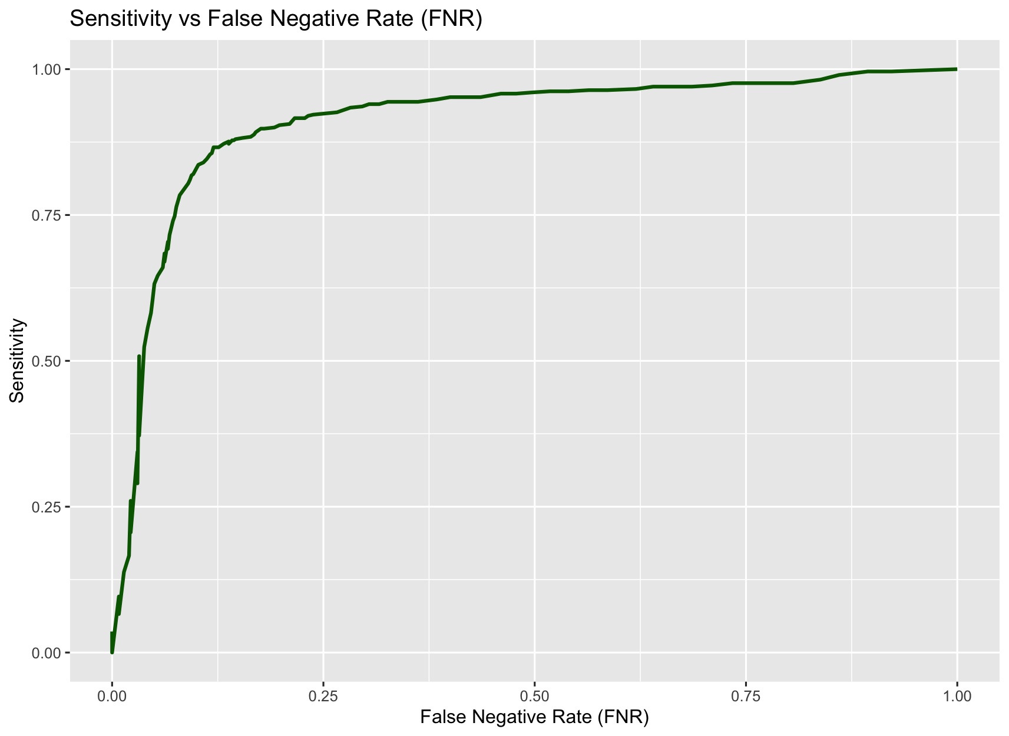
ROC Analysis: Sensitivity Across Varying False Negative Rates (FNR)
This plot is part of a Receiver Operating Characteristic (ROC) analysis, illustrating the relationship between sensitivity and the false negative rate (FNR) across a range of classification thresholds. The curve is derived from a continuous diagnostic score generated using LDA posterior probabilities based on LASSO-selected predictors.

Slide 10
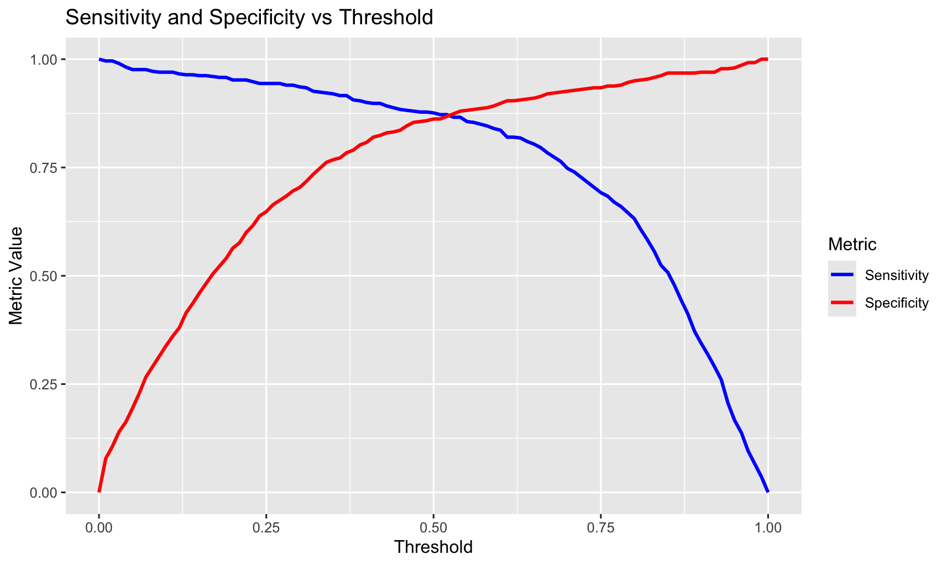
Sensitivity and Specificity Across Classification Thresholds
This plot displays the changes in sensitivity (blue line) and specificity (red line) as the decision threshold varies for the diagnostic model.
Threshold can be set dependent on the necessary requirements of your diagnostic.

Slide 11
Test Dataset Design and Summary
P256 P292 P94 P143 P81 P244
Here we settle on 6 predictors that are the same to the initial LASSO regression results.
Test Data stats
Sample Size: 50 observations
Class Balance:
Positive Cases (Y = 1): 15 cases - Minority class
Negative Cases (Y = 0): 35 cases -Majority class

Slide 12
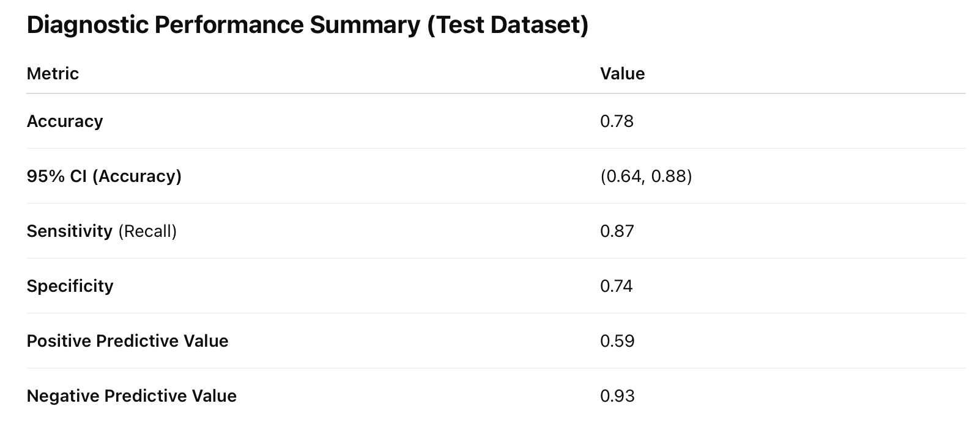
Output of Predictions on Test Dataset

