Slide 1
Simulated Data Application of Geostatistical Modeling and Environmental Raster Analysis in R
William Jones-Warner

Slide 2
Spatial Clusters: 300 survey locations were randomly generated around 6 artificial cluster centers were randomly placed within a bounding box in southern England (longitude: -1.5 to -1.0, latitude: 50.6 to 50.8).
Spatially Structured Noise: A spatial covariance matrix with an exponential decay model and a small nugget effect was used to simulate spatial autocorrelation (spatial_effect).
A logistic model with spatial and covariate effects was used to simulate the probability of a positive case (prob_pos). Binomial sampling generated the number of positives (positive) from the number of individuals surveyed (surveyed).
Final Output: The resulting dataset (survey_data) includes coordinates, covariates, simulated prevalence (prev), and other metadata, making it suitable for spatial and geostatistical modeling

Slide 3
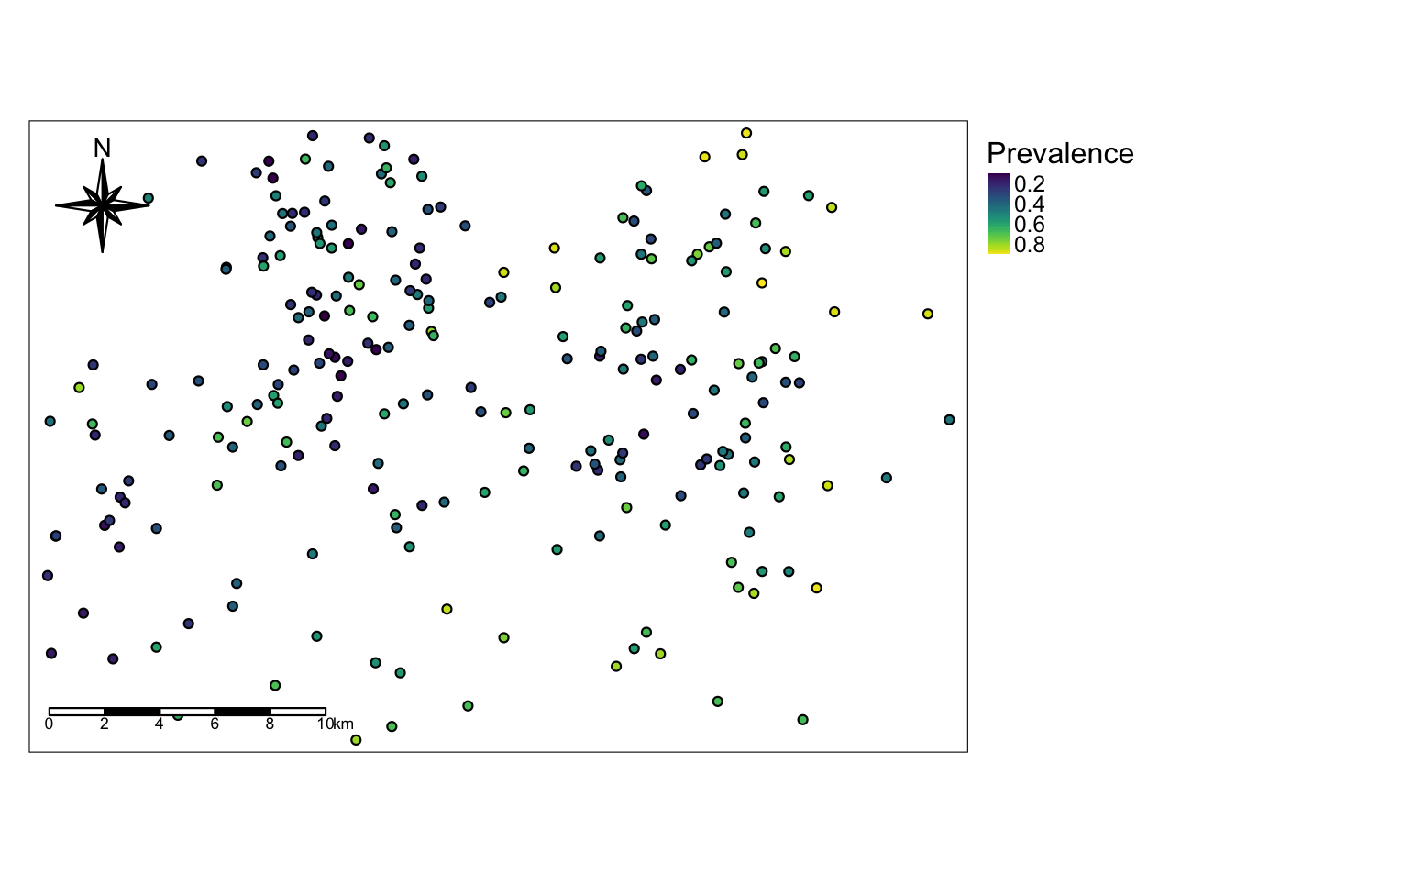
Spatial Distribution of Simulated Prevalence Data Across Survey Clusters
Map displaying simulated prevalence values (prev) at survey locations across six spatial clusters. Point colours represent prevalence levels using a continuous scale, with darker colours indicating higher prevalence

Slide 4
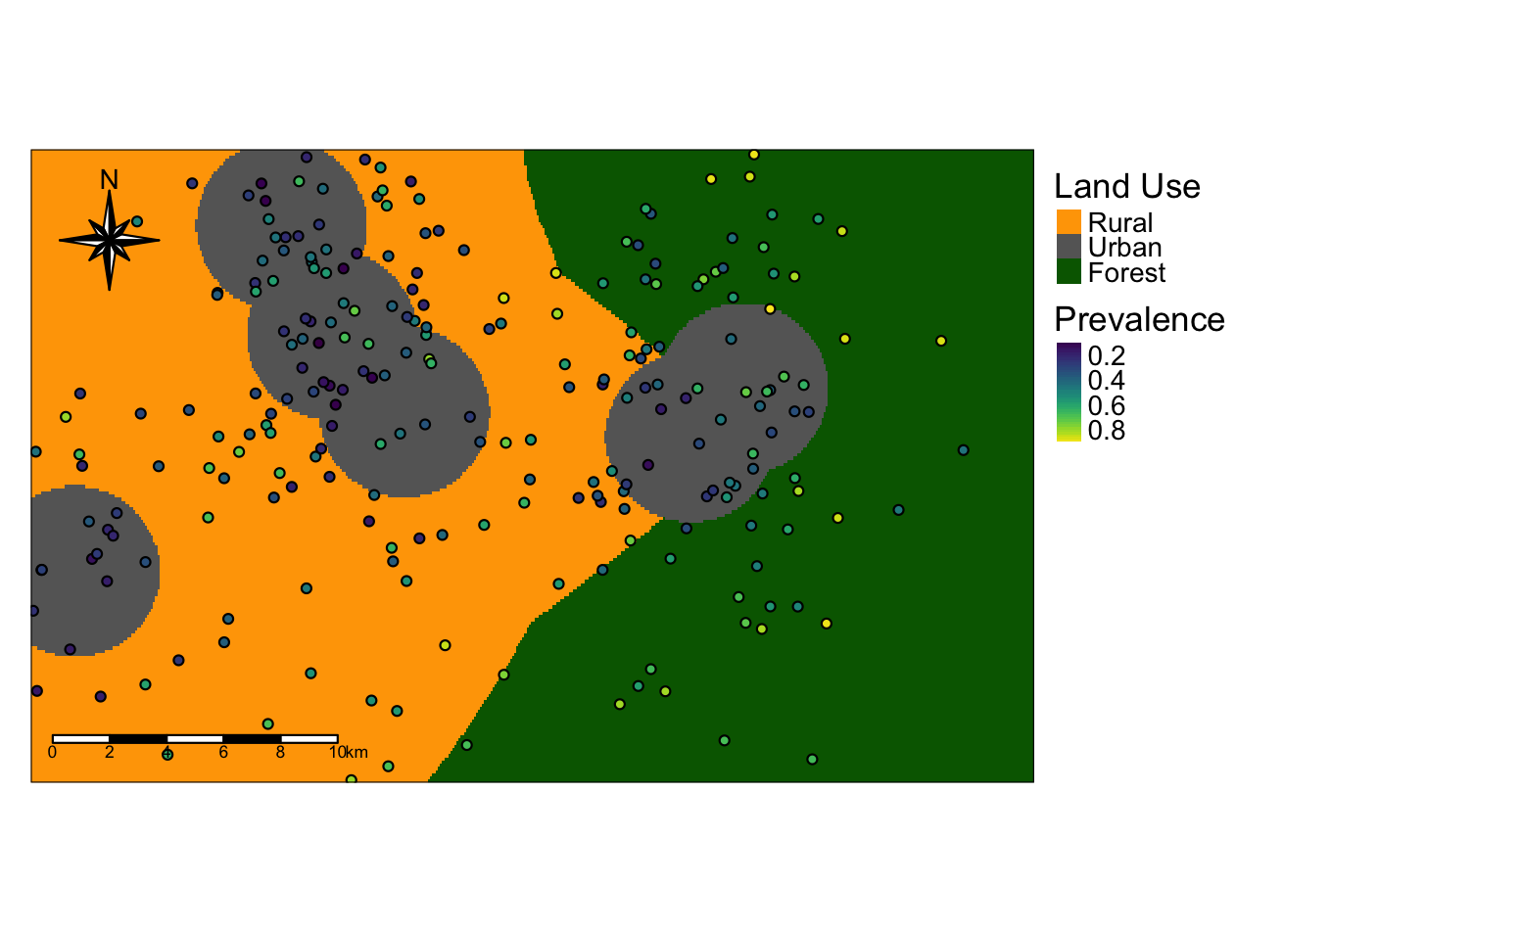
Simulated Land Use and Prevalence Data Visualization with Spatial Context
This map shows simulated land use categories represented by distinct colours according to the categorical land use palette. Overlaid are survey points coloured by simulated prevalence values (prev) using a continuous colour scale, where darker colours indicate higher prevalence. Both datasets are simulated to illustrate spatial relationships between land use and prevalence across survey clusters.

Slide 5
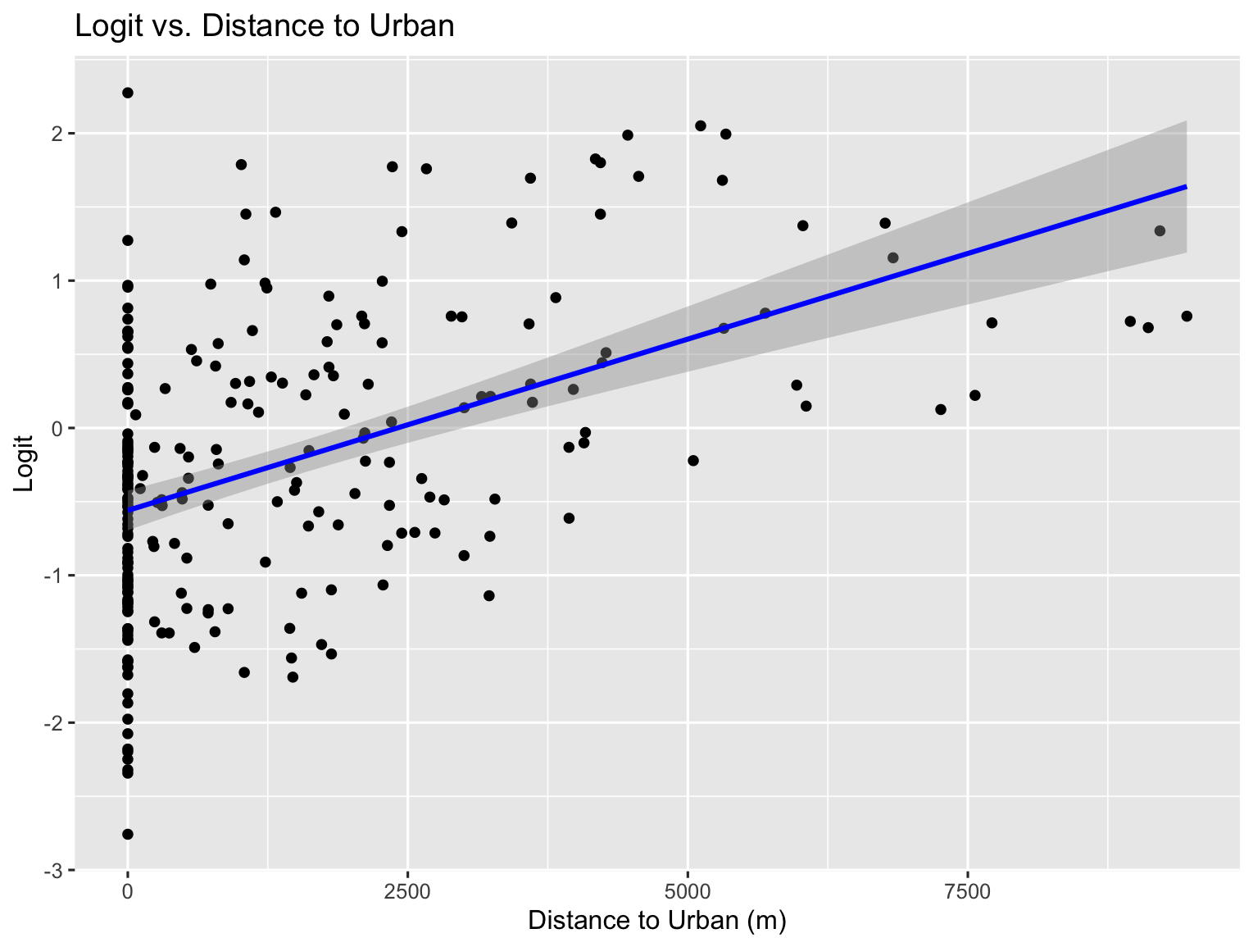
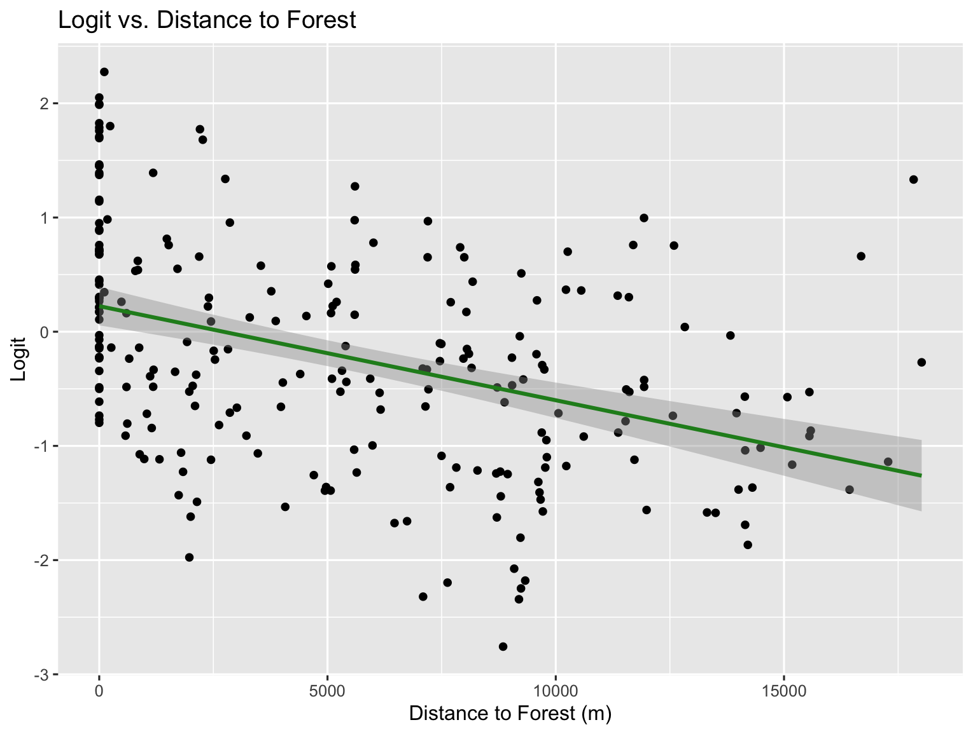
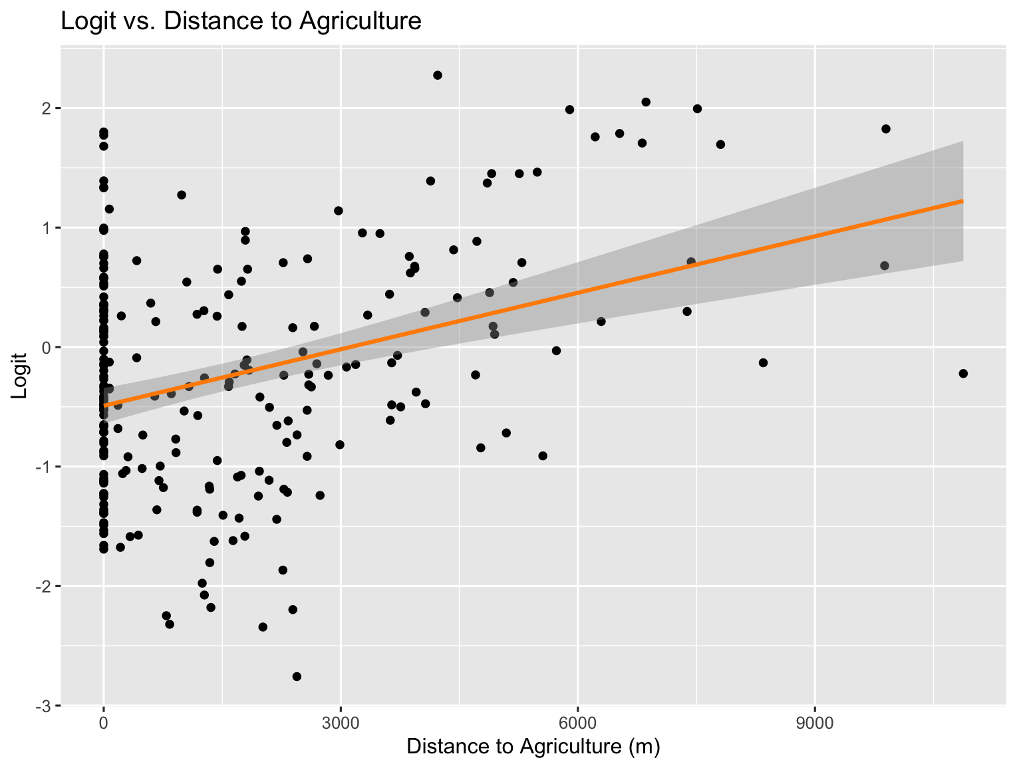
Associations Between Logit-Transformed Prevalence and Distances to Urban, Forest, and Agricultural Areas
These scatter plots examine the relationship between logit-transformed prevalence and distances to different land use types—urban areas, forests, and agricultural land—to explore potential correlations between environmental covariates and disease prevalence. Investigating these associations helps identify which factors might influence the outcome, informs model building by highlighting relevant predictors, and improves understanding of the underlying spatial patterns driving disease risk. This exploratory step is essential for selecting meaningful variables in subsequent geostatistical modeling and guiding targeted interventions.

Slide 6
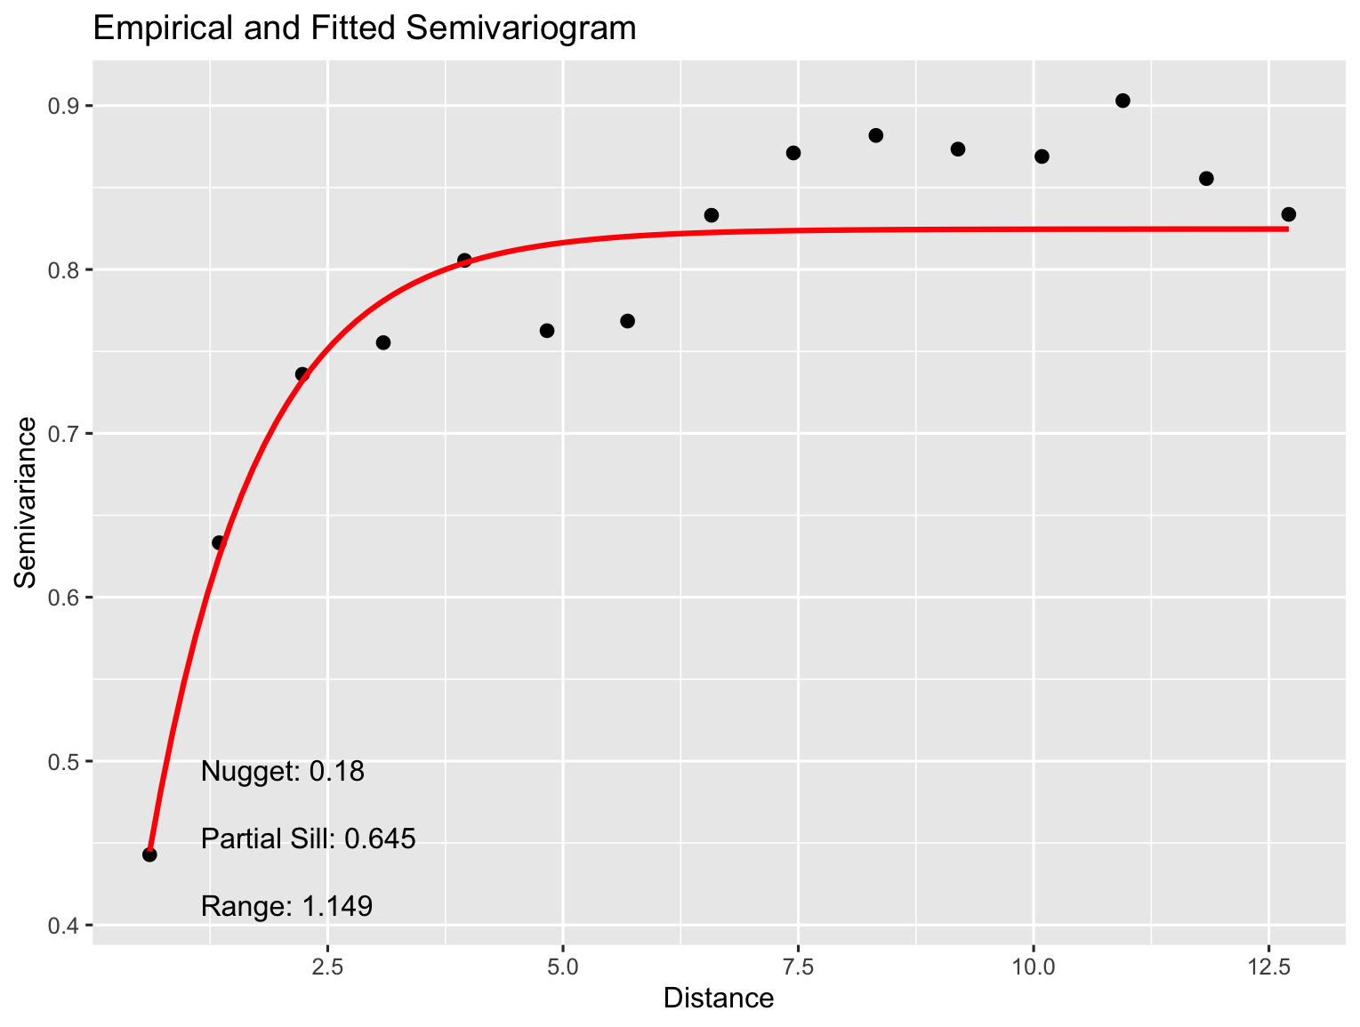
Empirical and Fitted Semivariogram of Spatial Data
This plot displays the empirical semivariogram (black points) and the fitted theoretical variogram model (red line) representing spatial autocorrelation in the data. The semivariogram quantifies how data similarity decreases with increasing distance between points. The fitted curve is used to summarize spatial dependence through key parameters: nugget (measurement error or microscale variation), partial sill (spatial variance), and range (distance beyond which spatial correlation becomes negligible). This analysis is critical for fitting geostatistical models, which leverage spatial correlation to improve prediction accuracy and uncertainty estimation.

Slide 7
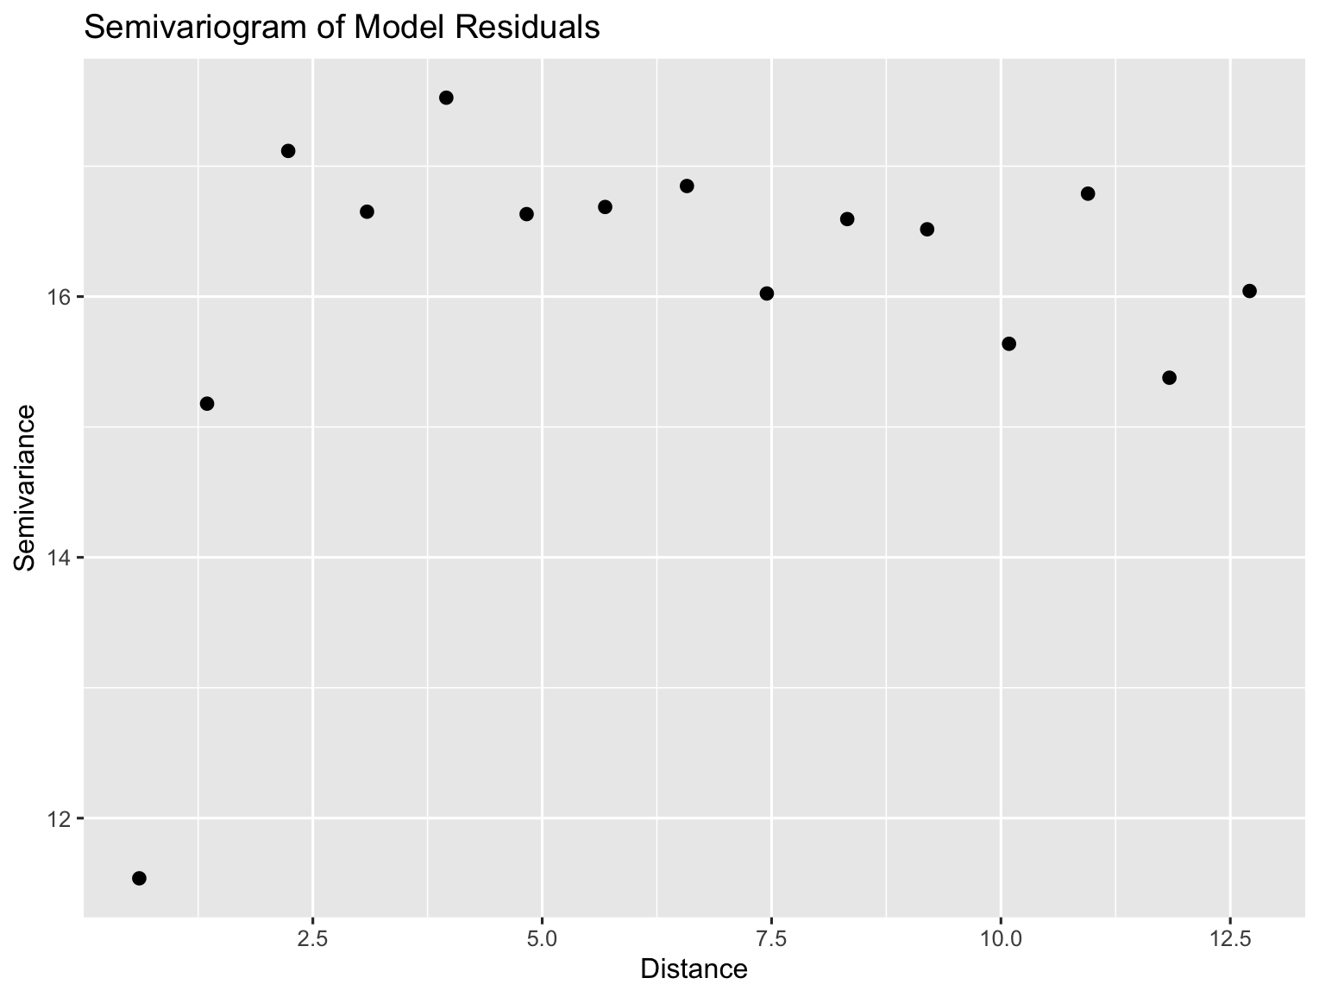
Semivariogram of Model Residuals
This plot shows the empirical semivariogram of the residuals from the geostatistical model. It is used to assess whether spatial autocorrelation remains after fitting the model. Ideally, the residual semivariogram should show no spatial structure, indicating that the model has adequately captured spatial dependence in the data. Detecting residual spatial autocorrelation would suggest the need for model refinement. Or if the initial model was a non-spatial model then it demonstrates the needs for a geospatial model to be utilised. Here we see some residual spatial structure.

Slide 8
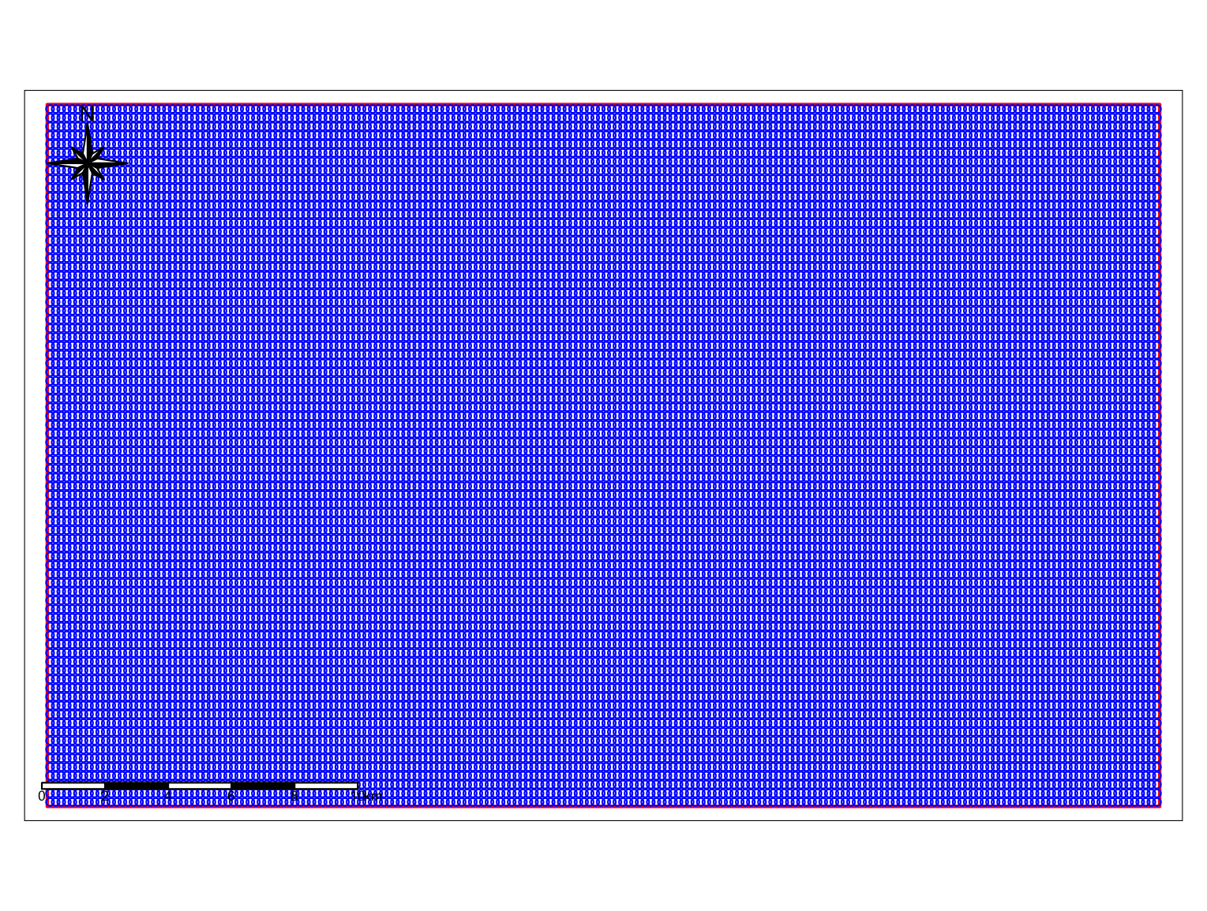
Survey Area with Sampling Points and Spatial Boundaries
This map displays the survey sampling points (blue circles) within the study area boundary (red polygon). These sampling sites provide the observational data used to calibrate and fit the geostatistical model. The spatial model leverages these data points to predict disease prevalence at unsampled locations across the study region. The north arrow and scale bar are positioned outside the map frame to avoid overlapping with key spatial features and improve map readability.

Slide 9
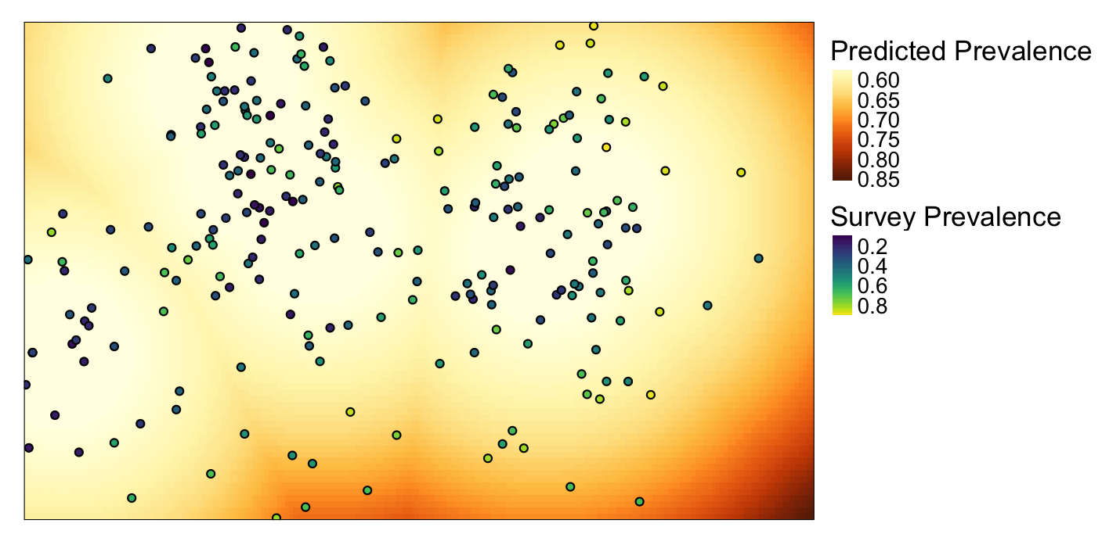
Predicted and Observed Prevalence of the Simulated Outcome Across the Study Area
This map shows the predicted prevalence surface (continuous raster) generated by the geostatistical model over the study region, with survey observations (points) overlaid to indicate observed prevalence values. The predicted prevalence helps identify spatial patterns and hotspots, while the survey points provide ground truth data used for model calibration and validation. Legends for predicted prevalence and survey prevalence are placed outside the map for clarity.

