Slide 1
Development of a User-Friendly Predictive Model to Adjust S.m. Prevalence Estimates for Diagnostic Sensitivity Limitations
William Jones-Warner

Slide 2
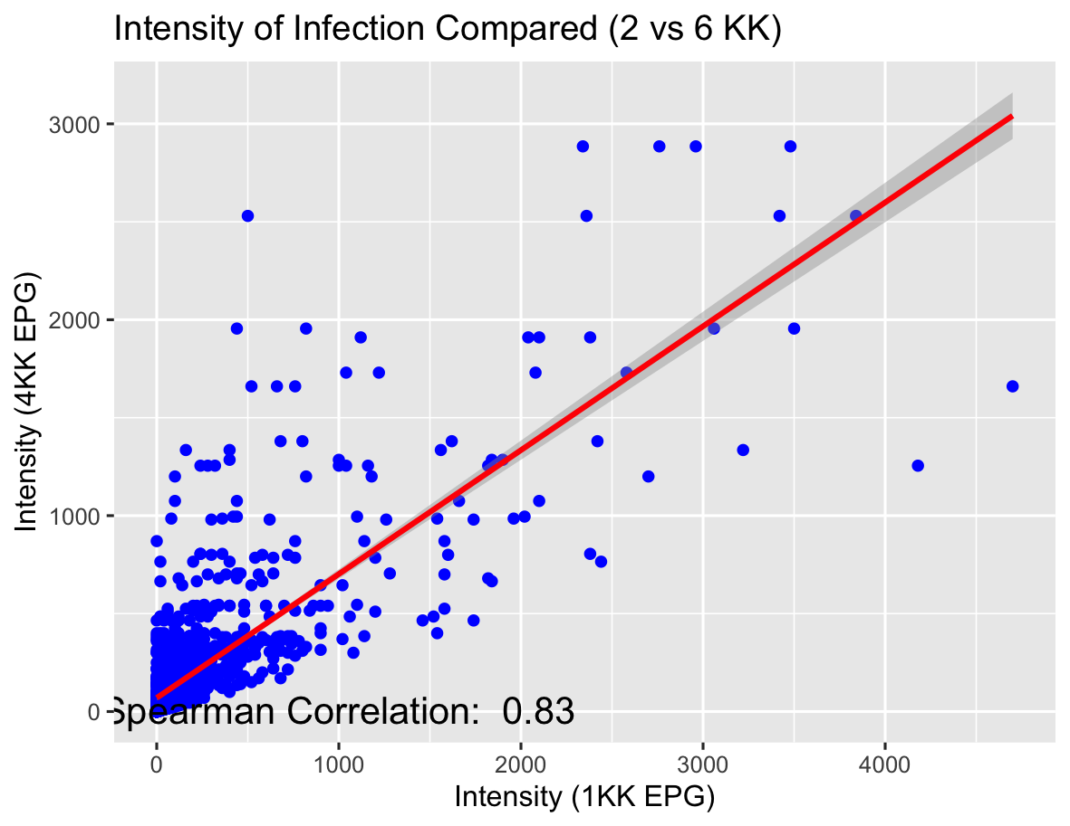
Positive correlation between intensity of infection obtained from 4KK and 1KK.

Slide 3
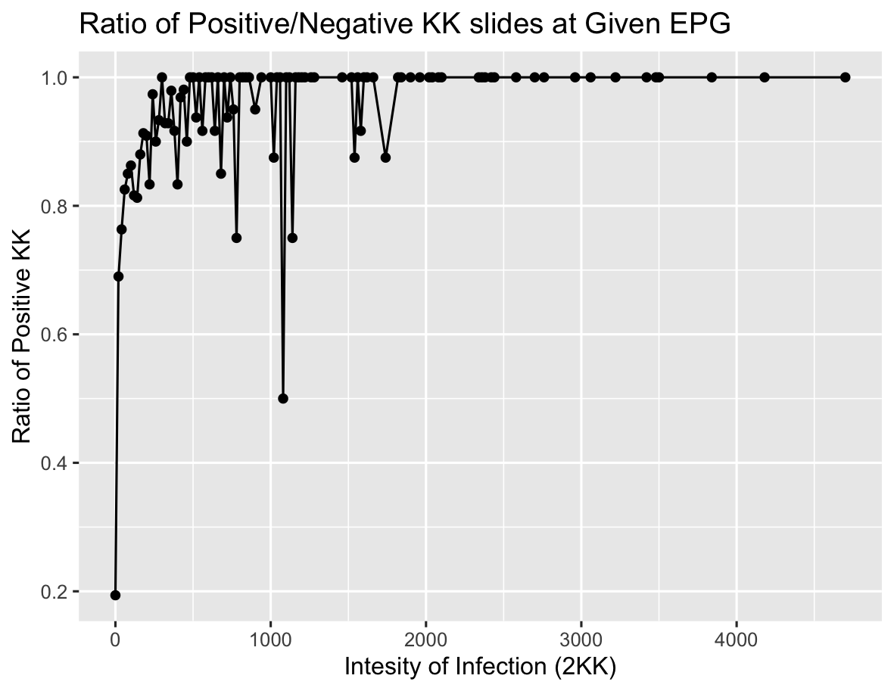
Number of positive KK’s from an individual increased as intensity of infection increases.

Slide 4
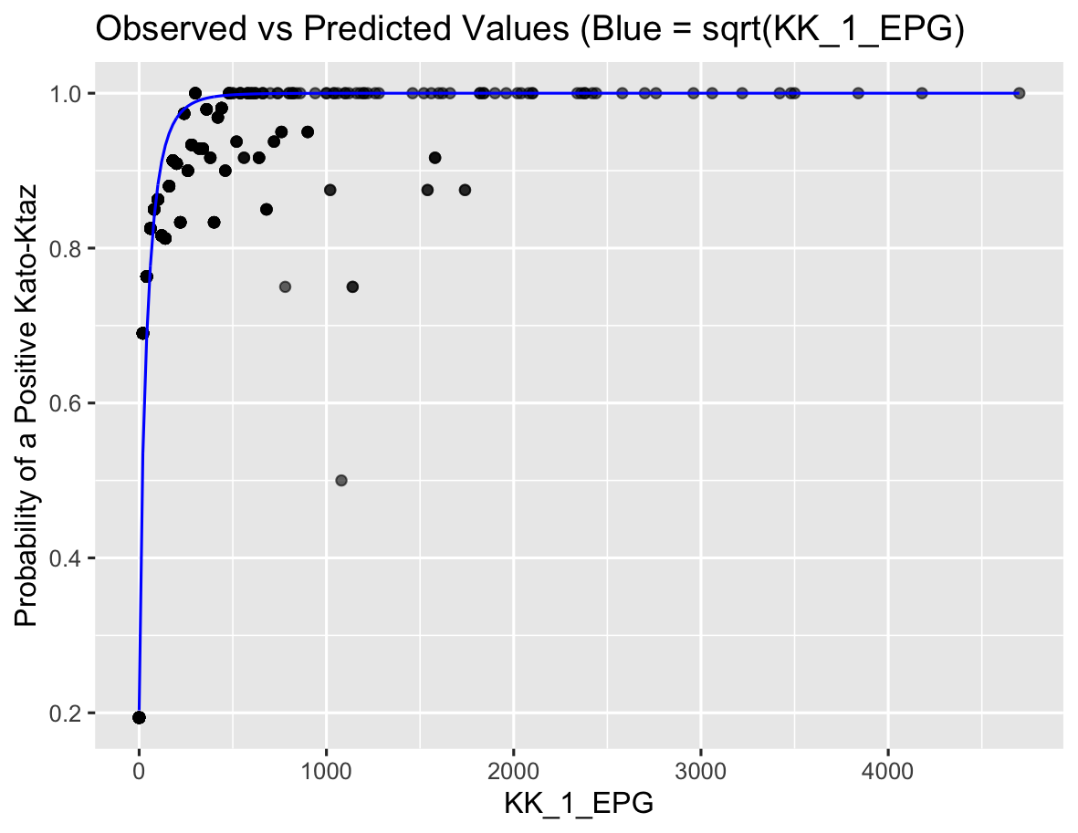
Probability of a positive KK increases as intensity of infection increases in a near predictable way

Slide 5
Model predicts the probability of KK identifying a positive result.
This model estimates the probability of detecting a positive Kato-Katz (KK) result based on infection intensity, using the square root of the 1KK EPG (eggs per gram) value as the predictor. It focuses on individuals who tested positive across multiple slides and models the likelihood that these positives were identified by the first KK slide (1KK). By transforming the observed detection proportions using the logit function, the model fits a linear relationship between detection probability and infection intensity. The inverse of the predicted probability (1/p) is then used to estimate how many infections were likely missed at each EPG level.

Slide 6
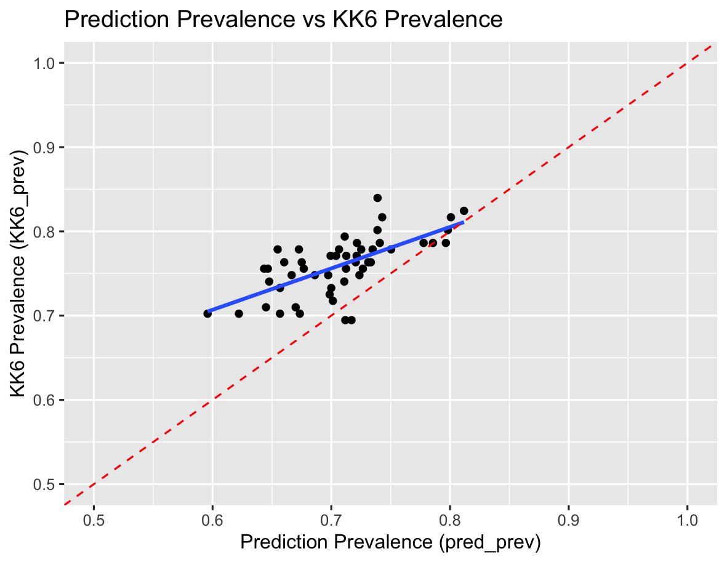
Model predicts population prevalence as is 4KK used.

Slide 7
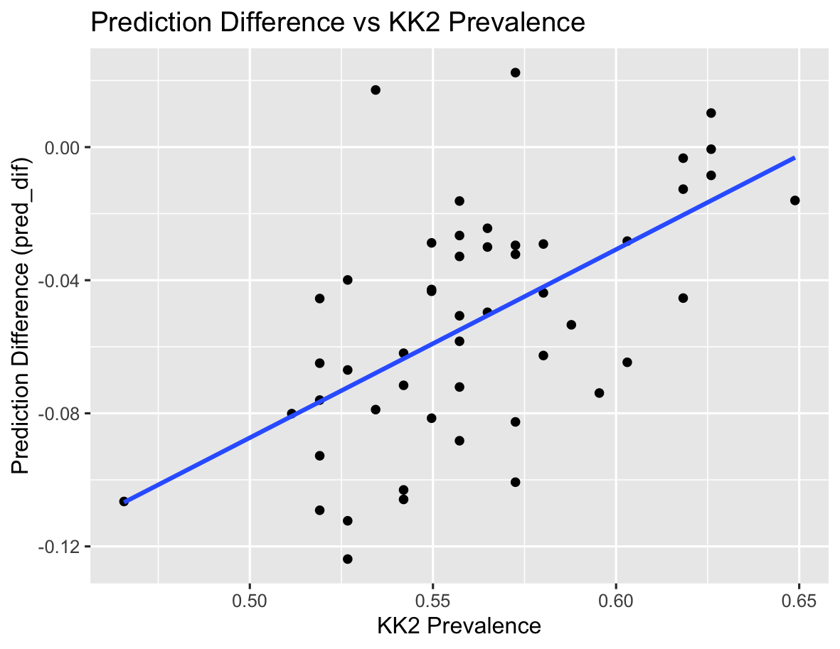
Model Underpredicts at lower base prevalence.

Slide 8
Now testing Further Models - GAM and GLM
model_logit <- lm(Ratio_logit ~ KK_1_EPG, data = combined_df)
Testing direstion relationship between the logit and EPG from a single KK.
model_glm <- glm(cbind(Sum_Weighted_Value, Total_Count - Sum_Weighted_Value) ~ sqrt(KK_1_EPG), family = binomial(link = "logit"), data = df_table_sum)
This works off the probability of a positive KK vs the square root of the EPG. Similar to the initial model but using a binomial model. Rather than the logit.
model_gam <- gam(Ratio_logit ~ s(KK_1_EPG), data = combined_df)
This is running a generalised additive model (GAM) as it might be more flexible.

Slide 9
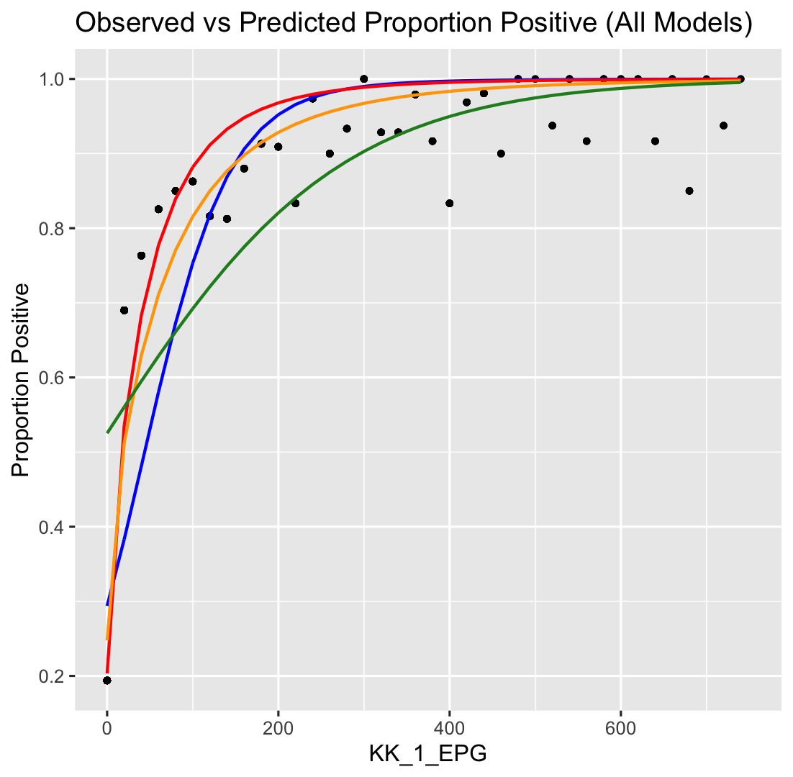
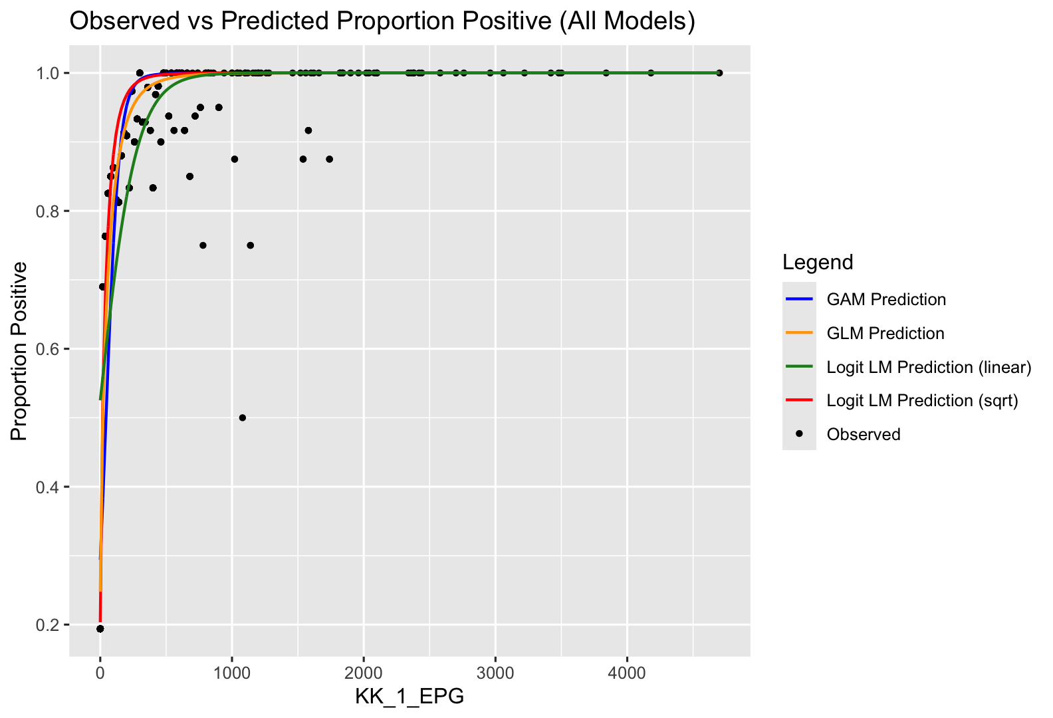
Comparison

Slide 10
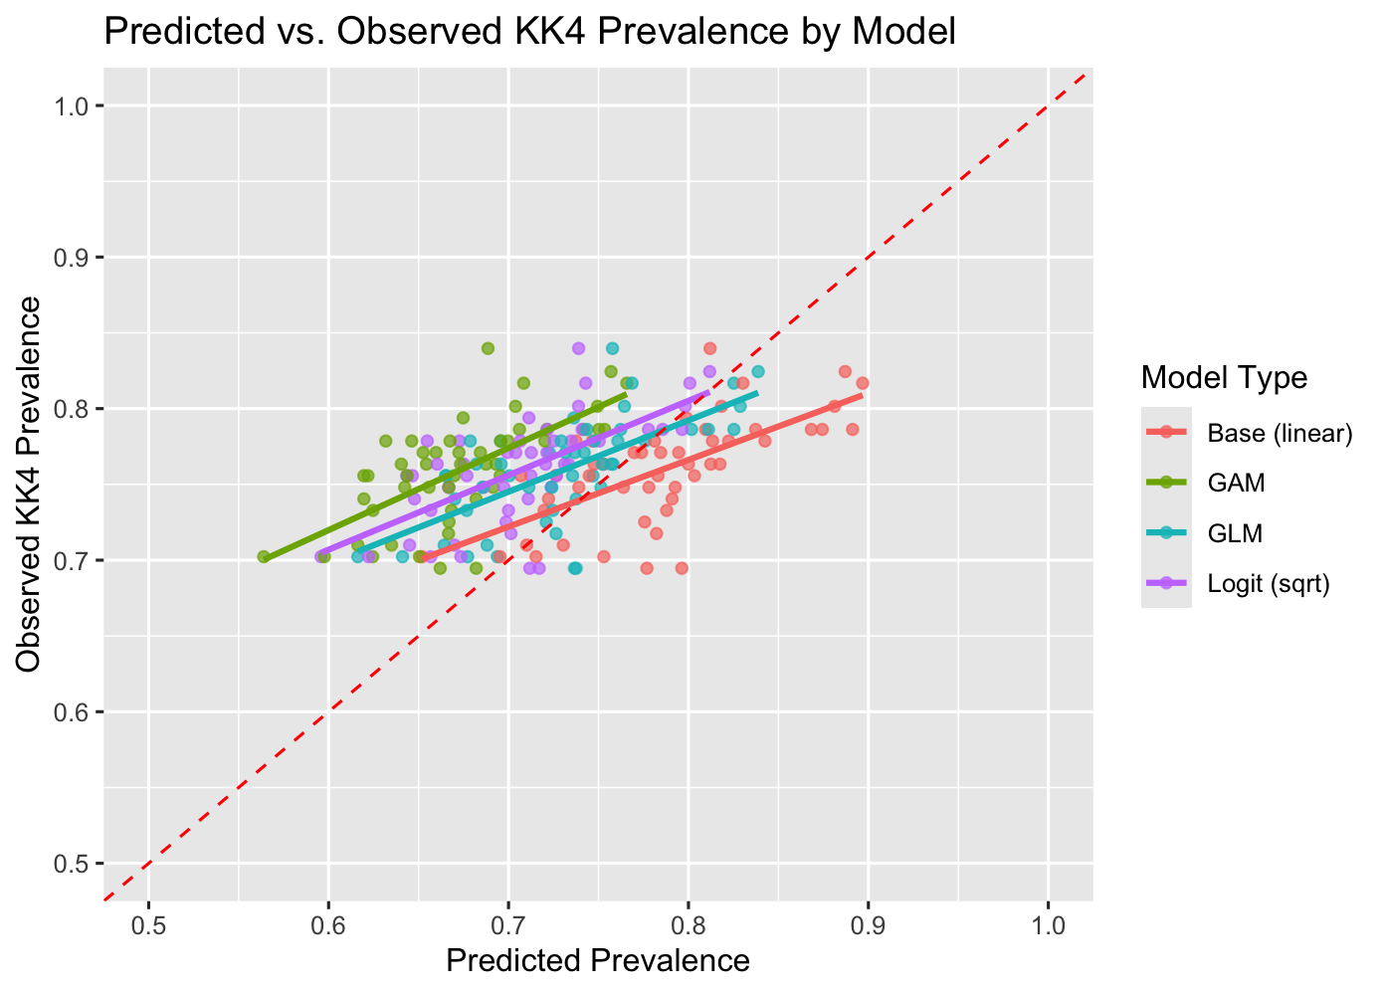
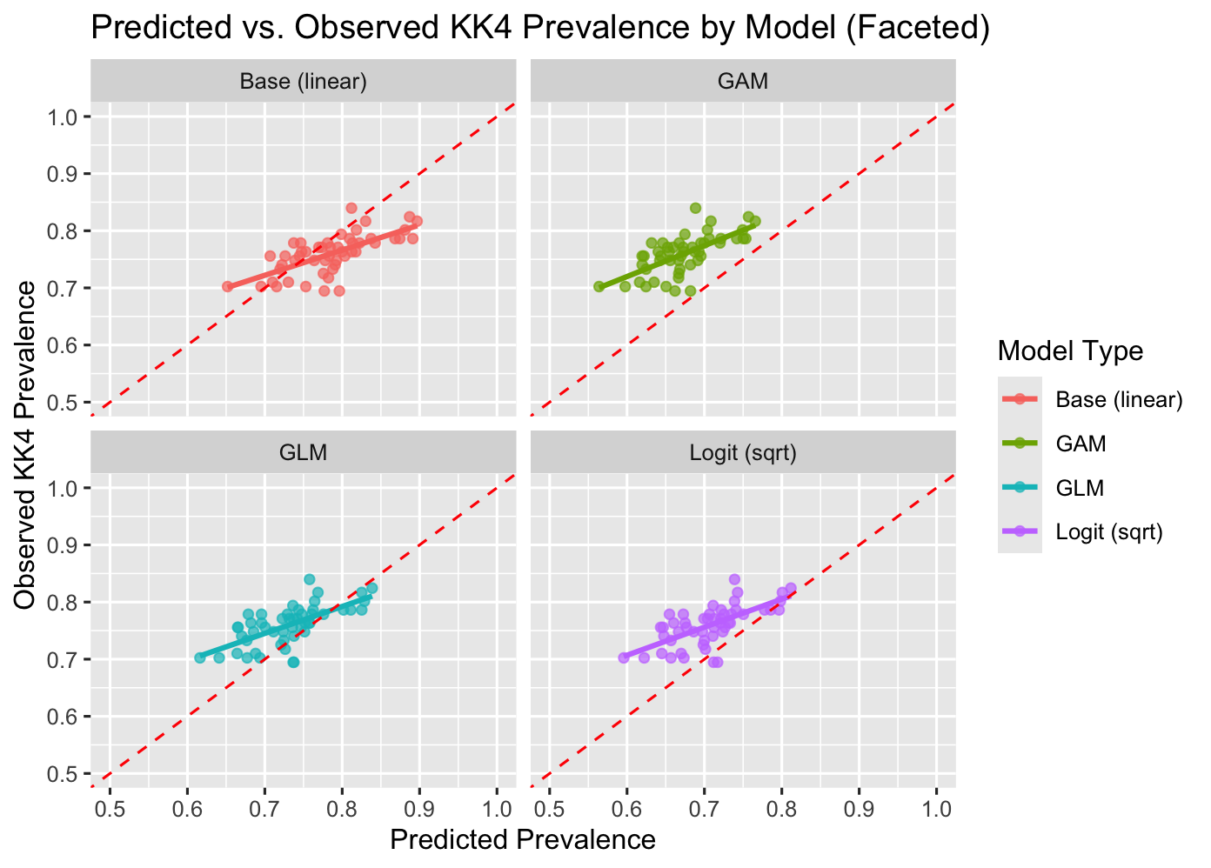
Predicted Values Vs. observed in train and hold out

Slide 11
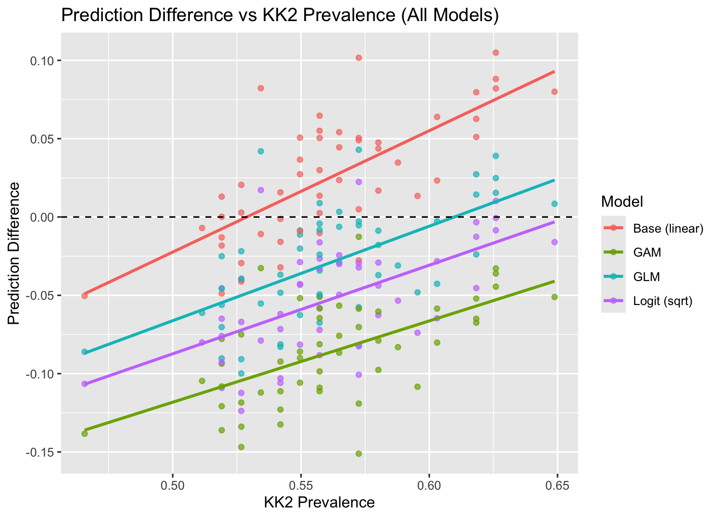
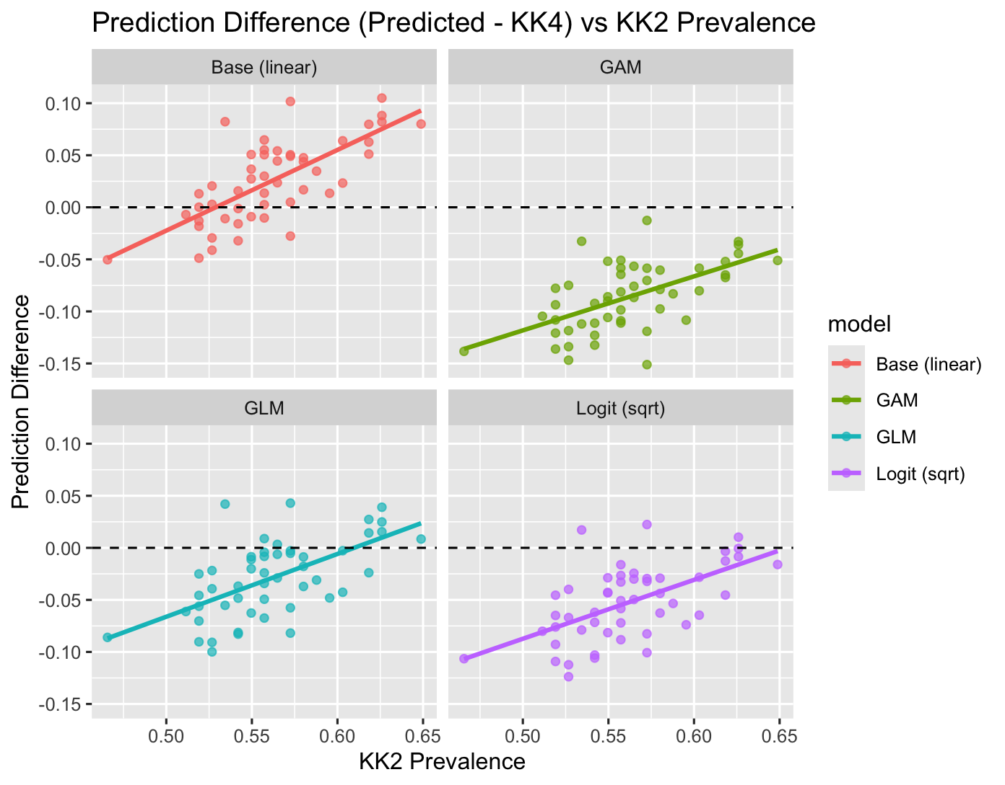
Difference at prevalence.

Slide 12
Model iteration summary

Slide 13
Summary Stats of the 2 Test populations

Slide 14
Testing on Two populations we have 2 and 3 KKs

