Slide 1
Modeling Tuberculosis Transmission and Disease Progression Using a Stochastic Bernoulli Framework: Evaluating a Novel Point-of-Care Rapid Diagnostic with Increased Diagnostic Coverage
William Jones-Warner

Slide 2
About
This stochastic compartmental model model uses a Bernoulli process framework to capture individual-level transitions between key disease states: Susceptible, Latent, Preclinical, Infectious, Diagnosed, Treated, and Recovered. It incorporates the randomness of real-world disease processes while preserving population-level structure.
The primary aim of this modelling framework is to compare baseline TB dynamics with those observed under the implementation of a theoretical novel point-of-care rapid diagnostic. This diagnostic is assumed to increase overall diagnostic coverage, potentially accelerating diagnosis and reducing transmission.

Slide 3
Model compartments and their initial population counts.
The table defines each compartment representing stages of TB infection and treatment status, along with the initial number of individuals in each category at the start of the simulation. Compartments include susceptible (uninfected), exposed (latent infection), preclinical (infectious but asymptomatic), infectious (symptomatic), diagnosed cases, individuals currently under treatment, and recovered individuals.These values were derived by running the dynamic TB transmission model and sampling from the simulation at the 95th percentile time point.
Compartment | Description | Initial Count
s | Susceptible – individuals not yet infected | 8,382
e | Exposed – latent infection | 457
p | Preclinical – infectious but not symptomatic | 54
i | Infectious – symptomatic and capable of transmission | 111
d | Diagnosed – confirmed TB cases | 10
t | Treated – currently receiving treatment | 236
r | Recovered – completed treatment or resolved | 750

Slide 4
Model parameters for tuberculosis transmission and disease progression
Parameter | Value | Description
inf.prob | 0.0024 | Probability of transmission per contact
act.rate | 5.0 | Number of contacts per person per time step
piu.rate | 1 / 365 | Rate of progression from latent to early infectious (E → P)
delay.rate | 1 / 45 | Rate of progression from preclinical to clinical TB (P → I)
p_diag_coverage | 0.1 | Proportion of preclinical cases (P) eligible for diagnosis
p_diag_rate | 1 / 183 | Probability of diagnosis among eligible preclinical cases (P → D)
i_diag_coverage | 0.76 | Proportion of clinical cases (I) eligible for diagnosis
i_diag_rate | 1.7 / 120 | Probability of diagnosis among eligible clinical cases (I → D)
treat.rate | 0.1 | Probability of treatment uptake once diagnosed (D → T)
rec.rate | 1 / 180 | Recovery rate following treatment (T → R)
recid.rate | 0.6 / 365 | Rate of relapse or TB-related death, balanced by entry into susceptible pool (R → S)
This table summarizes the key parameters used in the TB transmission model, including their numerical values and biological meanings. Parameters represent probabilities, rates of progression between disease states, diagnosis coverage and rates, treatment uptake, recovery, and relapse or death balanced by re-susceptibility

Slide 5
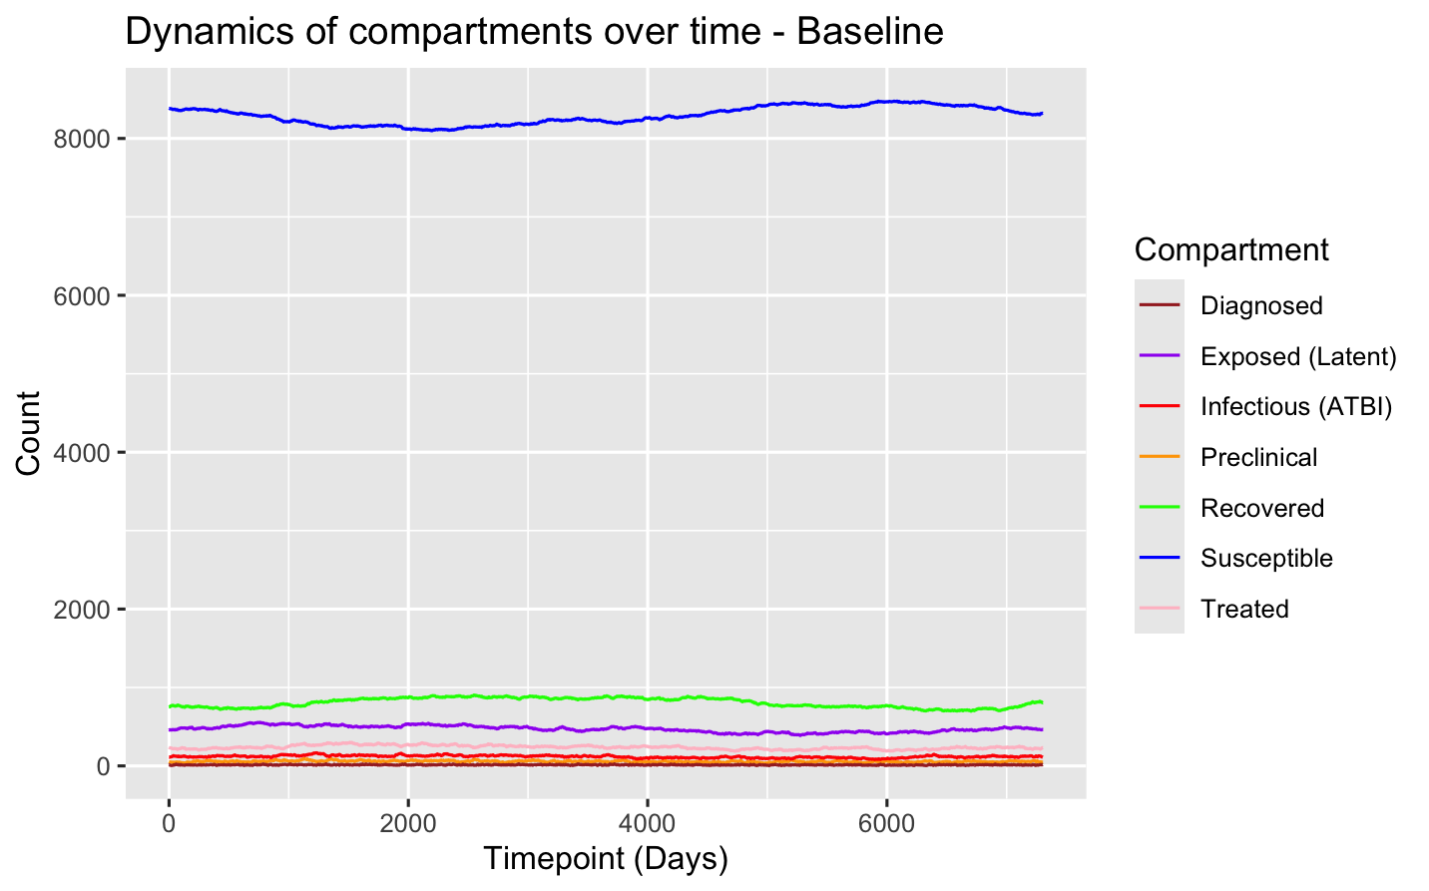
Simulated Tuberculosis Disease Dynamics Under Baseline Conditions Using a Stochastic Compartmental Model
Time series of compartment populations generated by a stochastic Bernoulli compartmental model simulating tuberculosis transmission and progression under baseline conditions. The model tracks the daily counts of individuals in each compartment: Susceptible (blue), Exposed/Latent (purple), Preclinical (orange), Infectious with active TB (red), Diagnosed (brown), Treated (pink), and Recovered (green). The figure illustrates transitions over time, capturing the natural history of TB infection and the impact of diagnosis and treatment within the simulated population.

Slide 6
Theoretical POC-RDT (tPOC-RDT)
The diagnostic evaluated in this model is a heat-stable, rapid point-of-care test that uses a finger-prick blood sample to detect active TB. Designed for use in decentralised settings, without considerable training, this test is particularly well-suited to low-resource and rural environments where access to conventional diagnostics is limited.
It offers a sensitivity of approximately 75–80% and a specificity of 95%, making it a promising tool for earlier case detection. Crucially, due to its portability, simplicity, and rapid turnaround time, this diagnostic is expected to substantially increase diagnostic coverage, especially among populations historically underserved by facility-based TB testing services.

Slide 7
Model compartments and their initial population counts.
Initial values remain the same as baseline model to help simulate introduction of the rPOC-RDT into the same population.
Compartment | Description | Initial Count
s | Susceptible – individuals not yet infected | 8,382
e | Exposed – latent infection | 457
p | Preclinical – infectious but not symptomatic | 54
i | Infectious – symptomatic and capable of transmission | 111
d | Diagnosed – confirmed TB cases | 10
t | Treated – currently receiving treatment | 236
r | Recovered – completed treatment or resolved | 750

Slide 8
tPOC-RDT Model parameters for tuberculosis transmission and disease progression
This table summarizes the key parameters used in the TB transmission model incorporating the novel point-of-care rapid diagnostic (POC-RDT), including their numerical values and biological interpretations. While these parameters reflect the enhanced diagnostic sensitivity, specificity, and coverage associated with the POC-RDT scenario, the initial population values and starting conditions remain the same as the baseline model in order to simulate the same underlying population for comparison.
Parameter | Value | Description
inf.prob | 0.0024 | Probability of transmission per contact
act.rate | 5.0 | Number of contacts per person per time step
piu.rate | 1 / 365 | Rate of progression from latent to early infectious (E → P)
delay.rate | 1 / 45 | Rate of progression from preclinical to clinical TB (P → I)
p_diag_coverage | 0.5 | Proportion of preclinical cases (P) eligible for diagnosis
p_diag_rate | 1 / 120 | Probability of diagnosis among eligible preclinical cases (P → D)
i_diag_coverage | 0.9 | Proportion of clinical cases (I) eligible for diagnosis
i_diag_rate | 1.7 / 120 | Probability of diagnosis among eligible clinical cases (I → D)
treat.rate | 0.1 | Probability of treatment uptake once diagnosed (D → T)
rec.rate | 1 / 180 | Recovery rate following treatment (T → R)
recid.rate | 0.6 / 365 | Rate of relapse or TB-related death, balanced by entry into susceptible pool (R → S)

Slide 9
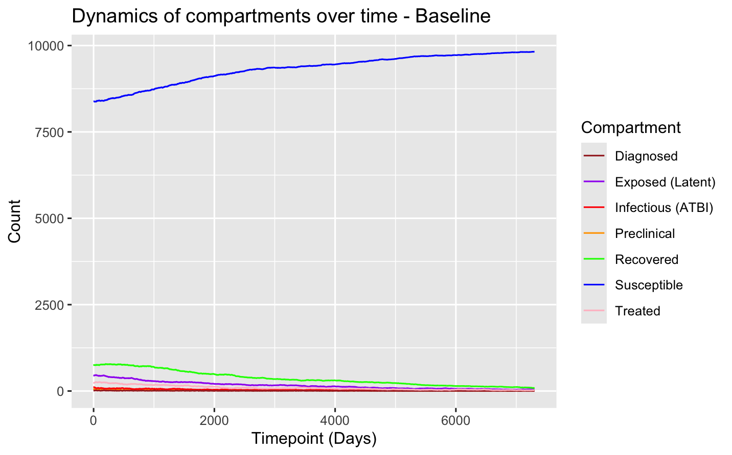
Time series of compartment populations generated by a stochastic Bernoulli compartmental model simulating tuberculosis transmission and progression under the tPOC-RDT scenario.
This time series illustrates the daily population counts across epidemiological compartments: Susceptible (blue), Exposed/Latent (purple), Preclinical (orange), Infectious with active TB (red), Diagnosed (brown), Treated (pink), and Recovered (green). The model simulates tuberculosis transmission and progression under a scenario that includes the implementation of a novel, heat-stable, finger-prick point-of-care rapid diagnostic test (tPOC-RDT) with an estimated sensitivity of 75–80% and specificity of 95%. The diagnostic is assumed to increase diagnostic coverage, particularly in rural and underserved populations.

Slide 10
Limitations of current Model in development and next steps.
Model is under development, and many key parameters are based on preliminary or assumed values that require empirical validation using epidemiological or field data.
Lack of geographic heterogeneity: The model does not currently differentiate between rural and urban settings, which is critical for tuberculosis due to variations in transmission dynamics, diagnostic access, healthcare infrastructure, and social contact structures. The tPOC-RDT would predominantly be implements in rural environments.
Uniform contact and progression rates: Contact rates and disease progression probabilities are not stratified by age or gender, despite strong evidence that both factors influence TB exposure, susceptibility, and disease outcomes. Age and gender need to be assigned to individuals within model.
No stratification of diagnostic coverage or delay: The diagnostic component assumes homogeneous coverage and time-to-diagnosis, but in practice, these vary substantially, especially between rural and urban populations. Given that the tPOC-RDT is targeted for rural use, differential diagnostic reach and delays should be explicitly modelled. The random sampling could be taken from different distributions in each setting.
Simplified disease natural history: The model does not yet incorporate HIV co-infection, reinfection, or drug resistance, which can significantly alter progression rates and treatment outcomes. Co-infections can be linked to individuals in the model to adjust for differential progression and death rates.
Health system constraints not modelled: No current mechanisms simulate healthcare system bottlenecks, such as diagnostic capacity limits, treatment availability, or patient follow-up attrition, which can affect real-world impact.
Stochastic variation not yet extensively explored: While the model is stochastic in nature, parameter uncertainty and sensitivity analysis have not yet been comprehensively assessed, limiting understanding of robustness. Explore a node-based transmission model.
The recidivism rate currently aggregates mortality, relapse, population turnover, and birth rate into a single parameter. To accurately assess the individual impact of each component, these rates should be disaggregated in future iterations of the model. This separation becomes particularly important if additional stratifications (e.g., by geography, age, or gender) are introduced; otherwise, the composite parameter risks introducing bias into the simulated population dynamics.

