Slide 1
Modelling Tuberculosis Transmission and Disease Progression Using a Stochastic Bernoulli Framework: Evaluating a Novel Point-of-Care Rapid Diagnostic with Increased Diagnostic Coverage
William Jones-Warner

Slide 2
About
This stochastic compartmental model model uses a Bernoulli process framework to capture individual-level transitions between key disease states: Susceptible, Latent, Preclinical, Infectious, Diagnosed, Treated, and Recovered. It incorporates the randomness of real-world disease processes while preserving population-level structure.
The primary aim of this modelling framework is to compare baseline TB dynamics with those observed under the implementation of a theoretical novel point-of-care rapid diagnostic. This diagnostic is assumed to increase overall diagnostic coverage, potentially accelerating diagnosis and reducing transmission.

Slide 3
Model compartments and their initial population counts.
The table defines each compartment representing stages of TB infection and treatment status, along with the initial number of individuals in each category at the start of the simulation. Compartments include susceptible (uninfected), exposed (latent infection), preclinical (infectious but asymptomatic), infectious (symptomatic), diagnosed cases, individuals currently under treatment, and recovered individuals.These values were derived by running the dynamic TB transmission model and sampling from the simulation at the 95th percentile time point.
•Starting values were created from running the model for 20 years to find the point of equilibrium.
Compartment | Description | Initial Count
s | Susceptible – individuals not yet infected | 12,491
e | Exposed – latent infection | 239
p | Preclinical – infectious but not symptomatic | 116
i | Infectious – symptomatic and capable of transmission | 197
d | Diagnosed – confirmed TB cases | 20
t | Treated – currently receiving treatment | 448
r | Recovered – completed treatment or resolved | 1489

Slide 4
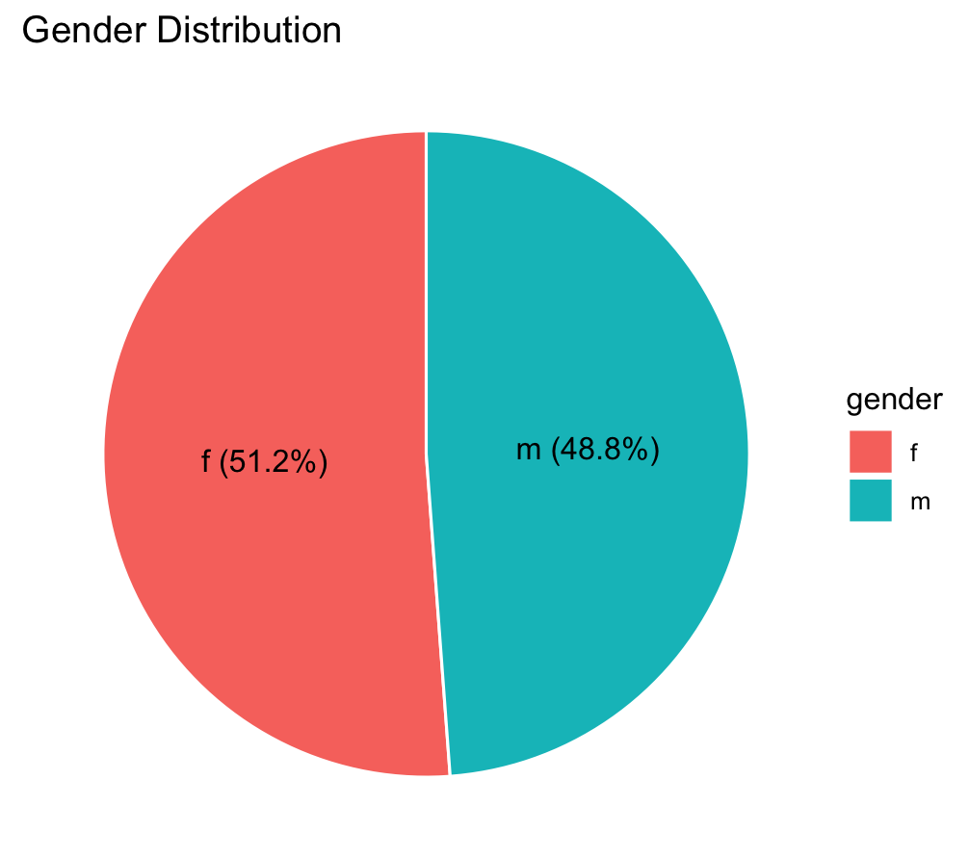
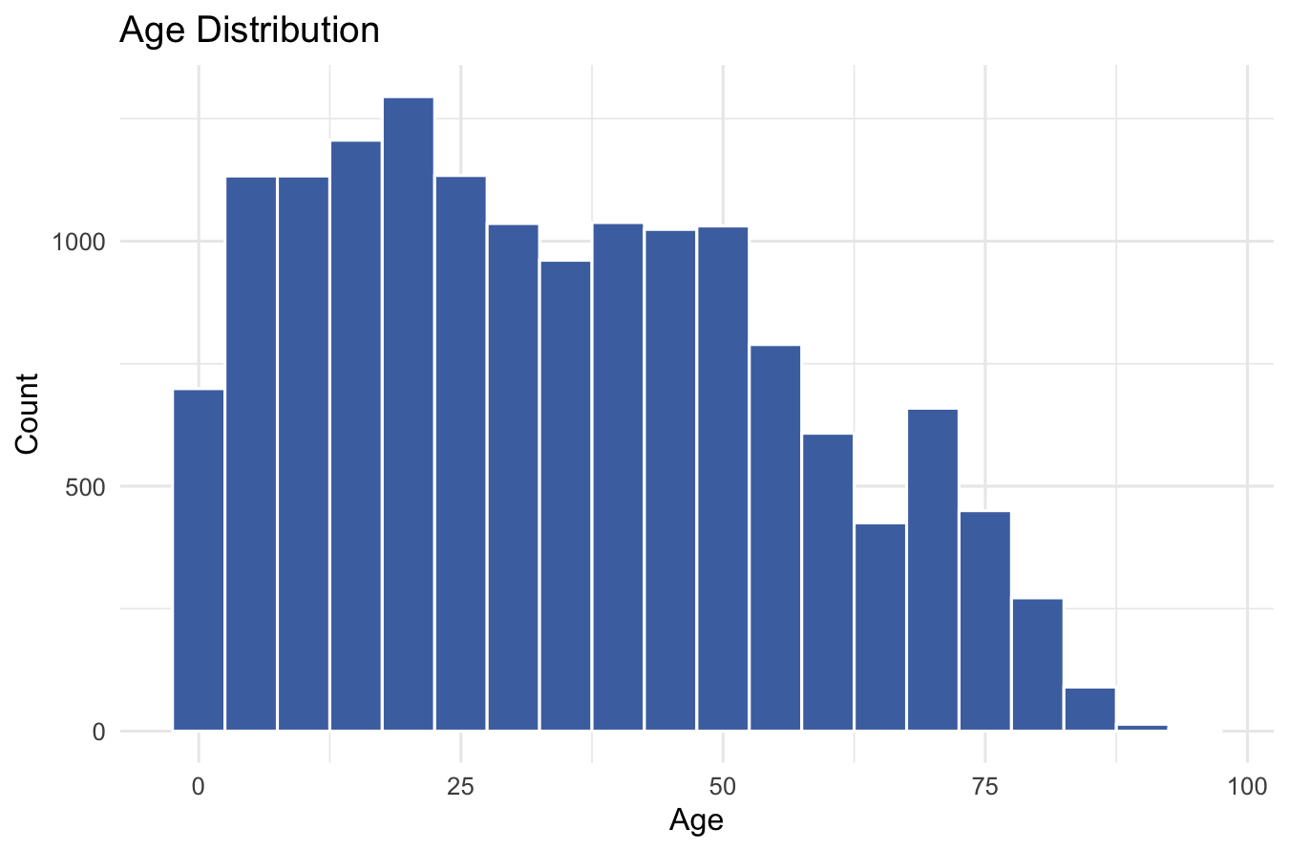
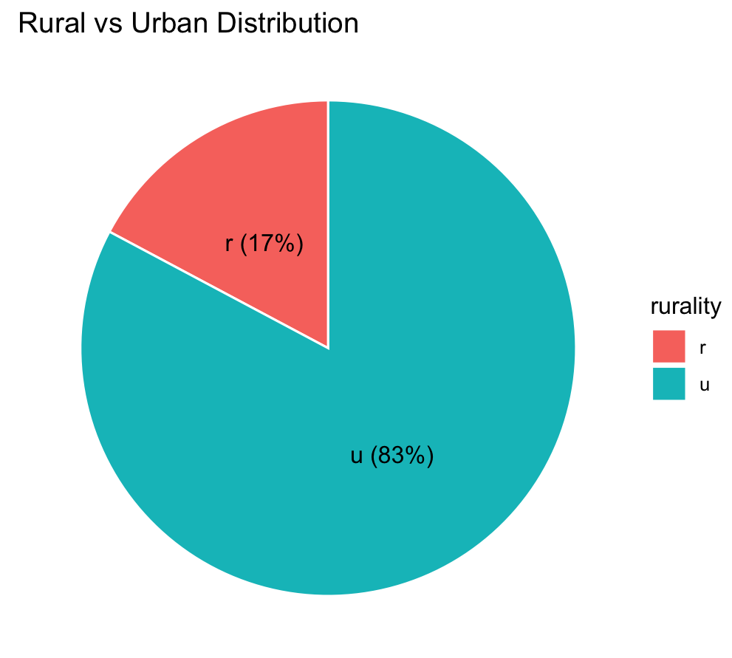
Demographics of Simulated Population

Slide 5
Model parameters for tuberculosis transmission and disease progression
Parameter | Value | Description
inf.prob | 0.0024 | Probability of transmission per contact
act.rate | 5 | Number of contacts per person per time step
piu.ratea0_4 | 15 / 730 ≈ 0.0205 | Progression rate from latent to early infectious for age 0–4
piu.ratea5_14 | 1.5 / 730 ≈ 0.0021 | Progression rate from latent to early infectious for age 5–14
piu.ratea15_24 | 2.5 / 730 ≈ 0.0034 | Progression rate from latent to early infectious for age 15–24
piu.ratea25_64 | 3.5 / 730 ≈ 0.0048 | Progression rate from latent to early infectious for age 25–64
piu.ratea65_up | 8 / 730 ≈ 0.0110 | Progression rate from latent to early infectious for age 65+
piu.rates_male | 1.5 | Multiplier on age-specific progression rate for males
delay.rate | 1 / 45 ≈ 0.0222 | Rate of progression from preclinical to clinical TB (P → I)
p_diag_rural_coverage | 0.05 | Proportion of preclinical rural individuals eligible for diagnosis
p_diag_urban_coverage | 0.1 | Proportion of preclinical urban individuals eligible for diagnosis
p_diag_rate | 1 / 183 ≈ 0.0055 | Probability of diagnosis among eligible preclinical cases (P → D)
i_diag_rural_coverage | 0.425 | Proportion of clinical rural individuals eligible for diagnosis
i_diag_urban_coverage | 0.875 | Proportion of clinical urban individuals eligible for diagnosis
i_diag_rate | 1.7 / 120 ≈ 0.0142 | Probability of diagnosis among eligible clinical cases (I → D)
treat.rate | 1 / 10 = 0.1 | Probability of treatment uptake once diagnosed (D → T)
rec.rate | 1 / 180 ≈ 0.0056 | Recovery rate following treatment (T → R)
recid.rate | 0.6 / 365 ≈ 0.0016 | Rate of relapse or TB-related death, with return to susceptible pool
This table summarizes the key parameters used in the TB transmission model, including their numerical values and biological meanings. Parameters represent probabilities, rates of progression between disease states, diagnosis coverage and rates, treatment uptake, recovery, and relapse or death balanced by re-susceptibility

Slide 6
Model Compartments and Transition Rates Simulating TB Transmission, Diagnosis, and Treatment under baseline and a tPOC-RDT Scenario

Slide 7
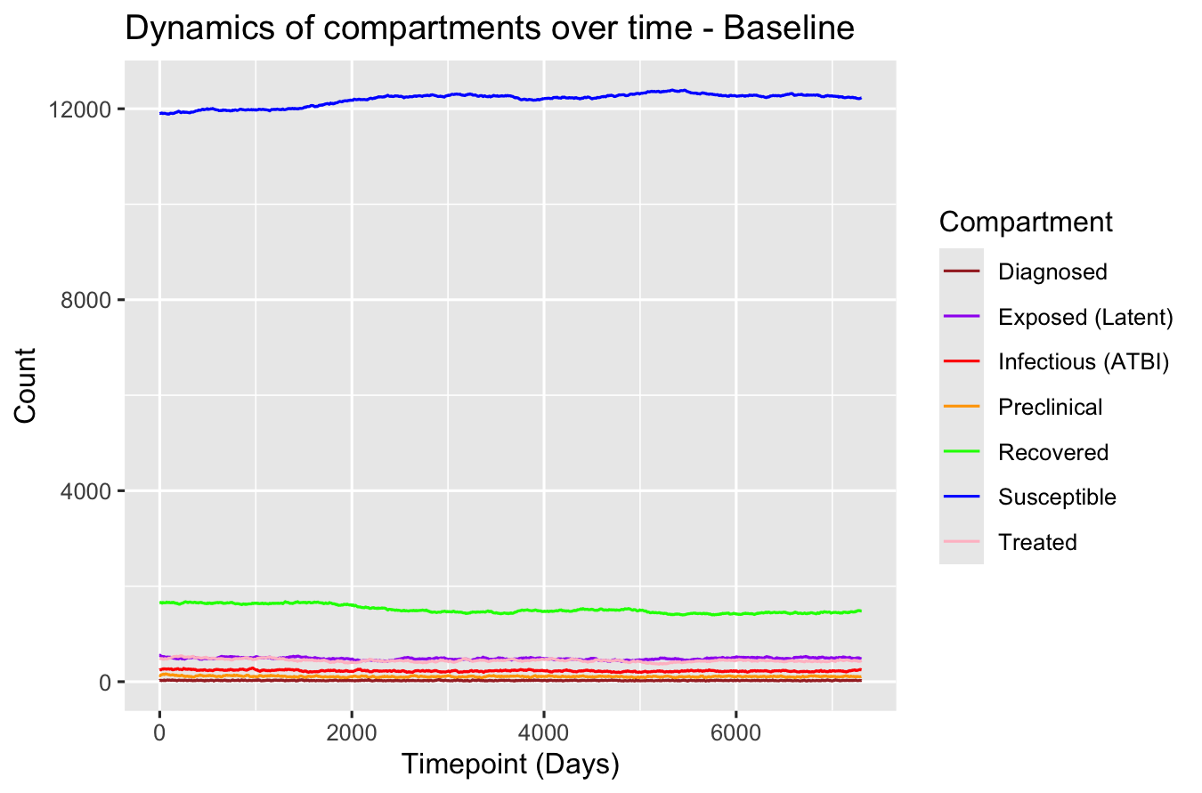
Simulated Tuberculosis Disease Dynamics Under Baseline Conditions Using a Stochastic Compartmental Model
Time series of compartment populations generated by a stochastic Bernoulli compartmental model simulating tuberculosis transmission and progression under baseline conditions. The model tracks the daily counts of individuals in each compartment: Susceptible (blue), Exposed/Latent (purple), Preclinical (orange), Infectious with active TB (red), Diagnosed (brown), Treated (pink), and Recovered (green). The figure illustrates transitions over time, capturing the natural history of TB infection and the impact of diagnosis and treatment within the simulated population.

Slide 8
Theoretical POC-RDT (tPOC-RDT)
The diagnostic evaluated in this model is a heat-stable, rapid point-of-care test that uses a finger-prick blood sample to detect active TB. Designed for use in decentralised settings, without considerable training, this test is particularly well-suited to low-resource and rural environments where access to conventional diagnostics is limited.
It offers a sensitivity of approximately 75–80% and a specificity of 95%, making it a promising tool for earlier case detection. Crucially, due to its portability, simplicity, and rapid turnaround time, this diagnostic is expected to substantially increase diagnostic coverage, especially among populations historically underserved by facility-based TB testing services.

Slide 9
Model compartments and their initial population counts.
Initial values remain the same as baseline model to help simulate introduction of the rPOC-RDT into the same population.
Compartment | Description | Initial Count
s | Susceptible – individuals not yet infected | 12,491
e | Exposed – latent infection | 239
p | Preclinical – infectious but not symptomatic | 116
i | Infectious – symptomatic and capable of transmission | 197
d | Diagnosed – confirmed TB cases | 20
t | Treated – currently receiving treatment | 448
r | Recovered – completed treatment or resolved | 1489

Slide 10
tPOC-RDT Model parameters for tuberculosis transmission and disease progression
This table summarizes the key parameters used in the TB transmission model incorporating the novel point-of-care rapid diagnostic (POC-RDT), including their numerical values and biological interpretations. While these parameters reflect the enhanced diagnostic sensitivity, specificity, and coverage associated with the POC-RDT scenario, the initial population values and starting conditions remain the same as the baseline model in order to simulate the same underlying population for comparison.
Parameter | Value | Description
inf.prob | 0.0024 | Probability of transmission per contact
act.rate | 5 | Number of contacts per person per time step
piu.ratea0_4 | 15 / 730 ≈ 0.0205 | Progression rate from latent to early infectious for age 0–4
piu.ratea5_14 | 1.5 / 730 ≈ 0.0021 | Progression rate from latent to early infectious for age 5–14
piu.ratea15_24 | 2.5 / 730 ≈ 0.0034 | Progression rate from latent to early infectious for age 15–24
piu.ratea25_64 | 3.5 / 730 ≈ 0.0048 | Progression rate from latent to early infectious for age 25–64
piu.ratea65_up | 8 / 730 ≈ 0.0110 | Progression rate from latent to early infectious for age 65+
piu.rates_male | 1.5 | Multiplier on age-specific progression rate for males
delay.rate | 1 / 45 ≈ 0.0222 | Rate of progression from preclinical to clinical TB (P → I)
p_diag_rural_coverage | 0.6 | Proportion of preclinical rural individuals eligible for diagnosis
p_diag_urban_coverage | 0.6 | Proportion of preclinical urban individuals eligible for diagnosis
p_diag_rate | 1 / 183 ≈ 0.0055 | Probability of diagnosis among eligible preclinical cases (P → D)
i_diag_rural_coverage | 0.7 | Proportion of clinical rural individuals eligible for diagnosis
i_diag_urban_coverage | 0.875 | Proportion of clinical urban individuals eligible for diagnosis
i_diag_rate | 1.7 / 120 ≈ 0.0142 | Probability of diagnosis among eligible clinical cases (I → D)
treat.rate | 1 / 10 = 0.1 | Probability of treatment uptake once diagnosed (D → T)
rec.rate | 1 / 180 ≈ 0.0056 | Recovery rate following treatment (T → R)
recid.rate | 0.6 / 365 ≈ 0.0016 | Rate of relapse or TB-related death, with return to susceptible pool

Slide 11
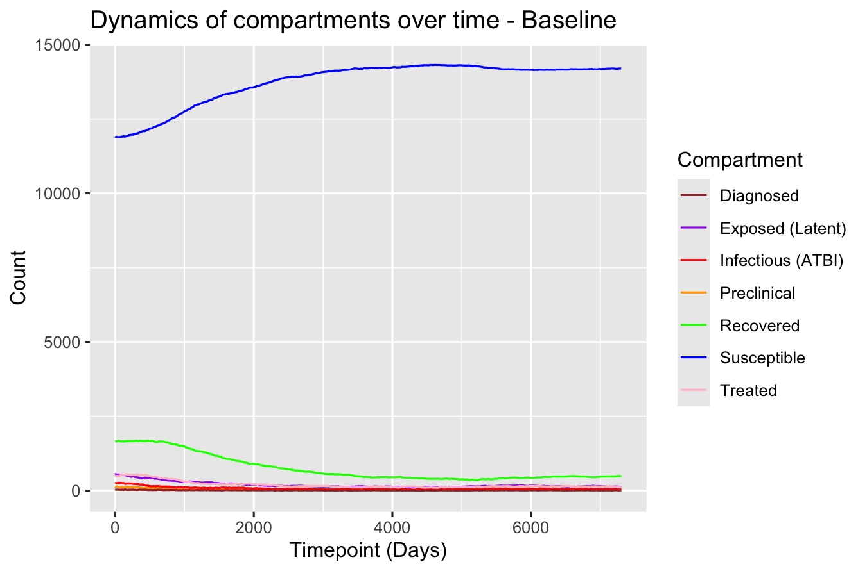
Time series of compartment populations generated by a stochastic Bernoulli compartmental model simulating tuberculosis transmission and progression under the tPOC-RDT scenario.
This time series illustrates the daily population counts across epidemiological compartments: Susceptible (blue), Exposed/Latent (purple), Preclinical (orange), Infectious with active TB (red), Diagnosed (brown), Treated (pink), and Recovered (green). The model simulates tuberculosis transmission and progression under a scenario that includes the implementation of a novel, heat-stable, finger-prick point-of-care rapid diagnostic test (tPOC-RDT) with an estimated sensitivity of 75–80% and specificity of 95%. The diagnostic is assumed to increase diagnostic coverage, particularly in rural and underserved populations.

Slide 12
Limitations of current Model in development and next steps.
Model under development: Many key parameters remain based on preliminary assumptions and require empirical validation using epidemiological or field data. Further calibration with real-world datasets is needed.
Geographic heterogeneity now partially addressed: The model now incorporates a rural/urban classification for individuals, allowing for differential diagnostic coverageand progression modelling by setting. However, additional heterogeneity in contact patterns, healthcare access, and social structure between rural and urban areas remains to be fully captured. Given that the tPOC-RDT is primarily intended for rural implementation, further refinement is necessary to better represent setting-specific transmission dynamics and health system characteristics.
Age and gender stratification implemented: Age and gender are now assigned at the individual level, with age- and sex-specific progression rates included. This improves biological realism, given the well-established influence of these factors on TB susceptibility, infectiousness, and clinical outcomes. Additional behavioural or contact-based heterogeneity by age and sex could further enhance model fidelity.
Diagnostic coverage and delay now stratified by geography: Diagnostic coverage is no longer homogeneous. The model now distinguishes between rural and urban diagnostic coverage and incorporates different probabilities of diagnosis based on location, allowing for more accurate simulation of time-to-diagnosis. Future work could model delays using distributions that reflect empirical time-to-care data in each setting.
Simplified disease natural history: HIV co-infection, reinfection, and drug resistance are not yet incorporated. These factors are known to significantly alter TB progression rates, treatment outcomes, and mortality. Future versions should link co-infection status to individuals and adjust progression and mortality parameters accordingly.
Health system constraints still not modelled: The model does not yet simulate healthcare system limitations such as diagnostic capacity, treatment availability, or loss to follow-up. These are important for understanding intervention impact, especially in under-resourced settings.
Limited exploration of stochastic variation and uncertainty: Although the model includes stochastic elements, parameter uncertainty and sensitivity analyses have not yet been comprehensively conducted. Future development should include formal exploration of model robustness under varying assumptions, potentially incorporating a node-based or agent-based framework for more granular dynamics.
Composite recidivism parameter should be disaggregated: The current recidivism rate bundles mortality, relapse, population turnover, and births into a single parameter. For more precise modelling—especially with stratifications by geography, age, and sex—these processes should be separated. Disaggregating them will improve transparency and reduce the risk of bias in population-level outcomes.

Slide 13
Next Steps
Next Steps
Building on the current model enhancements, future work will focus on incorporating spatially explicit node-based transmission dynamics using GPS coordinates of individuals or households. This approach will allow us to:
Capture fine-scale geographic heterogeneity in transmission risk by explicitly modelling spatial clustering and movement patterns within rural and urban environments.
Refine contact structure representation by integrating data on the number and nature of contacts specific to rural versus urban settings. This will address current limitations in assuming uniform contact rates and help to realistically simulate social mixing patterns.
Distinguish between novel and repeat contacts within individual contact networks. By accounting for repeated interactions with the same individuals, we aim to more accurately model transmission probabilities, as repeated contacts may confer diminishing infection risk compared to novel contacts.
Incorporate dynamic contact networks that evolve over time, reflecting changes in social behavior, mobility, and intervention impact, which are especially relevant in diverse geographic contexts.
These improvements will enhance the biological and social realism of the model, providing better insight into the drivers of TB transmission and more accurately predicting the potential impact of interventions such as the tPOC-RDT in both rural and urban populations.

Slide 14
Susceptible
piu.rate*
Age and Gender Specific Progression Rate
inf.prob*act.rate*(Infectious + Diagnosed)/Total Population
Exposed (LTBI)
diag_coverage**
Diagnostic Coverage has been separated by rurality with separate rural and urban diagnostic coverage.
piu.rate*
Preclinical
delay.rate
Infectious (ATBI)
p_diag_coverage** -> p_diag_rate
recid.rate
i_diag_coverage** -> i_diag_rate
Diagnosed
treat.rate
Treated
rec.rate
Recovered

