Slide 1

Political Tweet Sentiment Classifier
GA DS-DC-20 Final Project
William Lee

Slide 2
GOAL
To create a model which can classify the sentiment (positive, neutral, and negative) of tweets by members of Congress and the President of the United States

Slide 3
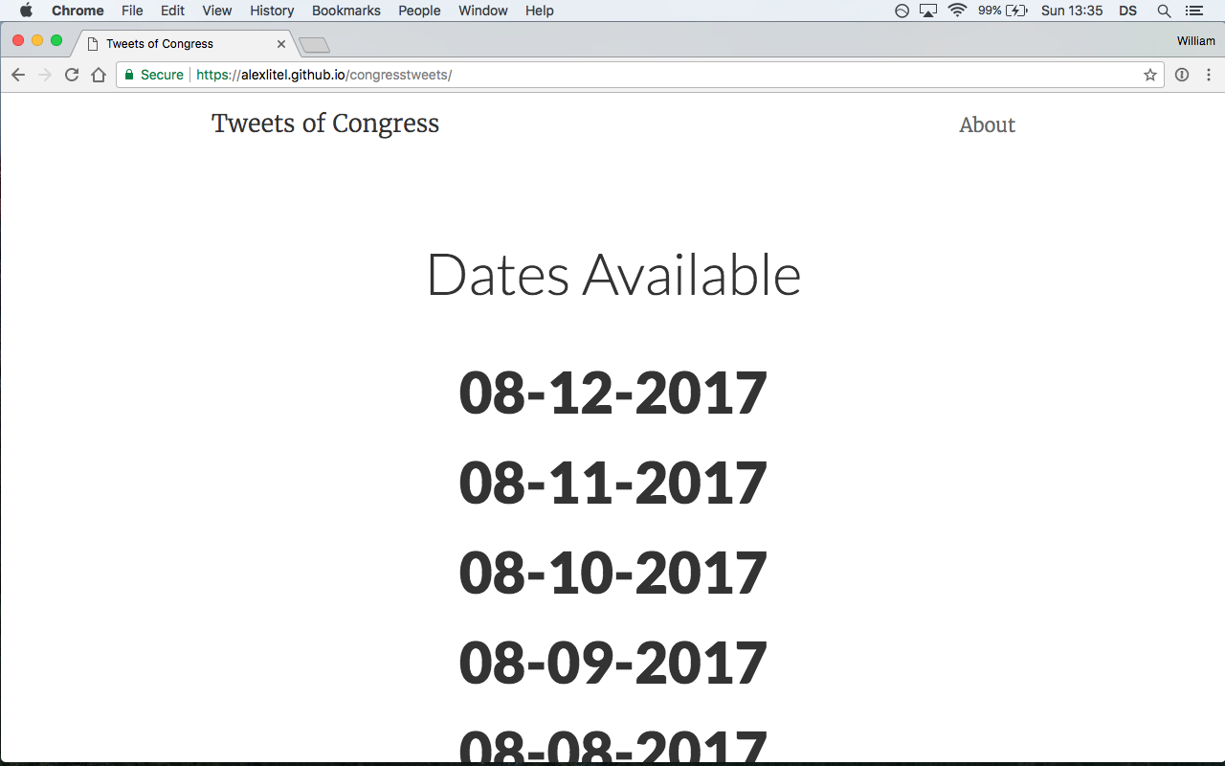

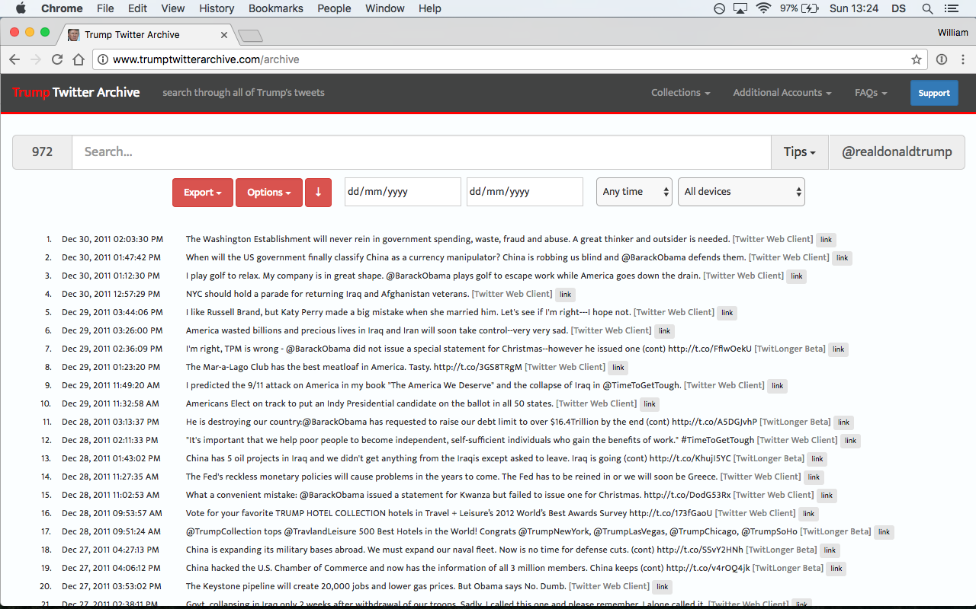
DATA ACQUISITION
Congressional Tweets: https://alexlitel.github.io/congresstweets/
Useful Features = screen name, time, text, source
Trump Tweets - http://www.trumptwitterarchive.com/archive
Notes:
Tweets of congress is a project which collects the daily tweets of both houses of congress, encompassing 1000+ campaign, office, committee and party accounts
This project collects data using the twitter API. If it had not existed it would have been possible to collect data through twitter api but this saved considerable time.

Slide 4
DATA ACQUISITION
Tweet Meta-Data: https://github.com/alexlitel/congresstweets-automator/blob/master/data/users-filtered.json
Meta-Data Features = screen name, chamber, type, party, state
Meta-Data Features = screen name, chamber, type, party, state
Using Pandas allows data sets to be merged on screen name
Congressional Tweet Features = time, text, source and screen name

Slide 5
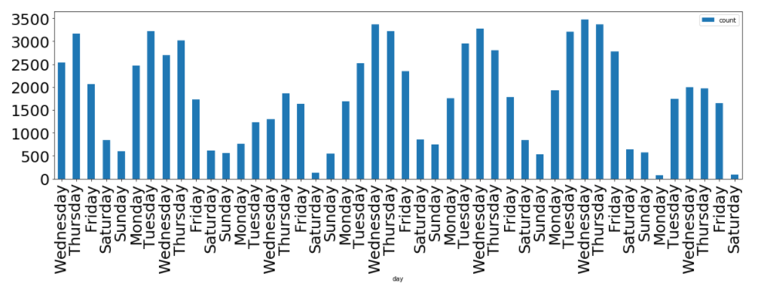
EXPLORATORY DATA ANALYSIS
Tweets collected between 06/21 and 08/04
Total Tweets = 83,147
48,493 Democrat, 33,751 Republican, 304 Independent
Average tweet length = 183 characters
12.847% mentioned ‘health’
13.704% mentioned ‘Trump’

Slide 6
SAMPLE SELECTION FOR SENTIMENT LABELLING
Eliminated Tweets where len(tweet) < 100
From this data set 3000 tweets were randomly selected for manual sentiment labelling (positive, negative, neutral)
Important assumptions and considerations
Training data set is labelled without political bias
Sentiment can be accurately captured on one dimensional positive to negative scale
Humans can only agree on sentiment labels only 80% of the time (Ingale & Deshmukh, 2015)

Slide 7
EXAMPLE OF TWEET LABELLING
I now see why Senate Republicans hid their version of #Trumpcare from the public until the very last second – Neutral
Grateful to speak to legislators from South Korea &amp; Japan about the threat from North Korea &amp; to discuss my #FY18NDAA amendment – Neutral
Today marks six months since I was sworn in as Senator for the great state of California. Humbled and honored every single day to serve you – Positive
The Senate might vote soon on #TrumpCare - a disaster for Kalpana and others dealing with cancer in their families – Negative

Slide 8
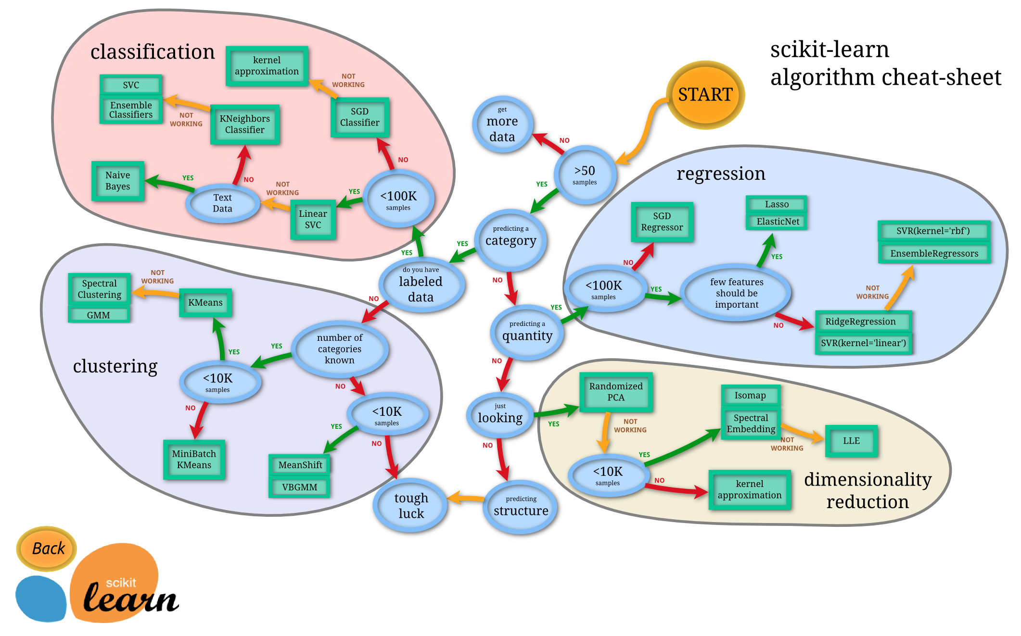
MODEL SELECTION
Multinomial Naïve Bayes

Slide 9
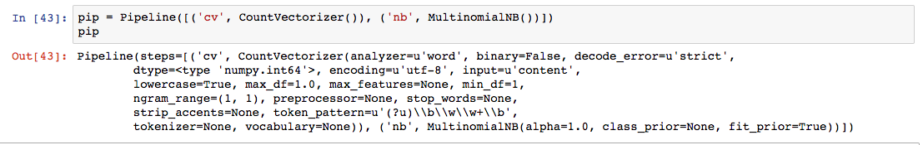
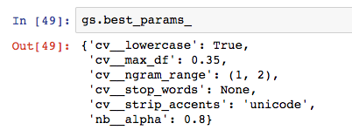
TUNING PARAMETERS
Used GridSearchCV in combination with Pipeline
Best Parameters with kfolds = 5 Cross Validation

Slide 10
RESULTS
Accuracy = 65.433% (null accuracy = 50.933%)
Macro Precision = 68.752%
Macro Recall = 58.298%
Vader Sentiment Analyzer Accuracy = 63.566%
Out of the box sentiment model selecting only positive and negative tweets was 86.101% (52.203% null accuracy)
Notes:
Precision – how many selected items are relevant
Accuracy – how many relevant items are selected

Slide 11
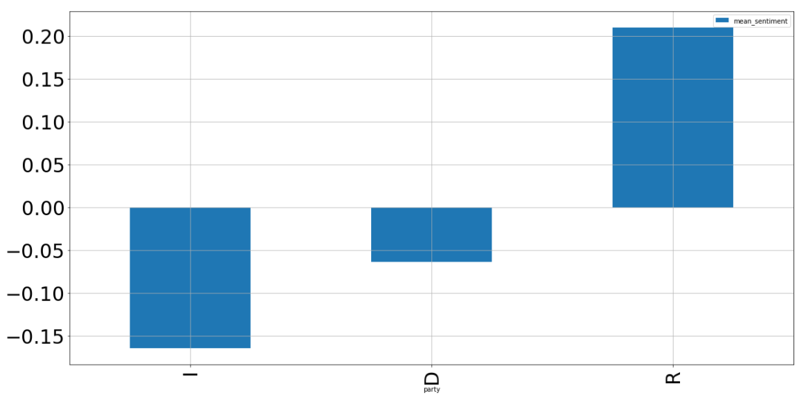
USING THE MODEL
Mean Sentiment by Party

Slide 12
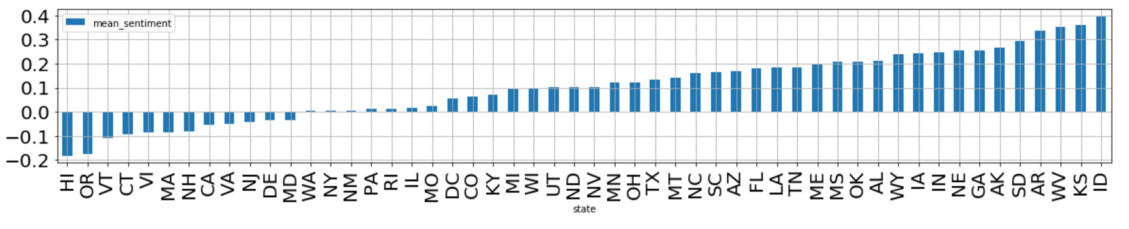
USING THE MODEL
Mean Sentiment by State

Slide 13
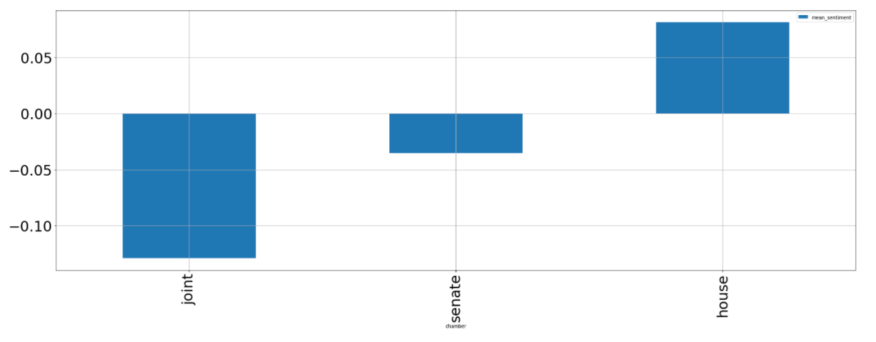
USING THE MODEL
Mean Sentiment by Chamber

Slide 14
THANK YOU FOR LISTENING ANY QUESTIONS?

