Slide 1


MetricsManager Ver 3.3 WCF Log Processor Framework & Database Architecture
William Liu
MetricsManager™

Slide 2

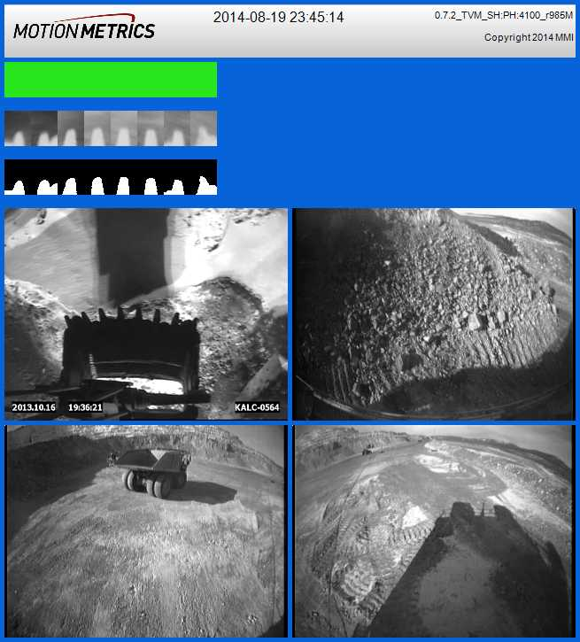
BBStream – metadata inside log image
TMLog 21
2015,05,19,16,43,04,1432078984,0.7.2_TVM_SH:PH:4100_r985M,8,Excavator,0,0,148,446,192,0,0,1,286,0,30,40,74,71,0,0,0,0,0,0,0,0,0,0,0,0,0,0,0,0,0,0,0,0,1,1,1,1,1,1,1,1,0,0,0,0,0,0,0,0,0,0,0,0,0.906667,0.9,0.93,0.931667,0.93,0.931667,0.86,0.876667,0,0,0,0,0,0,0,0,0,0,0,0,0.939285,0.948557,0.958661,0.938576,0.966424,0.967131,0.893527,0.913344,0,0,0,0,0,0,0,0,0,0,0,0,18,18,19,20,19,18,17,19,0,0,0,0,0,0,0,0,0,0,0,0,10,10,10,10,10,10,10,10,0,0,0,0,0,0,0,0,0,0,0,0,229,229,229,229,229,229,229,229,0,0,0,0,0,0,0,0,0,0,0,0,216,230,226,241,230,229,208,224,0,0,0,0,0,0,0,0,0,0,0,0,0,0,50,18.22,17.56,19.24,20.12,17.46,19.06,18.54,19.54,0,0,0,0,0,0,0,0,0,0,0,0,-0.22,0.44,-0.24,-0.12,1.54,-1.06,-1.54,-0.54,0,0,0,0,0,0,0,0,0,0,0,0,-0.22,0,0.66,-0.02,0.1,1.76,-0.84,-1.32,-0.32,0,0,0,0,0,0,0,0,0,0,0,0,0,0,0,0,0,0,0,0,0,0,0,0,0,0,0,0,0,0,0,0,100,100,100,100,100,100,100,100,0,0,0,0,0,0,0,0,0,0,0,0
TMLog 21
2015,05,19,16,43,04,1432078984,0.7.2_TVM_SH:PH:4100_r985M,8,Excavator,0,0,148,446,192,0,0,1,286,0,30,40,74,71,0,0,0,0,0,0,0,0,0,0,0,0,0,0,0,0,0,0,0,0,1,1,1,1,1,1,1,1,0,0,0,0,0,0,0,0,0,0,0,0,0.906667,0.9,0.93,0.931667,0.93,0.931667,0.86,0.876667,0,0,0,0,0,0,0,0,0,0,0,0,0.939285,0.948557,0.958661,0.938576,0.966424,0.967131,0.893527,0.913344,0,0,0,0,0,0,0,0,0,0,0,0,18,18,19,20,19,18,17,19,0,0,0,0,0,0,0,0,0,0,0,0,10,10,10,10,10,10,10,10,0,0,0,0,0,0,0,0,0,0,0,0,229,229,229,229,229,229,229,229,0,0,0,0,0,0,0,0,0,0,0,0,216,230,226,241,230,229,208,224,0,0,0,0,0,0,0,0,0,0,0,0,0,0,50,18.22,17.56,19.24,20.12,17.46,19.06,18.54,19.54,0,0,0,0,0,0,0,0,0,0,0,0,-0.22,0.44,-0.24,-0.12,1.54,-1.06,-1.54,-0.54,0,0,0,0,0,0,0,0,0,0,0,0,-0.22,0,0.66,-0.02,0.1,1.76,-0.84,-1.32,-0.32,0,0,0,0,0,0,0,0,0,0,0,0,0,0,0,0,0,0,0,0,0,0,0,0,0,0,0,0,0,0,0,0,100,100,100,100,100,100,100,100,0,0,0,0,0,0,0,0,0,0,0,0

Slide 3
MMStream – metadata formatted as JSON
{
"Header": {
"uuid": "10060",
"equipmentid": "SH05",
"time": 1432083154,
"tbias": -25200,
"priority": 0,
"ver": "0.7.2_TVM_SH:PH:4100_r985M",
"msgtype": [ "VES", "TOOTH", "NEWLOG" ]
},
"Body": {
"ver":21,
"toothstatus": [0,0,0,0,0,0,0,0],
"alarmstate":0,
"nteeth":8,
"bounds":[
{ "type":"bucket","rectangle":[5,236,320,240] },
{ "type":"rear", "rectangle":[330,236,320,240] },
{ "type":"left", "rectangle":[5,479,320,240] },
{ "type":"right", "rectangle":[330,479,320,240] },
{ "type":"front", "rectangle":[0,0,0,0] }
]
}",
"Data": "/9j/4AAQSkZJRgABAQEASABIAAD/4QO2RX ……
.... AAAgAAYdmIEYyo6k9z7v8A/J//2Q=="
}
Data : image binary string
Advantage:
Key-Value, extendable
Easily parse back to JSON Object
JSON is popular in front-end JS and
Restful Web Communication
Well support in C# JSON.Net
Get value by key, no worried about
position and order
Easy debug

Slide 4
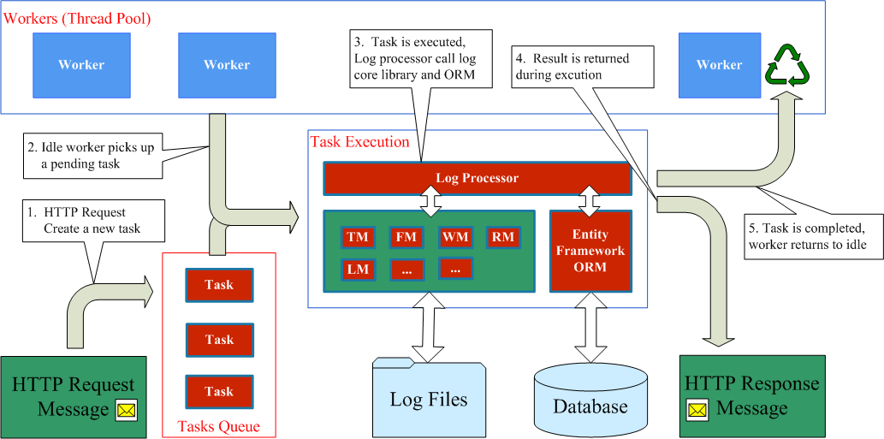
WCF – Concurrent Mode : Single/Mutilple
The mechanism of WCF service processing.
WCF handle the resource, what we are focus on is to configure properly.

Slide 5
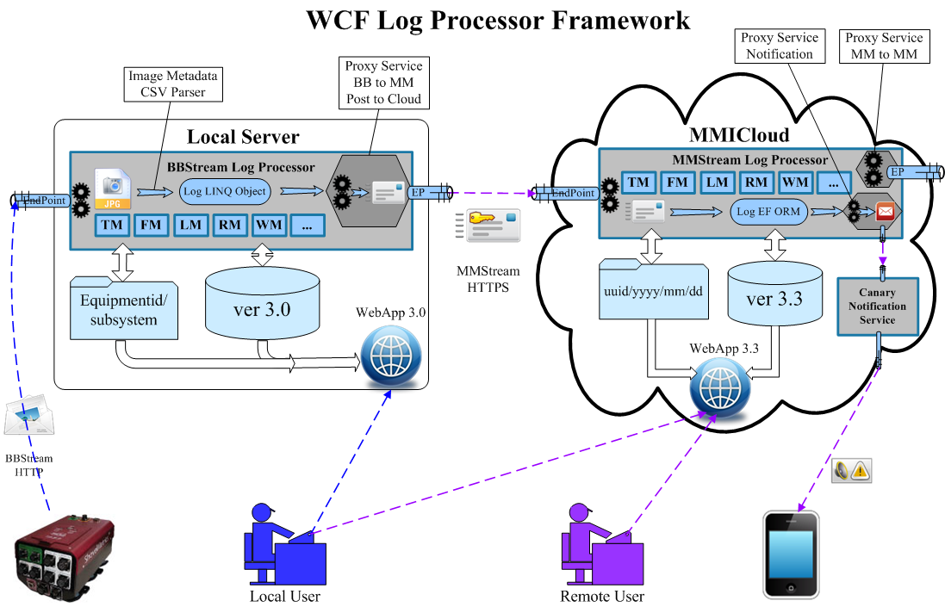

Slide 6
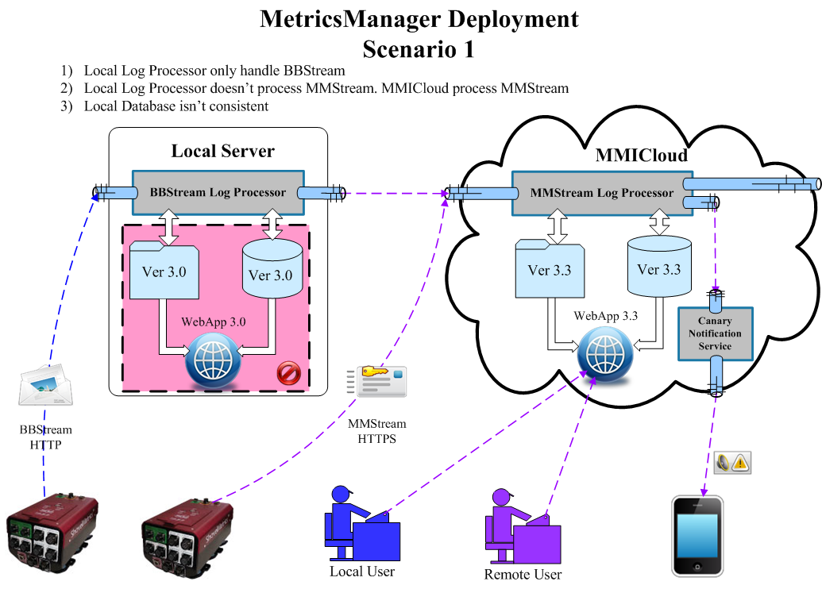

Slide 7
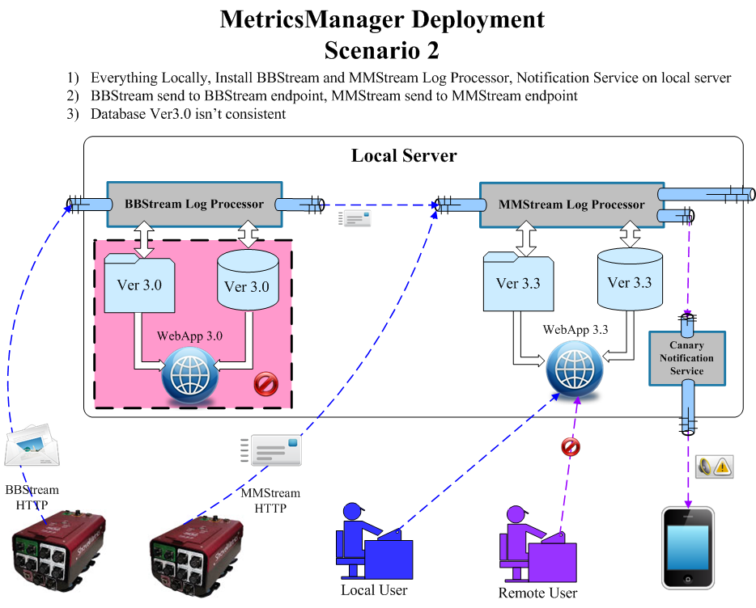

Slide 8
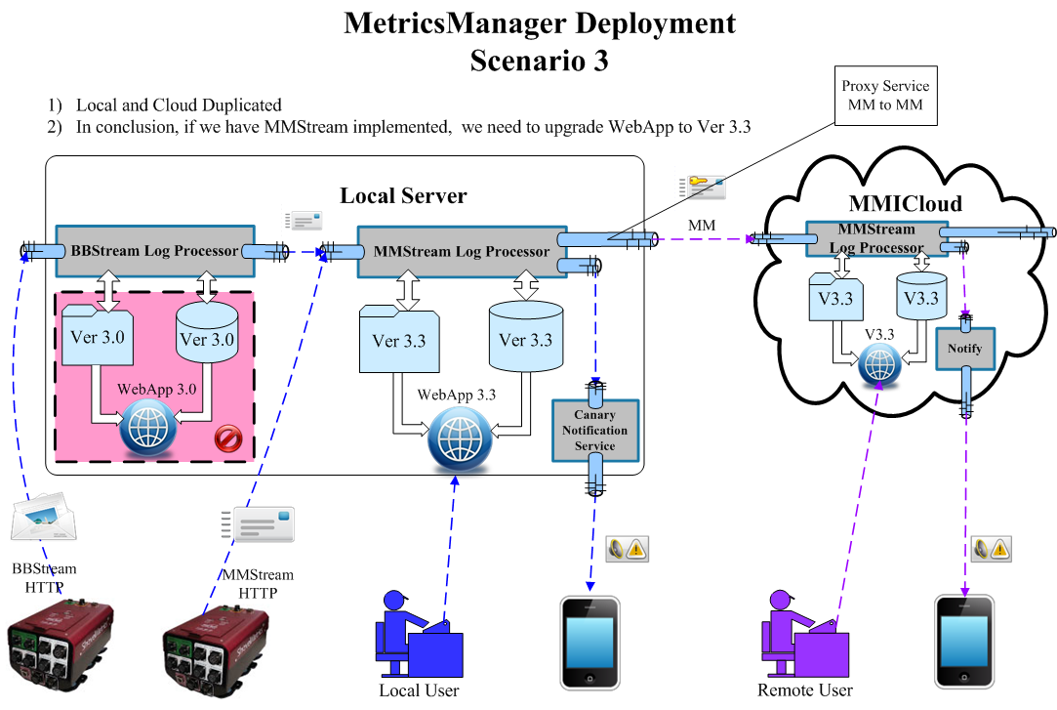

Slide 9

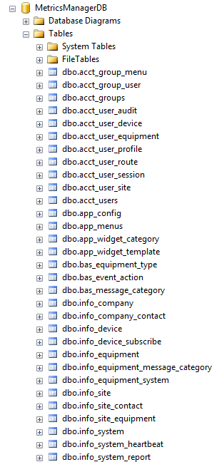
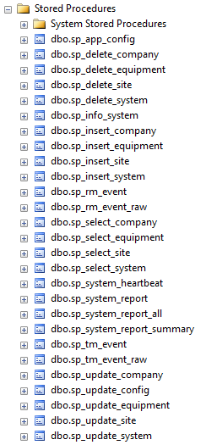
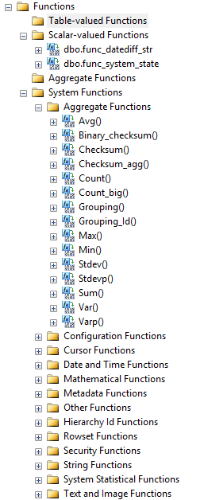
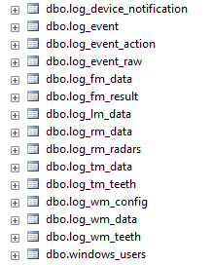
MetricsManager Database Ver 3.3

Slide 10

MetricsManager Database Diagram
Log Tables and Relationships
2. Application config, Account Manager,
3. Log configuration and relationship
4. Critical Event and Notification
* Database Diagram Show in OneNote

Slide 11

MetricsManager Database Features
Table Trigger :
Define triggers on a table when insert, update, delete a row.
Advantage:
1) directly manipulate database in memory without require additonal conection
2) move business logic from front end to database backend, better performance,
centralization and upgrade without re-compile and upgrade front-end applicaton
View, Store Procedure, Function
Advantage:
1) Compile once for all executions, SQL Server optimize the execution plan ,
only output the result exactly what you want.
2) Query all tables to front-end, then generate the result , it will cost high traffic
and more memory to output result.
3) Move business logic to backend, centralization and upgrade easily without affect
front-end application

Slide 12
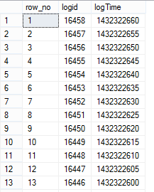
CTE - Common Table Expressions
Using a CTE offers the advantages of improved readability and ease in
maintenance of complex queries.
Syntax:
WITH expression_name [ ( column_name [,...n] ) ]
AS
( CTE_query_definition )
Sample:
with tm_log (row_no, logid, logTime ) as
(
select ROW_NUMBER() over ( order by log_utctime desc) as row_no, id, log_utctime from log_tm_data
)
select * from tm_log

Slide 13
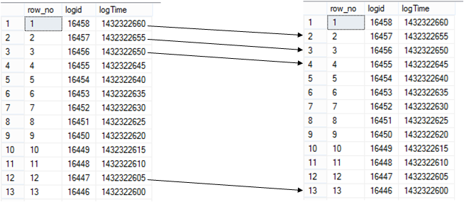
Sample:
in the same table , we compare with previous record
Traditional Solution:
with tm_log (row_no, logid, logTime ) as
(
select ROW_NUMBER() over ( order by log_utctime desc), id, log_utctime from log_tm_data
)
select a.*, b.*, a.logTime - b.logTime as timespan
from tm_log a
inner join tm_log b on ( a.row_no = b.row_no - 1 )

Slide 14
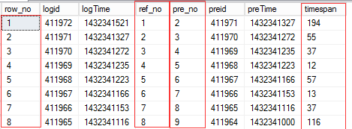
CTE Solution: Multiple CTE
with tm_log ( row_no, logid, logTime ) as
(
select ROW_NUMBER() over ( order by log_utctime desc) as row_no, id, log_utctime from log_tm_data
),
tm_log_pre ( ref_no, pre_no, preid, preTime ) as
(
select row_no - 1 as ref_no, row_no, logid, logTime from tm_log
)
select a.*, b.*, a.logTime - b.preTime as timespan
from tm_log a
inner join tm_log_pre b on ( a.row_no = b.ref_no )
We can create view to permanent save this sql statement
create view vw_tm_log
as
with tm_log (row_no, logid, logTime ) as
(
select ROW_NUMBER() over ( order by log_utctime desc) as row_no, id, log_utctime from log_tm_data
),
tm_log_pre (ref_no, pre_no, preid, preTime) as
(
select row_no - 1 as ref_no, row_no, logid, logTime from tm_log
)
select a.*, b.*, a.logTime - b.preTime as timespan
from tm_log a inner join tm_log_pre b on ( a.row_no = b.ref_no )

Slide 15
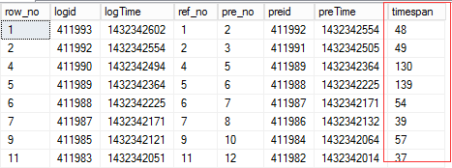

We can use the view “vw_tm_log” as a table to do any query
select * from vw_tm_log where timespan >= 30
Aggregate Query:
select min(timespan) as minTS, max(timespan) as maxTS, avg(timespan) as avgTS
from vw_tm_log
where timespan >= 30 and timespan <= 3600

Slide 16
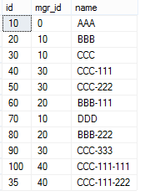
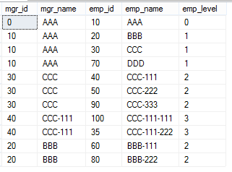
CTE Solution: Recrusive CTE for Tree Hierarchy
with manager (mgr_id, mgr_name, emp_id, emp_name, emp_level) as
(
SELECT 0, name, id, name, 0 as emp_level FROM employee WHERE mgr_id = 0
union all
SELECT employee.mgr_id, manager.emp_name, employee.id, employee.name, emp_level + 1
FROM employee
INNER JOIN manager on ( employee.mgr_id = manager.emp_id)
)
select * from manager
Employee Table
Query Result

