Slide 1
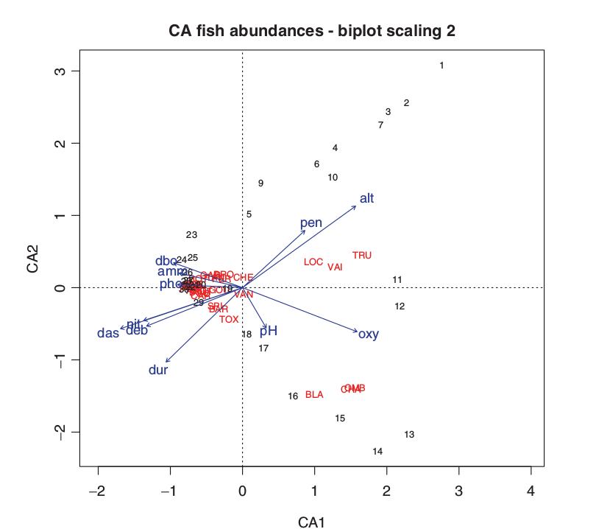
Introduction to ordination: principal components analysis and related methods

Slide 2
Aims of ordinations
Simplify complex datasets
  Find most relevant patterns in a dataset
  Summarize a dataset in a simple 2-dimensional scatterplot
    Relation among variables
    Distance among samples

Slide 3
Simplify a dataset
Dataset with 20 variables
  Methods to find main patterns:
    Visually?

Slide 4
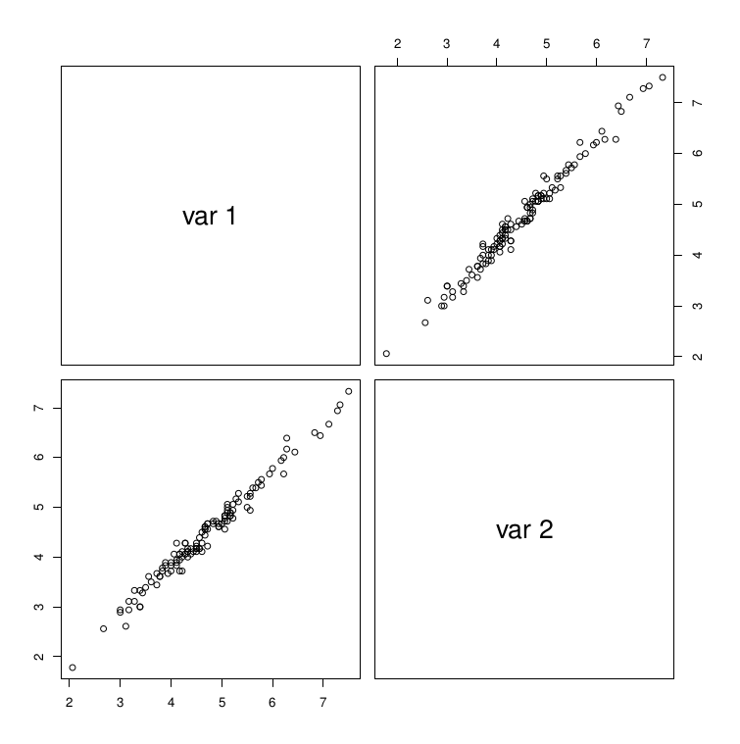
Temperatures in Wisconsin

Slide 5
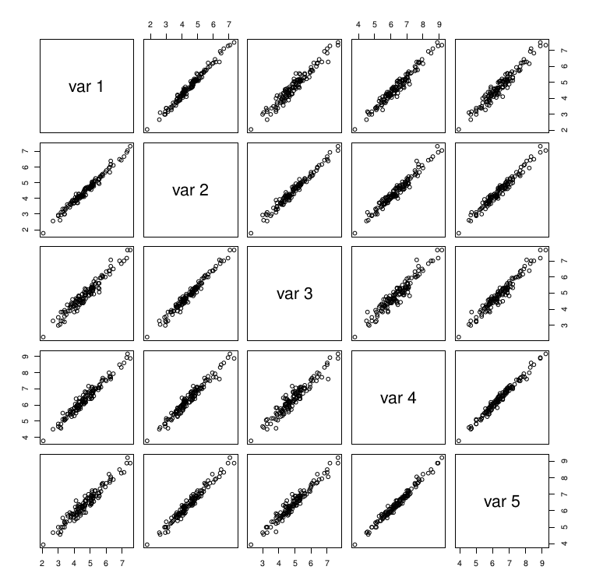
Temperatures in Wisconsin

Slide 6
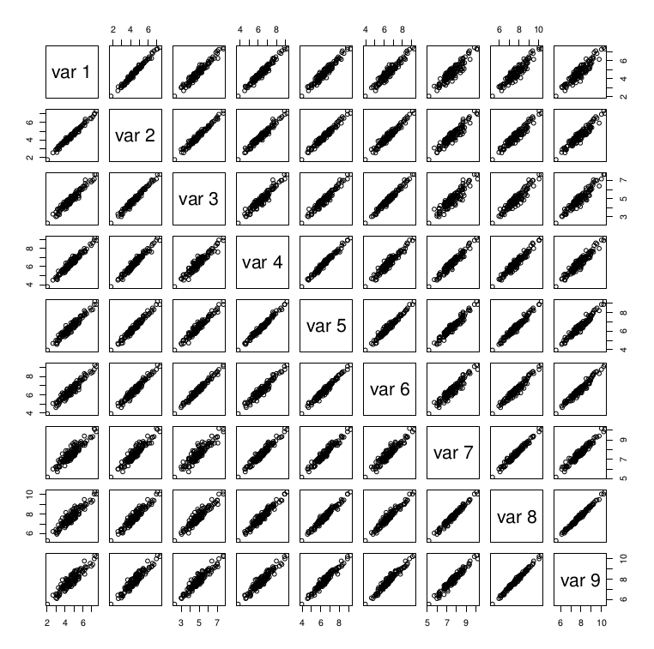
Simplify a dataset
Dataset with many variables
  Methods to find main patterns:
    Visually?
    Numerically?

Slide 7
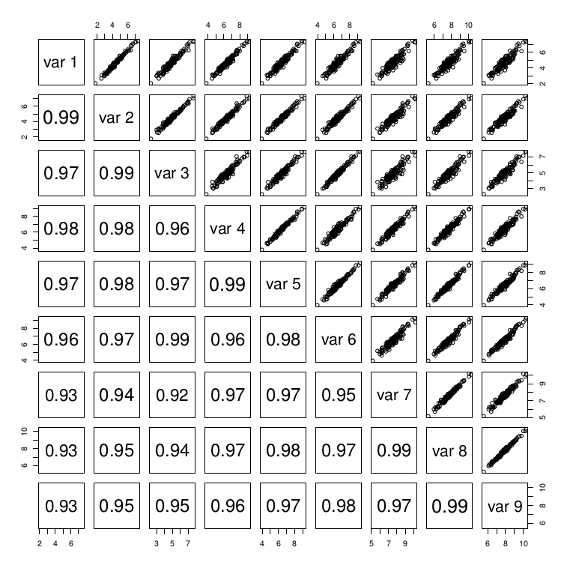
Simplify a dataset
Methods to find main patterns:
Numerically?
Covariance or correlation matrix

Slide 8
Simplify a dataset
Dataset with 20 variables
  Methods to find main patterns:
    Visually?
      Show a scatterplot of all variables
    Numerically?
      Covariance or correlation matrix

Slide 9
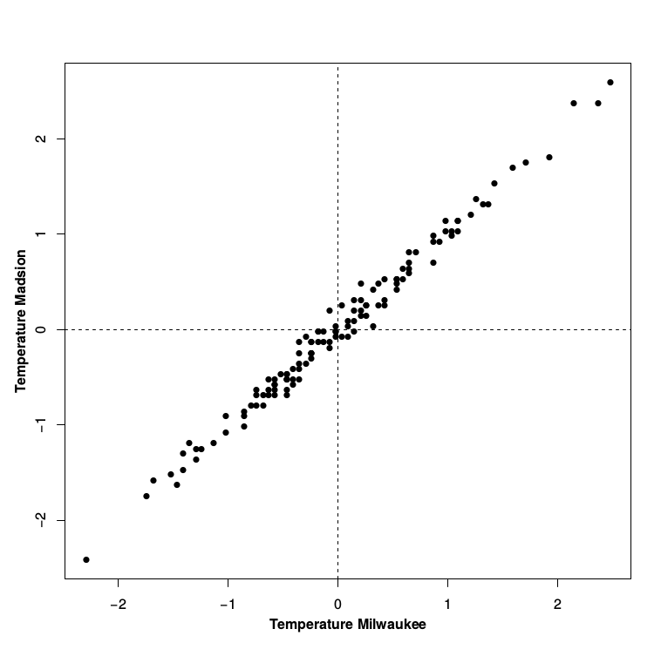
Two dimensional example
Data represented by a cloud of points in variable space
Usually our data has structure = correlation between variables = cloud of points is elongated

Slide 10
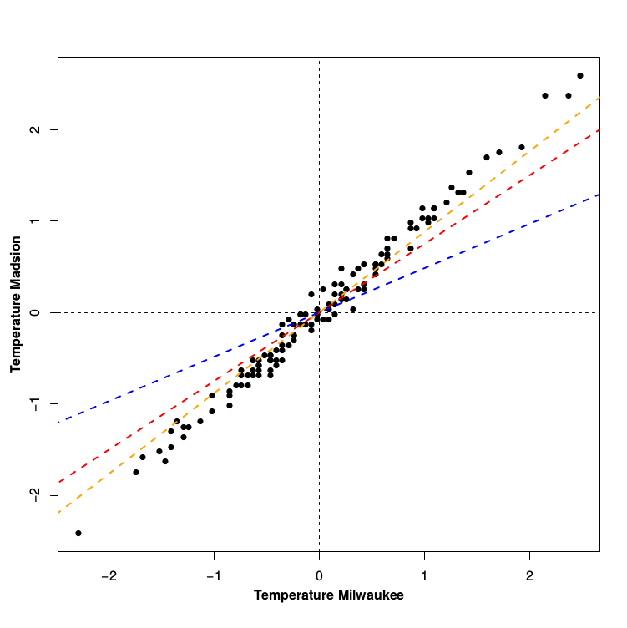
Geometric representation
Draw a line through the direction of maximum elongation that also passes through the center of the swarm:
  First principal component is the line that explains most variance
  Minimizes the distance to the observations
  Does this remind you of another mathematical operation?

Slide 11
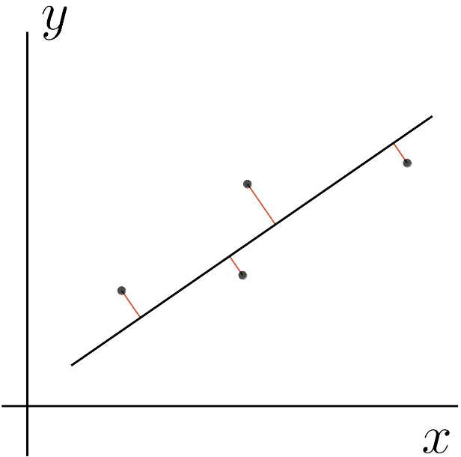
PCA as extension of regression
  Type II regression: minimizing distance perpendicular to the regression line

Slide 12
Formal solution
Eigenvalue decomposition of correlation or covariance matrix
  Eigenvalue decomposition (a little magic, no need to know what that is, eigen in R)
  Eigenvalue indicating how important a component is (as many eigenvalues as variables)
  Eigenvector describing the new coordinate system (as many eigenvectors as variables)

Slide 13
Eigenvalue decomposition 2 dimensions
              Eigenvalue (importance):
                Value 1: 1.985 (99.25%)
                Value 2: 0.015 (0.75%)
              Eigenvectors (new coordinate system)
 | Vector 1 | Vector 2
Milwaukee | 0.698 | -0.715
Madison | 0.715 | 0.698
 | Vector 1 | Vector 2
Milwaukee | 0.698 | -0.715
Madison | 0.715 | 0.698

Slide 14
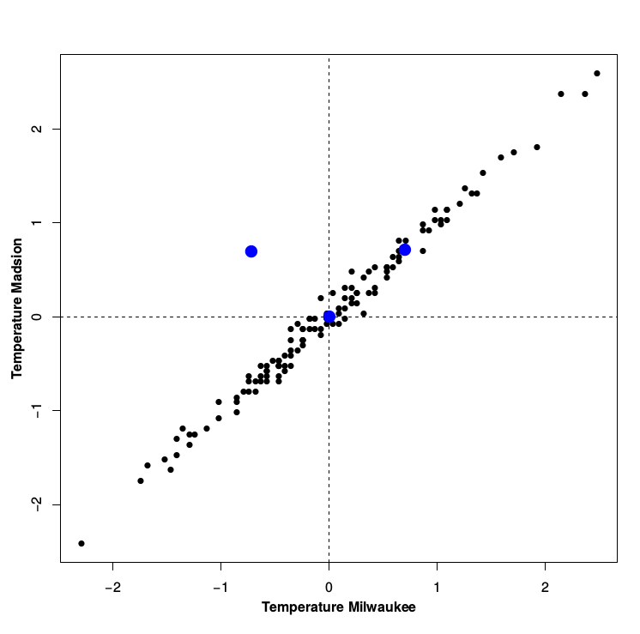
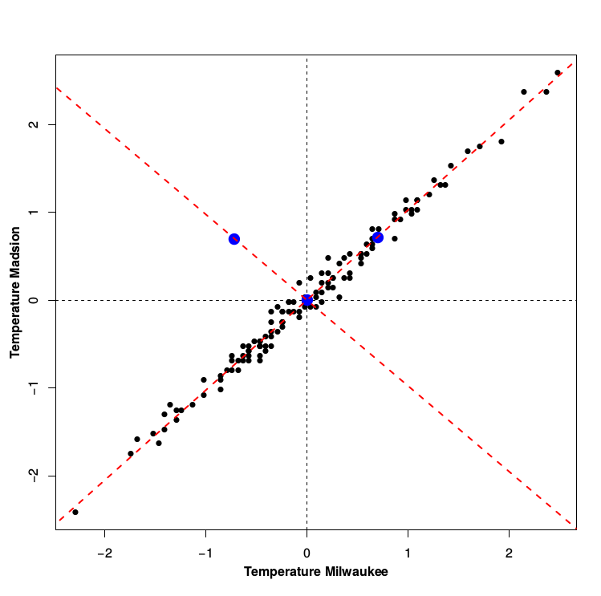
Two dimensional example
 | Vector 1 | Vector 2
Milwaukee | 0.698 | -0.715
Madison | 0.715 | 0.698

Slide 15
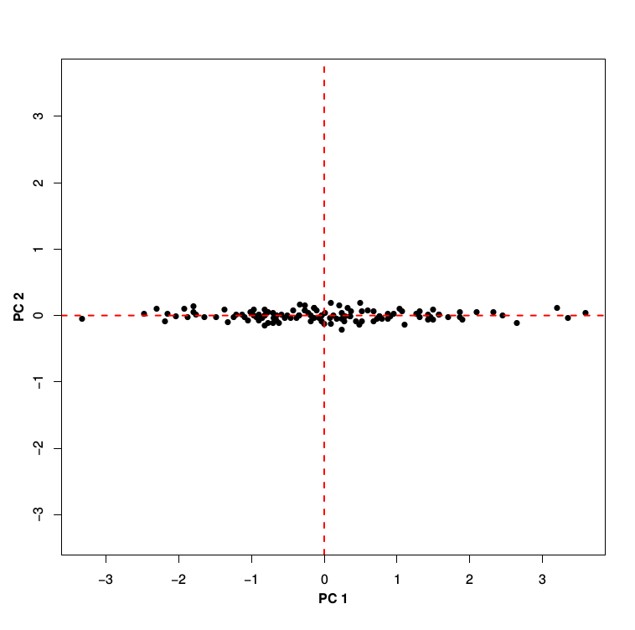
PC1 and PC2
 | Vector 1 | Vector 2
Milwaukee | 0.698 | -0.715
Madison | 0.715 | 0.698
PC1 = (Vec1_{Mil} * T_{Mil} + Vec1_{Ma} * T_{Ma})
PC2 = (Vec2_{Mil} * T_{Mil} + Vec2_{Ma} * T_{Ma})

Slide 16
PC1 and PC2
PC1 = (Vec1_{Mil} * T_{Mil} + Vec1_{Ma} * T_{Ma})
PC2 = (Vec2_{Mil} * T_{Mil} + Vec2_{Ma} * T_{ma})
PCs are linear combinations of initial variables with eigenvectors as coefficients: PC Scores (site score)
Eigenvectors also called PC loadings (species scores)
 | Vector 1 | Vector 2
Milwaukee | 0.698 | -0.715
Madison | 0.715 | 0.698

Slide 17
Variance explained
Variance PC1 = Eigenvalue 1 = λ₁
Variance PC2 = Eigenvalue 2 = λ₂
Variance PC1 = 1.539019 Eigenvalue 1 = 1.539018890
Variance PC2 = 0.005447696 Eigenvalue 2 = 0.005447696
Total Variance = Var TMil + Var TMad = Var PC1 + Var PC2 = Eig val 1 +Eig val 2
Variance explained = Eig val 1 (Var PC1) / Total Variance
_{Example: 1.539/1.544 = 0.996}
PC1 explains 99.6% of the total variance

Slide 18
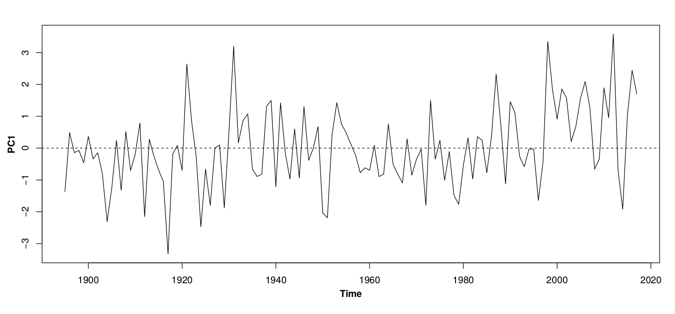
Summary
Simplify dataset:
  Correlation or covariance matrix
  A little magic

Slide 19
High dimensional dataset
Same methodology
No longer possible to visualize

Slide 20
Visualization of PCA results
PCA Biplot:
  Joint representation of variables and observations (samples, sites) on the same diagram
  Usual to represent observations/samples/sites by points and variables by arrows
  Arrows point in direction of maximum rate of change of that variable across the diagram
  Length of arrows indicate relative rate of change in that direction

Slide 21
Example: Climate data Minnesota
North American Modern Pollen Database (NAMPD)
Modern climate data at sites with pollen data
Choose:
          P Ann
          P Nov
          P Dec
          T ave
PCA with correlation matrix (standardized variables)

Slide 22
Correlation matrix
Eigenvector and eigenvalues depend on correlation of variables among each other
 | tave | tjul | annp | pnov | pdec
tave | 1 | 0.95 | 0.24 | 0.18 | -0.01
tjul | 0.95 | 1 | -0.04 | -0.11 | -0.3
annp | 0.24 | -0.04 | 1 | 0.96 | 0.92
pnov | 0.18 | -0.11 | 0.96 | 1 | 0.94
pdec | -0.01 | -0.3 | 0.92 | 0.94 | 1
Two highly correlated groups of variables
Two groups are unrelated
Probably two important PCs

Slide 23
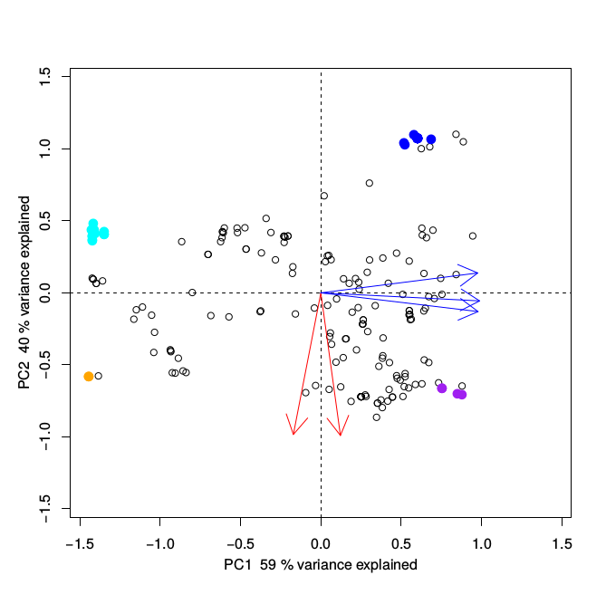
Biplot Example
Dimension reduction 5 to 2

Slide 24
Biplot Example
Angle between arrows:
  relation between variables
  Same direction:
    Positive relation
  Orthogonal:
    No relation
  Opposite direction
    Negative relation
  Describe highlighted points

Slide 25
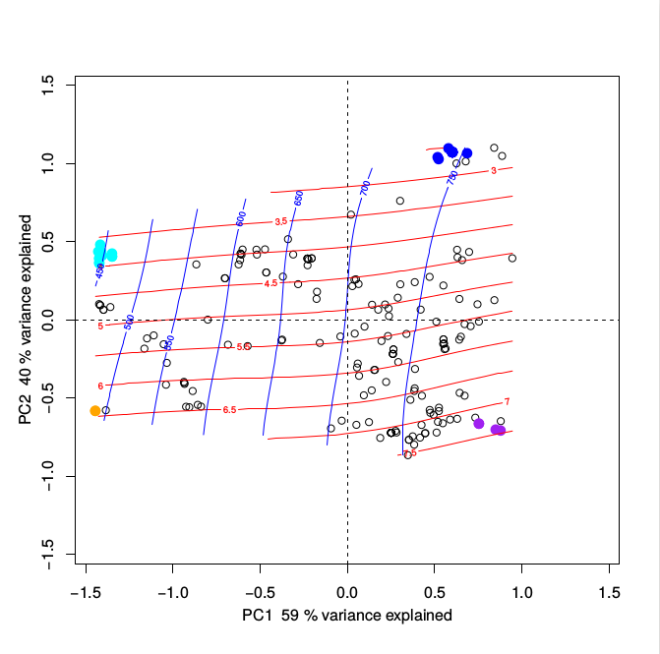
Ordination surface

Slide 26
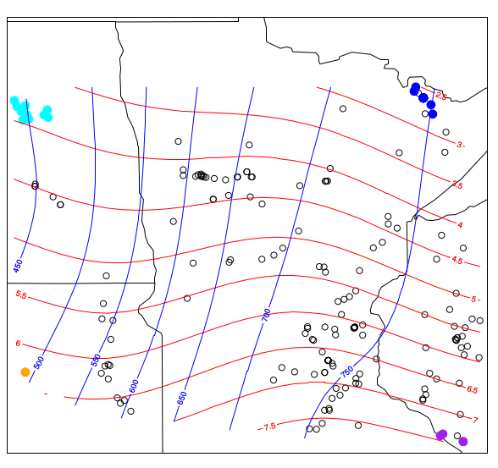
Climate Space
Real Space

Slide 27
Climate Space
Real Space

Slide 28
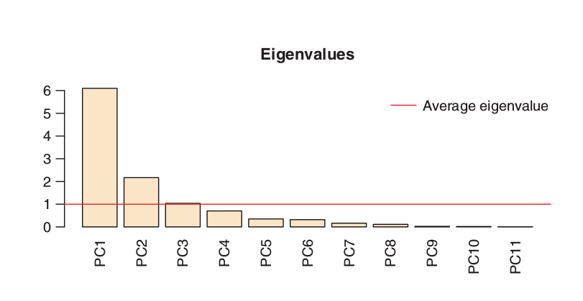
How many axes?
Screeplot: Histogram of variance explained by each PC axis

Slide 29
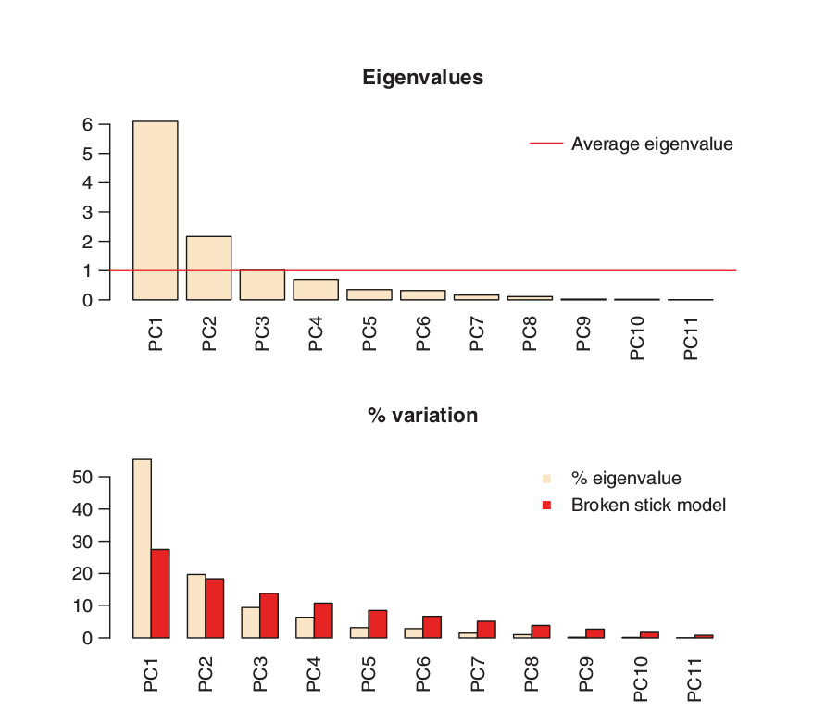
How many axes?

Slide 30
Standardized or non-standardized PCA?
Principal components represent directions of maximum variation through multivariate space
If original variables are measured on different scales variables with large absolute values will dominate simply because they represent directions of maximum variance
To avoid this standardize data by centering and dividing by the standard deviation

Slide 31
Standardized or non-standardized PCA?
A PCA on the non-standardized data is equivalent to a PCA of a covariance matrix between variables
  Also known as centered variables
A PCA on the standardized data is equivalent to a PCA of a correlation matrix between variables

Slide 32
Data transformations for PCA
Usual to center data (subtract mean) – implicit in most software. Variables implicitly weighted by their variances
For non-species data
  Standardize data – variables have equal weight
For species data
  Log10(x+1) transformation useful for abundance (count) data
  Square root transformation useful for percentage data

Slide 33
Dealing with closed data
Closed data: percentage or as a fraction of a fixed total
Frequent in geochemical and microfossil studies

