Slide 1
The Renewable Energy Model
(reV)
Katy Waechter, Travis Williams

Slide 2
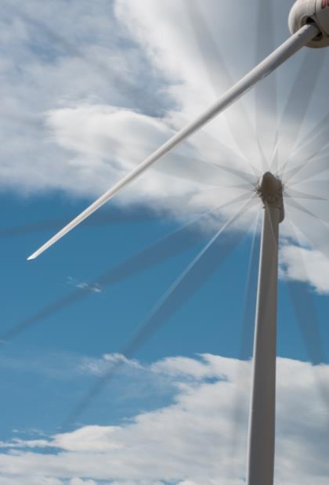
The Renewable Energy Potential Model
Thoughts:
General Overview
Make sure we define technical potential well, as in this provides the field of options for downstream models to actual place the plants in space and integrate them into an energy system
Placement in NREL Modeling Pipeline
Describe the model pipeline, then each major module
Include a series of plots with the same study area
Start with resource at the 2km scale – “Resource”
Move to generation at 2km scale – “Generation”
Move to aggregation at 11.5km scale – “Aggregation”
Keep 2km grid cells within
Move to exclusions at 90m scale – “Exclusions”
Keep 11.5km grid, replace 2km grid with 90m grid
Move to trans features back at the 11.5km scale – “Supply-curve”
Keep 1.5km grid, remove 90m grid, add transmission features
Move to trans connections at 11.5km grid – “Supply-Curve”
Keep features show potential connections
Move to trans assignment at 11.5km grid - “Supply-Curve”
Remove other options, keep cheapest, or else keep top sorted option
Move to rep-profiles – “Rep-Profiles”
Remove trans features, add 2km grid back in
Move to rep-profiles selection with meanoid – “Rep-Profiles”.
Highlight singular point chosen, add time series graph
Move to rep-profiles selection with aggregation– “Rep-Profiles”.
Highlight all 2km points, add time series graph
Zoom out to national view, show icon for hdf5s and csvs.
Upcoming model features:
NRWAL for flexibility
”Bespoke” for individual turbine placement
Hybrid module for combining wind and solar
Notes:
The reV model is a platform for assessing renewable energy potential and its geospatial intersection with grid infrastructure and land use characteristics.

Slide 3
The Renewable Energy Potential (V) Model
reV is a geospatial platform for assessing system performance, available capacity, distance to transmission, and total costs for potential solar and wind energy deployment at regional to continental scales.
System Performance & Costs
Distance to Transmission
Available Capacity
Notes:
The reV model is a platform for assessing renewable energy potential and its geospatial intersection with grid infrastructure and land use characteristics.

