Slide 1
The Renewable Energy Model
(reV)
Katy Waechter, Travis Williams

Slide 2
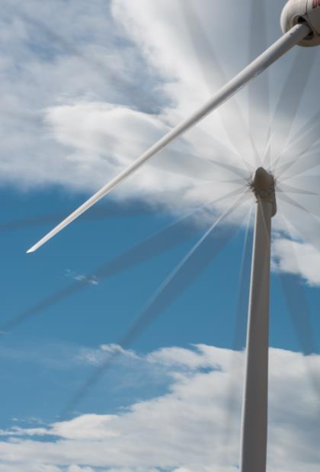
The Renewable Energy Potential Model
General Outline:
General Overview
Make sure we define technical potential well, as in this provides the field of options for downstream models to actual place the plants in space and integrate them into an energy system
Placement in NREL Modeling Pipeline
Describe the model pipeline, then each major module
Include a series of plots with the same study area
Start with resource at the 2km scale – “Resource”
Move to generation at 2km scale – “Generation”
Move to aggregation at 11.5km scale – “Aggregation”
Keep 2km grid cells within
Move to exclusions at 90m scale – “Exclusions”
Keep 11.5km grid, replace 2km grid with 90m grid
Move to trans features back at the 11.5km scale – “Supply-curve”
Keep 1.5km grid, remove 90m grid, add transmission features
Move to trans connections at 11.5km grid – “Supply-Curve”
Keep features show potential connections
Move to trans assignment at 11.5km grid - “Supply-Curve”
Remove other options, keep cheapest, or else keep top sorted option
Move to rep-profiles – “Rep-Profiles”
Remove trans features, add 2km grid back in
Move to rep-profiles selection with meanoid – “Rep-Profiles”.
Highlight singular point chosen, add time series graph
Move to rep-profiles selection with aggregation– “Rep-Profiles”.
Highlight all 2km points, add time series graph
Zoom out to national view, show icon for hdf5s and csvs.
Upcoming model features:
NRWAL for flexibility
”Bespoke” for individual turbine placement
Hybrid module for combining wind and solar
Notes:
The reV model is a platform for assessing renewable energy potential and its geospatial intersection with grid infrastructure and land use characteristics.

Slide 3
What is reV?
reV is an open-source geospatial platform for assessing system performance, available capacity, distance to transmission, and total costs for potential solar and wind energy deployment at regional to continental scales.
System Performance & Costs
Distance to Transmission
Available Capacity
https://github.com/NREL/reV
Notes:
The reV model is a platform for assessing renewable energy potential and its geospatial intersection with grid infrastructure and land use characteristics.

Slide 4
What is reV?
Let’s give some example output images here to maintain interest.
Notes:
The reV model is a platform for assessing renewable energy potential and its geospatial intersection with grid infrastructure and land use characteristics.

Slide 5
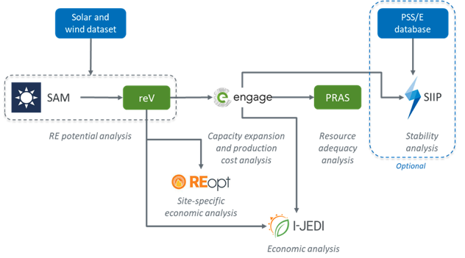
How Does reV Fit into Deployment Modeling?
reV coordinates SAM and takes developable land into account to provide a spatial field of potential RE plants that feed downstream economic and capacity expansion models.
Notes:
The reV model is a platform for assessing renewable energy potential and its geospatial intersection with grid infrastructure and land use characteristics.

Slide 6

The Systems Advisor Model (SAM)
SAM is an open-source techno-economic software model that simulates renewable energy modules and plants. It includes models for:
Photovoltaic
Wind
Concentrating Solar
Geothermal
Biomass Combustion
Battery Storage
Solar Water Heating
Financial Cash Flow
At its foundation, reV serves a spatial coordinator for SAM.
https://sam.nrel.gov/
https://github.com/NREL/pysam
Notes:
The reV model is a platform for assessing renewable energy potential and its geospatial intersection with grid infrastructure and land use characteristics.

Slide 7
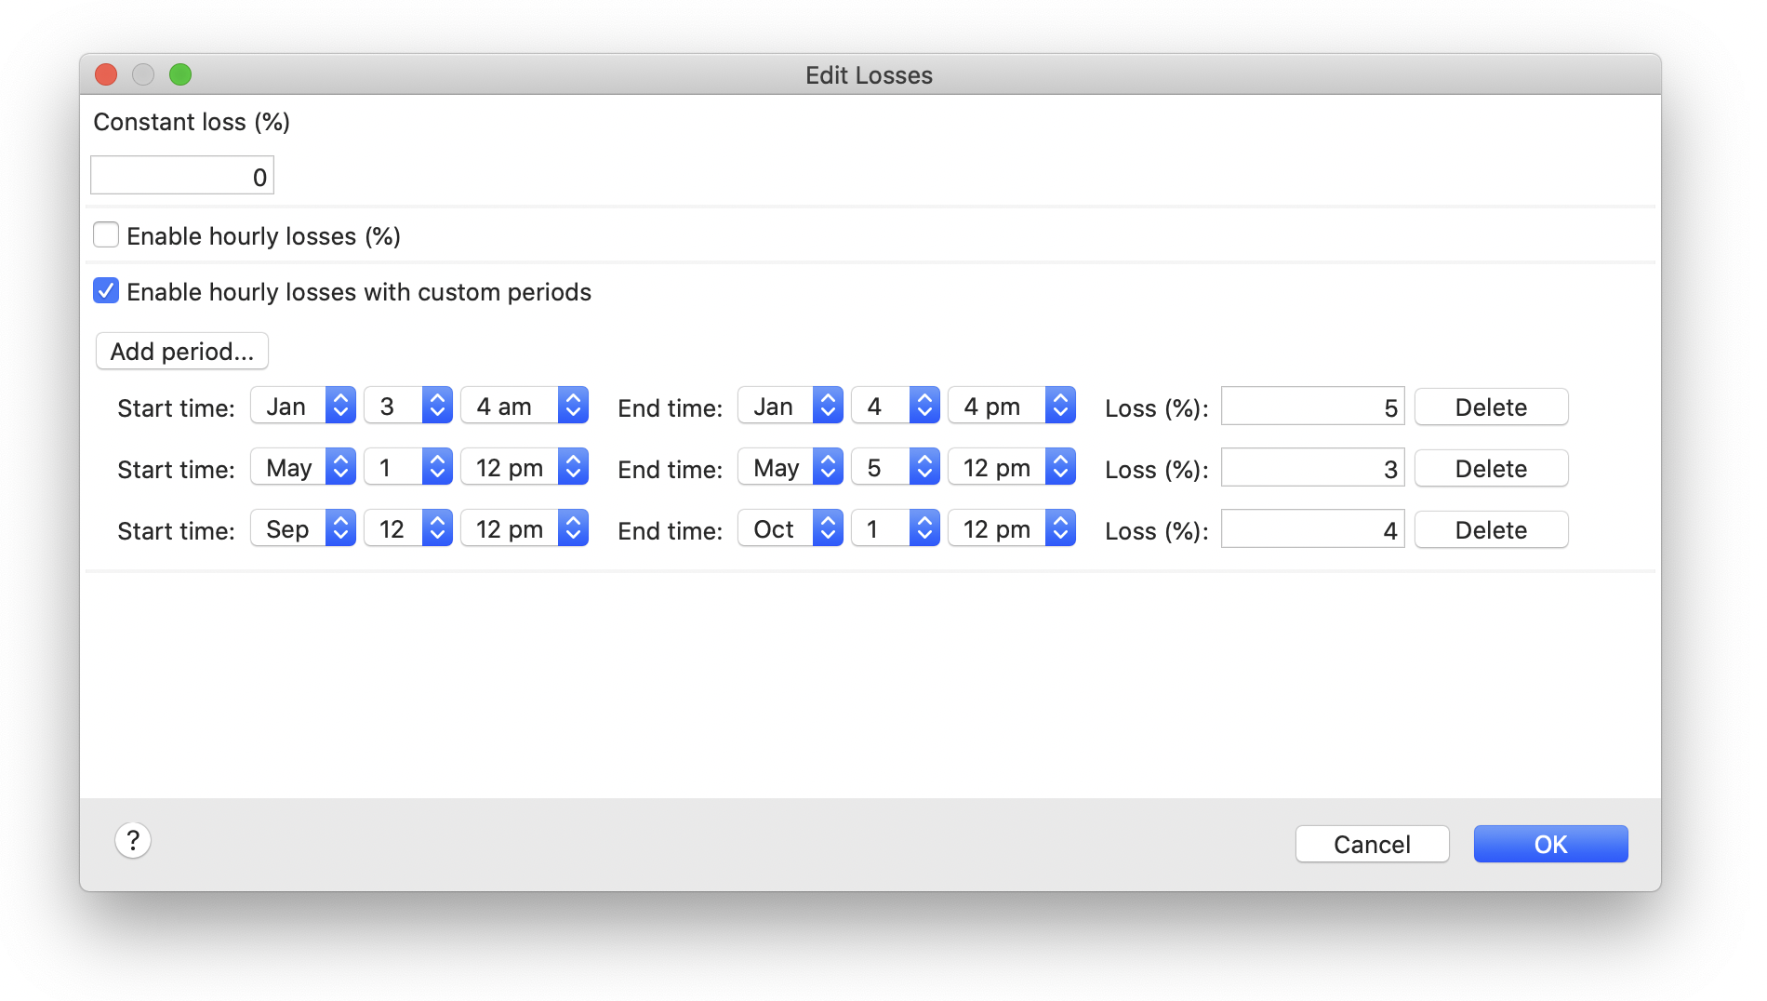
The Systems Advisor Model - Losses
Dynamic losses are not fully integrated into SAM and reV.
Notes:
The reV model is a platform for assessing renewable energy potential and its geospatial intersection with grid infrastructure and land use characteristics.

Slide 8
The Renewable Energy Potential (V) Model
Overview
Inputs
Integration with SAM:
List models currently assimilated
Outputs
Note some limitations for reV (i.e. the outputs we get
are only as good as the inputs). It require a good deal of data collection and preprocessing.

Slide 9
The Renewable Energy Potential (V) Model
With the caveat above, show an example output of each module with our Morocco runs.
Start with resource at the 2km scale – “Resource” – show aggregate diurnal timeseries plot
Move to generation at 2km scale – “Generation” – show aggregate diurnal timeseries plot
Move to aggregation at 11.5km scale – “Aggregation”
Keep 2km grid cells within
Move to exclusions at 90m scale – “Exclusions”
Keep 11.5km grid, replace 2km grid with 90m grid
Move to trans features back at the 11.5km scale – “Supply-curve”
Keep 1.5km grid, remove 90m grid, add transmission features
Move to trans connections at 11.5km grid – “Supply-Curve”
Keep features show potential connections
Move to trans assignment at 11.5km grid - “Supply-Curve”
Remove other options, keep cheapest, or else keep top sorted option
Move to rep-profiles – “Rep-Profiles”
Remove trans features, add 2km grid back in
Move to rep-profiles selection with meanoid – “Rep-Profiles”.
Highlight singular point chosen, add time series graph
Move to rep-profiles selection with aggregation– “Rep-Profiles”.
Highlight all 2km points, add time series graph
Zoom out to national view, show icon for hdf5s and CSVs.

Slide 10
The Renewable Energy Potential (V) Model
Sample Outputs

Slide 11
The Renewable Energy Potential (V) Model
New/Developing Functionality
NRWAL:
Mainly designed for offshore costs.
Provides a way to incorporate mathematical relationships into reV outputs.
“Bespoke” Wind Turbine Placement:
Dynamically placing turbines in the ground
Optimizes placement based on the wind strength, direction, land availability and an objective function (max profit, max generation, least cost).
“Hybrid” Plants:
Combines wind and solar profiles with user-defined ratios.
Brand new as of this month
Once you have the profiles you can treat them as a generation file in the aggregation module.

Slide 12
The Renewable Energy Potential (V) Model
Introduce reView
THIS IS NOT REV

Slide 13
The Renewable Energy Potential (V) Model
In the News
IRENA Hydrogen Report (2022)*:
Africa highest in technical potential for green hydrogen (GH).
Morocco policy front runner in GH industry:
Has potential to become significant exporter of GH.
“﻿For these countries [Chile, Morocco, and Namibia], a green hydrogen transformation represents a complete reversal of fortune ﻿as ample renewable potential opens new possibilities.” (page 48)
Given that, it’s worth mentioning:
NREL is currently experimenting with reV-NRWAL production/cost equations for GH production.
﻿*IRENA (2022), Geopolitics of the Energy Transformation: The Hydrogen Factor, International Renewable Energy Agency, Abu Dhabi. ISBN: ﻿978-92-9260-370-0.

Slide 14
The Renewable Energy Potential (V) Model
Citations
UNEP-WCMC and IUCN (2022), Protected Planet: The World Database on Protected Areas (WDPA) and World Database on Other Effective Area-based Conservation Measures (WD-OECM) [Online], February 2022, Cambridge, UK: UNEP-WCMC and IUCN. Available at: www.protectedplanet.net.
Florczyk A.J., Corbane C., Ehrlich D., Freire S., Kemper T., Maffenini L., Melchiorri M., Pesaresi M., Politis P., Schiavina M., Sabo F., Zanchetta L., GHSL Data Package 2019, EUR 29788 EN, Publications Office of the European Union, Luxembourg, 2019, ISBN 978-92-76-13186-1, doi:10.2760/290498, JRC 117104
Open Africa. “Morocco Maps”.Code for Africa. 2016. https://open.africa/fr/dataset/morocco-maps/
Michael R. Meuser. https://mapcruzin.com/free-morocco-arcgis-maps-shapefiles.htm

