Slide 1
Social Network Data Structures Assignment 4 Graph
2021.5.10
NTHU EECS

Slide 2
Background
Social network analysis is the process of investigating the structure of a social network.
In this task, we want to know some properties of a social network, where nodes represent users, and directed edges mean that users can propagate information in that direction.

Slide 3
Representation
Use matrices to represent the network.
Nonzero digits means weights of the edges.
0 means there are no edges between the two nodes.

Slide 4
Information propagation
Node2 can propagate information to node1.
Node2 can propagate information to node0.
Node1 can not propagate information to node2.

Slide 5
Difficulty Of Information Propagation
The weights of edges represent the difficulty of information propagation.
Smaller difficulty value means that the information is more likely to be propagated.
The difficulty of a path is determined by summing up the difficulty values of edges in the path.

Slide 6
Difficulty Of Information Propagation
Node2 can propagate information to node3 with the path : 2->4->0->3
The difficulty of the path : 7+1+3 = 11

Slide 7
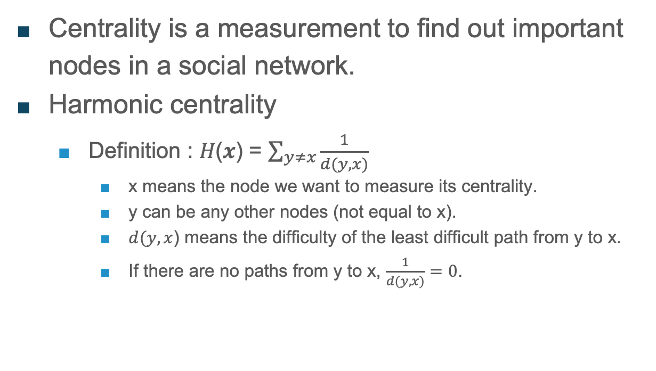
Centrality
Centrality is a measurement to find out important nodes in a social network.
Harmonic centrality
Definition : 𝐻(𝒙) = $\sum_{y≠x}{\frac{1}{d(y,x)}}$
x means the node we want to measure its centrality.
y can be any other nodes (not equal to x).
$d(y,x$) means the difficulty of the least difficult path from y to x.
If there are no paths from y to x, $\frac{1}{d(y,x)}=0$.

Slide 8
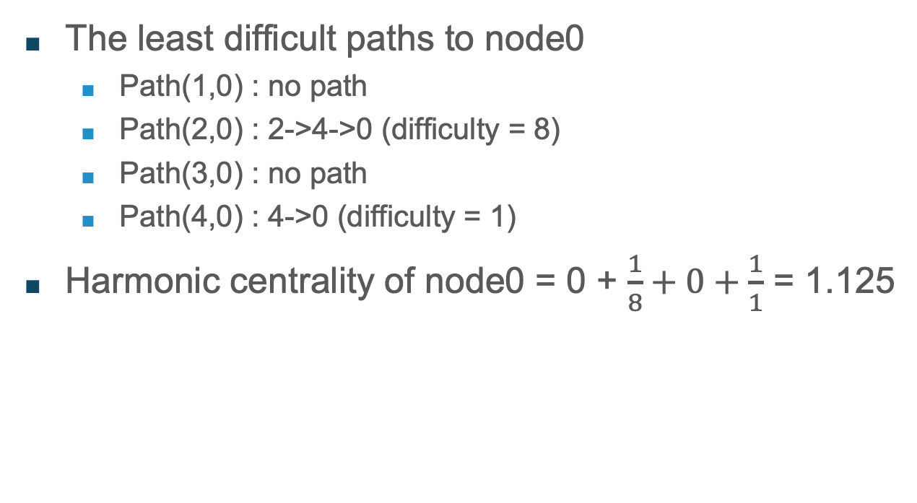
Centrality
The least difficult paths to node0
Path(1,0) : no path
Path(2,0) : 2->4->0 (difficulty = 8)
Path(3,0) : no path
Path(4,0) : 4->0 (difficulty = 1)
Harmonic centrality of node0 = 0 + $\frac{1}{8}+0+\frac{1}{1}$ = 1.125

Slide 9
Goal
Find out least difficult paths (paths with least difficulty) for each node pair.
Print out the nodes that the path traversed.
Print the difficulty of the path.
Show the harmonic centrality of each node.

Slide 10
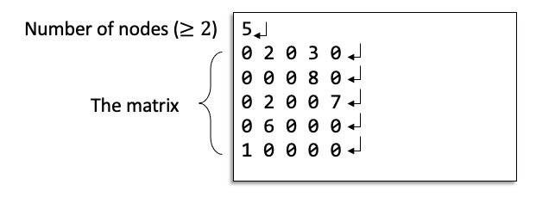
Input
Given the number of nodes in the social network.
2 ≦ Number of nodes ≦ 100
A matrix contains a digit value
Non-zero digits represent the weights (difficulty) of the edge between nodes.​​
0 represents no edge between two nodes

Slide 11
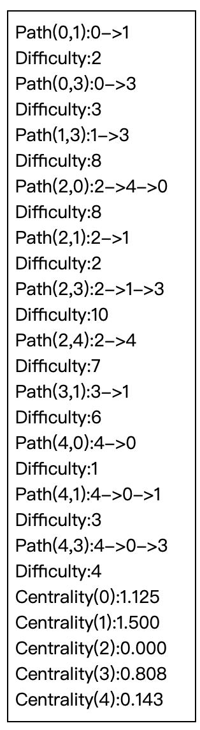
Output
Print out the least difficult path with row major order and the corresponding difficulty for each pair.
Print out the harmonic centrality of each node.

Slide 12
Constraints
If the difficulty of the multiple paths are equivalent, select the one which first go through the smaller node. (Compare the nodes)
EX: (three paths with the same difficulty)
path A: 0->9->1
path B: 0->10->1
You need to print path A.
The value of the centrality is accurate to the third digit after the decimal point.
You can use iomanip::setprecision(int) to achieve this.

Slide 13
HW4 String Comparison Version
If you develop code based on string comparison constraint, you can submit your code here.
EX: (two paths with the same difficulty)
path A: 0->10->1
path B: 0->9->1
You need to print path A.
EX: (two paths with the same difficulty)
path A: 0->1->2
path B: 0->10->2
You need to print path A.
If you decide to use the submission in this newly-opened contest as your score of HW4, please email TA Jeremy (sponge611@gmail.com)

Slide 14
HW4 Timeline
HW4 registration: 5/10 9:00a.m.~ 5/11 9:00a.m.
HW4 deadline: 5/25 12:00 (at noon)
Quiz4: 5/24 18:30~20:30

