Slide 1
Final
Project

Slide 2


SmartHealth Clinic
Paper Charts

Slide 3
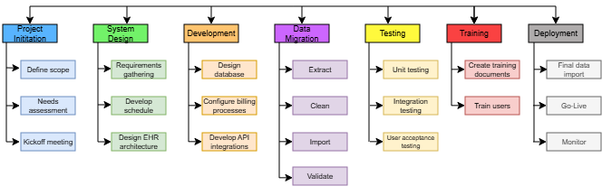
Work Breakdown Structure

Slide 4
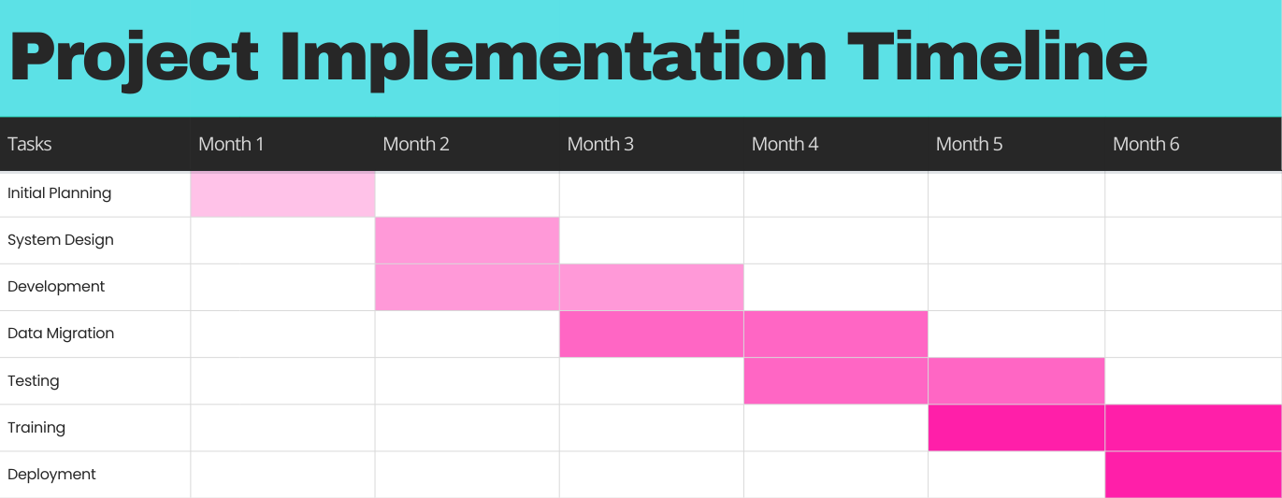
Gantt Chart

Slide 5
Risk Assessment Matrix
Category | Description | Probability | Impact | Mitigation Plan
Operations | Staff resistance | Medium | High | Involve staff in planning and provide thorough training
Operations | API Integration failure | Low | Impact | Conduct phased testing with vendors
Finances | Budget overruns | Low | Medium | Allocate a 15% contingency fund for unforeseen costs
Security | Data breach | Medium | High | Implement encryption and access controls
Operations | Migration downtime | High | Low | Schedule migration during off-hours

Slide 6
Project Tasks, Dependencies, and Durations
Initial Planning – 4 weeks, no dependencies
System Design – 4 weeks, depends on planning
Development – 8 weeks, depends on design
Data Migration – 8 weeks, depends on development
Testing – 8 weeks, depends on development
Training – 8 weeks, depends on testing
Deployment – 4 weeks, depends on testing

Slide 7
Data Migration
Plan
Extraction: Scan in paper files, use optical character recognition tools like Adobe Acrobat or Foxit Pro to convert into text
Cleaning: Remove duplicates, manually review for misspelling and data entry errors
Mapping: Ensure fields names are planned out and aligned with existing paper records
Validation: Compare data sample pre and post-migration to ensure accuracy
Backup procedures: create full backups before migration, store offline backup drives in fireproof safe offsite

Slide 8
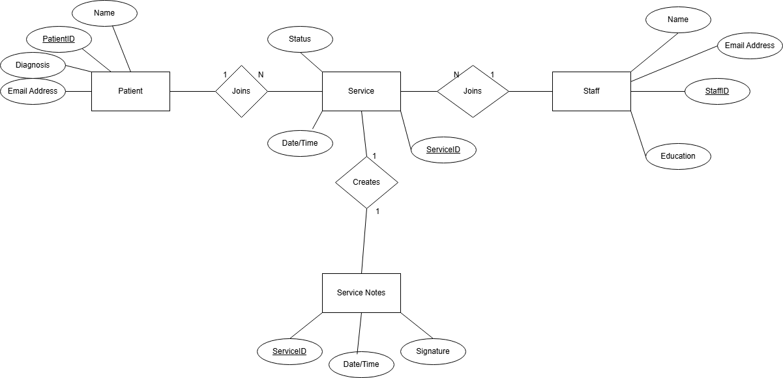
Entity-Relationship Diagram

Slide 9
Objectives
Full System Deployment for every module
  6 months
  All active charts migrated
  All staff trained and operational

Slide 10

Lessons Learned
Plan thoroughly
Keep everyone on the same page
Celebrate the wins
GET THE BUY IN!!!

Slide 11

Power of communication

Slide 12
Thank you
Joshua Willis
willis56@iu.edu

