Slide 1
Midterm Project

Slide 2


Tri-County’s Big Move

Slide 3
Project Implementation Team
Executive Sponsor (CIO)
Project Manager (IT Coordinator)
System Administrator (EHR Admin Specialist)
Subject Matter Experts (Department Supervisors)

Slide 4
Risk Assessment Matrix
Category | Description | Probability | Impact | Mitigation Plan
Operational | Staff resistance to adoption | Medium | High | Establish regular training sessions
Regulatory | Failure to comply with HIPAA guidelines | Low | Impact | Establish internal auditing team to perform regular compliance audits
Financial | Budget overrun rising from project delays | Medium | Medium | Weekly project team meetings to monitor costs vs timelines
Security | Cybersecurity data breach | High | High | Establish multi-factor authentication, network firewalls
Operational | Loss of existing patient records | Medium | High | Project team implement ETL workflow

Slide 5
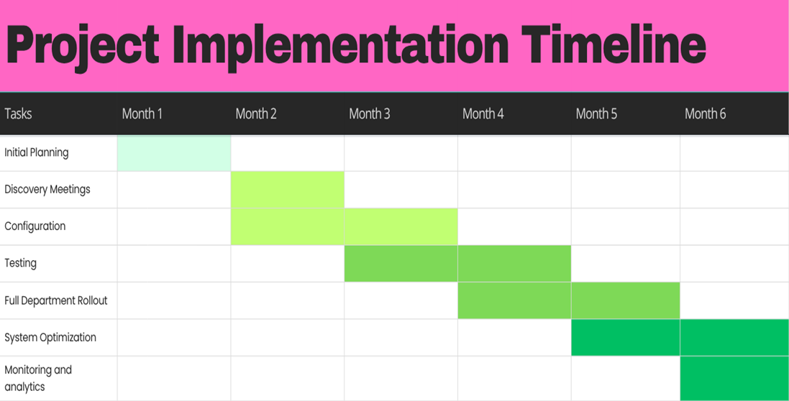
Gantt Chart

Slide 6
Installation Schedule
Week 1-4 (Month 4): Hardware installation and user training
Week 5-8: Community programs rollout
Week 9-12: Outpatient rollout
Week 13-16: Residential rollout and system optimization

Slide 7
Data Migration Plan
Extract: Data pulls from the legacy system with CSV exports and SQL Server integration, will pull patient charts, service records, and historical billing data
Transform: Map fields to ensure standardization (date formats, removing hyphens from social security number records, etc.) and validate to ensure no record duplication
Load: Import data to Epic in batches

Slide 8
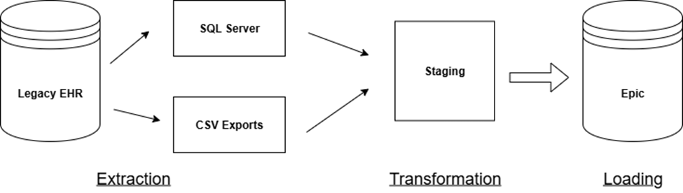
ETL Diagram

Slide 9
Test Plan
Scope: Test system stability, administrative user functions, end user functions and workflows
Objectives: ensure system stability, reliability, and usability
Tools: Selenium and Postman
Responsibilities: System administrator will lead the testing team, configuration adjustments will be handled by the system administrator, bugs will be reported to the Epic vendor for fixes, subject-matter experts will validate fixes.

Slide 10
Test Cases
Test Case ID | Case Description | Test Steps | Expected Result
TC01 | User login validation | 1. User enters valid username and password 2. User clicks login button | Successful login to homepage
TC02 | Patient record update | User searches for patient record 2. User clicks view record button 3. User clicks update record button 4. User inputs patient vitals 5. User clicks save button | Patient record updated

Slide 11
Data Quality Issues
Incompatible field formats (dates, timestamps, social security numbers, phone numbers)
Inconsistent naming conventions (procedure acronyms, diagnosis codes)
Incomplete patient records
Duplicate patient records
Data overload
Unclear data management policies

Slide 12
Objectives
Full System Deployment for every department
6 months
All active charts migrated
All staff trained and operational in Epic

Slide 13

Lessons Learned
Plan thoroughly
Keep everyone on the same page
Celebrate the wins
GET THE BUY IN!!!

Slide 14

Power of communication

Slide 15
Thank you
Joshua Willis
willis56@iu.edu

