Slide 1
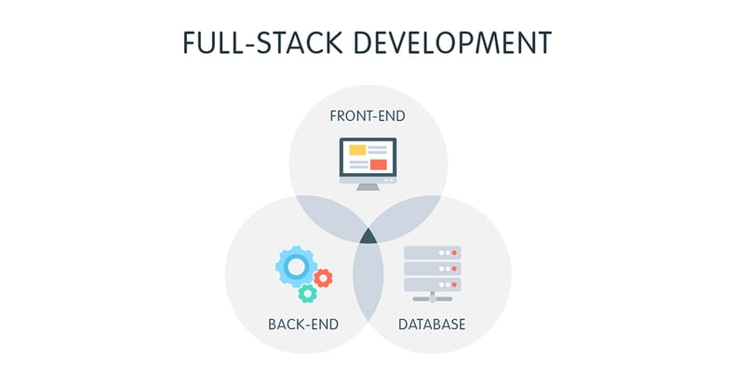
Front-end Web
pygeoapi
MapServer
deegree
OpenLayers
GeoMoose
Mapbender
PyWPS
GeoServer
Postgres w/ postgis

Slide 2
Front-end Web
MapLibre
Leaflet
OpenLayers
deck.gl
d3

Slide 3
Tools
HTML/CSS/JS
Maplibre, Leaflet, OpenLayers, deck.gl
  x ArcGIS
  x Mapbox (well, sort of)
Git
Github/Gitlab
NodeJS - https://github.com/nodejs/node

Slide 4
Web Maps

