Slide 1
Free and Open Source Software (FOSS) for Web Maps

Slide 2
Git and Github
What is a git repository?
Github

Slide 3
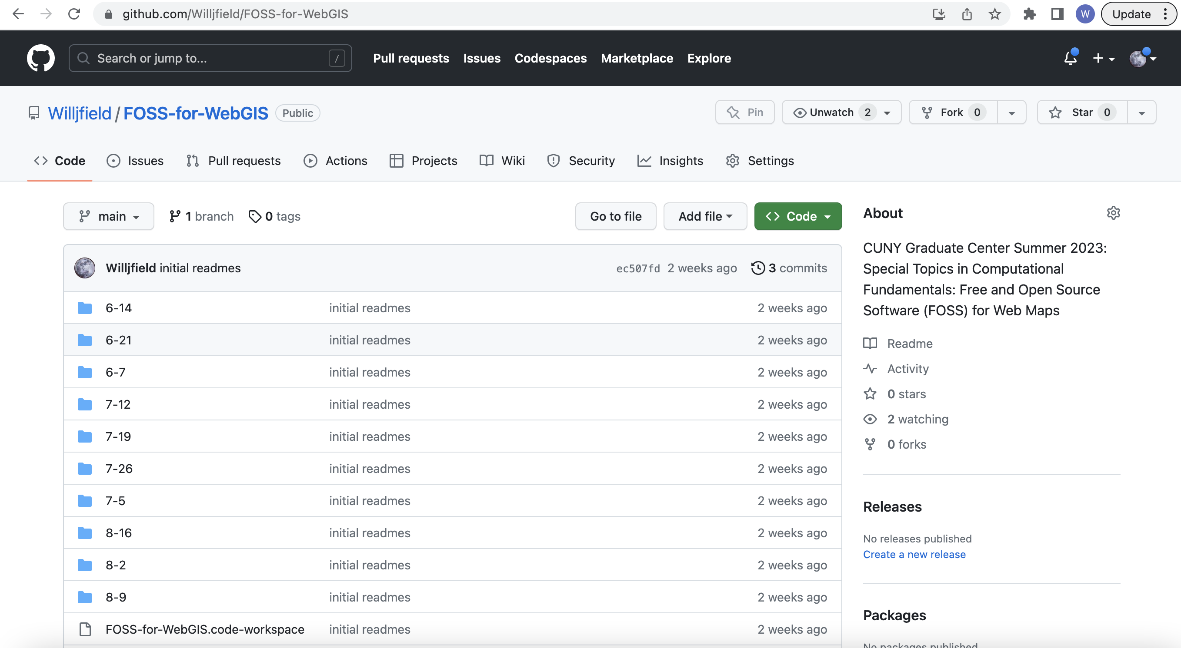
Git and Github

Slide 4
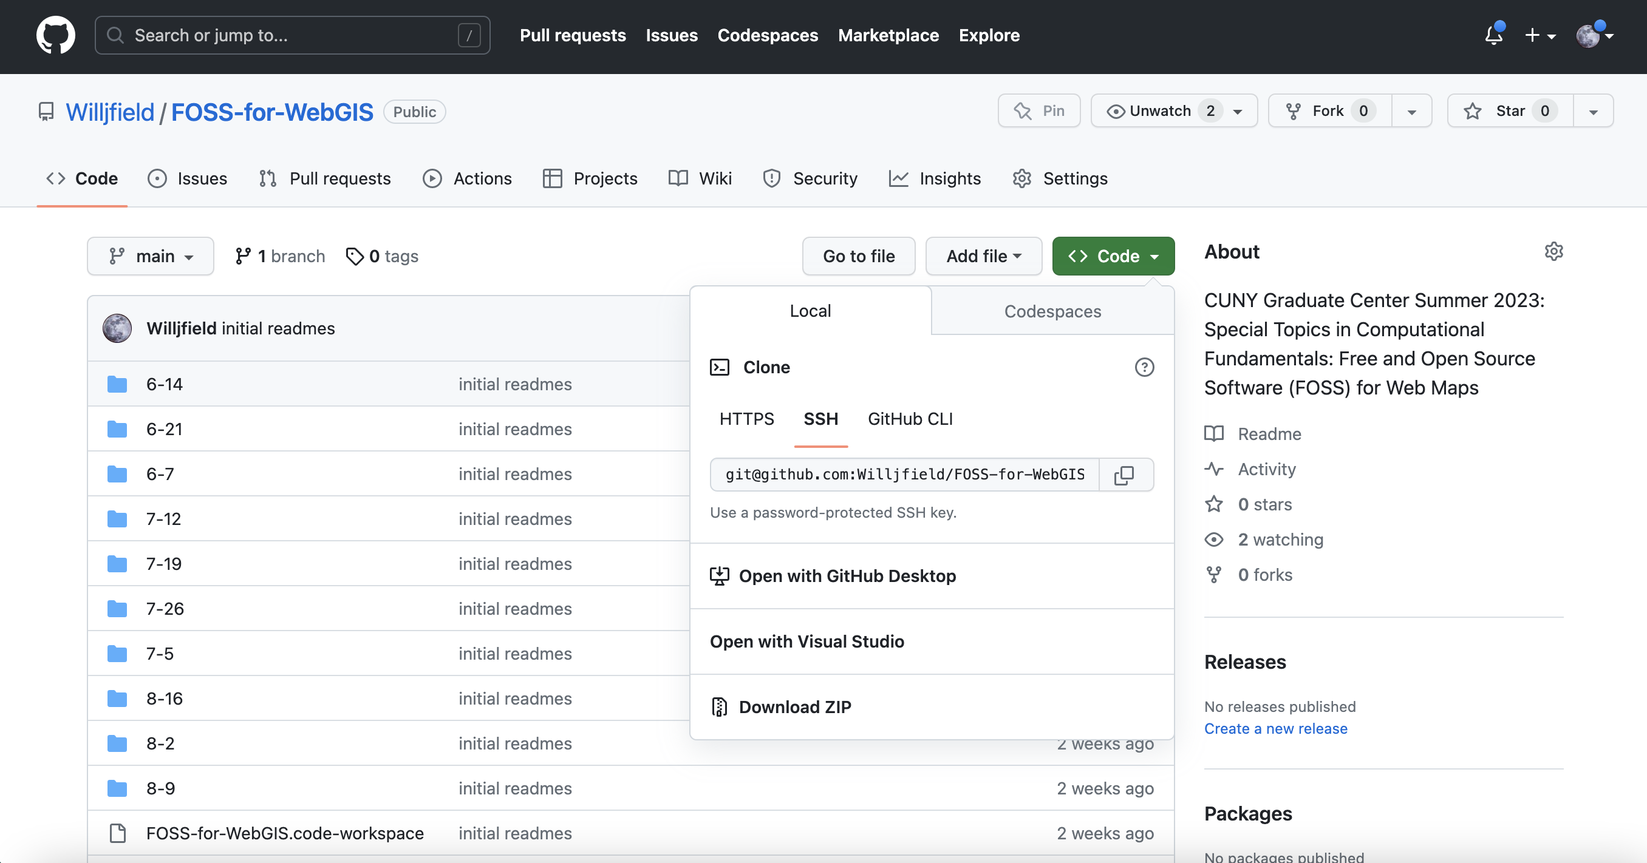
Git and Github

Slide 5
VS Codium/VS Code
https://vscodium.com/
https://code.visualstudio.com/
Other editors: Sublime, Atom, vi, vim, neovim, emacs...

Slide 6
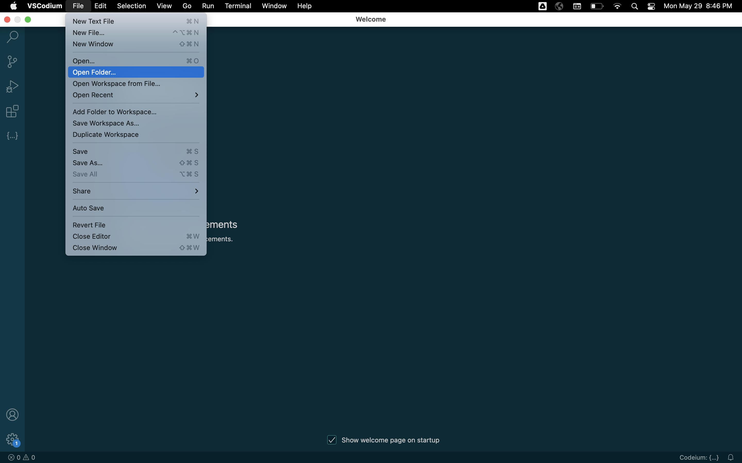
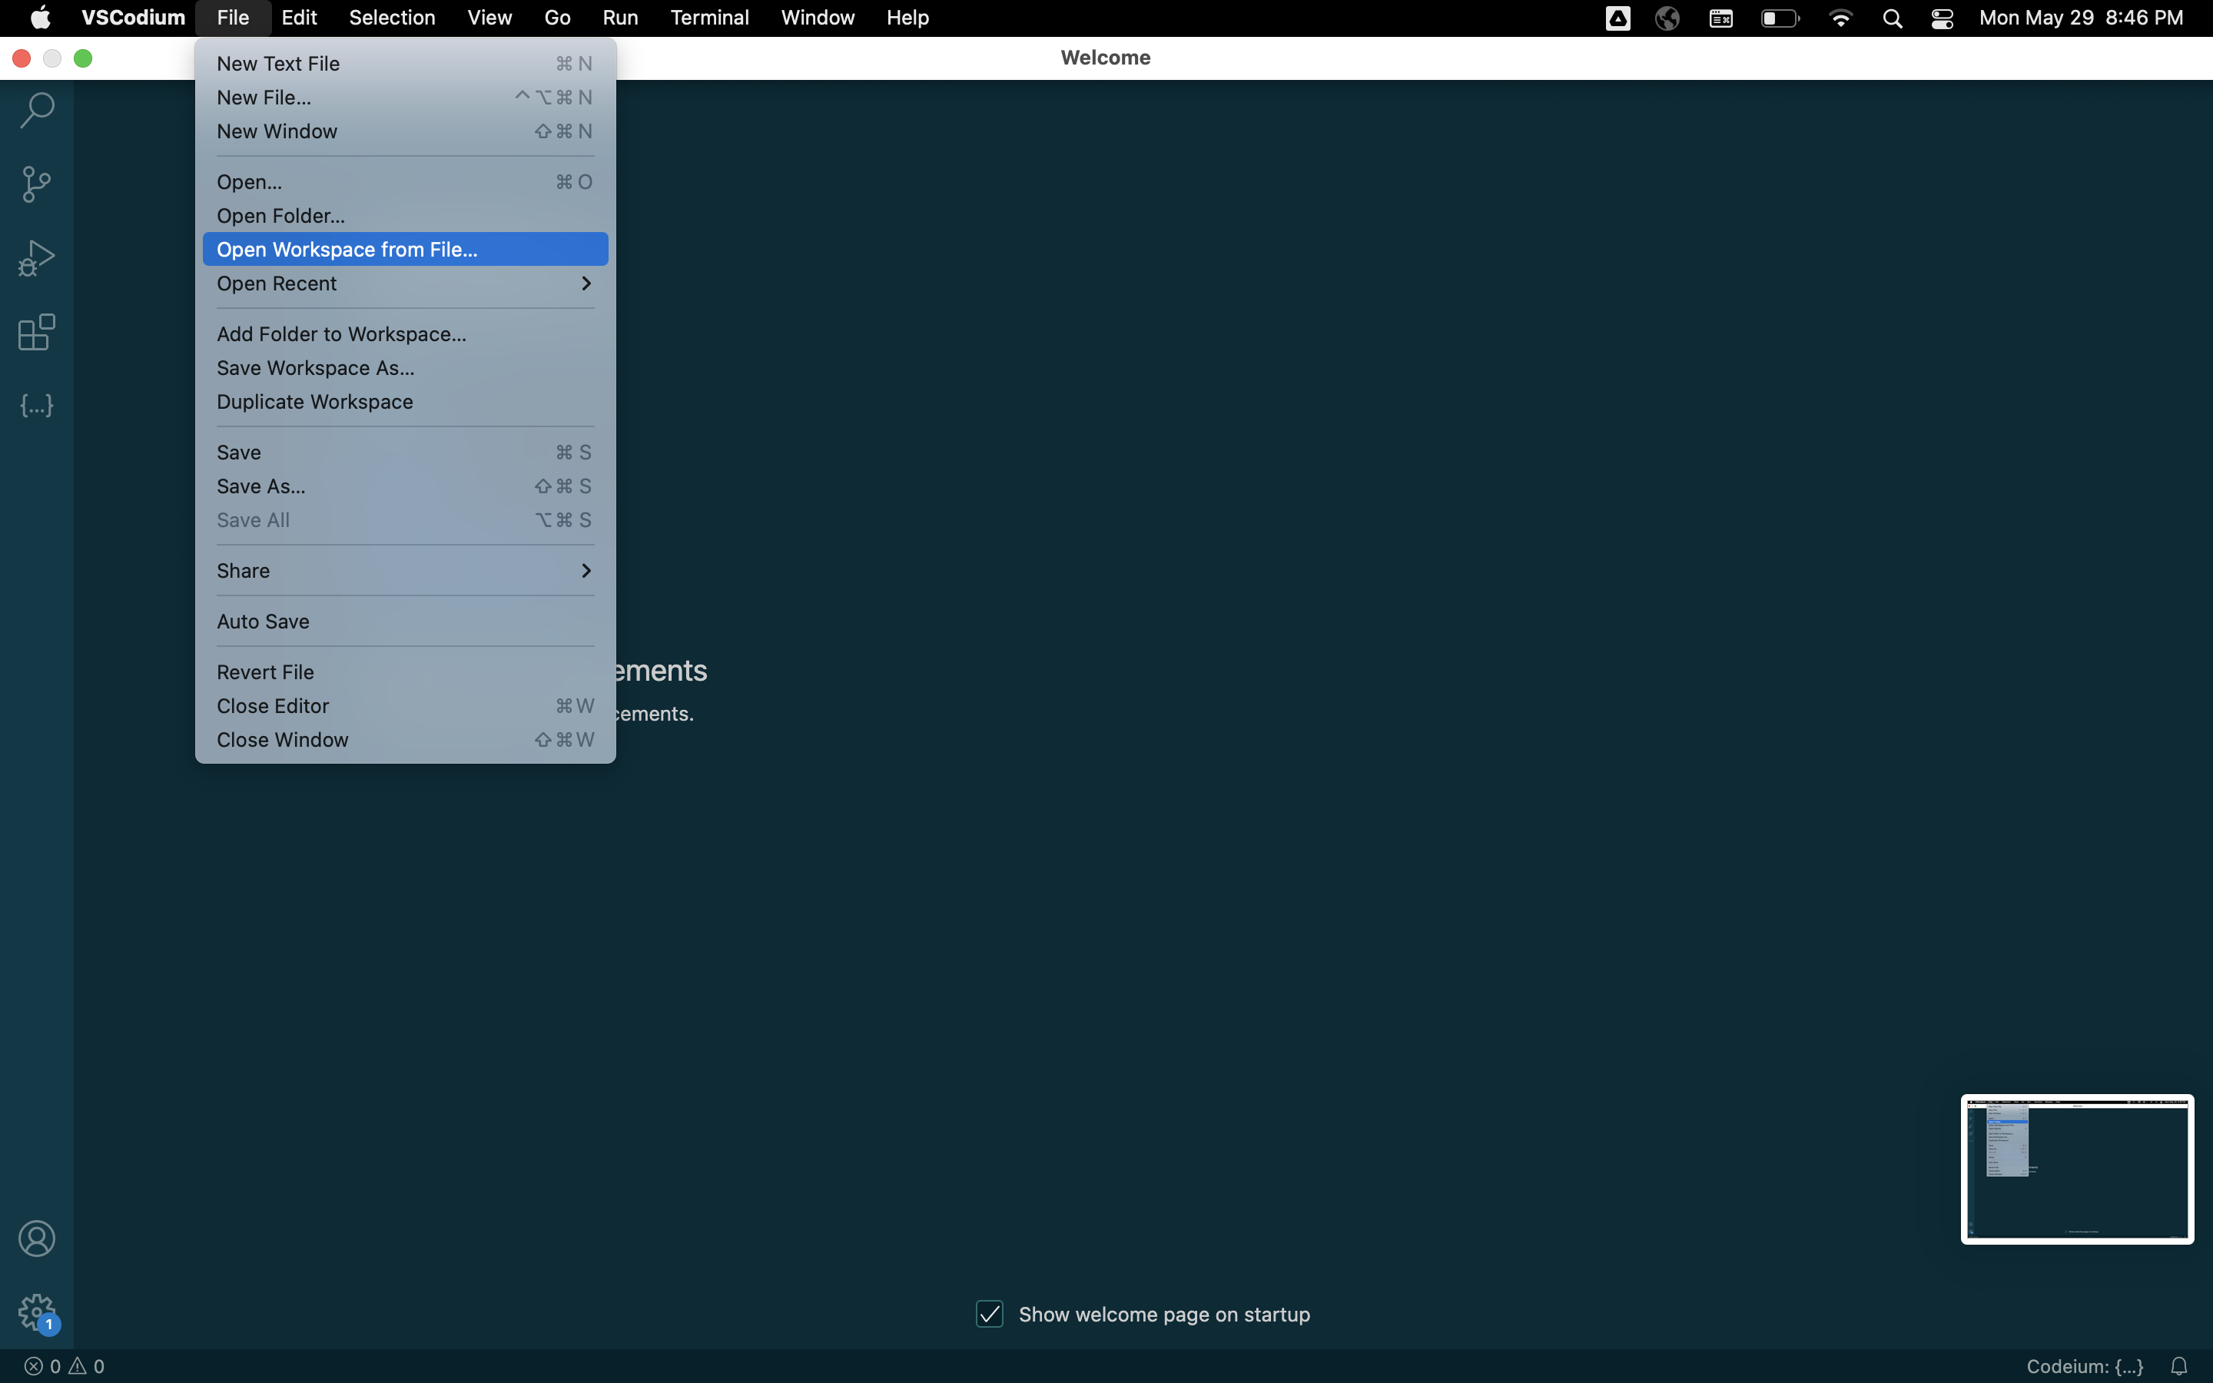
VS Codium/VS Code

Slide 7
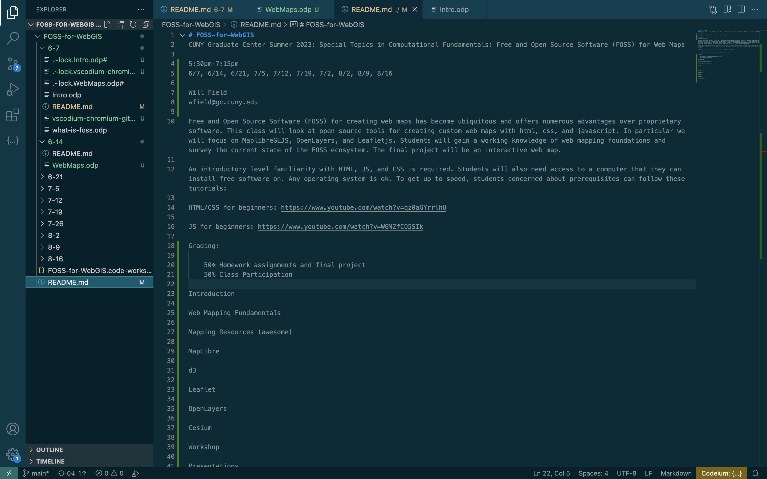
VS Codium/VS Code

Slide 8
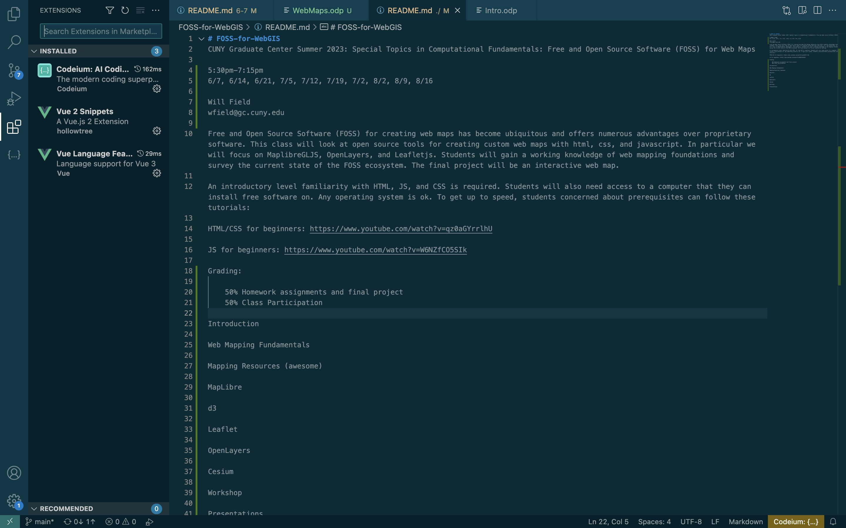
VS Codium/VS Code

Slide 9
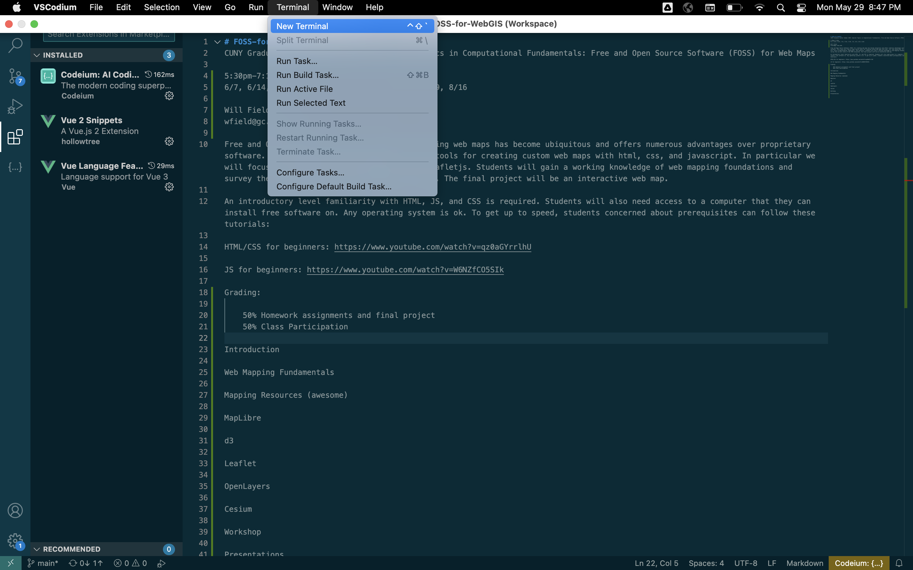
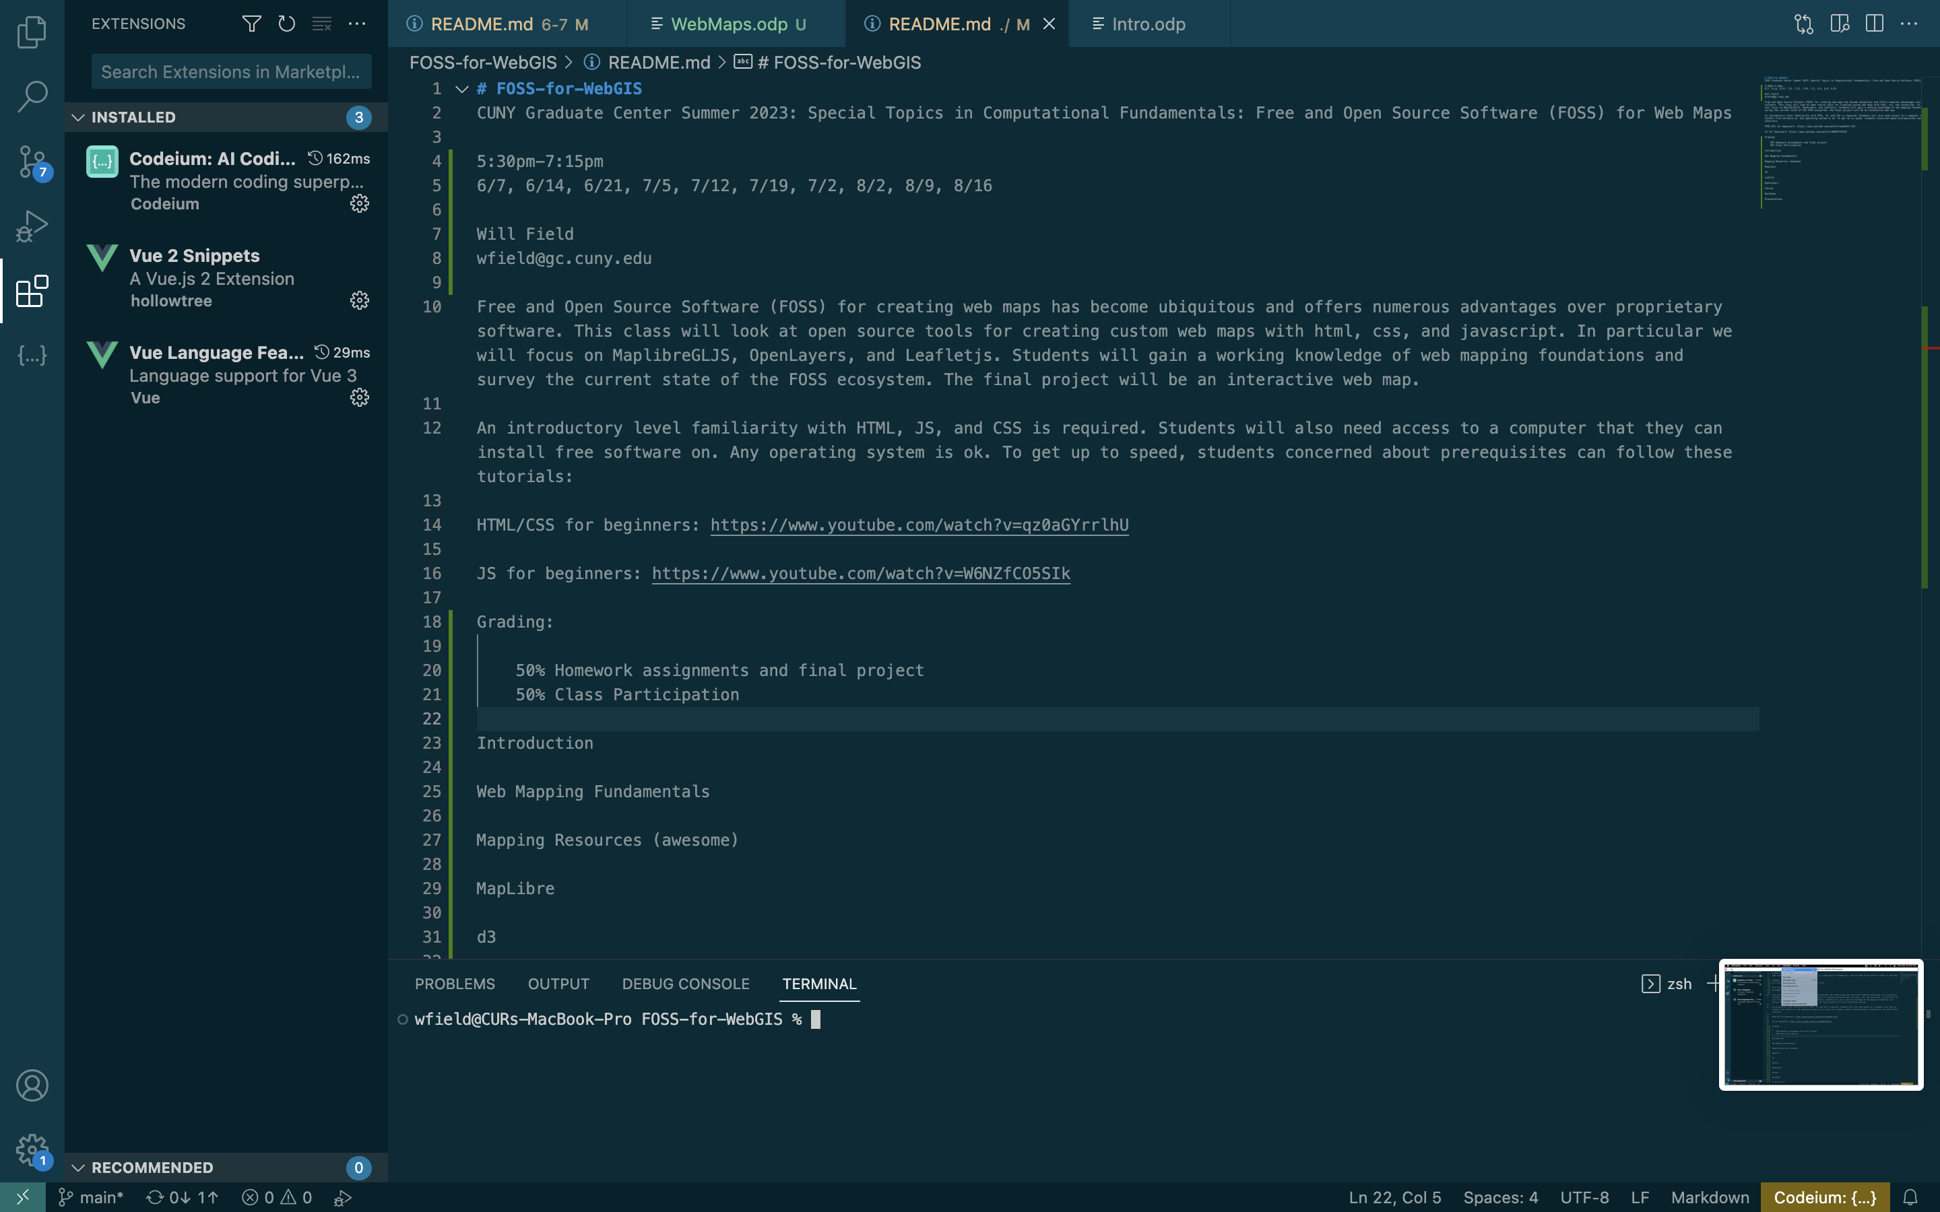
VS Codium/VS Code

Slide 10
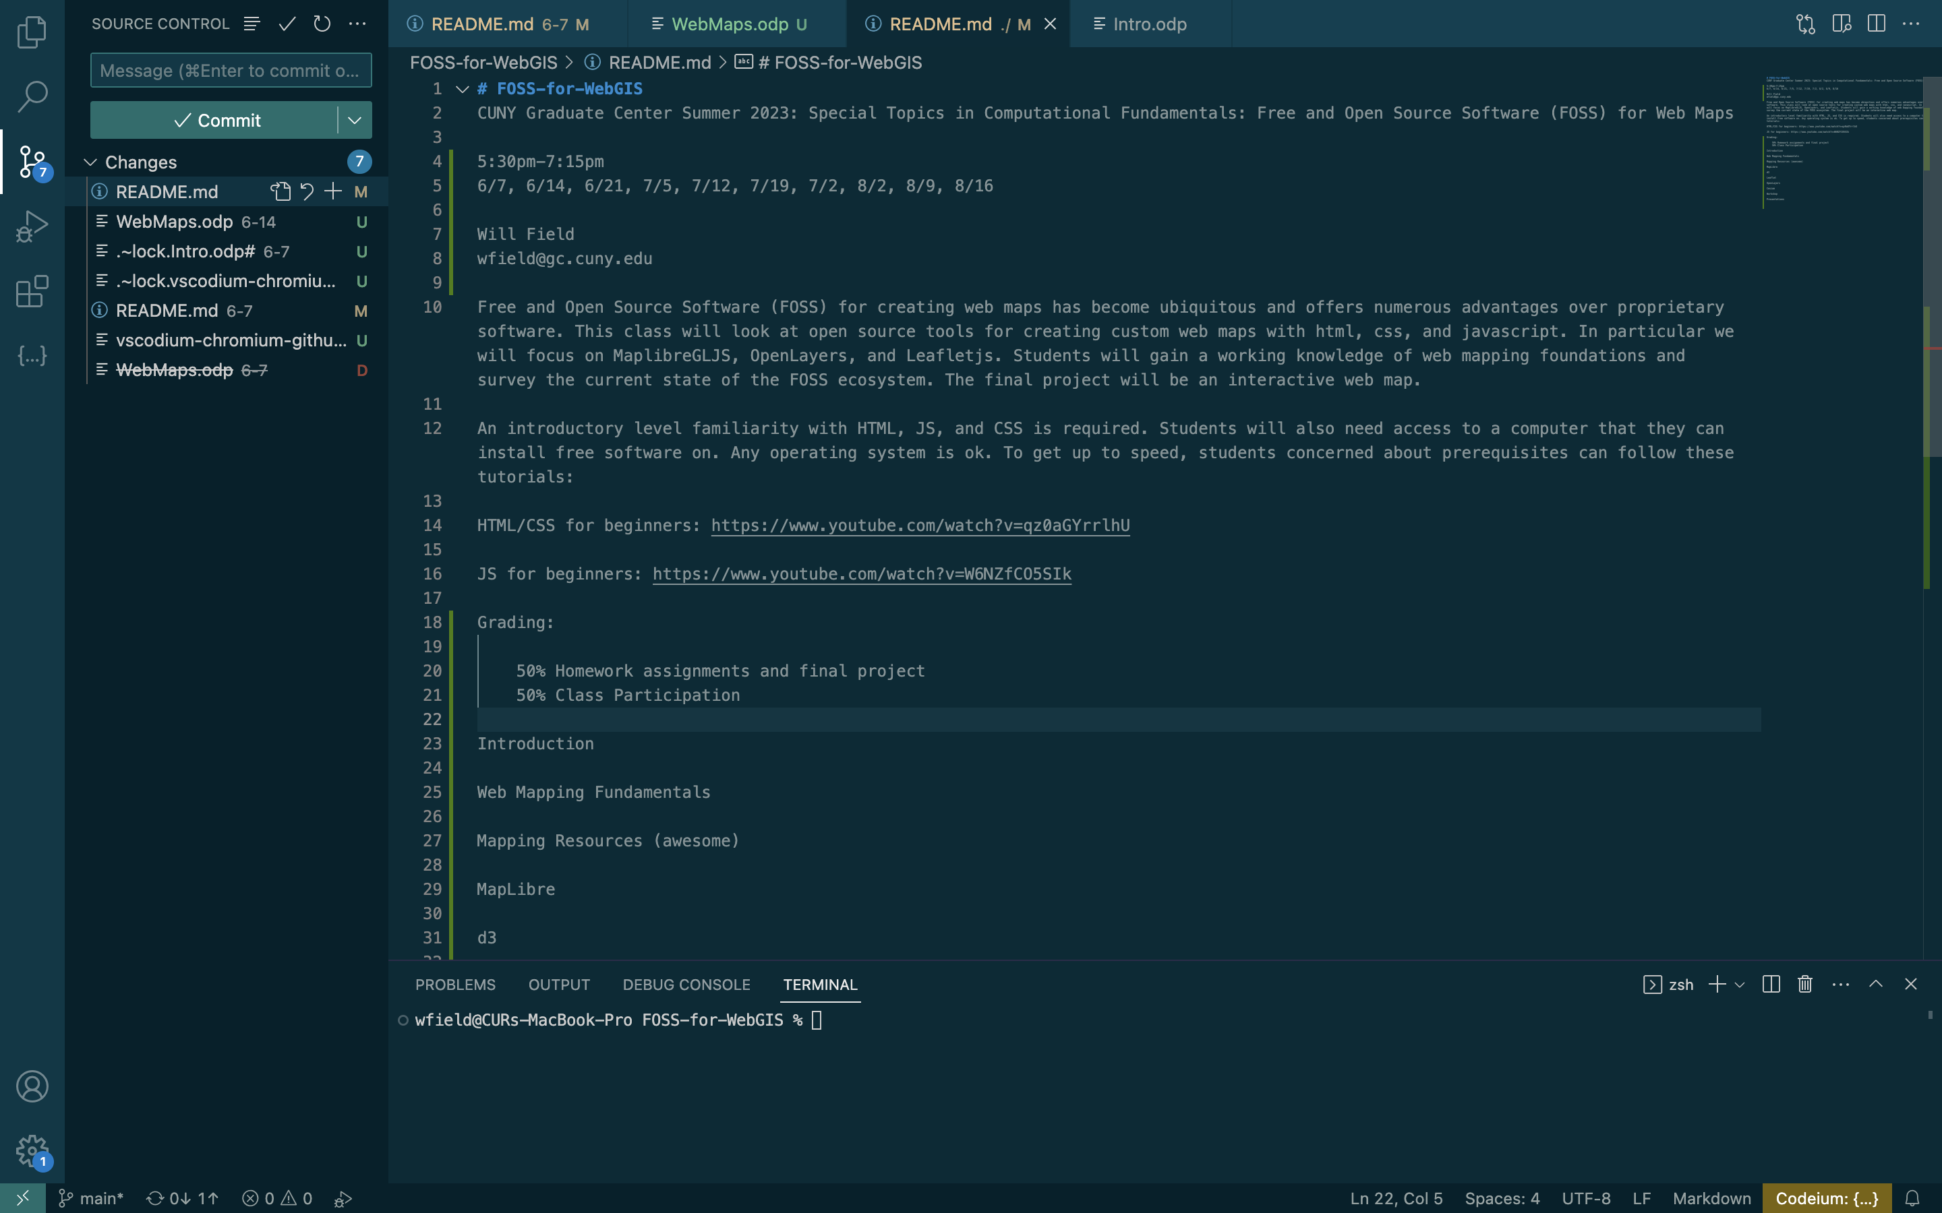
VS Codium/VS Code

Slide 11
Chromium/Chrome
https://download-chromium.appspot.com/
https://www.google.com/intl/en/chrome/canary/
https://www.google.com/intl/en/chrome/

Slide 12
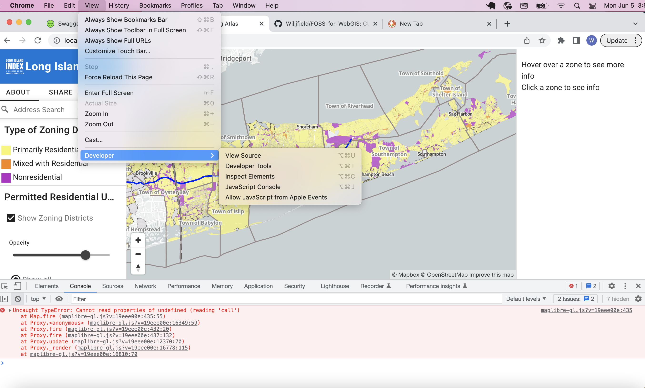
Chromium/Chrome

Slide 13
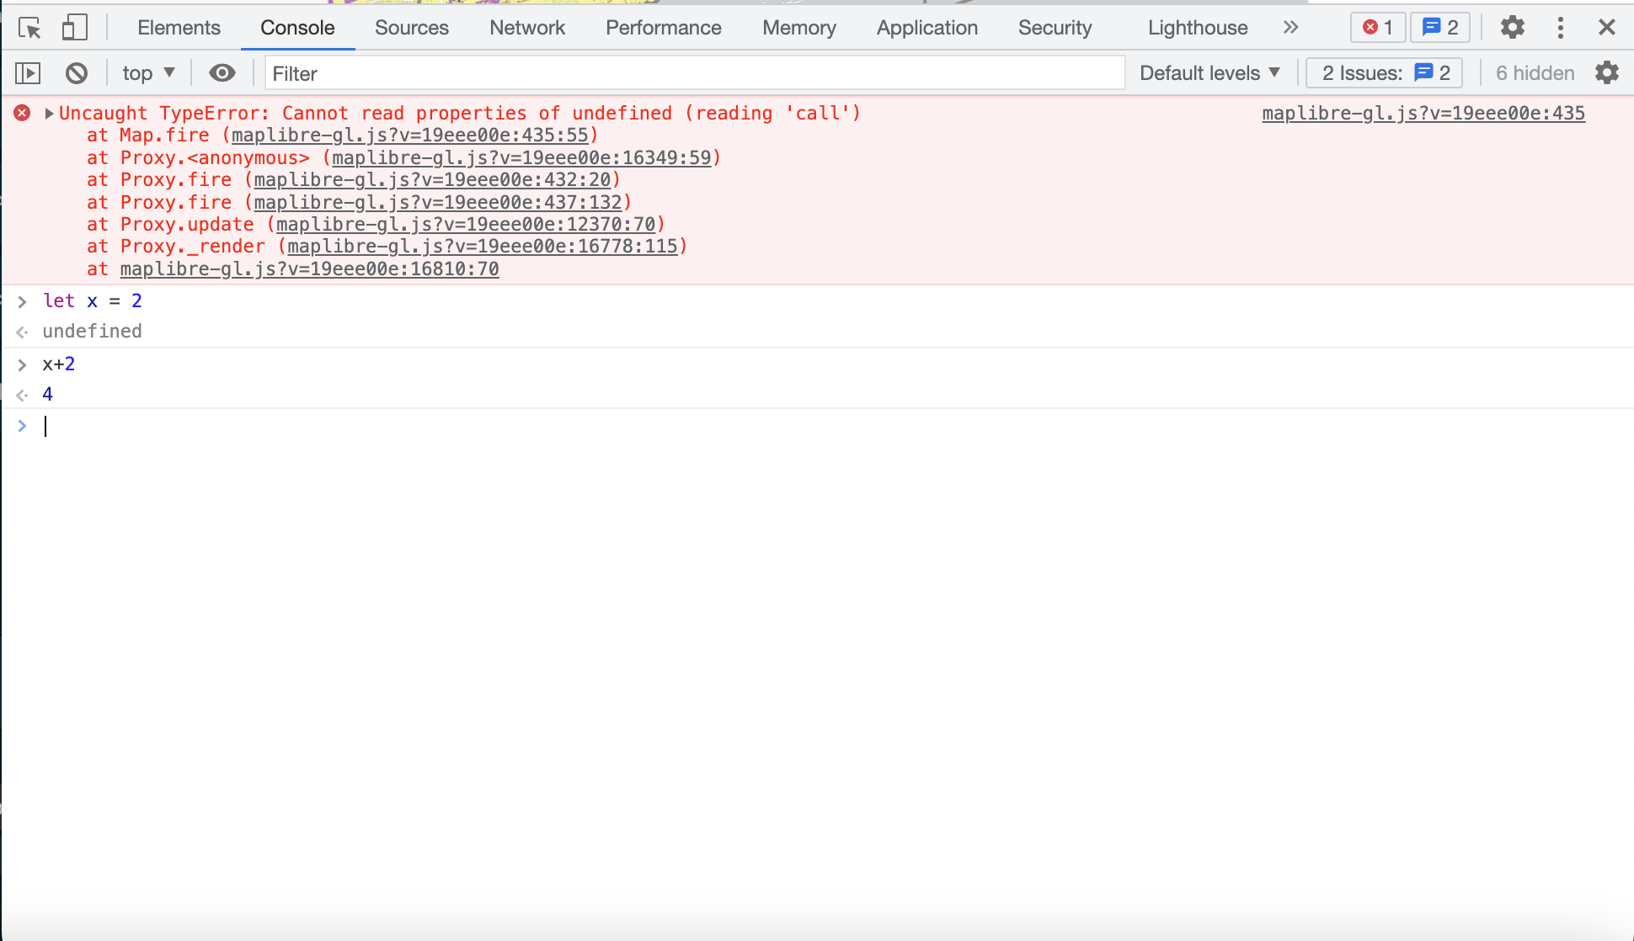
Chromium/Chrome

Slide 14
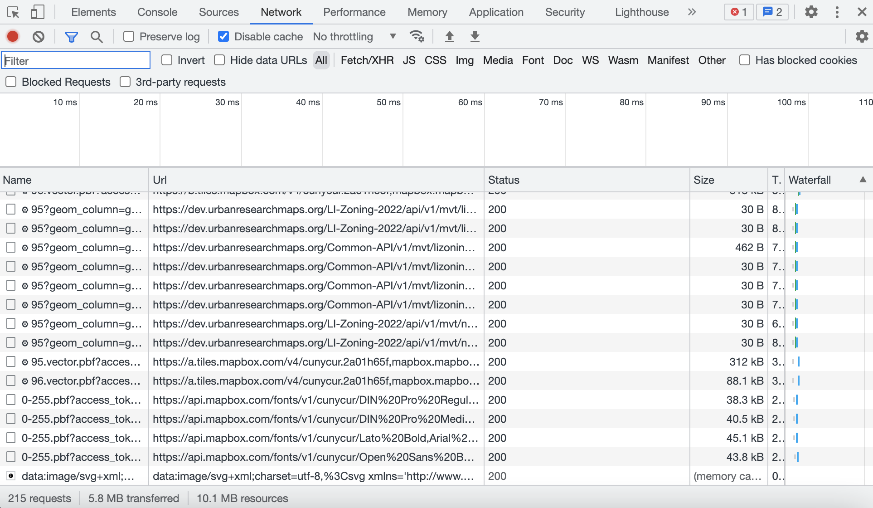
Chromium/Chrome

Slide 15
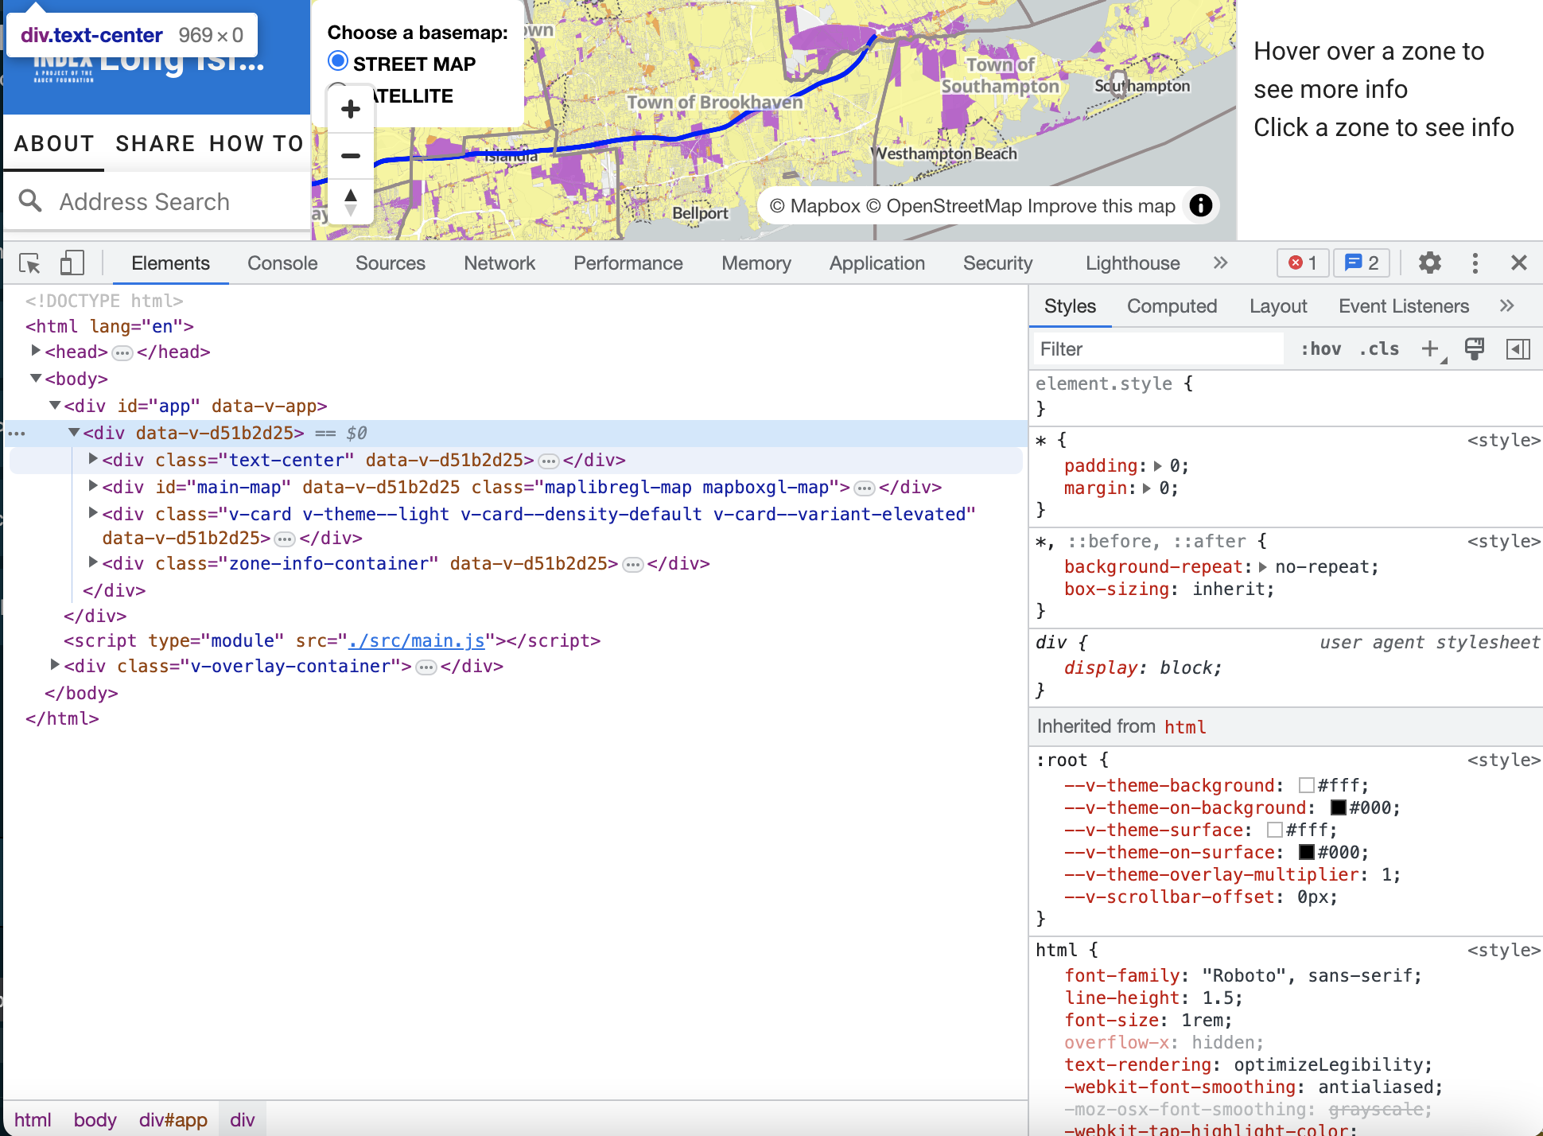
Chromium/Chrome

