Slide 1
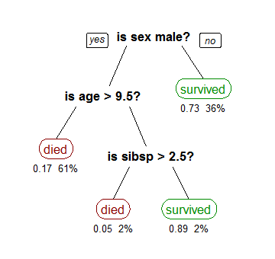
Recursive Partitioning
Recursive partitioning creates a decision tree that strives to correctly classify members of the population based on several dichotomous independent variables. (Wikipedia)
http://visualgo.net/recursion.html
Credit: Stephen Milborrow

Slide 2
Introduction http://www.r-bloggers.com/example-9-10-more-regression-trees-and-recursive-partitioning-with-partykit/
> ds =read.csv("http://www.math.smith.edu/r/data/help.csv")
> library(rpart); library(partykit)
> ds$sub = as.factor(ds$substance)
> homeless.rpart = rpart(homeless ~ female + i1 + sub + sexrisk + mcs + pcs, method="class", data=ds)
> plot(homeless.rpart)
> text(homeless.rpart, use.n=TRUE, all=TRUE, cex=.8)

Slide 3
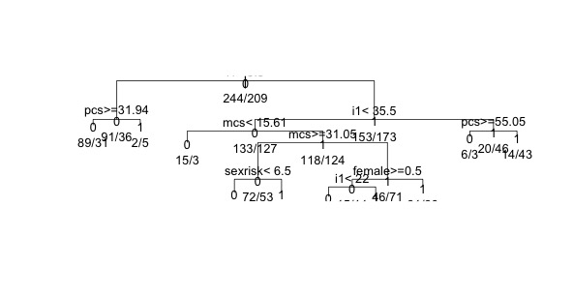

Slide 4
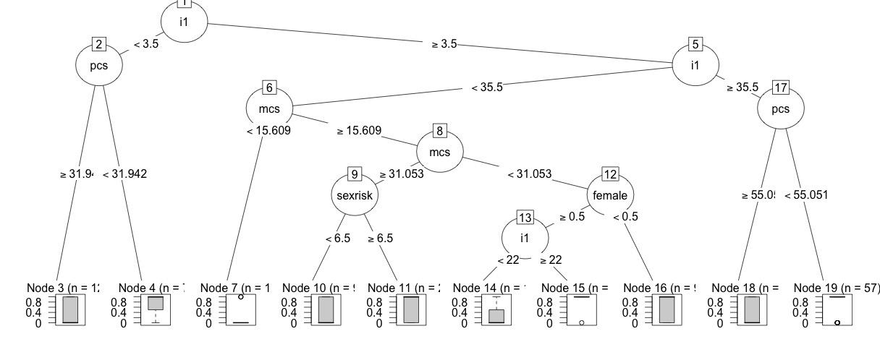
> printcp(homeless.rpart)
  #This will print a text read out of the variables used in the tree and how the #algorithm decided to split the variables
> Plot(as.party(homeless.rpart), type="extended")

Slide 5
Working with our own data
> library(rpart); library(partykit)
> ramphs = read.csv('/Users/willjfield/Desktop/Projects/ITP/Spring_2015/ISAW_MapDataViz/Week_3_Class/roman-amphitheaters.csv')
#or get the latest ramphs from url
>ramphs.rpart = rpart(capacity ~ quarries.nearest + freq.modcountry + elevation, method="anova", data=ramphs, na.action=na.rpart)
> plot(ramphs.rpart)
> text(ramphs.rpart, use.n=TRUE, all=TRUE, cex=.6)

Slide 6
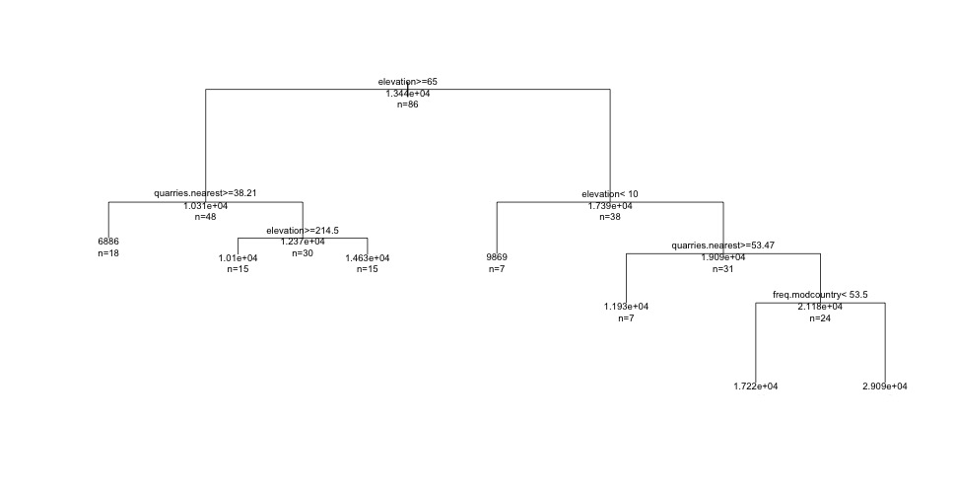

Slide 7
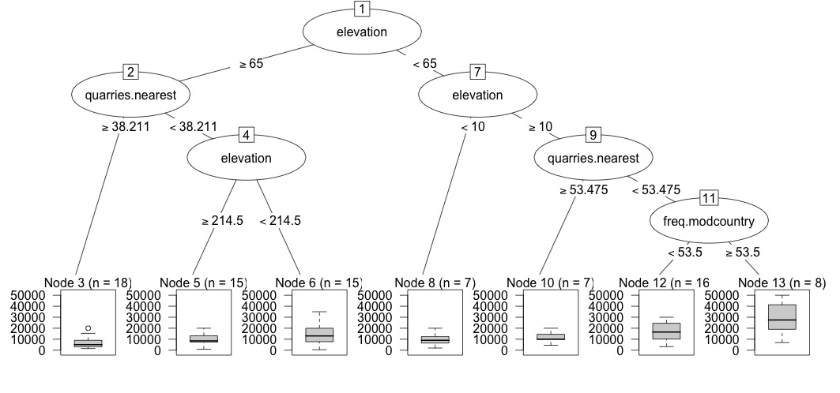
> printcp(ramphs.rpart)
> plot(as.party(ramphs.rpart), type="extended")

