Slide 1
FreqMamba:Generalizable Frequency-Spatial Mamba Network for Structure-Preserving Retinal Image Enhancement
Jialiang Liu, Xiangyang Yu, Huiyan Lin, Heng Li and Jiang Liu
Southern University of Science and Technology
July 25, 2026 | 22:45–23:00 CST
ICIC 2026 — Session 2: Image Processing — Online Room E — Paper 5225

Slide 2
OUTLINE
PART 1
Motivation & Background
PART 2
FreqMamba Method
PART 3
Experiments & Results
PART 4
Conclusion

Slide 3
1
Motivation
________________________________________

Slide 4
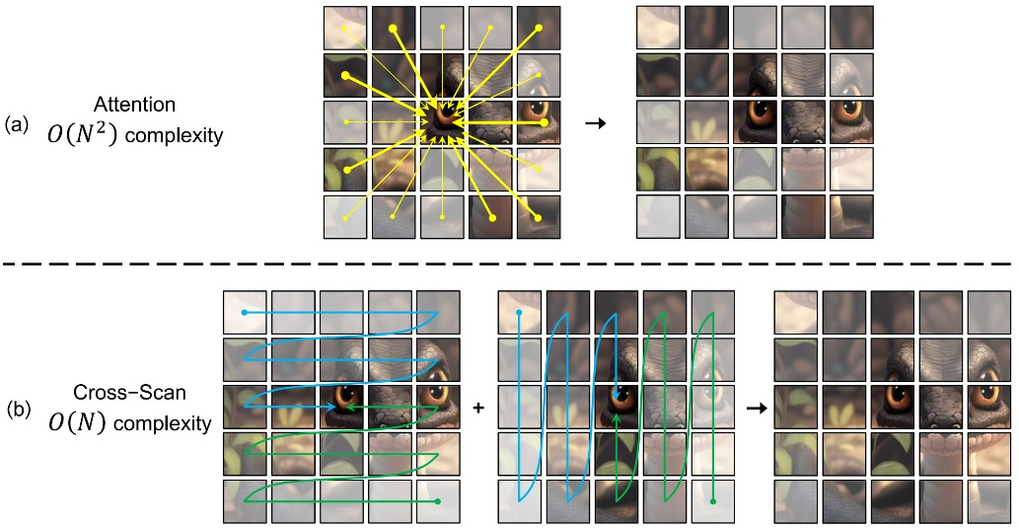
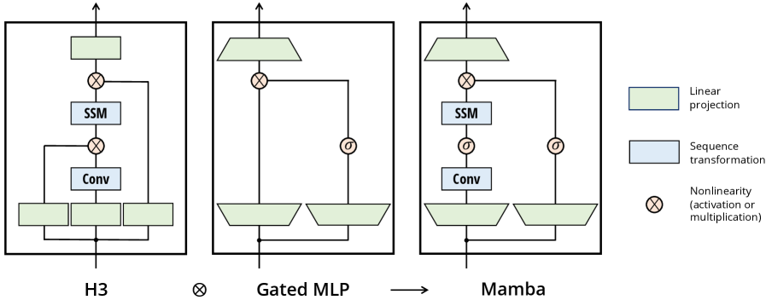
FreqMamba: spatial (Mamba) + frequency (FFT) dual-domain with linear O(N) complexity
I Background
Three Key Challenges
Current Limitations
CNN: limited receptive field
Transformer: O(H²W²) complexity
End-to-end denoising: over-smoothing
① Structural Continuity vs. Noise Suppression
Vessel structures need long-range modeling
without over-smoothing fine details
② Adaptive Degradation Separation
Real-world degradations vary in type & severity
Need to decouple artifacts from anatomy
③ Downstream Task Awareness
Enhancement must preserve vascular integrity
for subsequent diagnostic analysis

Slide 5
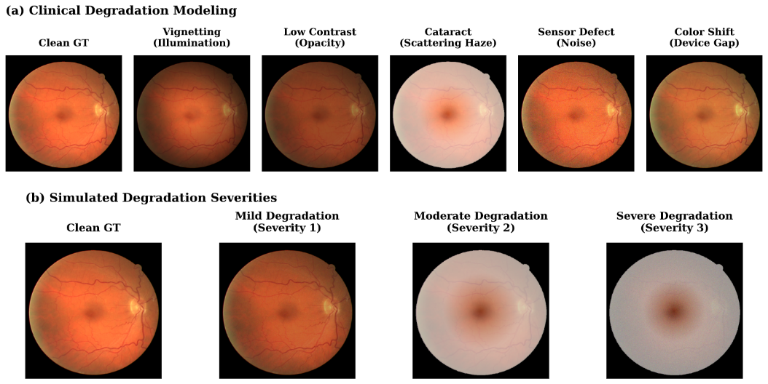
I Background
Synthetic Degradation Protocol
• Five frequency-dependent artifacts:
Illumination shading (radial)
Contrast reduction
Scattering haze (atmospheric)
Sensor noise (Gaussian)
Color cast (channel-wise)
• 3 severity levels for rigorous testing
• Random on-the-fly composition during training
• Deterministic md5-seeded for validation

Slide 6
Contribution
1. A highly generalizable hybrid architecture, FreqMamba, is proposed, integrating bidirectional Mamba-based spatial modeling with adaptive frequency-domain modulation.
2. The FSMB is designed as the core computational unit, combining long-range spa-tial SSMs with a learnable, Butterworth-guided implicit residual frequency modu-lation to resolve the over-smoothing dilemma.
3. A rigorous downstream-task-aware evaluation protocol under zero-shot cross-dataset settings is introduced, demonstrating that FreqMamba outperforms state-of-the-art methods in both perceptual quality and downstream robustness.

Slide 7
2
FreqMamba Method
________________________________________

Slide 8
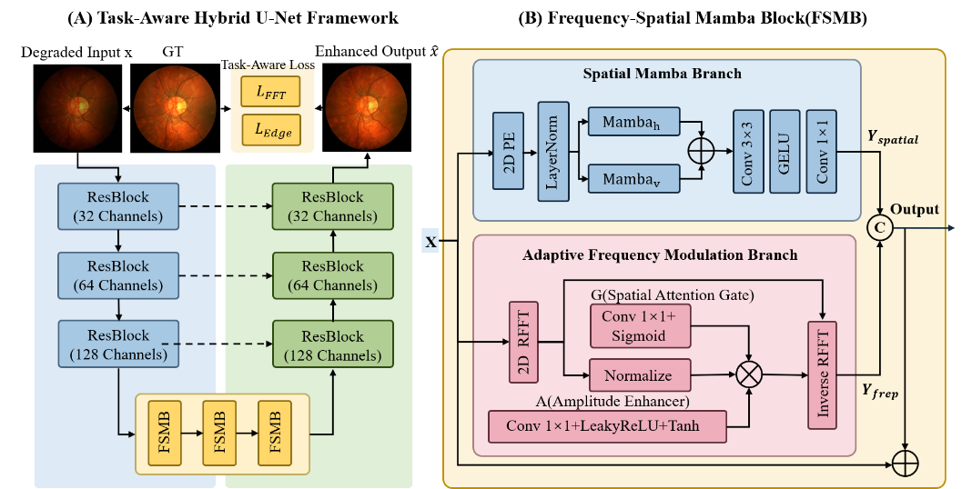
The overview of FreqMamba
Notes:
我们的算法流程如图。首先在本地训练时，我们提取模型每一层的输入，生成核心梯度空间，上传到服务器。然后服务器聚合来自不同客户端的梯度投影矩阵，生成联合投影矩阵，再发送回各个客户端。最后在本地训练过程中，根据使用梯度投影记忆来更新模型。训练损失函数我们使用一般的分类损失。接下来我将详细介绍这三个部分。

Slide 9

I Architecture
HybridMambaUNet
• U-shaped network with skip connections
• Encoder: Conv → ResBlock → Downsample
3 → 32 → 64 channels
• Bottleneck (128 ch):
3 × Frequency-Spatial Mamba Block
• Decoder: Upsample → Concat → Conv
• Residual: output = input + tail_pred

Slide 10
II FSMB Design
Spatial Mamba Branch
• Bidirectional Mamba scanning:
Horizontal scan (H×W → sequence)
Vertical scan (W×H → sequence)
• Learnable 2D positional encoding
• Preserve spatial topology priors
• Depth-wise spatial fusion:
Conv3×3 → GELU → Conv1×1
• Complexity: O(HW) linear

Slide 11
II FSMB Design
Adaptive Frequency Modulation
• RFFT2 → magnitude M + phase φ
• Mean-normalize M to mitigate
global illumination discrepancies
• Multiplicative modulation:
Gate G: spatial attention map
Enhancer A: Tanh-bounded activation
• Butterworth-like high-frequency prior W:
W = σ(s · (R − c))
c: learnable cutoff, s: learnable sharpness
Modulation formula:
M' = M · (1 + α · G × A × W)
• After unnormalization:
M' × M̄
• Inverse RFFT back to spatial
• Implicit residual nature:
Frequency branch preserves
anatomical structures

Slide 12
II FSMB Design
Dual-Pathway Fusion + Loss
• Adaptive Fusion:
out = σ(gate) × spatial
+ (1−σ(gate)) × freq
Learnable sigmoid gate balances
spatial vs. frequency contribution
Task-Aware Loss Function:
L = L_char + λ_fft · L_fft + λ_edge · L_edge
Loss Details
L_char: Charbonnier (ε=1e-3)
Smooth L1 variant
L_fft: Log-magnitude FFT L1
Preserves frequency distribution
L_edge: Sobel gradient L1
Preserves vessel boundaries
λ_fft=0.3, λ_edge=0.3

Slide 13
3
Experiments
________________________________________

Slide 14
I Setup
• Zero-shot cross-dataset protocol
• AdamW (lr=4e-4, wd=1e-4)
• ReduceLROnPlateau (factor=0.5)
• EMA decay = 0.999
• Early stopping (patience=30)
• Mixed precision (AMP + GradScaler)
• Image size: 512×512, batch=8
Experimental Configuration
Training Dataset | train | validate | test
APTOS 2019 | 1024 | 128 | 128
Evaluating datasets | Num.
DRIVE | 20
HRF | 15
CHASE_DB1 | 28
Evaluation Metrics
PSNR, SSIM = fidelity
LPIPS = perceptual quality
Dice, AUC = downstream seg.
Baselines:
U-Net, Restormer, NAFNet, FFCNet
(same U-Net skeleton)

Slide 15
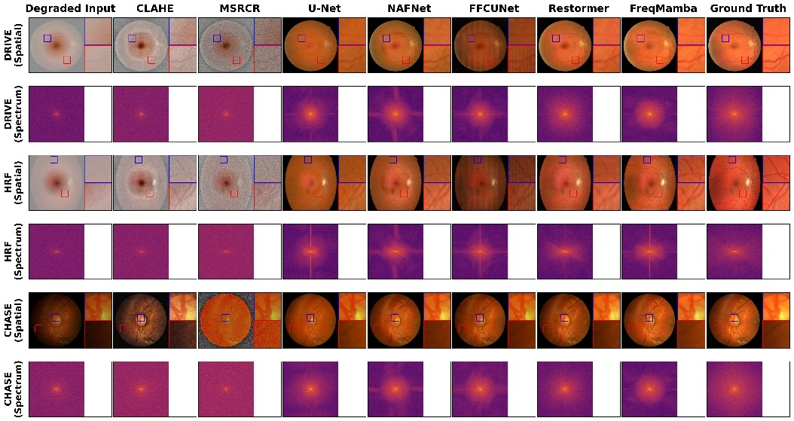
II Results
Image Quality Comparison
FreqMamba effectively restores global illumination and vascular de-tails, while its frequency spectrum closely aligns with the healthy ground truth state,explicitly avoiding the severe high-frequency loss typical of CNN-based enhancement.

Slide 16
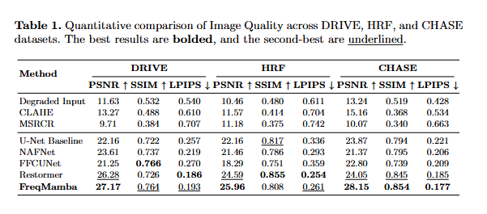
II Results
Image Quality Comparison (Table 1)
• FreqMamba achieves SOTA across all metrics
• Best PSNR, SSIM, LPIPS on DRIVE, HRF, CHASE
• LPIPS: significant perceptual quality gain
• CLAHE deteriorates SSIM/LPIPS by amplifying
high-frequency sensor noise indiscriminately

Slide 17
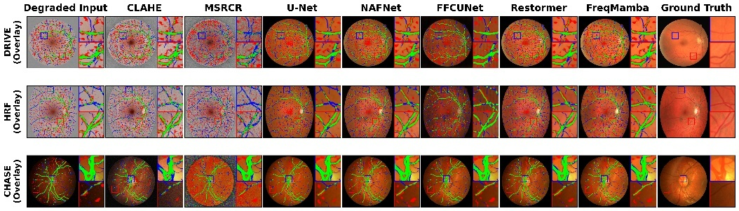
II Results
Downstream Segmentation
Segmentation overlay comparison. Green indicates True Positive (TP), Red indicates False Positive (FP), and Blue indicates False Negative (FN, representing disconnected vessels). FreqMamba significantly reduces topological disconnections commonly caused by conventional over-smoothing.

Slide 18
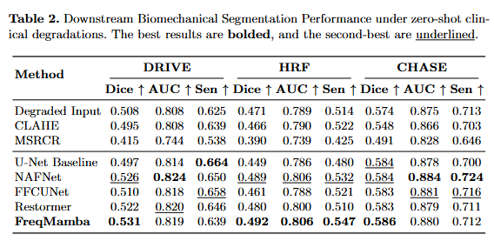
II Results
Downstream Segmentation (Table 2)
• Frozen segmentation UNet evaluates
enhancement quality on downstream task
• Baseline CNNs degrade Dice score
(over-smoothing destroys vessel connectivity)
• FreqMamba preserves vascular structures
→ highest Dice + AUC on all datasets

Slide 19
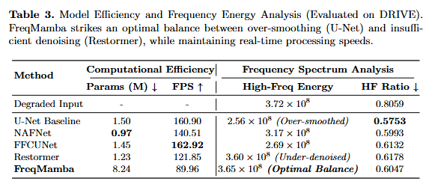
II Results
Efficiency Analysis (Table 3)
• FreqMamba strikes optimal balance between
over-smoothing (U-Net) & under-denoising (Restormer)
• Maintains moderate model complexity:
Fewer parameters than Restormer
Efficient linear-complexity Mamba
• Frequency energy analysis:
Preserves mid-to-high frequency structures
without noise amplification

Slide 20
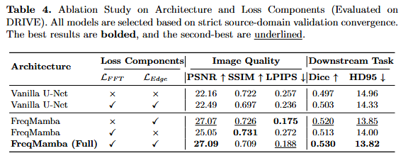
II Results
Ablation Study (Table 4)
• Dual-domain design validated:
Spatial branch only → detail loss
Frequency branch only → structure loss
Both branches combined → best
• Loss components:
L_fft + L_edge improve Dice on baseline
But may degrade PSNR without FSMB
FSMB resolves over-smoothing dilemma

Slide 21
4
Conclusion
________________________________________

Slide 22
FreqMamba: hybrid architecture integrating bidirectional Mamba-based spatial modeling with adaptive frequency modulation
1
FSMB: core computational unit combining long-range S6 SSMswith Butterworth-guided implicit residual frequency modulationto resolve the over-smoothing dilemma
2
Downstream-task-aware evaluation protocol under zero-shot cross-dataset settings, demonstrating SOTA perceptual quality and vascular preservation for enhanced clinical utility
3

Slide 23
Thank You! Q&A
FreqMamba — ICIC 2026 — Paper 5225
Jialiang Liu | Southern University of Science and Technology

Slide 24
References
1. Bansal, S., A, S., Prasath, M.J., et al.: A comprehensive survey of mamba architectures for medical image analysis: Classification, segmentation, restoration and beyond. arXiv preprint arXiv:2410.02362 (2024)
2. Cao, H., Wang, Y., Chen, J., Jiang, D., Zhang, X., Tian, Q., Wang, M.: Swin-unet: Unet-like pure transformer for medical image segmentation. In: European Conference on Computer Vision Workshops (ECCVW) (2022)
3. Cheng, P., Lin, L., Huang, Y., Lyu, J., Tang, X.: I-secret: Importance-guided fundus image enhancement via semi-supervised contrastive constraining. In: Medical Image Computing and Computer Assisted Intervention–MICCAI. pp. 87–96. Springer (2021)
4. Fan, H., Yu, X., Li, H., Li, H., Liu, J.: Gdaformer: Transformer-driven fundus image enhancement with gated dual-attention. arXiv preprint arXiv:2403.01234 (2024)
5. Gu, A., Dao, T.: Mamba: Linear-time sequence modeling with selective state spaces. arXiv preprint arXiv:2312.00752 (2023)
6. Jena, R., et al.: Self-supervised vessel enhancement using flow-based consistencies. In: Medical Image Computing and Computer Assisted Intervention–MICCAI. Springer (2021)
7. Li, H., Liu, H., Fu, H., Shu, H., Zhao, Y., Luo, X., Hu, Y., Liu, J.: Structure-consistent restoration network for cataract fundus image enhancement. In: Medical Im-age Computing and Computer-Assisted Intervention–MICCAI. pp. 487–496. Springer (2022)
8. Li, H., Liu, H., Fu, H., et al.: A generic fundus image enhancement network boosted by frequency self-supervised representation learning. Medical Image Analysis 90, 102945 (2023). https://doi.org/10.1016/j.media.2023.102945
9. Li, T., Bo, W., Hu, C., Kang, H., Liu, H., Wang, K., Fu, H.: Applications of deep learn-ing in fundus images: A review. Medical Image Analysis 69, 101971 (2021)
10. Liao, W., Chen, Z., Xie, J., Zheng, Y., Ma, Y., Zhao, Y.: A frequency-aware self-supervised learning for ultra-wide-field image enhancement. In: Medical Image Compu-ting and Computer Assisted Intervention–MICCAI. Springer (2025)

Slide 25
References
11. Litjens, G., S´anchez, C.I., Timofeeva, N., Hermsen, M., et al.: Deep learning as a tool for increased accuracy and efficiency of histopathological diagnosis. Scientific reports 6(1), 26286 (2016). https://doi.org/10.1038/srep26286
12. Liu, D., et al.: Adaptive frequency-domain enhanced deep model driven by heterogene-ous networks for medical image segmentation. Knowledge-Based Systems (2025)
13. Liu, H., Li, H., Fu, H., Xiao, R., Gao, Y., Hu, Y., Liu, J.: Degradation-invariant en-hancement of fundus images via pyramid constraint network. In: Medical Image Com-puting and Computer-Assisted Intervention–MICCAI. pp. 507–516. Springer (2022)
14. Liu, Y., Tian, Y., Zhao, Y., Yu, H., Xie, L., Wang, Y., Ye, Q., Jiao, J., Liu, Y.: Vmamba: Visual state space model. In: Advances in Neural Information Processing Systems (2024)
15. Luo, B., Wen, Y., Ji, J., Cao, W., Li, P.: Frequency-domain assisted fundus image en-hancement network based on the mamba model. In: 2024 IEEE International Confer-ence on Progress in Informatics and Computing (PIC). pp. 239–243. IEEE (2024)
16. Ma, J., Li, F., Wang, B.: U-mamba: Enhancing long-range dependency for biomedical image segmentation. arXiv preprint arXiv:2401.04722 (2024)
17. Pazo, E.E., Moutari, S., Gao, F., Hu, L., Usama, M., Li, X., Liu, J.: Structure- preserv-ing super-resolution of retinal fundus images via a dual-transformer residual network. Frontiers in Medicine 12, 1730678 (2026)
18. Ronneberger, O., Fischer, P., Brox, T.: U-net: Convolutional networks for biomedical image segmentation. In: Medical Image Computing and Computer-Assisted Interven-tion–MICCAI. pp. 234–241. Springer (2015)
19. Shen, Z., Fu, H., Shen, J., Shao, L.: Modeling and enhancing low-quality retinal fun-dus images. IEEE Transactions on Medical Imaging 40(3), 996–1006 (2020)
20. Wang, Z., Zheng, J.Q., Zhang, Y., Cui, G., Li, L.: Mamba-unet: Unet-like pure visual mamba for medical image segmentation. arXiv preprint arXiv:2402.05079 (2024)

Slide 26
References
21. Wen, Y., Luo, Y., et al.: Dsf-net: a dual-stream fusion network integrating structural and detailed features for fundus-based diabetic retinopathy classification. The Visual Computer (2025)
22. Wu, W., Xing, Z., Gong, J., Peng, Q., Zhu, L.: Hybridmamba: A dual-domain mamba for 3d medical image segmentation. arXiv preprint arXiv:2509.14609 (2025)
23. Xie, R., et al.: Analysis of in vivo sclera impact on the biomechanics of myopic eyes. Translational Vision Science & Technology 14(6), 8 (2025). https://doi.org/10.1167/tvst.14.6.8
24. Xing, Z., Ye, T., Yang, Y., Liu, G., Zhu, L.: Segmamba: long-range sequential model-ing mamba for 3d medical image segmentation. In: Medical Image Computing and Computer Assisted Intervention–MICCAI. Springer (2024)
25. Xu, K., Liang, Z., Wei, W., Chen, H., Jin, Y.: Fundus image enhancement with pyra-mid conditional flow. IEEE Journal of Biomedical and Health Informatics (2025)
26. Yuan, Y., Zhang, Y., et al.: Exploiting cross-scale attention transformer and progres-sive edge refinement for retinal vessel segmentation. Mathematics 12(2), 264 (2024)
27. Zheng, P., Chen, K., Huang, J., Chen, B., Liu, J., Ren, Y., Pu, X.: Efficient medical image restoration via reliability guided learning in frequency domain. arXiv preprint arXiv:2504.11286 (2025). https://doi.org/10.48550/arXiv.2504.11286
28. Zhou, Y., Ahmed, T.S., et al.: Masked vascular structure segmentation and completion in retinal images. IEEE Transactions on Medical Imaging (2025)
29. Zou, H., Liu, J., et al.: Retinal features as predictive indicators for high myopia: in-sights from explainable multi-machine learning models. Frontiers in Bioengineering and Biotechnology 13, 1609639 (2025)

