Slide 1
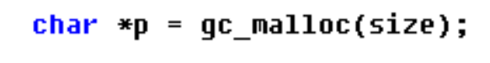
Functionality of the program [main() in driver.c]
Read test data from .rep file, which is used for allocating and free spaces
correctness() test correctness of your garbage collector
speed() test speed of your garbage collector
Garbage collection based malloc operation

Slide 2
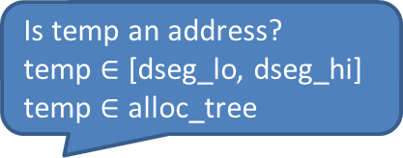
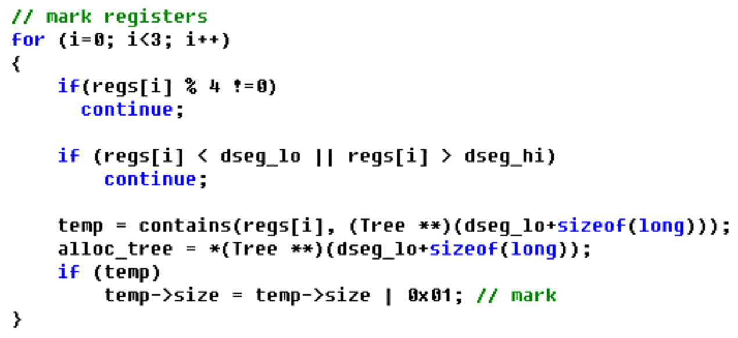
Root pointer in register
通过void garbage_collect(int *regs, int pgm_stack)函数形参*regs获得

Slide 3
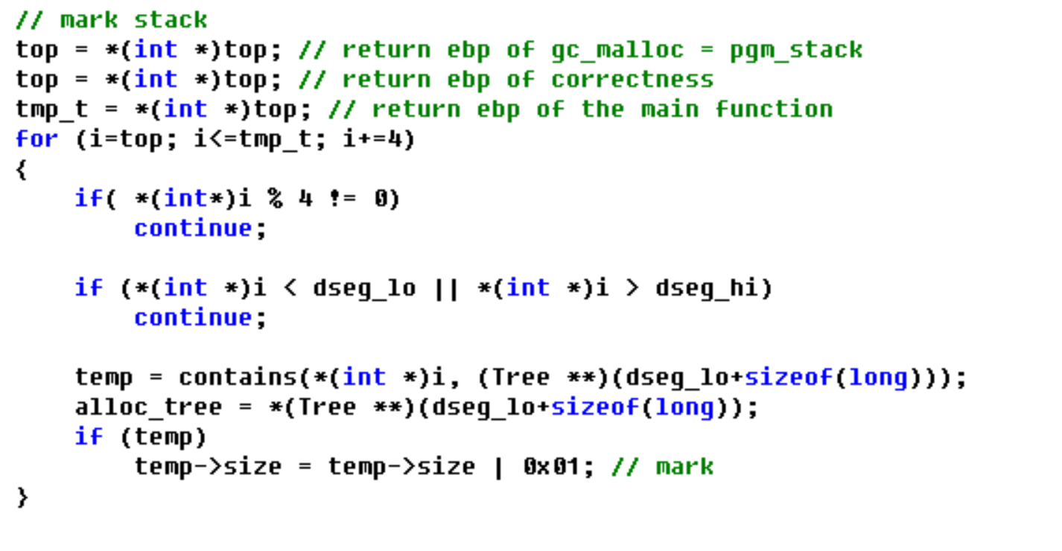
Root pointer of the stack
通过宏定义PGM_STACK_TOP获得当前ebp值，ebp里面保存的是调用函数的ebp，这样可一直向上访问到main()对应的栈空间
不对吧

Slide 4
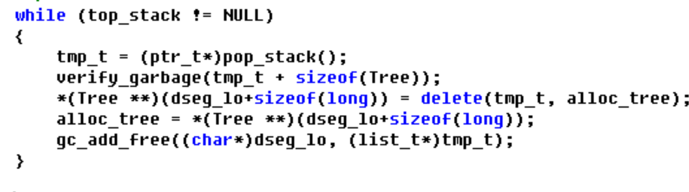
Delete allocated node and add it to free list

