Slide 1
Human Computer Interaction Project
Group Members:
William Torres
Ben Koutsoumbaris
Steven Valdez

Slide 2
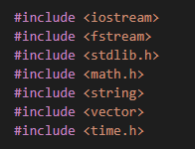
Introduction
C++ was used for this project
Considered Python but…
Lack of experience
Found better libraries in C++
Problems to go over:
Removing ‘?’ Rows
Splitting the data
Working with the 70% and 30% set
Results, Improvements

Slide 3
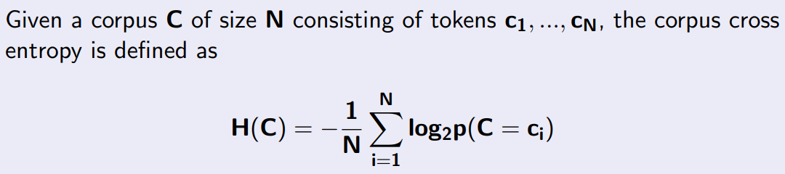
Algorithms Used
For the 70%
Max Likelihood Estimation (MLE)
For the 30%
Corpus Cross Entropy
Formula we followed:

Slide 4
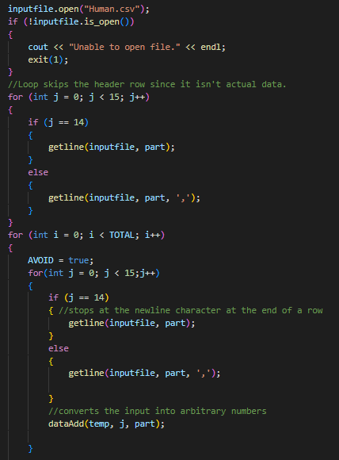
Training: Implementing the Data Set File
Open the file, and make sure to skip the first row since it only contains the column headers
Line is done if a newline character is hit
Using dataAdd() function, converts the input into arbitrary numbers (discussed later)

Slide 5
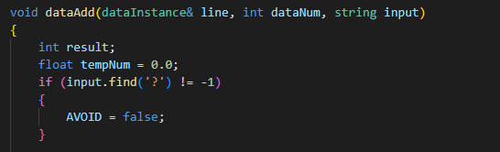
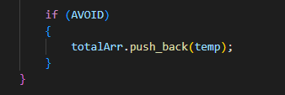
Training: Removing the ‘?’s
In The dataAdd() function…
Flags the ‘?’ row so it won’t be added to the data
In the main() function…
Avoid the rows where the flag is set to true

Slide 6
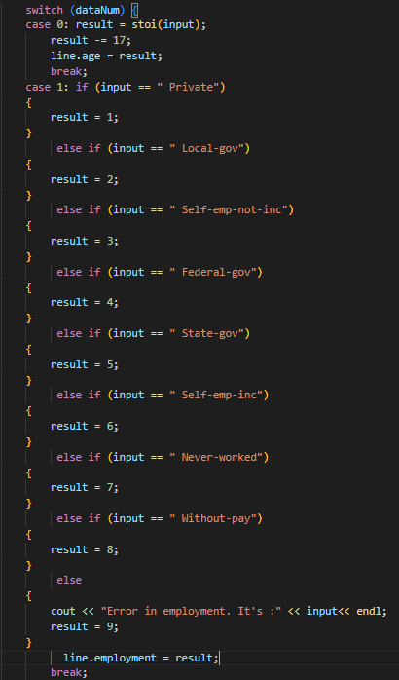
Training: Assigning Arbitrary Values
An arbitrary number was assigned for each value in the array
Note that this was hard-coded specifically for Human.csv (future improvement)
Examples:

Slide 7
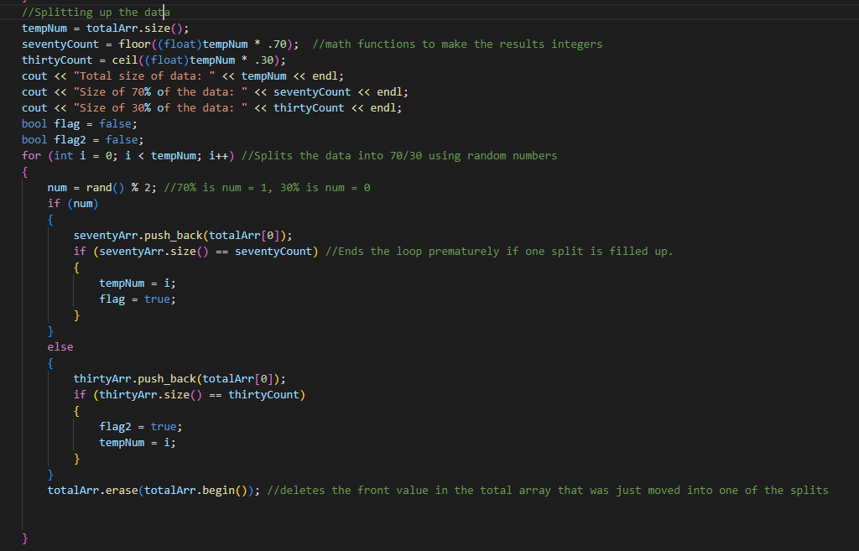
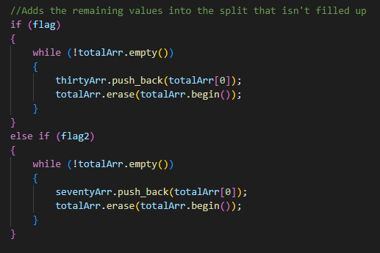
Training: Splitting the Code
First, find the total array size and multiply the value by 0.7 and 0.3 to find the size of each percentage array
Using the rand() function, for each array entry…
Generate an integer with value 0 or 1
Add to the 30% or 70% array respectively
If the number of entries equals the size of the percentage array (found before)
Stop filling that array and enter the rest of the entries into the other array

Slide 8
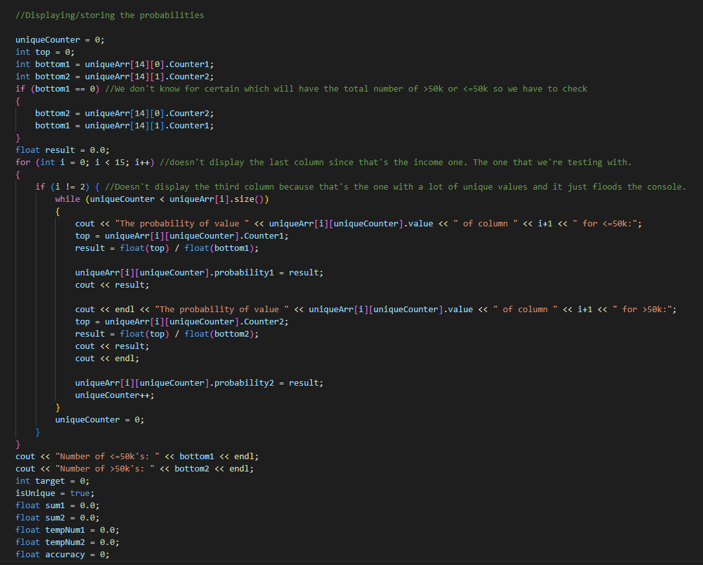
Training: On the 70% Split
Before probability calculation, find the unique values and how many times they appear
70% split code:

Slide 9
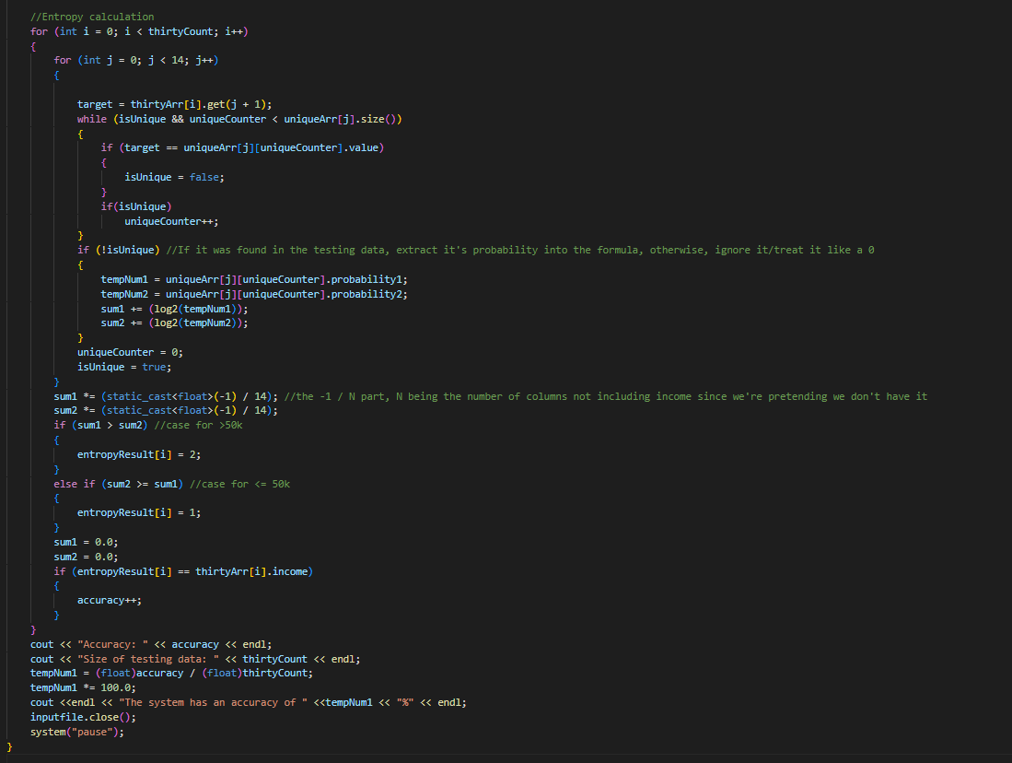
Training: On the 30% split
Testing the Cross Entropy method on the 30% data set
Code:

Slide 10

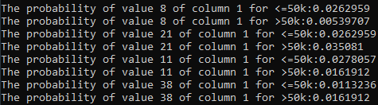

Sample Results
For data splitting:
Example probabilities generated:
Results of 70% split and 30% split testing:
Entropy accuracy value and percentage (accuracy between 73%-77%)

Slide 11
Pros/Cons
Pros:
Accomplished core objective (high accuracy)
Simplicity (no complicated libraries to learn)
Speedy (less than a second to compile)
Cons
May not compile as fast on lower end computer specs
Some parts were hard coded
Can only work with provided Human.csv file

Slide 12



Improvements
Allowing/changing code for use on any .csv file
Slight improvements to UI
Custom UI rather than Terminal-based
Further improve code efficiency
Take into account larger amounts of data
More probability calculation options besides MLE and Entropy

Slide 13

Questions?

