Slide 1
硬體描述語言
Homework 02
班級：資工二
學號：S1154007
姓名：賴宥瑋
日期：2023/11/23

Slide 2
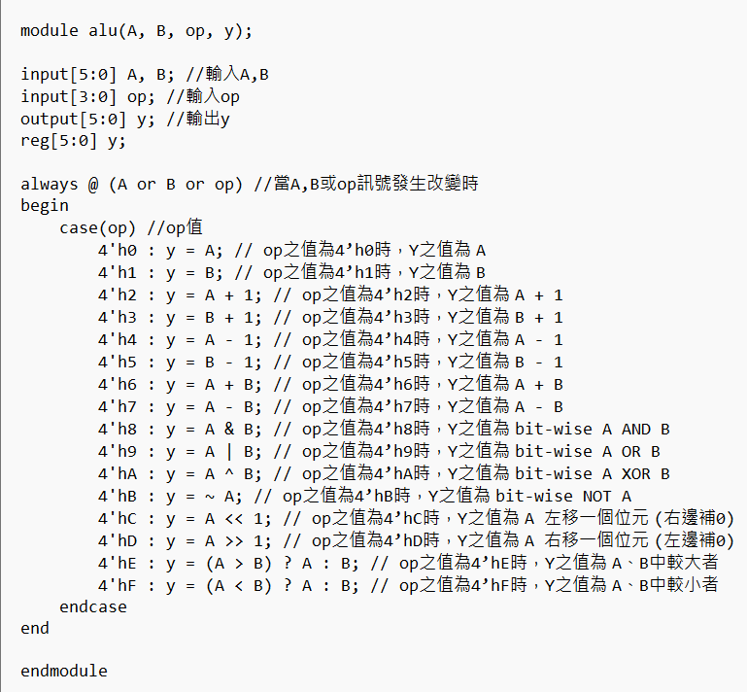
Verilog Code (alu.v)

Slide 3
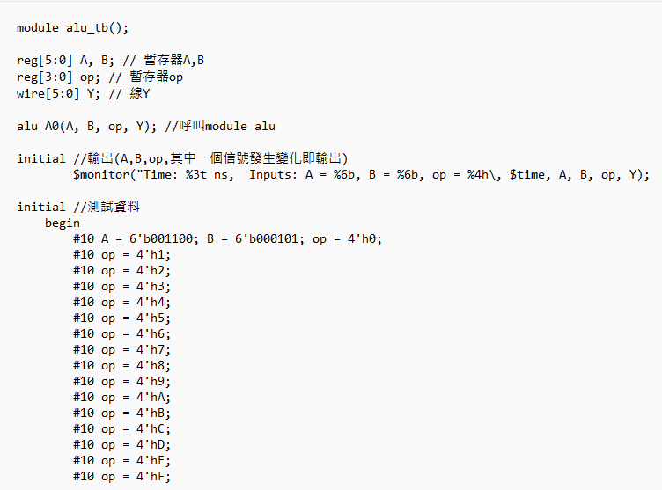
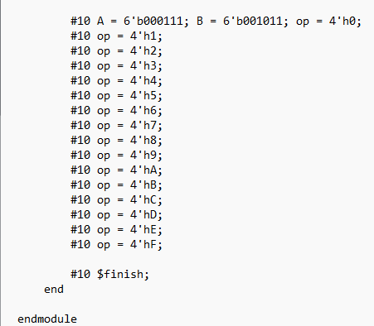
Verilog Code (alu_tb.v)

Slide 4
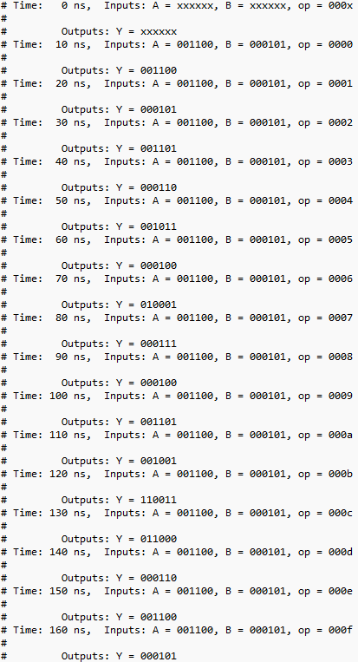
Text Message Output (1/2)
A = 6’b001100 (6’d12), B = 6’b000101 (6’d5), op = 4’h0~4’hF

Slide 5
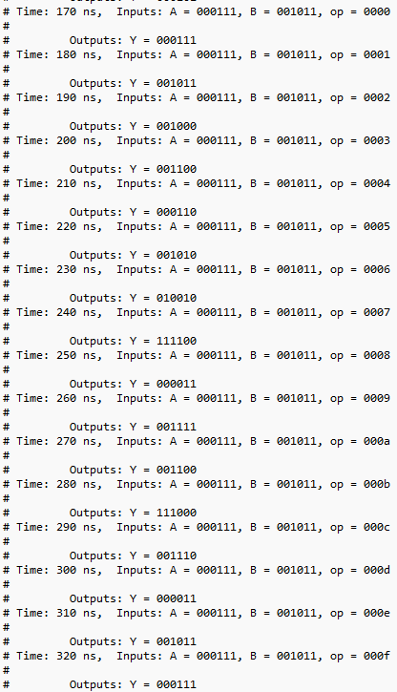
Text Message Output (2/2)
A = 6’b000111 (6’d7), B = 6’b001011 (6’d11), op = 4’h0~4’hF

Slide 6
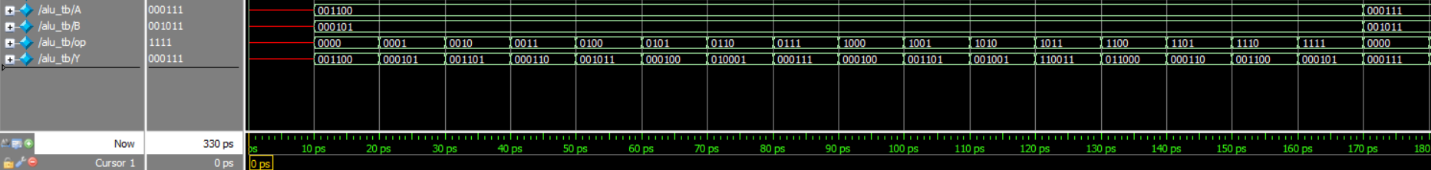
Simulation Waveform (1/2)
A = 6’b001100 (6’d12), B = 6’b000101 (6’d5), op = 4’h0~4’hF
1
2
3
4
5
6
7
8
9
10
11
12
13
14
15
16
17
1. Time = 0, A, B, op未給值，所以和Y一樣都是x(未知)
2. Time = 10, A = 001100, B = 000101, op=0000, Y=A(001100) OK
3. Time = 20, op = 0001, Y = B(000101) OK
4. Time = 30, op = 0010, Y = A+1(001101) OK 13. Time = 120, op = 1011, Y = ~A(110011) OK
5. Time = 40, op = 0011, Y = B+1(000110) OK 14. Time = 130, op = 1100, Y = A左移(011000) OK
6. Time = 50, op = 0100, Y = A-1(001011) OK 15. Time = 140, op = 1101, Y = A右移(000110) OK
7. Time = 60, op = 0101, Y = B-1(000100) OK 16. Time = 150, op = 1110, Y = 傳較大值(001100) OK
8. Time = 70, op = 0110, Y = A+B(010001) OK 17. Time = 160, op = 1111, Y = 傳較小值(000111) OK
9. Time = 80, op = 0111, Y = A–B(000111) OK
10. Time = 90, op = 1000, Y = A & B(000100) OK
11. Time = 100, op = 1001, Y = A | B(001101) OK
12. Time = 110, op = 1010, Y = A ^ B(001001) OK
6

Slide 7
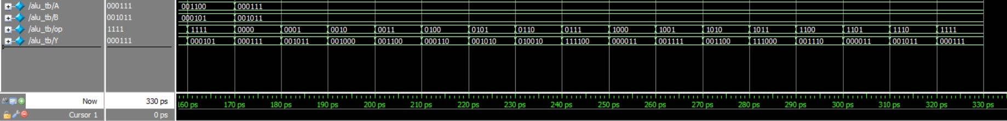
Simulation Waveform (2/2)
A = 6’b000111 (6’d7), B = 6’b001011 (6’d11), op = 4’h0~4’hF
18
19
20
21
22
23
24
25
26
27
28
29
30
31
32
33
34
18. Time = 170, A = 000111, B = 001011, op = 0000, Y = A(000101) OK
19. Time = 180, op=0001, Y = B(000111) OK
20. Time = 190, op = 0010, Y = A+1(001000) OK
21. Time = 200, op = 0011, Y = B+1(001100) OK 30. Time = 290, op = 1100, Y = A左移(001110) OK
22. Time = 210, op = 0100, Y = A-1(000110) OK 31. Time = 300, op = 1101, Y = A右移(000011) OK
23. Time = 220, op = 0101, Y = B-1(001010) OK 32. Time = 310, op = 1110, Y = 傳較大值(001011) OK
24. Time = 230, op = 0110, Y = A+B(010010) OK 33. Time = 320, op = 1111, Y = 傳較小值(000111) OK
25. Time = 240, op = 0111, Y = A-B(111100) OK 34. Time = 330, Finish OK
26. Time = 250, op = 1000, Y = A & B(000011) OK
27. Time = 260, op = 1001, Y = A | B(001111) OK
28. Time = 270, op = 1010, Y = A ^ B(001100) OK
29. Time = 280, op = 1011, Y = ~A(111000) OK

