Slide 1
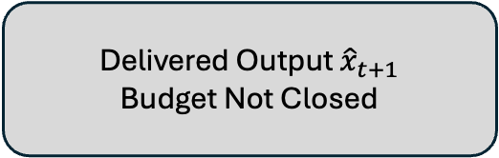
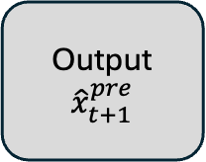

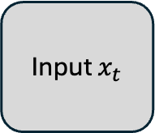


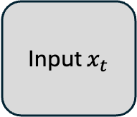
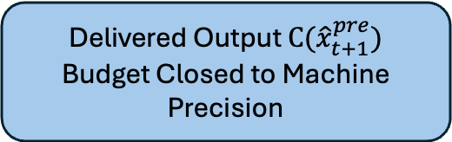
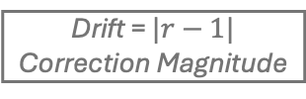
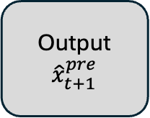
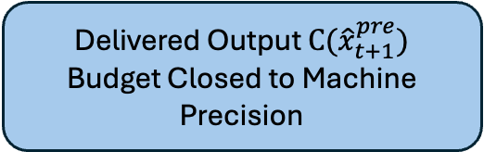
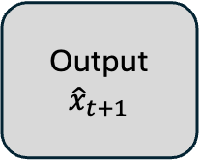


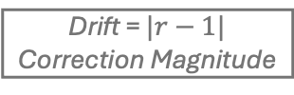
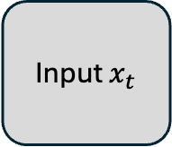
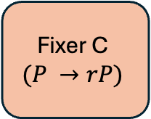
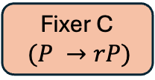
a) No constraint
Supervised Loss (${\hat{x}}_{t+1}, x_{t+1})$
Input $x_{t}$
Network
Output ${\hat{x}}_{t+1}$
Delivered Output ${\hat{x}}_{t+1}$
Budget Not Closed
gradient
b) Hard Corrector in Supervised Path:
Scale Degeneracy
Supervised Loss ($C({\hat{x}}_{t+1}^{pre}), x_{t+1})$
Input $x_{t}$
Network
Output${\hat{x}}_{t+1}^{pre}$
Fixer C
$$(P →rP)$$
Delivered Output $C({\hat{x}}_{t+1}^{pre})$
Budget Closed to Machine Precision
Drift = $|r−1|$
Correction Magnitude
raw amplitude gradient component: $J_{c}\left(P\right)P=0$
c) Pre-correction supervision + imbalance penalty
Supervised Loss (${\hat{x}}_{t+1}^{pre}, x_{t+1})$
+
Imbalance Penalty ${\left(r−1\right)}^{2}$
Compute $r$
Input $x_{t}$
Network
Output${\hat{x}}_{t+1}^{pre}$
Delivered Output $C({\hat{x}}_{t+1}^{pre})$
Budget Closed to Machine Precision
Fixer C
$(P →rP)$
gradient
Drift = $|r−1|$
Correction Magnitude

