Slide 1
POP goes the CAMulator
Initial Results: CAMulator ↔ POP2 inside CESM2/3 Will Chapman | CU Boulder

Slide 2
The Scientific Gap

Slide 3
We have been working significantly with uncoupled systems:
Why it matters:
The climate system is coupled
ENSO is an air-sea coupled phenomenon
MJO propagation depends on air-sea heat exchange
AMOC sensitivity to wind stress changes
Climate drift in long runs is partly an air-sea feedback problem
Note
Standard GIAF runs have been the workhorse of ocean-only CESM science for 20(?) years. We’re upgrading the atmosphere from “prescribed file reader” to “AI physics.”
Mode | Atmosphere | Ocean
AMIP | active | prescribed SST/ICE
OMIP / GIAF | prescribed ATM | active
This work | ML ATM | active
The problem:
In OMIP, the ocean responds to forcing — but the forcing never changes based on what the ocean does
Warm SST anomalies can’t generate more evaporation, shift the jet stream, or modify precipitation
Interactive air-sea feedback is missing

Slide 4
CAMulator in 30 Seconds

Slide 5
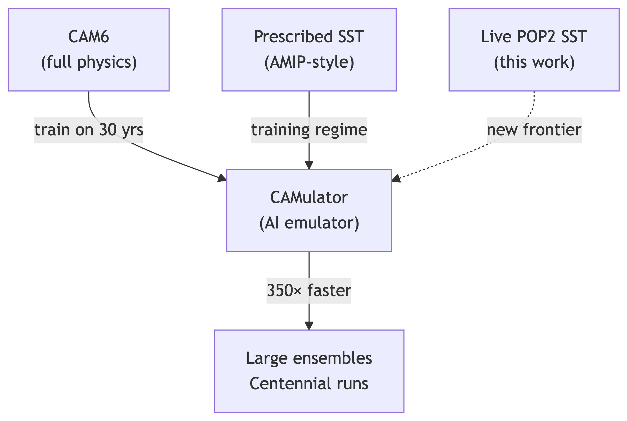
Quick framing:
Autoregressive 6-hr emulator of CAM6
1° resolution, 130 prognostic channels
Enforces conservation of dry air mass, moisture, total energy
350× speedup over CAM6
Captures ENSO, NAO, PNA, realistic variability
The limitation this coupling addresses:
CAMulator was trained and evaluated with prescribed SST/IFRAC — it responds to the ocean but the ocean never responds back. This is exactly the AMIP problem, now for ML models.
This work: replace the prescribed SST/ICE with a live POP2 ocean/CICE.
Today’s: Does a coupled CAMulator + POP2 system stay stable and physically meaningful? I will only show smoke tests.

Slide 6
What I Built

Slide 7
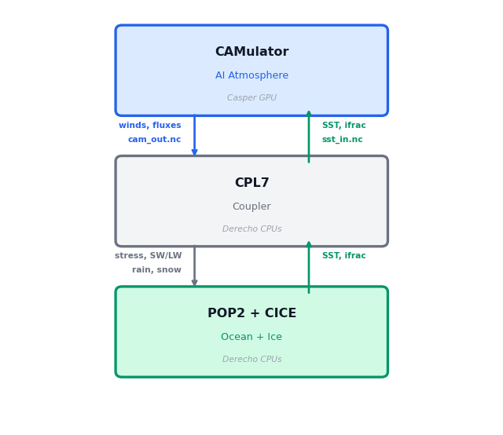
First(?) coupling of an ML atmosphere to a fortran/physics ocean + sea ice
CAMulator replaces DATM prescribed forcing entirely
POP2 + CICE receive evolving, CAMulator air-sea fluxes
Ocean SST feeds back into CAMulator every 6 hours
No coupler modifications — piggybacked on existing GIAF compset
First results:
10-day test: stable, no blow-up
3, 35 year runs completed
42 SYPD on 2 Derecho CPU nodes + 1 Casper A100

Slide 8
How It Works: The DATM Mode

Slide 9
Idea: write a new DATM datamode
Instead of reading CORE2/JRA55 forcing files, DATM_MODE = CAMULATOR calls our Python inference server via the filesystem:
Every 6 hours: DATM writes → sst_in.nc (SST from POP2) DATM writes → go.flag [polls every 1s, timeout 1h] DATM reads ← cam_out.nc (10 flux fields) DATM reads ← done.flag
Two files changed in CESM source:
New: datm_datamode_camulator.F90
Wired into: datm_comp_mod.F90 (case('CAMULATOR'))
Activated by DATM_MODE = CAMULATOR in user_nl_datm
Why file-based interface?
No Fortran↔Python interop (no FTORCH/FORPY, no sockets)
6-hr coupling interval → ~10 MB I/O overhead is negligible
Fully debuggable: inspect every sst_in.nc and cam_out.nc independently
Model-agnostic: swap camulator_server.py for any CREDIT model — Fortran side never changes
Key physics handled server-side:
SST/IFRAC injected into forcing tensor
FSNS → FSDS: albedo inversion so CPL7 doesn’t double-count surface reflection
FLNS → FLDS: isolates downwelling component
Over-land SST fill for continental grid points
Dynamic boundary layer height (z_bot ∝ T_bot)

Slide 10
Flux Conversions: Net → Downwelling
CAMulator outputs net fluxes at the surface. CPL7 expects downwelling fluxes and applies surface albedo internally — so we have to invert before handing off.

Slide 11
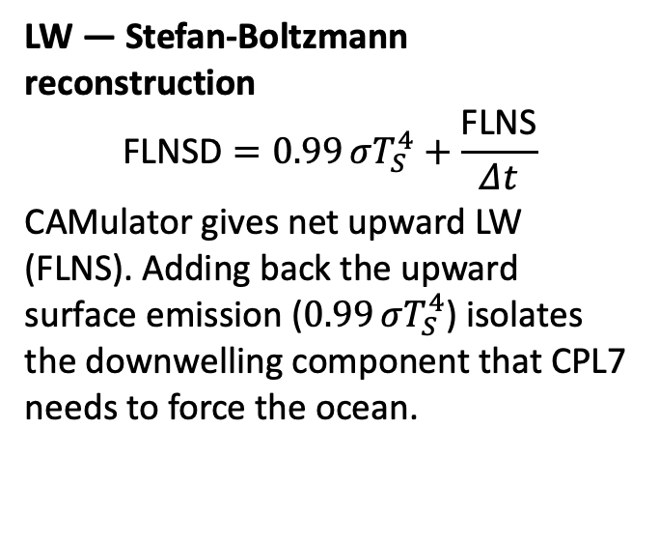
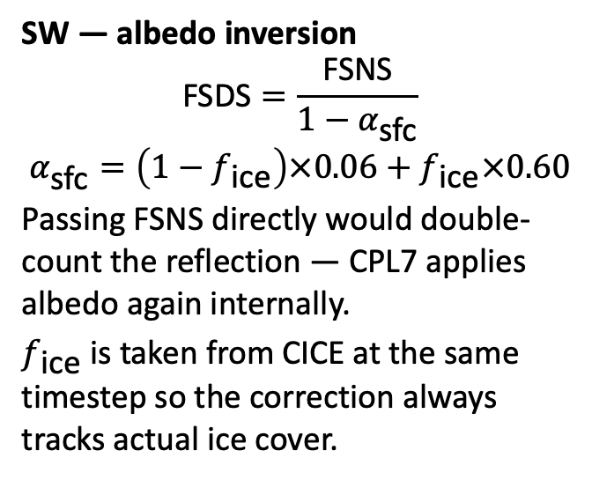
SW — albedo inversion
$$\text{FSDS}=\frac{\text{FSNS}}{1−α_{\text{sfc}}}$$
$$α_{\text{sfc}}=\left(1−f_{\text{ice}}\right)×0.06+f_{\text{ice}}×0.60$$
Passing FSNS directly would double-count the reflection — CPL7 applies albedo again internally.
$f_{\text{ice}}$ is taken from CICE at the same timestep so the correction always tracks actual ice cover.
LW — Stefan-Boltzmann reconstruction
$$\text{FLNSD}=0.99 σT_{S}^{4}+\frac{\text{FLNS}}{Δt}$$
CAMulator gives net upward LW (FLNS). Adding back the upward surface emission ($0.99 σT_{S}^{4}$) isolates the downwelling component that CPL7 needs to force the ocean.

Slide 12
Dynamic $z_{\text{bot}}$ and Monin-Obukhov Theory (?)

Slide 13
CPL7’s COARE-style bulk scheme needs the reference height $z_{\text{bot}}$: the height of the data read in to compute the M-O stability correction and from that the wind stress $τ$, sensible heat $H$, and latent heat $LE$.
In CAM6 it’s not a fixed number; it varies ~50–67 m with surface temperature. We derive it consistently from the hybrid coordinate and the hypsometric equation:
$$p_{\text{mid}}=\underset{≈ 0}{\underset{⏟}{a_{N−1}p_{0}}}+\frac{b_{N−1}+1}{2} p_{s} ≈ \frac{b_{N−1}+1}{2} p_{s}$$
$$z_{\text{bot}}=\frac{R_{d}}{g}ln​\frac{p_{s}}{p_{\text{mid}}}⋅T_{\text{bot}}≈\frac{R_{d}}{g}\left(−ln\frac{b_{N−1}+1}{2}\right)T_{\text{bot}}≈0.219 T_{\text{bot}}$$
Z_BOT_SCALE = (287.058/9.80616) \ * (-np.log(0.5*(hybi[-2]+1))) # 0.2187 m/K z_bot = Z_BOT_SCALE * T_bot # 50–67 m
Getting $z_{\text{bot}}$ wrong changes which stability regime CPL7 thinks it’s in.
In stable conditions (cold SST under warm air), a wrong $z_{\text{bot}}$ artificially suppresses wind stress
In unstable conditions (warm tropical SST), it sets the strength of the convective enhancement of $H$ and $LE$
These aren’t small corrections and this is the thing I’m most neverous about
For example: the Southern Ocean, Arctic margins, the MJO warm pool, and eastern boundary upwelling zones all spend significant time in strongly stratified regimes.

Slide 14
Speed: How does 42 SYPD Compare?

Slide 15
Note
we get a prognostic, interactive atmosphere at roughly the same wall-clock cost as prescribed forcing and 6X cheaper than running full CAM6 + POP2.
Configuration | Speed (SYPD) | Hardware
Full CESM2 (CAM6 + POP2) | ~7.3 | 8 Derecho nodes
GIAF (DATM + POP2, no AI) | 37.935 | 2 Derecho nodes
CAMulator + POP2 (this work) | 42.025 | 2 CPU + 1 A100
Stage | Time
Build input tensor | ~5
CAMulator inference (JIT) | ~190
Inverse transform | ~8
Grid remap (T62 ↔ 1°) | ~3
Write cam_out.nc | ~15
Total server time | ~220
Per-step breakdown on A100 (ms):
CAM6 reference: one 6-hr step ~4932 ms on 8 CPU Nodes
CESM’s ocean/ice compute is the wall-clock bottleneck — not inference.

Slide 16
Movie: Monthly SSTs and Precip
Movie: ENSO

Slide 17
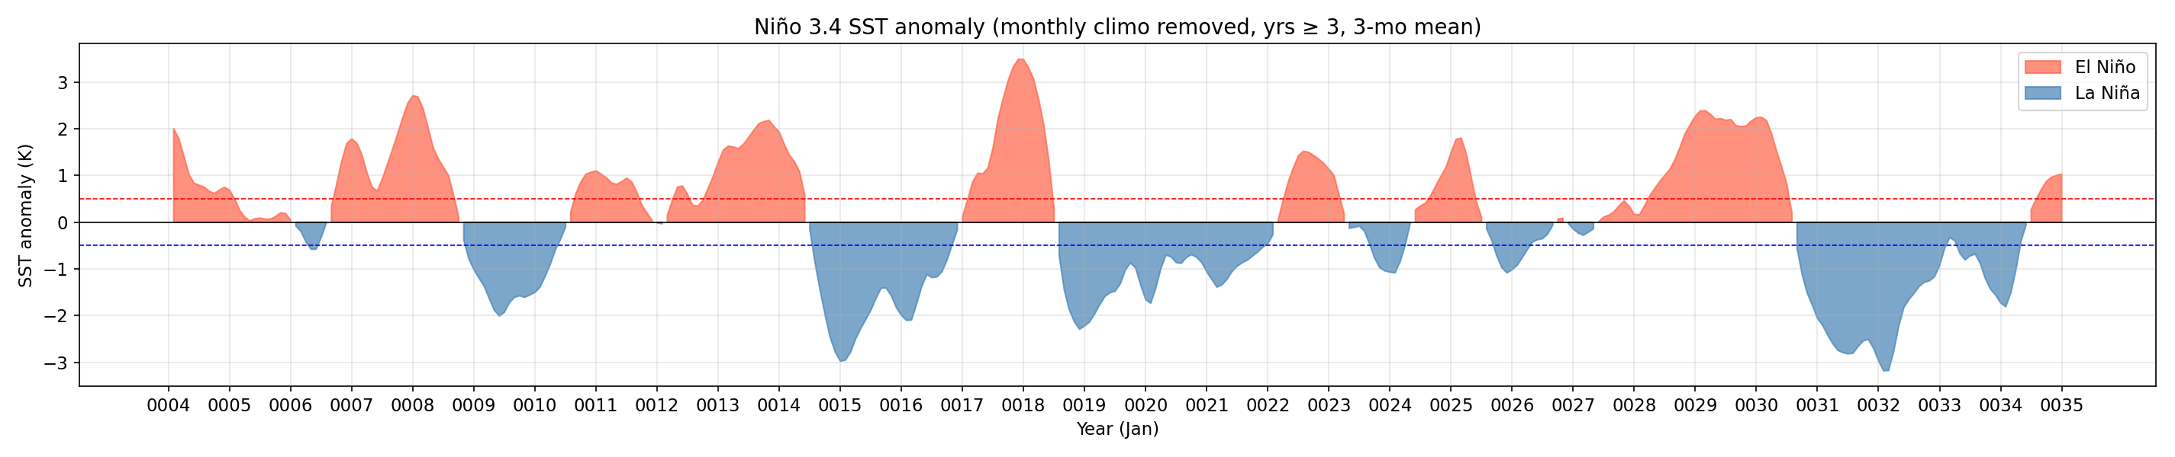
ENSO: Niño 3.4 Index
The coupled run produces realistic interannual SST variability in the tropical Pacific — ENSO cycles emerge spontaneously from the coupled system.

Slide 18
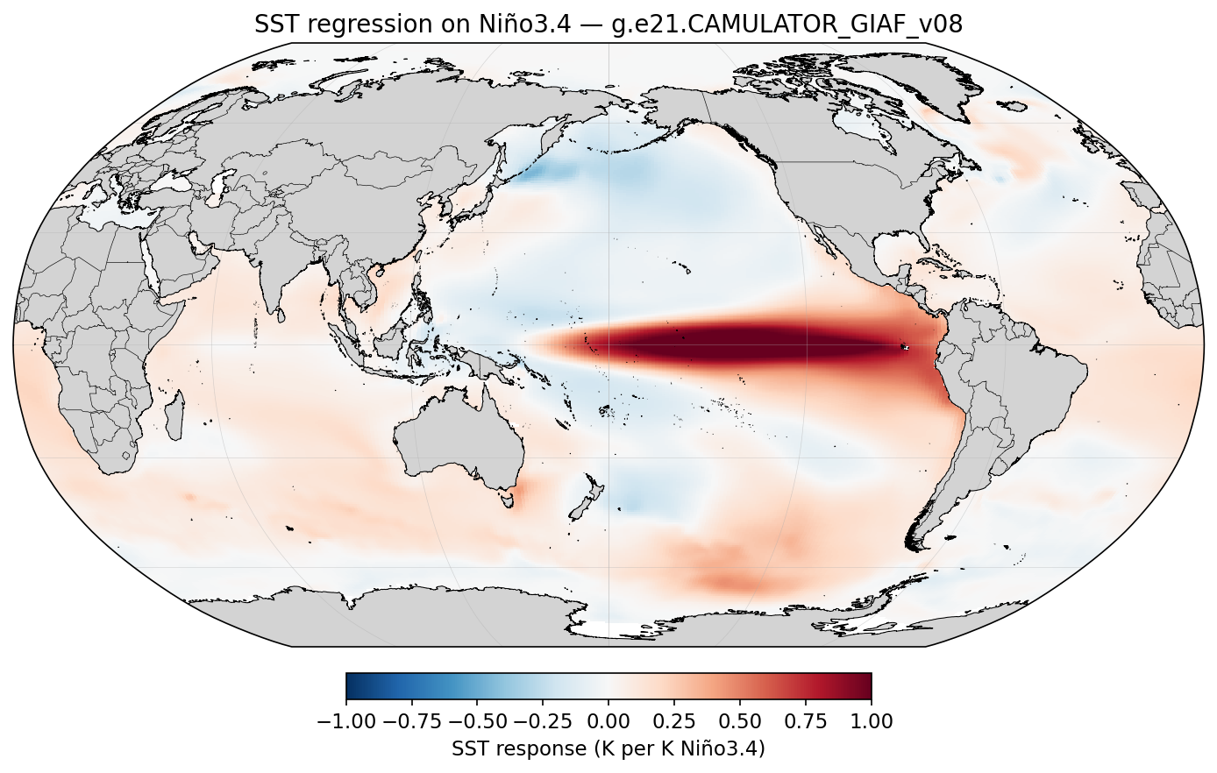
ENSO: Spatial Pattern
SST regression on Niño 3.4 shows the correct east-Pacific warming structure and horseshoe cooling in the off-equatorial Pacific.

Slide 19
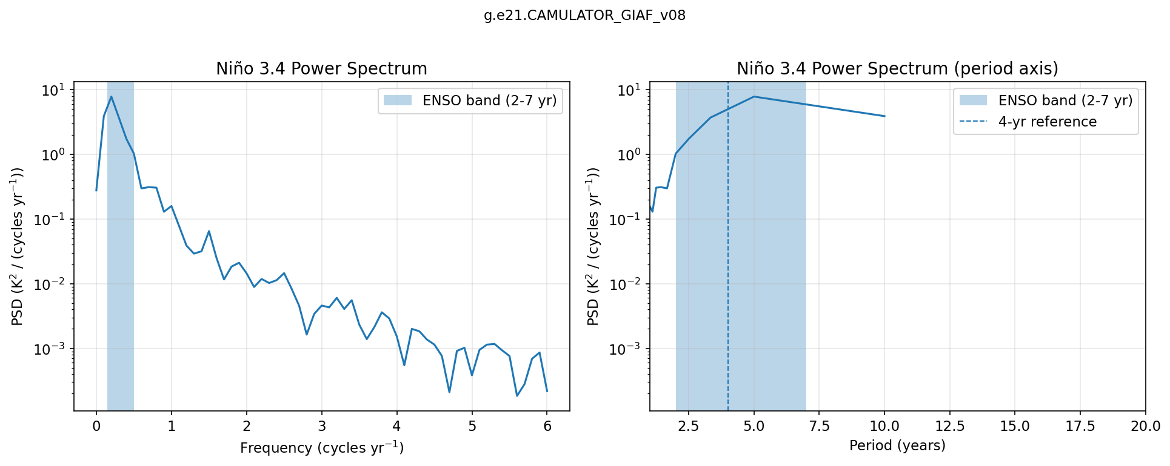
ENSO: Power Spectrum
Spectral power peaks within the 2–7 year ENSO band, consistent with observed ENSO periodicity.

Slide 20
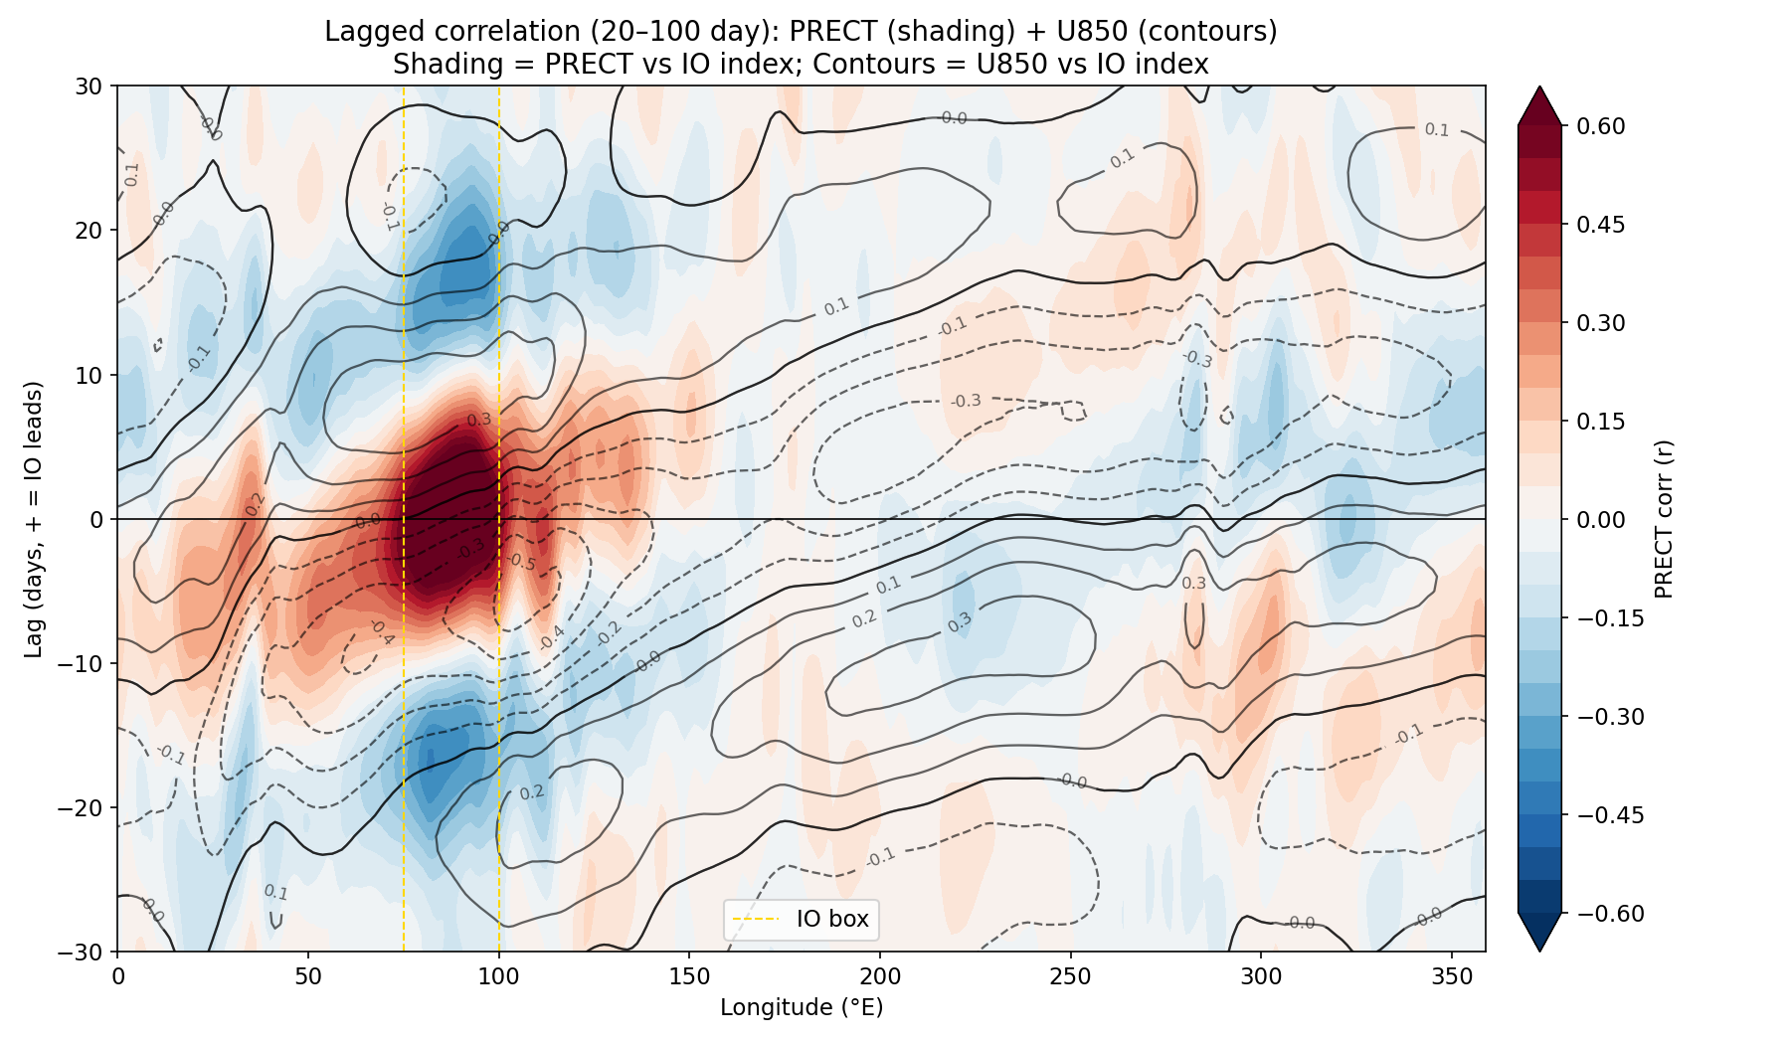
MJO: Lagged Correlation
The coupled run captures eastward-propagating convective anomalies on intraseasonal timescales — precipitation and 850 hPa wind both track the Indian Ocean signal with the correct-ish phase relationship.

Slide 21
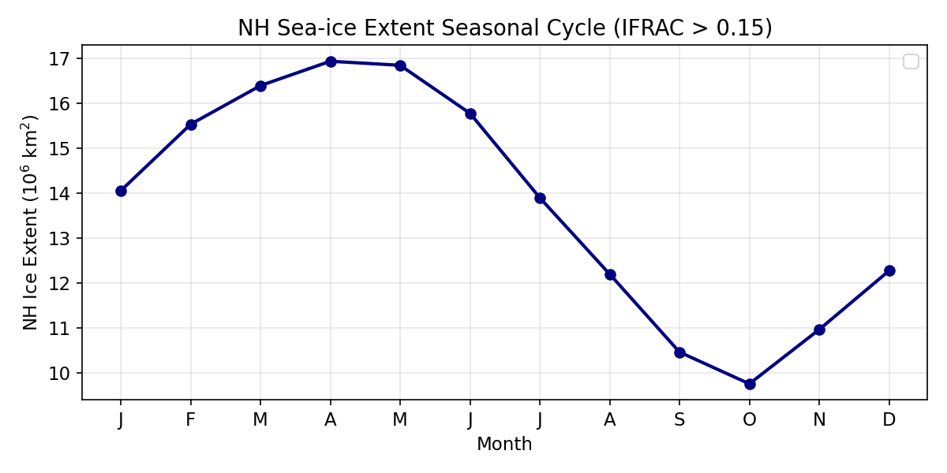
Results: Northern Hemisphere Sea Ice
NH sea ice extent follows a realistic seasonal cycle with no runaway loss or gain over the 35-year run.

Slide 22
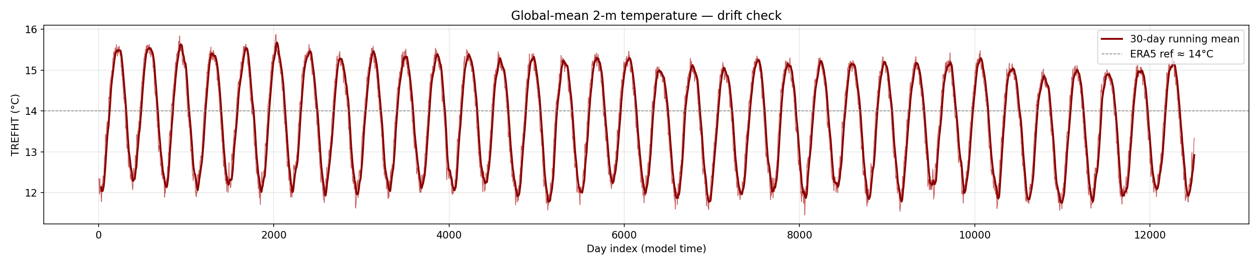
Results: Global Mean Temperature
Global-mean 2m air temperature shows no long-term drift over the 35-year run — the coupled system is stable (ish).

Slide 23
What 42 SYPD Enables

Slide 24
With a large speedup over CAM6, coupled experiments become feasible that weren’t before:
Large ensembles with interactive ocean — 50–100 member ENSO forecasts at seasonal range
Centennial runs to study climate drift, AMOC stability, heat uptake
Parameter sensitivity sweeps — vary ocean mixing, ice albedo, test parameterization choices at low cost
Rapid prototyping of new coupling strategies before investing in full CESM runs
The flag-file interface is intentionally model-agnostic:
# Swap in any CREDIT model: camulator_server.py # CAMulator → fuxi_server.py # FuXi → pangu_server.py # Pangu-Weather → ACE2_server.py # Ai2
The Fortran side (datm_datamode_camulator.F90) never changes. Any model that can read sst_in.nc and write cam_out.nc can be plugged in.

Slide 25
Next Steps

Slide 26
Science questions now open:
ENSO response — does CAMulator + POP2 produce realistic ENSO amplitude and period? Does it improve over OMIP?
Creating an ACE2 Sever is Trivial in CREDIT - what ocean biases emerge with a reanalysis atmosphere?
MJO air-sea feedback — does the interactive atmosphere change MJO propagation speed or coherence?
Creating an ACE2 Sever is Trivial in CREDIT - what ocean biases emerge with a reanalysis atmosphere?
AMOC stability — multi-decadal runs with changing wind stress
SST bias evolution — does CAMulator’s known high-latitude cold bias change ocean heat uptake?
Ensemble spread — do coupled members diverge faster than AMIP/OMIP members? S2S simulations
Ocean stuff, I know next to nothing about the ocean.
Does calibrating ocean with this atmosphere help the bottleneck?
Technical next steps:
Phase 2: bypass CPL7 bulk formula — pass Faxa_taux/tauy directly instead of Sa_u/Sa_v and Latent / Sensible Heat
Retrain CAMulator to directly simulated downward fluxes at surface
MOM6 coupling (CESM3 ocean)
Just switch the compset and this should(?) work now.
Community:
CESM patch + camulator_server.py → open release
Generalise server interface for any CREDIT model
Share restart-safe launch scripts with the community

Slide 27
Summary

Slide 28
We coupled an AI atmosphere to a dynamic ocean by:
Writing a new DATM datamode (CAMULATOR) — zero coupler modifications, file-based flag I/O, fully debuggable
Tried to get the physics right: FSNS→FSDS albedo inversion so CPL7 doesn’t double-count surface reflection; dynamic $z_{\text{bot}}$ derived from hybrid coordinates for physically consistent M-O stability corrections
Running it: 42 SYPD, 35-year run stable, POP2 + CICE receiving evolving AI-generated fluxes and feeding SST back at every step
(Also had to fix a deep CPL7 pointer bug where xao_ax was never assigned for DATA ATM — see Appendix)
42 SYPD + prognostic ocean = multi-century coupled experiments at a fraction of the cost of full CESM
Code / contact:
# Implementation /glade/work/wchapman/Roman_Coupling/ credit_feb182026/climate/ camulator_server.py datm_datamode_camulator.F90 launch_coupled_run.sh # Active case /glade/work/wchapman/cesm/CREDIT/ g.e21.CAMULATOR_GIAF_v02/

Slide 29
Appendix
Slides below contain implementation detail for follow-up discussion

Slide 30
Component | Role in this project
CESM2/CPL7 | Framework + MCT-based Fortran coupler; remaps fields between grids, applies bulk formulae
DATM (Data ATM) | Normally reads CORE2/JRA55 prescribed forcing. Here: runs CAMULATOR mode — a new datamode we wrote
CAMulator | Autoregressive 6-hr AI atmosphere trained on CAM6 output. 192×288 (1°), 130 prognostic channels
POP2 | 3D ocean on gx1v7 displaced-pole grid (~1°, 320×384). Evolves SST, salinity, currents
CICE | Sea ice on same gx1v7 grid. Exchanges heat, momentum, freshwater with POP + atmosphere
T62 grid | DATM’s native Gaussian grid: 94 lat × 192 lon. All DATM→CPL fields live here
GIAF compset | DATM%IAF + POP2 + CICE — the baseline we piggyback on
A: Component Glossary

Slide 31
B: Full Architecture
┌─────────────────────────────────────────────────────────────────────────┐ │ CESM2 CPL7 coupled run (Fortran/MPI, CPU ranks on Derecho) │ │ │ │ POP2 ──SST──► CPL7 ──x2a_So_t──► DATM (CAMULATOR mode) │ │ │ │ │ write camulator_sst_in.nc │ │ write camulator_go.flag ───► [GPU server] │ │ ↑ │ │ read camulator_done.flag ◄─── [GPU server] │ │ read camulator_cam_out.nc │ │ │ │ │ POP2 ◄──a2x fluxes──── CPL7 ◄──────────┘ │ └─────────────────────────────────────────────────────────────────────────┘ ▲ shared GLADE filesystem ┌──────────────────┴──────────────────────────────────────────────────────┐ │ camulator_server.py (Python, A100 GPU, pre-launched on Casper) │ │ │ │ loop: watch go.flag → read sst_in.nc → inject SST → run CAMulator │ │ → write cam_out.nc → write done.flag │ └─────────────────────────────────────────────────────────────────────────┘

Slide 32
C: Grid Remapping

Slide 33
Grid | Dims | Used by
T62 Gaussian | 94 × 192 | DATM, CPL7
CAMulator 1° | 192 × 288 | AI model
class BilinearRemap: """Precomputed bilinear weights for T62 ↔ CAMulator.""" def __init__(self, src_lat, src_lon, dst_lat, dst_lon): # compute weight matrices once at startup ... def batch(self, fields_dict: dict) -> dict: """Remap all fields in one vectorised call.""" out = {} for name, arr in fields_dict.items(): out[name] = (self.weights @ arr.ravel() ).reshape(self.dst_shape) return out

Slide 34
D: SST Injection Detail
# 1. Read SST from sst_in.nc [K] sst_t62 = ds['sst'].values # 94×192 # 2. Remap T62 → CAMulator 1° grid sst_cam = remap_t62_to_cam(sst_t62) # 192×288 # 3. Over-land fill (POP only provides ocean points) mask = sst_cam > 270.0 # True = ocean sst_blended = np.where(mask, sst_from_pop, 283.0) # 4. Normalize and inject into forcing tensor sst_norm = (sst_blended - sst_mean) / sst_std model_input = stepper.state_manager \ .build_input_with_forcing(state, forcing_t, static) accessor_input.set_state_var(model_input, 'SST', sst_norm_tensor) # 5. Run inference prediction = stepper.model(model_input.float())
SST is a dynamic_forcing_variable (not prognostic state) — it lives in the forcing tensor, not in the 130-channel prognostic state. This is why injection works without retraining the model.

Slide 35
E: Flux Conventions

Slide 36
Variable | CAMulator units | → cam_out.nc
FSNS | J m⁻² (6h total) | ÷ 21600 → W m⁻²
FLNS | J m⁻² upward | ÷ (−21600) → W m⁻² ↓
PRECT | m s⁻¹ liq-eq | direct
TAUX/TAUY | Pa | direct
LW reconstruction:
$$\text{FLNSD}=0.99 σ T_{S}^{4}+\frac{\text{FLNS}}{Δt}$$
Dynamic boundary layer height:
Z_BOT_SCALE = (287.058/9.80616) \ * (-np.log(0.5*(hybi[-2]+1))) # = 0.2187 m/K z_bot = Z_BOT_SCALE * T_bot # 50–67 m range

Slide 37
F: Restart Handling

Slide 38
ATM restart file (camulator_atm_restart.pth):
{ 'state': state_tensor, # 130-ch CPU tensor 'timestep': int, 'last_ymd': int, 'last_tod': int, 'cam_out': cam_out_dict, # re-send on CONTINUE_RUN }
On CONTINUE_RUN=TRUE, CESM re-sends the last go.flag. Server detects current_ymd == last_ymd, re-sends saved cam_out without re-inference.
Year-boundary repeated dates:
CESM sends the year-boundary date three times during restart init. Fix: date-based forcing index (same date → same forcing slice, always).
Annual archive:
rundir/atm_archive/ YYYY/ camulator_atm_YYYY-001.nc camulator_atm_YYYY-002.nc (daily) camulator_atm_restart.pth

Slide 39
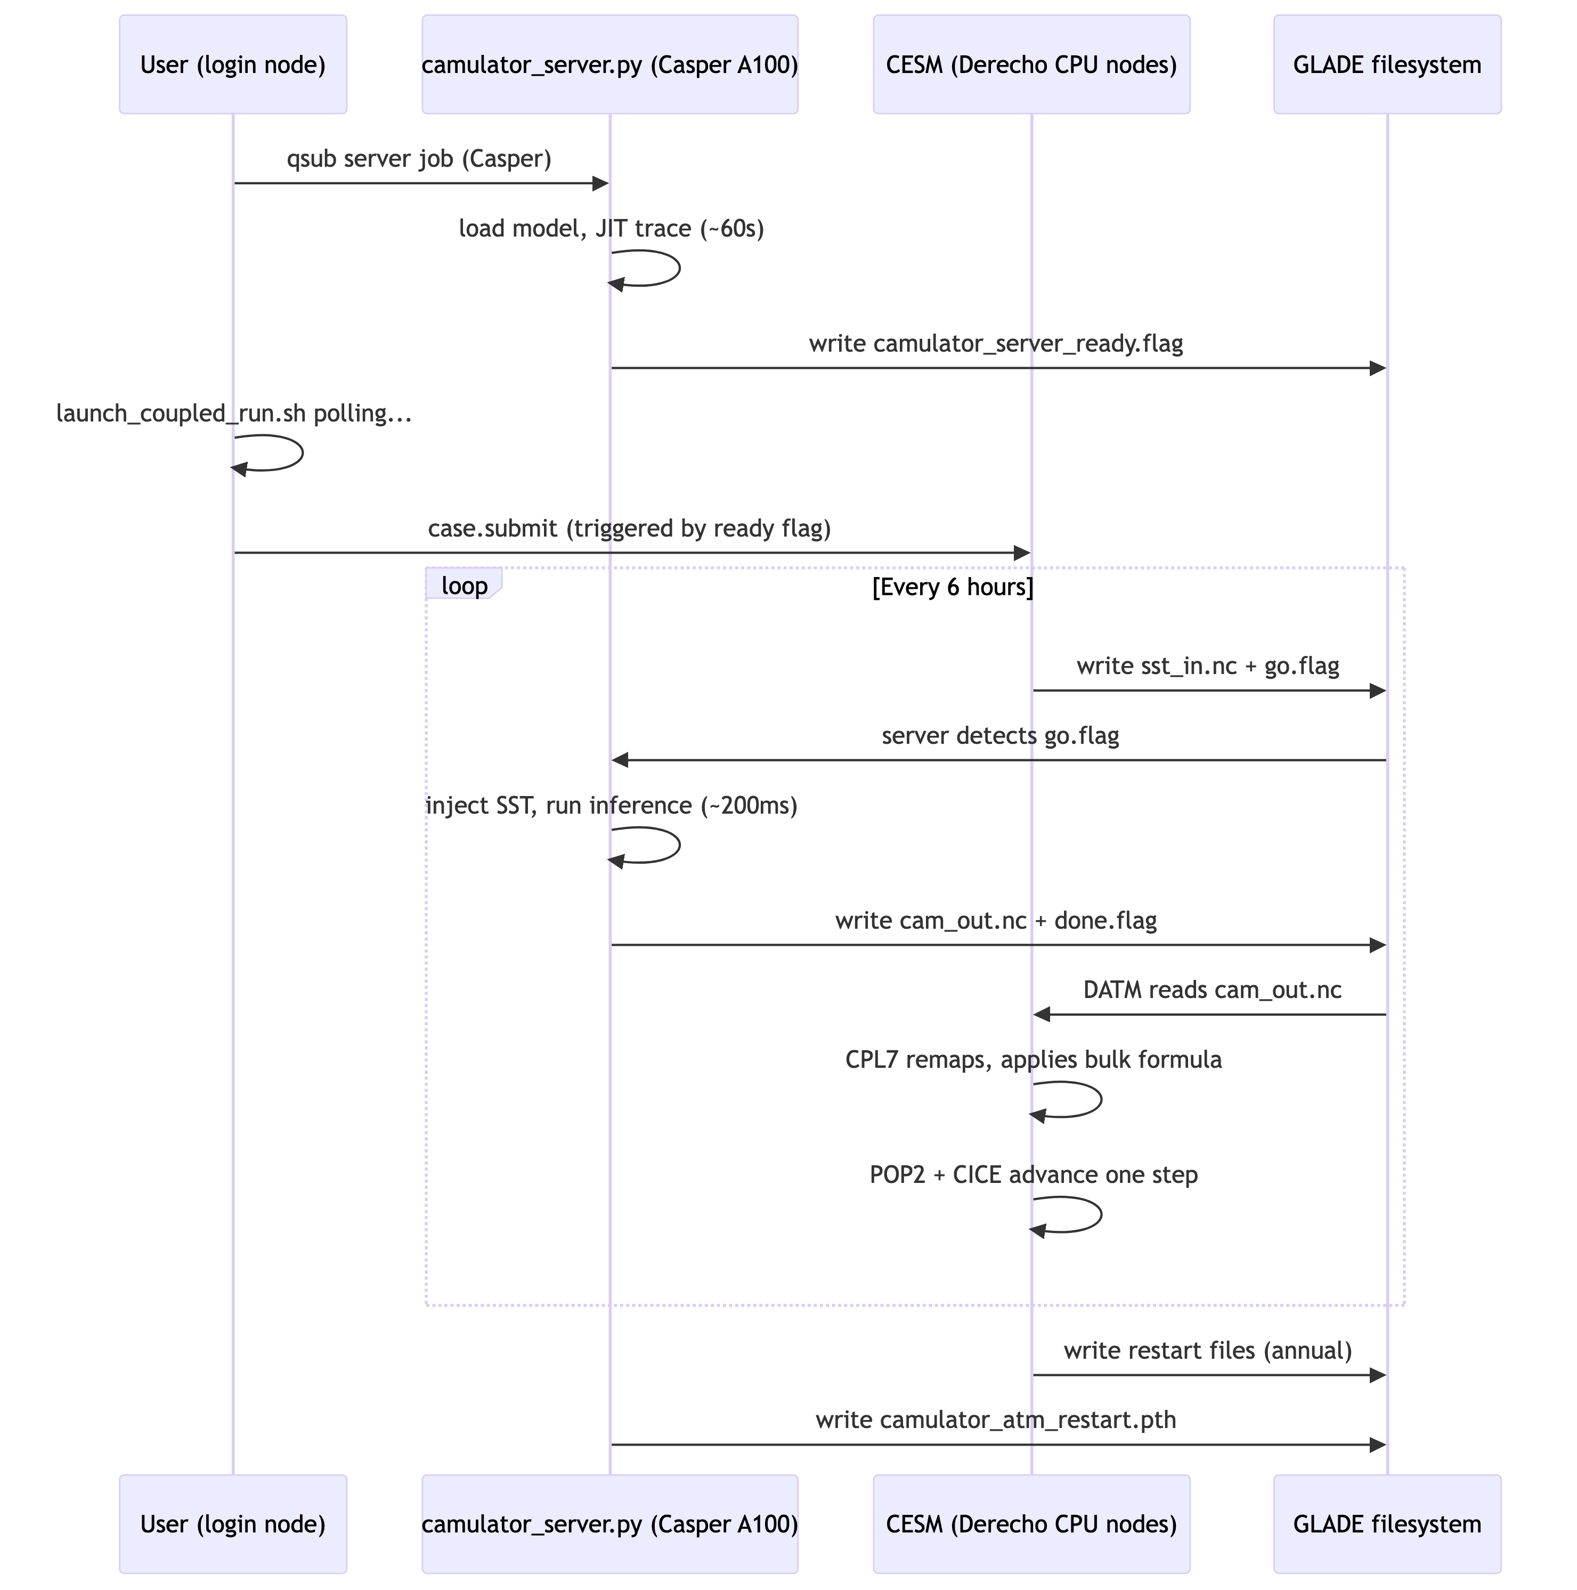
G: Launch Workflow

Slide 40
H: The CPL7 Bug

Slide 41
Symptom: Ocean sees SST = 0 K on every coupling step despite POP sending valid temperatures.
Root cause — cime_comp_mod.F90:
The xao_ax pointer (ATM↔OCN flux object) is initialised only inside:
if (atm_prognostic) then ! ... init phase ... xao_ax => prep_aoflux_get_xao_ax() ! line ~1974 end if
For DATA ATM (atm_prognostic = .false.), this block is never entered → xao_ax stays null().
Later at every coupling step:
if (associated(xao_ax)) then ! .false. ! call prep_atm_mrg(...) ! NEVER RUNS end if ! → x2c_cx stays zero → SST = 0
No one had ever run a DATA ATM that needed to read back ocean state — this code path had never been exercised in 20 years of CESM.
Three-part fix (all in ATM SETUP-SEND block):
Fix 1 & 2 — widen two guards from atm_prognostic to (atm_prognostic .or. atm_present):
if (atm_prognostic .or. atm_present) then ! prep-merge block end if if (atm_prognostic .or. atm_present) then call component_exch(atm, flow='x2c') end if
Fix 3 — assign pointer before the associated() check:
! ROOT CAUSE FIX xao_ax => prep_aoflux_get_xao_ax() if (associated(xao_ax)) then call prep_atm_mrg(...) ! now runs! end if
Confirmed: 10-day coupled run at 42 SYPD ✅

