Slide 1
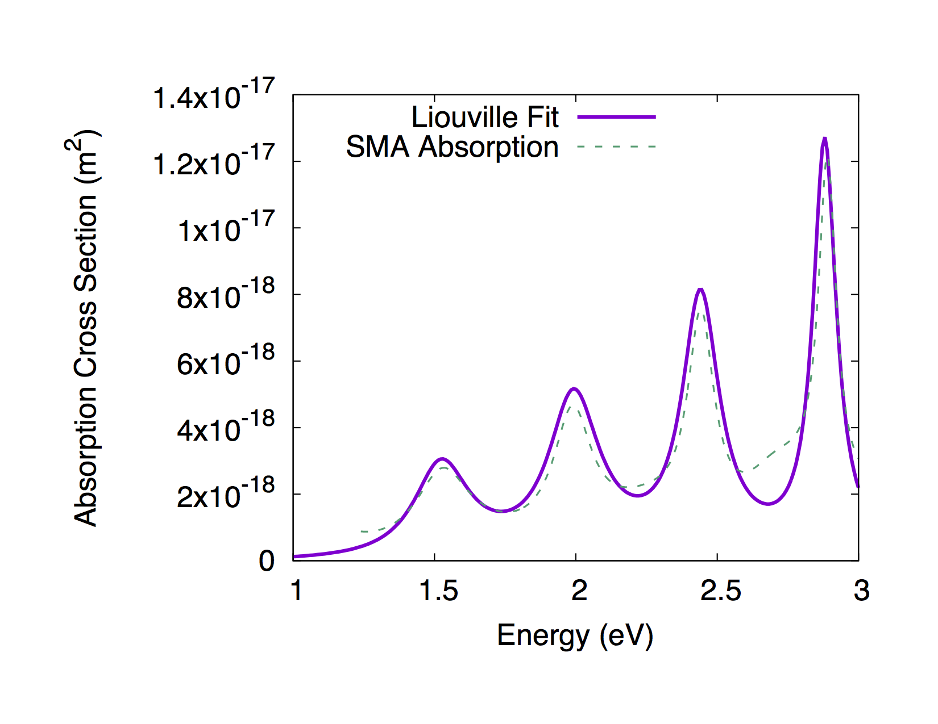
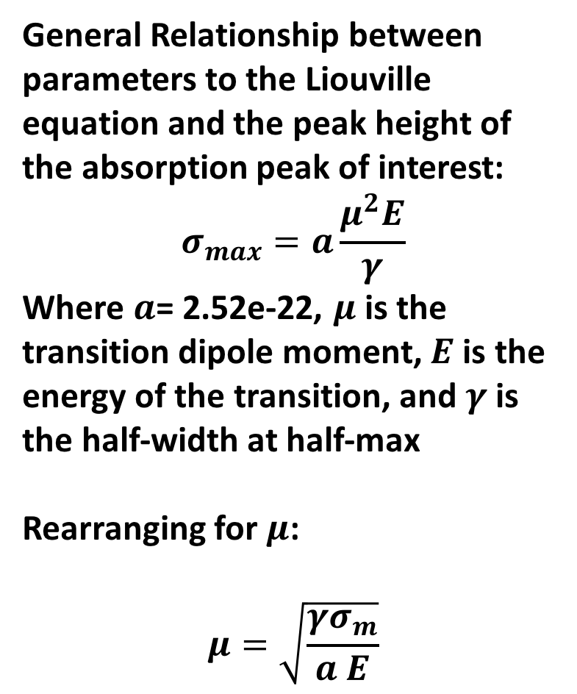
General Relationship between parameters to the Liouville equation and the peak height of the absorption peak of interest:
$$σ_{max}=a\frac{μ^{2}E}{γ}$$
Where $a$= 2.52e-22, $μ$ is the transition dipole moment, $E$ is the energy of the transition, and $γ$ is the half-width at half-max
Rearranging for $μ$:
$$μ=\sqrt{\frac{γσ_{m}}{a E}}$$

Slide 2
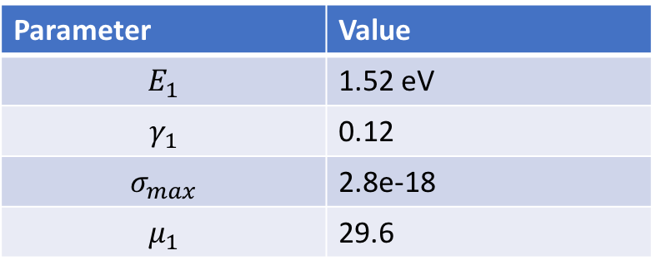
Parameter | Value
$$E_{1}$$ | 1.52 eV
$$γ_{1}$$ | 0.12
$$σ_{max}$$ | 2.8e-18
$$μ_{1}$$ | 29.6
Peak 1

Slide 3

Parameter | Value
$$E_{2}$$ | 1.99 eV
$$γ_{2}$$ | 0.11
$$σ_{max}$$ | 4.67e-18
$$μ_{2}$$ | 32.0
Peak 2

Slide 4
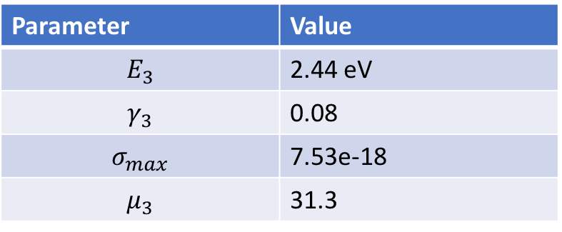
Parameter | Value
$$E_{3}$$ | 2.44 eV
$$γ_{3}$$ | 0.08
$$σ_{max}$$ | 7.53e-18
$$μ_{3}$$ | 31.3
Peak 3

Slide 5

Peak 4
Parameter | Value
$$E_{4}$$ | 2.88 eV
$$γ_{4}$$ | 0.05
$$σ_{max}$$ | 1.21e-17
$$μ_{4}$$ | 28.8

Slide 6
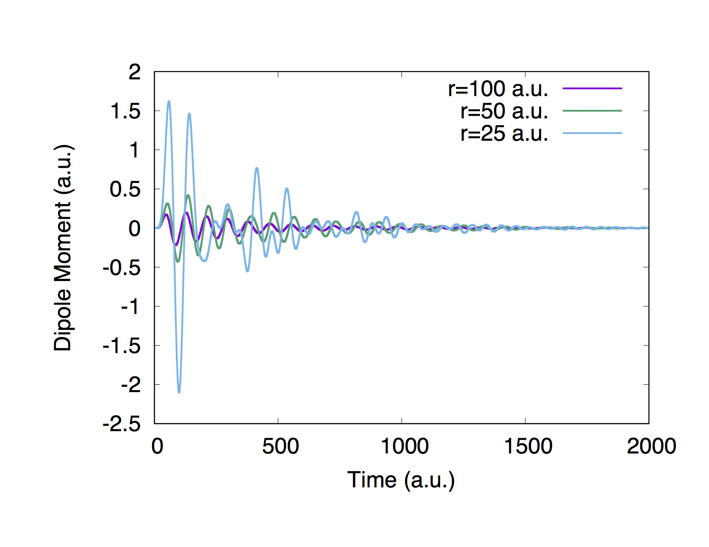
Time-dependent dipole moment of Malachite Green coupled to the hierarchical nanoparticle at various separation distances along the z-axis (polarization direction)

Slide 7
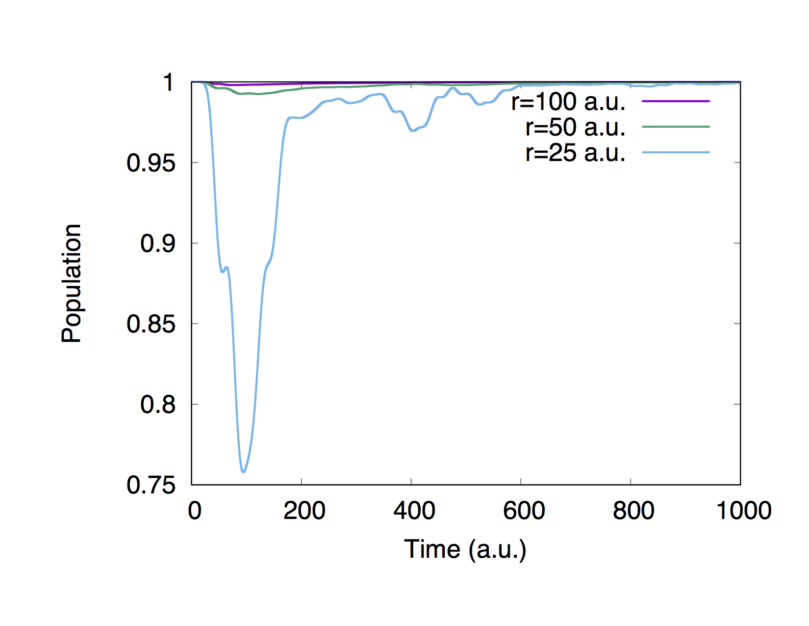
Ground-state population as a function of time of Malachite Green coupled to the hierarchical nanoparticle at varying separations along the z-axis

Slide 8
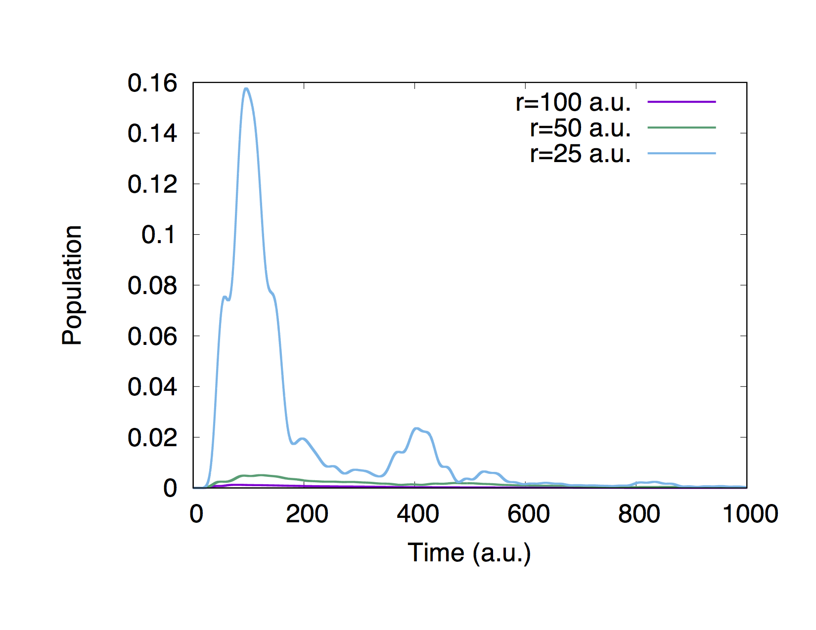
First excited-state population as a function of time of Malachite Green coupled to the hierarchical nanoparticle at varying separations along the z-axis

Slide 9
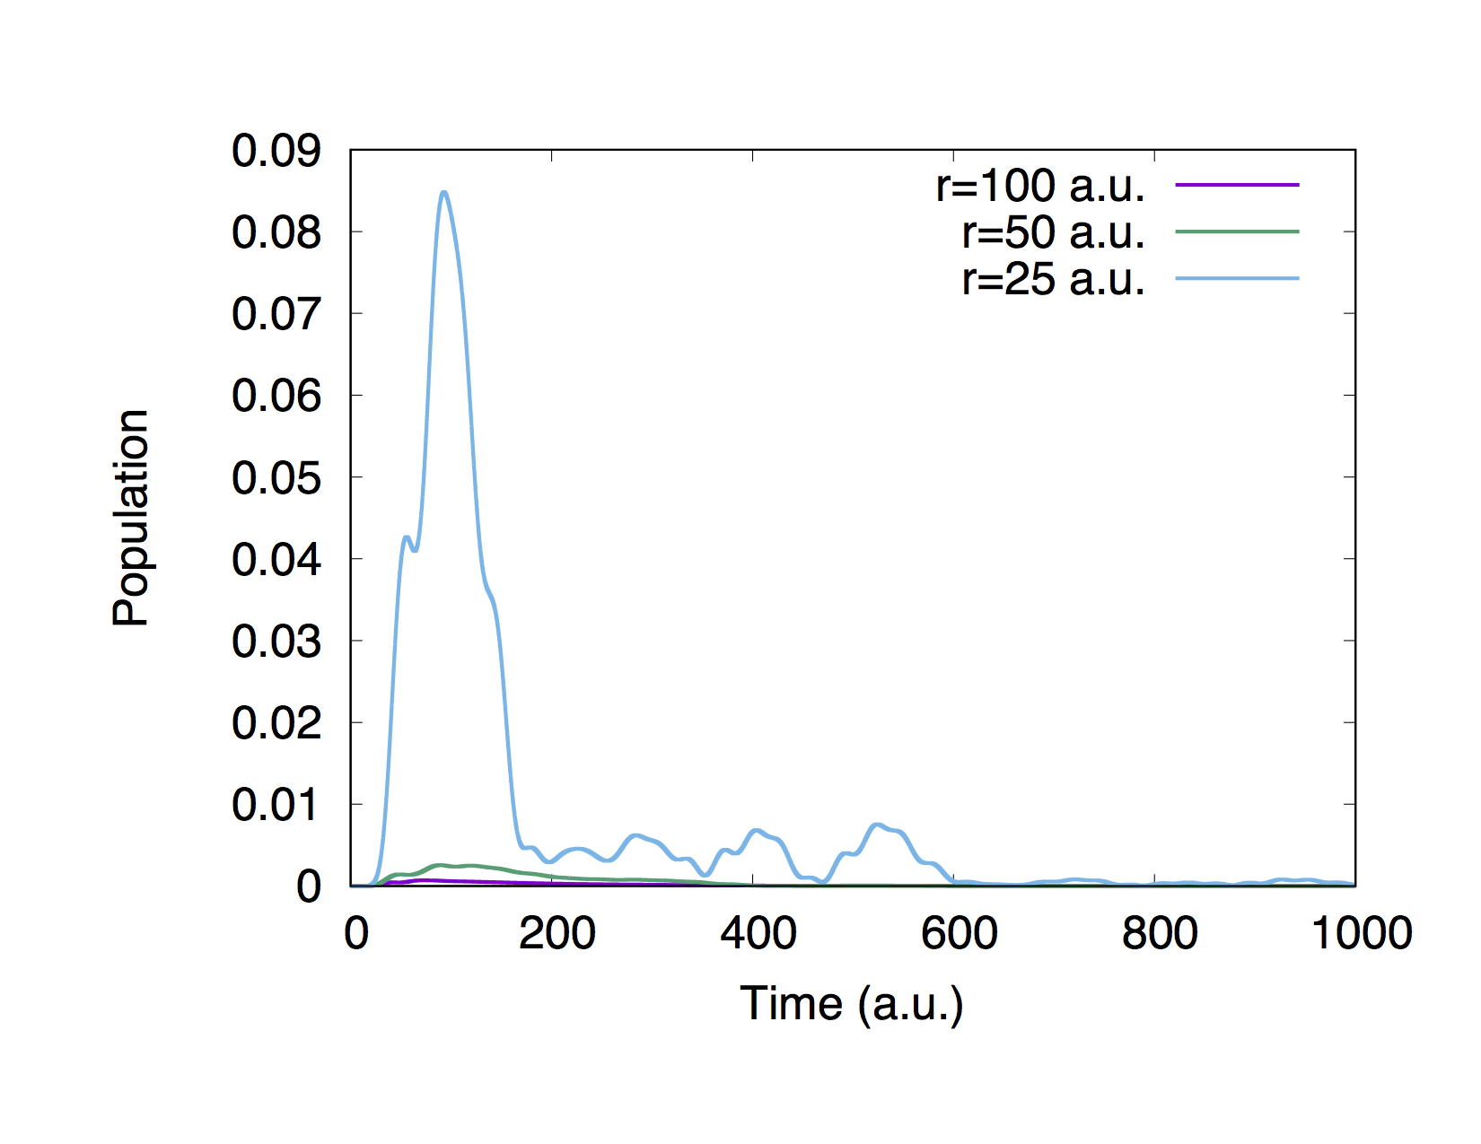
Second excited-state population as a function of time of Malachite Green coupled to the hierarchical nanoparticle at varying separations along the z-axis

