Slide 1

Voice-Controlled Photo Manager
14 October 2018
Team nop-nop
Arkajit Banerjee
Haihui Zhu
Lucas Cerchiaro
Tian

Slide 2
Existing Method
Voice-controlled Photo Manager
Go to Gallery
Select each photo
Click send
Say “Send all pictures of dogs taken today to Lucas”

Slide 3
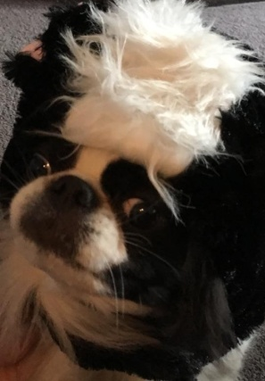

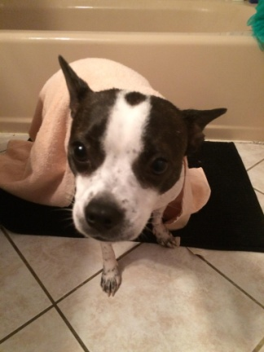
Value Proposition
Provide convenience to users who will edit and/or share chunks of photos at multiple levels in various devices using smart voice control.
Basic Actions

Slide 4
Minimum Viable Prototype
Voice
Informal Text
Service
Type-in
New Photos
User Gallery
Sync

Slide 5
Minimum Viable Prototype
speech
Watson Speech-to-text
result
Tag-Image Match
text
image/photo
Watson Visual Recog. API
User Image DB
image tags

Slide 6
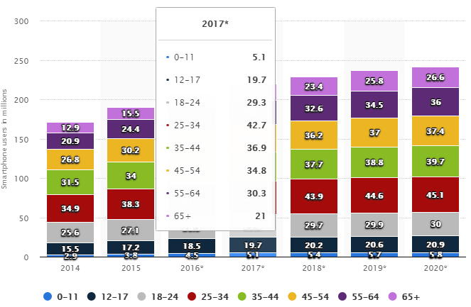
Business model
Notes:
36.2 + 32.6 = 68.8 million 2020
37 + 34.5 = 71.5 million 2019
37.4 + 36 = 73.4 million 2018

Slide 7
Business Model
Smartphone users 45-64 years age group = 65.1 M
Hope to reach 1 percent within 2 years = 651,000 user
Sell app for $1.99 to 651,000 = 1,295,490
http://www.pewinternet.org/fact-sheet/mobile/
https://www.census.gov/prod/cen2010/briefs/c2010br-03.pdf

Slide 8
Web App Demo
http://10.215.25.242/demo.html

Slide 9
Thank you!

