Slide 1



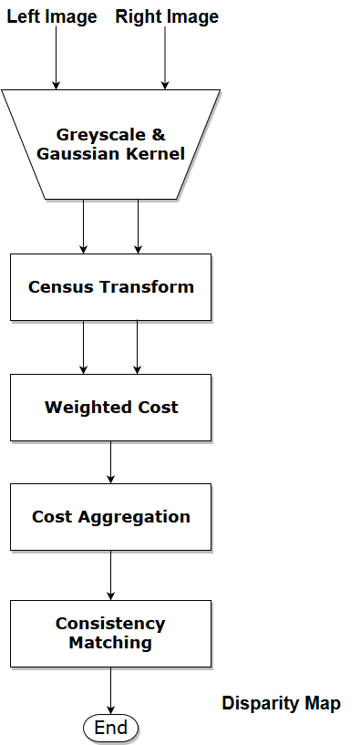
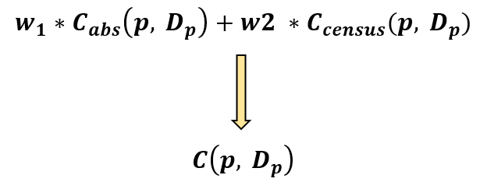
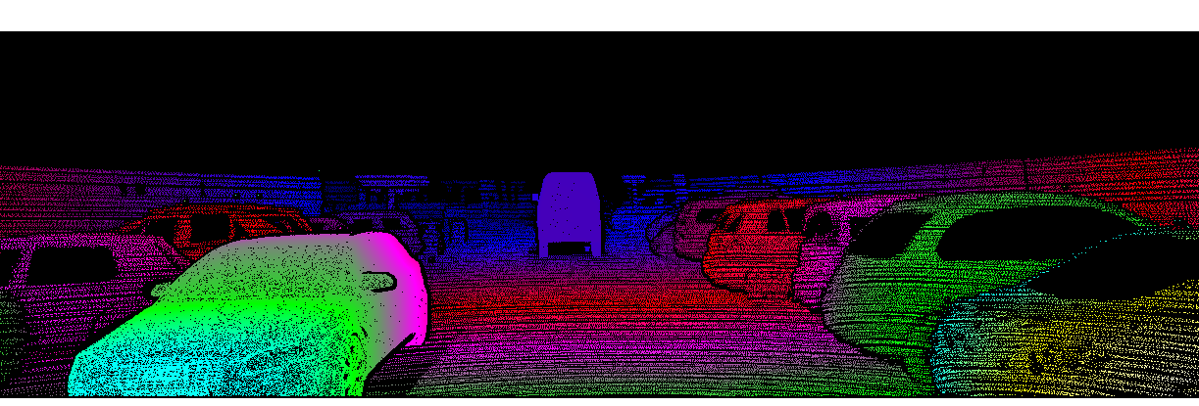
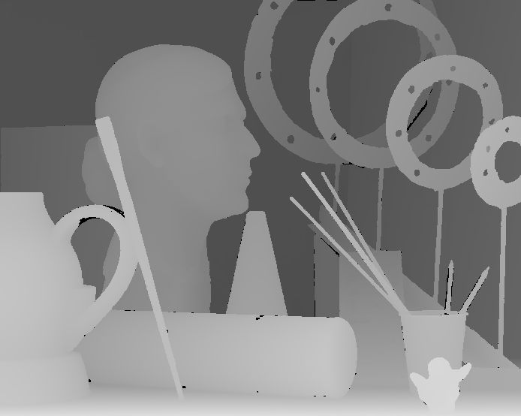
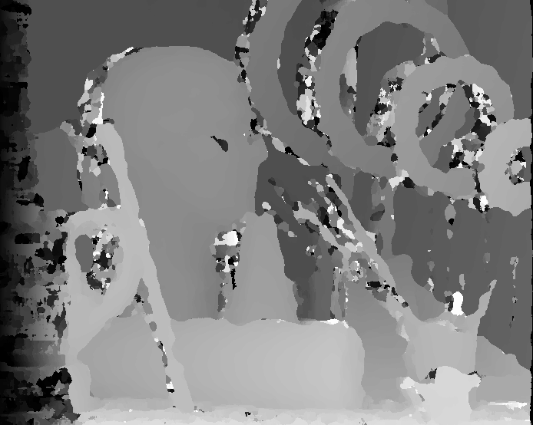
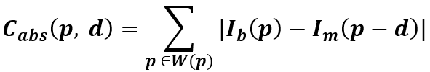
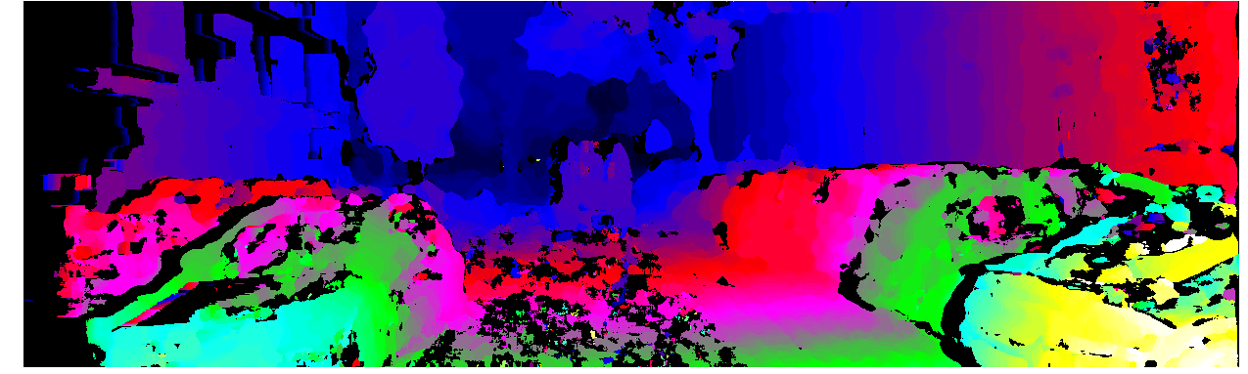
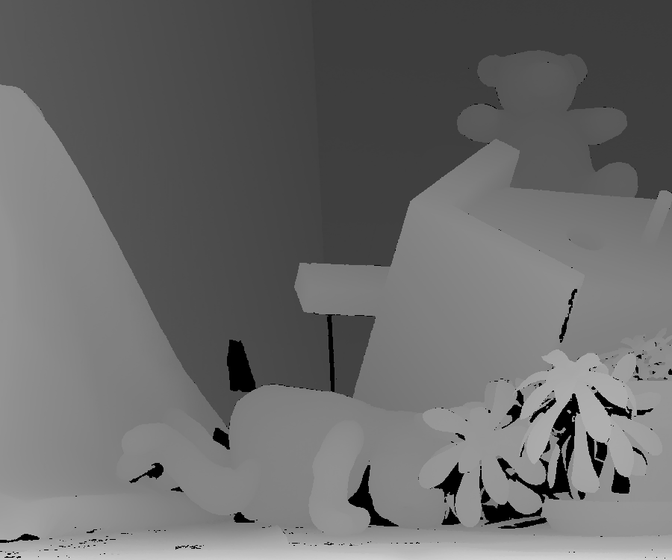
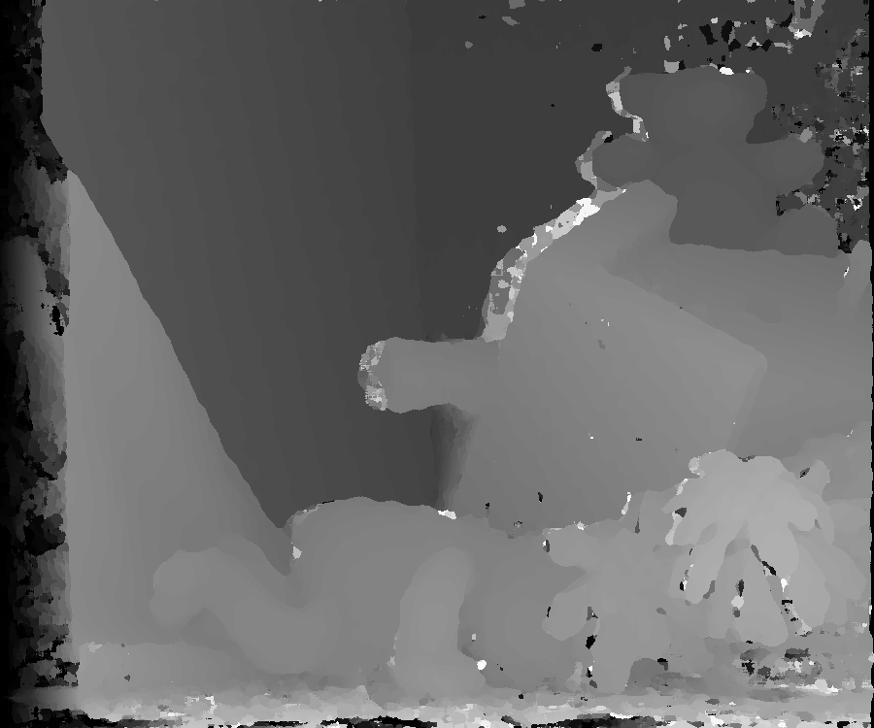
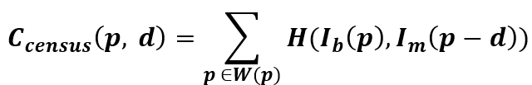
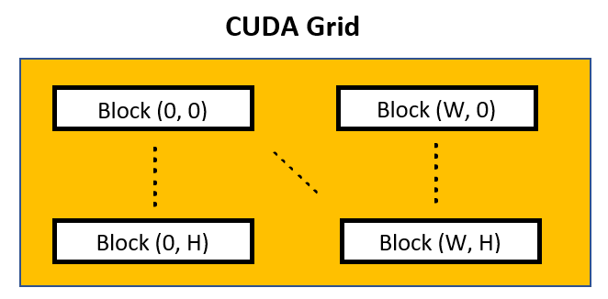

SHREC
PaP
Weighted-Cost Stereo Vision
and its CUDA Implementation
SURG
SUMMER UNDERGRADUATE RESEARCH GROUP
Haihui Zhu, Evan Gretok, Alan George
Introduction
Results
Goals
Parallelization of stereo-vision algorithms in CUDA
Research the algorithm performance
Motivations
3D vision input is fundamental to many high-level applications
Collision Avoidance
Scene Understanding
Industry trend: Cheaper GPU devices
Challenges
Pixel-level correspondence is sensitive to noise & texture
Memory Bottleneck
Performance Benchmark
GPU Utilization
CUDA Kernel Time Cost
Graphic Card
KITTI Benchmark
SM Utilization | Warp Occupancy | Active Warp per SM
94.65% | 91.75% | 58.72 (max = 64)
Weighted Cost | Cost Aggregation | Census Transform
99.22% | 0.43% | 0.15%
GeForce 940MX | Tesla P100-PCIE-16GB
1820 ms | 157.10 ms
Approach
Algorithm Workflow
Middlebury Dataset Evaluation
Weighted Cost
where
$W\left( p\right)$: neighbor pixels of p
H : Hamming distance
CUDA Architecture
Ground Truth
Disparity Map
Ground Truth
Art
Error: 9.67%
Error: 27.18%
Teddy
Error: 6.98%
Conclusions
CUDA Implementation is efficient: 94.65% SM busy
Weighted-Cost method decreases the error rate
Future work
Parameter Tuning
Optimization by using Shared Memory
Each thread finds the disparity value for one pixel

