Slide 1
Multimedia Processor
ESE 345
Himanshu Goel
Wilmer Suarez

Slide 2
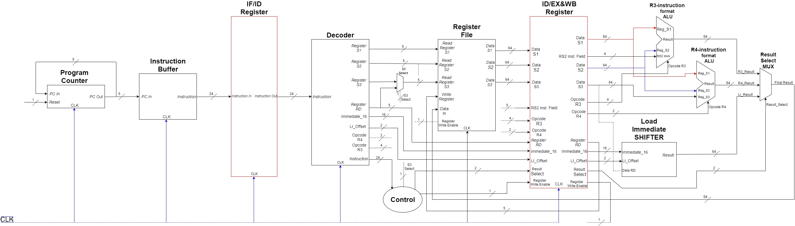
Multimedia Unit Block Diagram

Slide 3
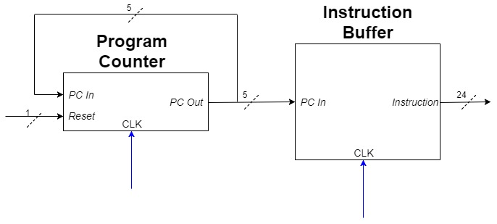
Program Counter and Instruction Buffer

Slide 4
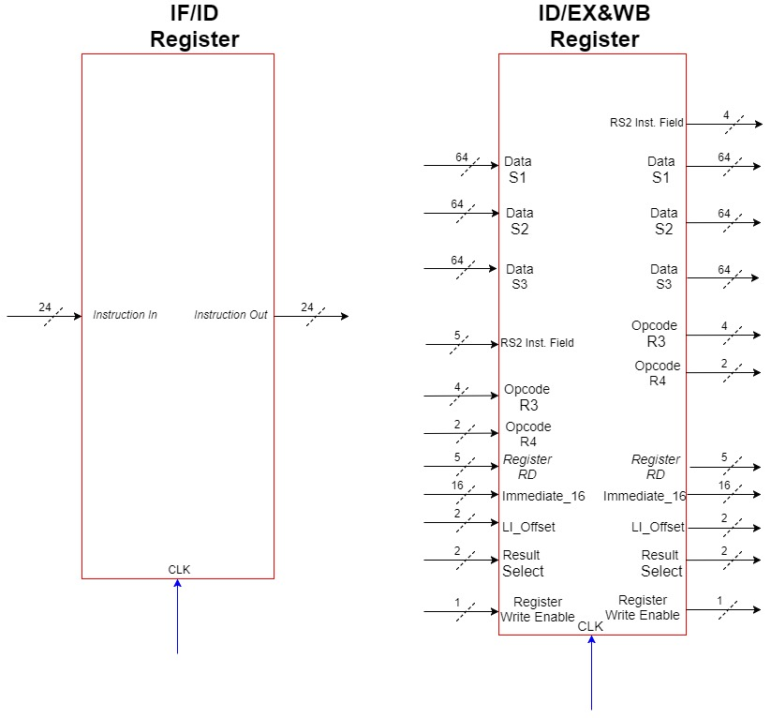
Pipeline Registers

Slide 5
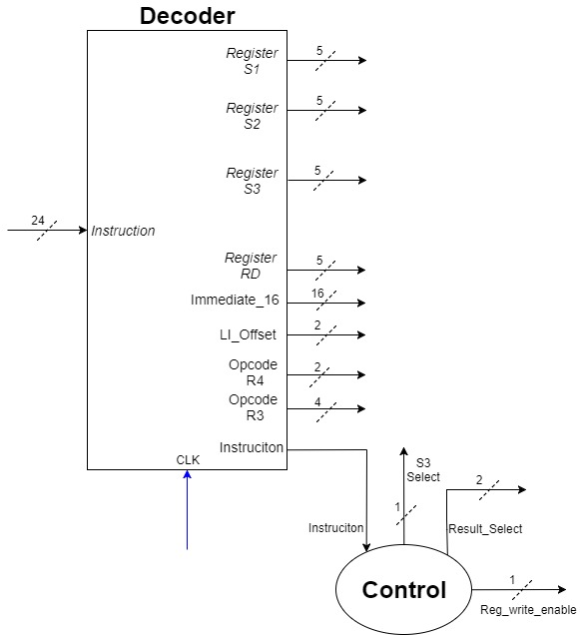
Instruction Decoder and Control Unit

Slide 6
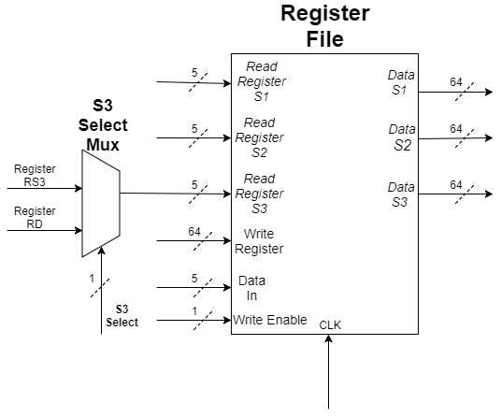
Register File

Slide 7
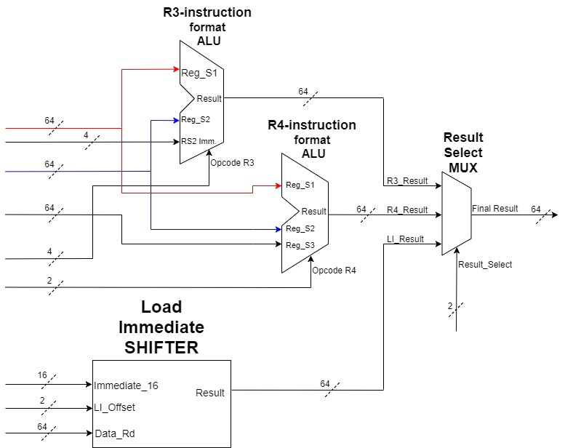
ALU 1, ALU 2 and Load Immediate Shifter

Slide 8
CODE
Program Counter

Slide 9
CODE
Instruction Buffer

Slide 10
CODE
Instruction Decoder

Slide 11
CODE
Register File

Slide 12
CODE
Control Unit

Slide 13
CODE
Pipeline Registers

Slide 14
CODE
ALU 1

Slide 15
CODE
Load Immediate Shifter

Slide 16
CODE
Multimedia Unit

