Slide 1
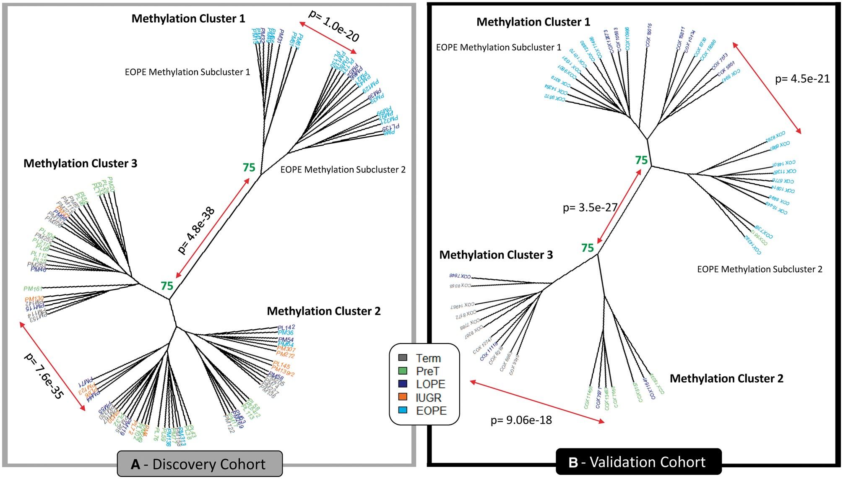

Figure 3. Hierarchical clustering (Euclidean) on the 599 validated hits in both the discovery (left) and validation ...
Notes:
Figure 3. Hierarchical clustering (Euclidean) on the 599 validated hits in both the discovery (left) and validation (right) cohorts. Numbers represent the percentage of times these clusters formed when using 1000 iterations with pvclust. Those highlighted in green are considered stable, where clusters formed >75% of the time. Those highlighted in red were unstable. P values signify clusters are significantly different from one another.
Unless provided in the caption above, the following copyright applies to the content of this slide: © The Author 2017. Published by Oxford University Press.This is an Open Access article distributed under the terms of the Creative Commons Attribution Non-Commercial License (http://creativecommons.org/licenses/by-nc/4.0/), which permits non-commercial re-use, distribution, and reproduction in any medium, provided the original work is properly cited. For commercial re-use, please contact journals.permissions@oup.com© The Author 2017. Published by Oxford University Press.

