Slide 1
2. Digital Filter Design (A)
任何可以用來去除 noise 作用的 operation，皆被稱為 filter
甚至有部分的 operation，雖然主要功用不是用來去除 noise，但是可以用 FT + multiplication + IFT 來表示，也被稱作是 filter
=
convolution
Reference
[1] A. V. Oppenheim and R. W. Schafer, Discrete-Time Signal Processing, London: Prentice-Hall, 3rd ed., 2010.
[2] D. G. Manolakis and V. K. Ingle, Applied Digital Signal Processing, Cambridge University Press, Cambridge, UK. 2011.
[3] B. A. Shenoi, Introduction to Digital Signal Processing and Filter Design, Wiley-Interscience, N. J., 2006.
[4] A. A. Khan, Digital Signal Processing Fundamentals, Da Vinci Engineering Press, Massachusetts, 2005.

Slide 2
· 2-A Classification for Filters
bilinear transform
IIR (infinite impulse response)
impulse invariant
digital filter
step invariant
others
關心平均誤差
filter
(1) MSE (mean square error)
FIR (finite impulse response)
最小化最大誤差
(2) Minimax (minimize the maximal error)
analog filter
(3) frequency sampling
(4) others
由 response 是否 有限長分類
由 數位類比分類
由設計方法分類

Slide 3
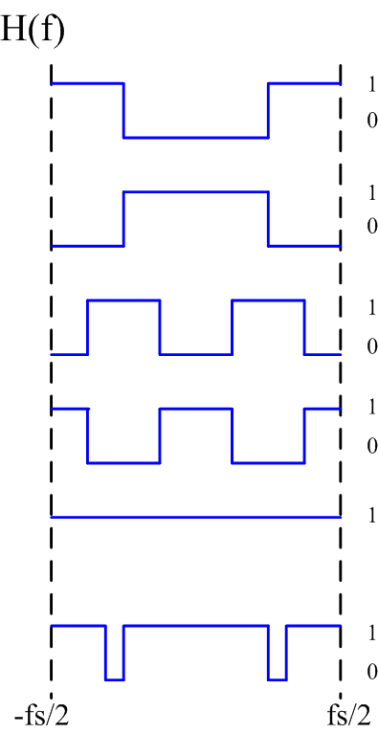
Classification for filters (依型態分)
high pass filter
pass-stop filter
low pass filter
band pass filter
band stop filter
all pass filter
matched filter
Notch filter
Wiener filter
0
differentiation
equalizer filter
integration
others
Hilbert transform
smoother
edge detection
Kalman filter
particle filter

Slide 4
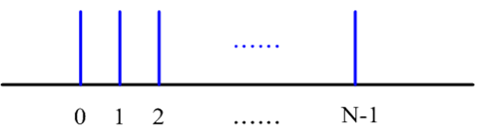
2-B FIR Filter Design
FIR filter: impulse response is nonzero at finite number of points
h[n] = 0 for n < 0 and n ≥ N
(h[n] has N points, N is a finite number)
h[n]
• FIR is more popular because its impulse response is finite.

Slide 5
(假設一)
Specially, when h[n] is even symmetric
h[n] = h[N−1 −n]
and N is an odd number
(假設二)
h[-1] h[0] h[1] h[k-2] h[k-1] h[k] h[k+1] h[k+2] h[N-2] h[N-1] h[N] h[N+1]
r[-k-1] r[-k] r[-k+1] r[-2] r[-1] r[0] r[1] r[2] r[k-1] r[k] r[k+1] r[k+2]
s[0] s[1]/2 s[2]/2 s[k-1]/2 s[k]/2
(a) r[n] = h[n + k], where k = (N−1)/2.
(b) s[0] = r[0], s[n] = 2r[n] for 0 < n ≤ k.

Slide 6
Impulse Response of the FIR Filter:
h[n] (h[n] ≠ 0 for 0 ≤ n ≤ N−1) r[n] = h[n + k], k = (N−1)/2 (r[n] ≠ 0 for -k ≤ n ≤ k, see page 41)
Suppose that the filter is even, r[n] = r[−n].
Set s[0] = r[0], s[n] = 2r[n] for n ≠ 0.
Then, the discrete-time Fourier transform of the filter is
(F = f Δ_{t} is the normalized frequency)
See page 22

Slide 7
2-C Least MSE Form and Minimax Form FIR Filters
(1) least MSE (mean square error) form
(關心 平均 誤差)
MSE = , f_{s}: sampling frequency
H(f): the spectrum of the filter we obtain H_{d}(f): the spectrum of the desired filter
(2) mini-max (minimize the maximal error) form (關心 最大 誤差)
maximal error:
The transition band is always ignored

Slide 8
Example: desired output H_{d}(F)
(A) larger MSE, but smaller maximal error
(B) smaller MSE, but larger maximal error
F

Slide 9
Generalization for Mini-Max Sense by weight function
maximal error:
weighted maximal error:
where W(f) is the weight function.
The weight function is designed according to which band is more important.
H_{d}(f)
transition band
passband
stopband
f
Q: How do we choose W(f) When SNR ?

Slide 10
Example: If we treat the passband the same important as the stopband.
W(f) = 1 in the passband, W(f) = 1 in the stopband
Q1: W(f) = 1 in the passband, W(f) < 1 in the stopband 代表什麼？
Q2: W(f) < 1 in the passband, W(f) = 1 in the stopband 代表什麼？
Q3: 如何用來壓縮特定區域 (如 transition band 附近) 的 error？
Q4: Weighting function 的概念可否用在 MSE sense ？

Slide 11
2-D Review: FIR Filter Design in the MSE Sense
F = f / f_{s}

Slide 12
From the facts that
when n ≠ τ,
when n = τ, n ≠ 0,
when n = τ, n = 0.
Therefore,
for n ≠ 0.

Slide 13
Minimize MSE → Make for all n’s
∴ , .
Finally, set h[k] = s[0],
h[k+n] = s[n]/2, h[k − n] = s[n]/2 for n = 1, 2, 3, …., k,
h[n] = 0 for n < 0 and n ≥ N.
Then, h[n] is the impulse response of the designed filter.

Slide 14
· 2-E FIR Filter Design in the Mini-Max Sense
It is also called“Remez-exchange algorithm”
or “Parks-McClellan algorithm”
References
[1] T. W. Parks and J. H. McClellan, “Chebychev approximation for nonrecursive digital filter-linear phase”, IEEE Trans. Circuit Theory, vol. 19, no. 2, pp. 189-194, March 1972.
[2] J. H. McClellan, T. W. Parks, and L. R. Rabiner “A computer program for designing optimum FIR linear phase digital filter”, IEEE Trans. Audio- Electroacoustics, vol. 21, no. 6, Dec. 1973.
[3] F. Mintz and B. Liu, “Practical design rules for optimum FIR bandpass digital filter”, IEEE Trans. ASSP, vol. 27, no. 2, Apr. 1979.

Slide 15
Two constraints
Suppose that:
① Filter length = N, N is odd, N = 2k+1.
② Frequency response of the desired filter: H_{d}(F) is an even function
(F is the normalized frequency)
③ The weighting function is W(F)

Slide 16
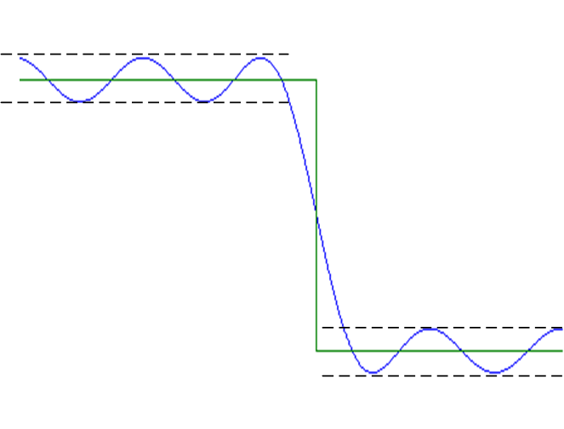
用Mini-Max方法所設計出的filters，一定會滿足以下二個條件
(1) 有k+2個以上的extreme points
(2) 在extreme points上， 是定值
Error 的 local maximal
local minimum
的情形
證明可參考
T. W. Parks and J. H. McClellan, “Chebychev approximation for nonrecursive digital filter-linear phase”, IEEE Trans. Circuit Theory, vol. 19, no. 2, pp. 189-194, March 1972.

Slide 17
(Step 1): Choose arbitrary k+2 extreme frequencies in the range of
0 ≤ F ≤ 0.5, (denoted by F₀, F₁, F₂, ….., F_{k+1})
Note: (1) Exclude the transition band.
(2) The extreme points cannot be all in the stop band.
Set E₁ (error) → ∞
Extreme frequencies: the locations where the error is maximal.
Step1
Step2
Step3
Step4
Step5
Step6
:
:
(參考 page 52)

Slide 18
(Step 2): From page 42, [R(F_{m}) − H_{d}(F_{m})]W(F_{m}) = (−1)^{m+1}e (where m = 0, 1, 2, ….. , k+1) can be written as
where m = 0, 1, 2, ….. , k+1.
Expressed by the matrix form:
Solve s[0], s[1], s[2], ….. , s[k] from the above matrix
(performing the matrix inversion).
Square matrix

Slide 19
(Step 3): Compute err(F) for 0 ≤ F ≤ 0.5, exclude the transition band.
(Step 4): Find k+2 local maximal (or minimal) points of err(F)
local maximal point: if q(τ) > q(τ + Δ) and q(τ) > q(τ − Δ),
then τ is a local maximal of q(x).
local minimal point: if q(τ) < q(τ + Δ) and q(τ) < q(τ − Δ),
then τ is a local minimal of q(x).
Other rules: Page 58
Denote the local maximal (or minimal) points by
These k+2 extreme points could include the boundary points of the transition band

Slide 20
(Step 5):
Set E₀ = Max(|err(F)|).
(Case a) If E₁ − E₀ > Δ, or E₁ − E₀ < 0 (or the first iteration) →
set F_{n} = P_{n} and E₁ = E₀, return to Step 2.
(Case b) If 0 ≤ E₁ − E₀ ≤ Δ → continue to Step 6.
(Step 6):
Set h[k] = s[0],
h[k+n] = s[n]/2, h[k − n] = s[n]/2 for n = 1, 2, 3, …., k
(referred to page 41)
Then h[n] is the impulse response of the designed filter.

Slide 21
57
· 2-F Mini-Max FIR Filter 設計時需注意的地方
(1) Extreme points 不要選在 transition band
Initial guess的extreme points只要注意別取在transition band裡，即能保證 converge，不同的guess會影響converge的速度但不影響結果
(2) E₁ (error of the previous iteration) < E₀ (present error) 時，亦不為收斂
(3) 思考： page 53 中的 matrix operation，如何用一行的指令寫出？

Slide 22
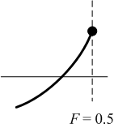
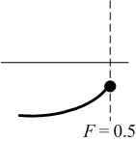
58
(4) Extreme points 判斷的規則：
(a) The local peaks or local dips that are not at boundaries must be extreme points.
boundaries: F = 0, F = 0.5, 以及 transition band 的兩端
(b) For boundary points
H_{d}(F)
F = 0
F = 0
Add a zero to the outside and conclude whether the point is a local maximum or a local minimum.

Slide 23
59
(5) 有時，會找到多於 k+2 個 extreme points, 該如何選
(a) 優先選擇不在 boundaries 的 extreme points
(b) 其次選擇 boundary extreme points 當中 |err(F)| 較大的，
直到湊足 k+2 個 extreme points 為止
(c) 在 boundary extreme points 的 |err(F)| 一樣大的情形，
優先選擇 transition bands 兩旁的點

Slide 24
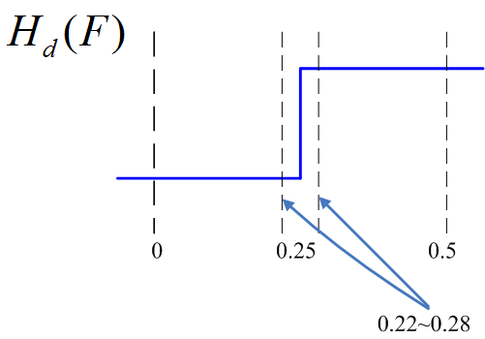
· 2-G Examples for Mini-Max FIR Filter Design
Example 1: Design a 9-length highpass filter in the mini-max sense
ideal filter: H_{d}(F) = 0 for 0 ≤ F < 0.25,
H_{d}(F) = 1 for 0.25 < F ≤ 0.5,
transition band: 0.22 < F < 0.28 Δ = 0.001
weighting function: W(F) = 0.25 for 0 ≤ F ≤ 0.22,
W(F) = 1 for 0.28 ≤ F ≤ 0.5,
(Step 1) Since N = 9, k = (N-1)/2 = 4, k+2 = 6,
→ Choose 6 extreme frequencies
(e.g., F₀ = 0, F₁ = 0.1, F₂ = 0.2, F₃ = 0.3, F₄ = 0.4, F₅ = 0.5)
[R(F_{n}) −H_{d}(F_{n})]W(F_{n}) = (−1)^{n+1}e, n = 0, 1, 2, 3, 4, 5.

Slide 25
(Step 2)

Slide 26
s [0]
s [1]
s [2]
s [3]
R(F) = 0.5120 – 0.6472cos(2πF) – 0.0297cos(4πF) + 0.2472cos(6πF)
+ 0.0777cos(8πF)
s [4]
(Step 3) err(F) = [R(F) – H_{d}(F)]W(F)
W[F] = 0 for 0.22 < F < 0.28
err(F)

Slide 27
(Step 4) Extreme points:
F₀ = 0, F₁ = 0.125, F₂ = 0.22, F₃ = 0.28, F₄ = 0.356, F₅ = 0.5
(Step 5) E₀ = Max[|err(F)|] = 0.1501, return to Step 2.
Second iteration
(Step 2) Using F₀ = 0, F₁ = 0.125, F₂ = 0.22, F₃ = 0.28, F₄ = 0.356, F₅ = 0.5
→ s[0] = 0.5018, s[1] = –0.6341, s[2] = –0.0194, s[3] = 0.3355, s[4] = 0.1385
(Step 3) err(F) = [R(F) – H_{d}(F)]W(F),
(Step 4) extreme points : 0, 0.132, 0.22, 0.28, 0.336, 0.5
(Step 5) E₀ = Max[|err(F)|] = 0.0951, return to Step 2.

Slide 28
Third iteration
(Step 2), (Step 3), (Step 4), peaks : 0, 0.132, 0.22, 0.28, 0.334, 0.5
(Step 5) E₀ = 0.0821, return to Step 2.
Fourth iteration
(Step 2), (Step 3) , (Step 4), peaks : 0, 0.132, 0.22, 0.28, 0.334, 0.5
(Step 5) E₀ = 0.0820, E₁ − E₀ = 0.0001 ≤ Δ, continues to Step 6.

Slide 29
(Step 6) From s[0] = 0.4990, s[1] = –0.6267, s[2] = –0.0203, s[3] = 0.3316, s[4] = 0.1442
h[4] = s[0] = 0.4990, h[3] = h[5] = s[1]/2 = –0.3134,
h[2] = h[6] = s[2]/2 = –0.0101, h[1] = h[7] = s[3]/2 = 0.1658,
h[0] = h[8] = s[4]/2 = 0.0721.

Slide 30
Example 2: Design a 7-length digital filter in the mini-max sense
ideal filter: H_{d}(F) = 1 for 0 ≤ F < 0.24,
H_{d}(F) = 0 for 0.24 < F ≤ 0.5, transition band: 0.21 < F < 0.27
weighting function: W(F) = 1 for 0 ≤ F ≤ 0.21,
W(F) = 0.5 for 0.27 ≤ F ≤ 0.5,
(Step 1) Since N = 7, k = (N-1)/2 = 3, k+2 = 5, → Choose 5 extreme frequencies
(e.g., F₀ = 0.05, F₁ = 0.15, F₂ = 0.3, F₃ = 0.4, F₄ = 0.5)

Slide 31
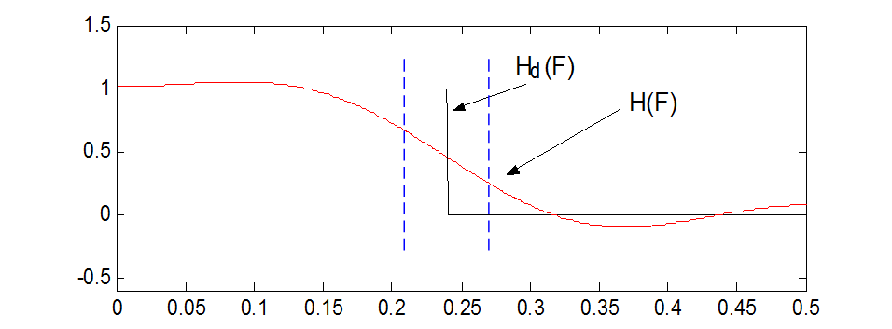
(Step 2)
→ s[0] = 0.4638, s[1] = 0.6327, s[2] = 0.0809, s[3] = -0.1608, e = -0.0364
R(F)

Slide 32
After Step 2,
(Step 3) err(F)
(Step 4) extreme points: 0.089, 0.21, 0.27, 0.369, 0.5.
(Step 5) E₀ = Max[|err(F)|] = 0.3396, return to Step 2.
Iteration | 1 | 2 | 3 | 4 | 5 | 6 | 7
Max[|err(F)|] | 0.3396 | 0.2371 | 0.3090 | 0.1944 | 0.1523 | 0.1493 | 0.1493

Slide 33
After 7 times of iteration
s[0] = 0.4243, s[1] = 0.7559, s[2] = -0.0676, s[3] = -0.2619, e = 0.1493
(Step 6):
h[3] = 0.4243, h[2] = h[4] = s[1]/2 = 0.3780,
h[1] = h[5] = s[2]/2 = -0.0338,
h[0] = h[6] = s[3]/2 = -0.1309, h[n] = 0 for n < 0 and n > 6

Slide 34
附錄二：Spectrum Analysis for Sampled Signals
(學信號處理的人一定要會的基本常識)
已知 x[n] 是由一個 continuous signal y(t) 取樣而得
x[n] = y(nΔ_{t})
DFT: FT:
Q: x[n] 的 DFT 和 y(t) 的 Fourier transform 之間有什麼關係？
Basic rule：把間隔由 1 換成 f_{s} /N where f_{s} = 1/ Δ_{t}
(Very important)

Slide 35
(1)
f_{s} = 1/ Δ_{t}
for m ≤ N/2
(2)
for m > N/2
frequency
0 fs/2 fs
(1)
(2)
m:
0 N/2 N

Slide 36
Proof：
用 t = nΔ_{t}, f = mΔ_{f} 代入
當
i.e.,

Slide 37
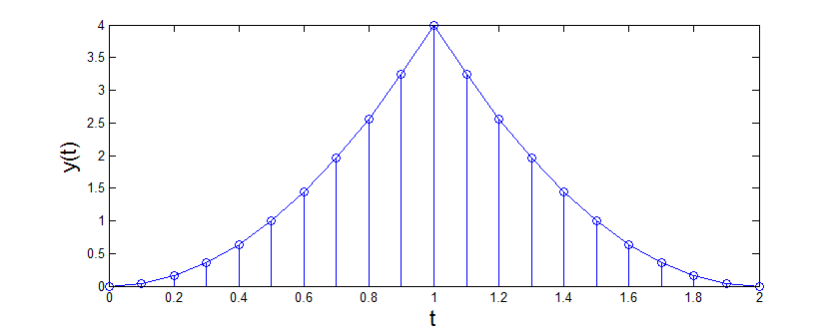
Example：已知
y(t) = (2t)² for 0 ≤ t ≤ 1
y(t) = (4－2t)² for 1 ≤ t ≤ 2
取樣間隔： Δ_{t} = 0.1
x[n] = y(n Δ_{t}) for 0 ≤ n ≤ 20
如何用 DFT 來正確的畫出 y(t) 的頻譜？

Slide 38
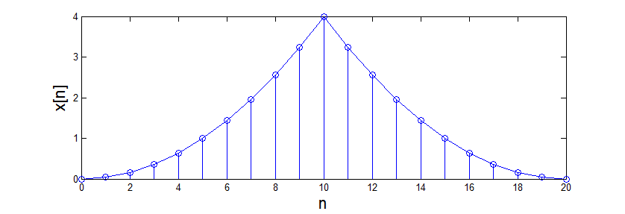
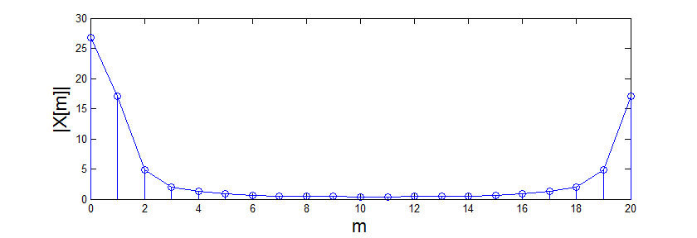
x[n] = y(n Δ_{t}) for 0 ≤ n ≤ 20
(Step 1) Perform the DFT for x[n]
N = 21

Slide 39
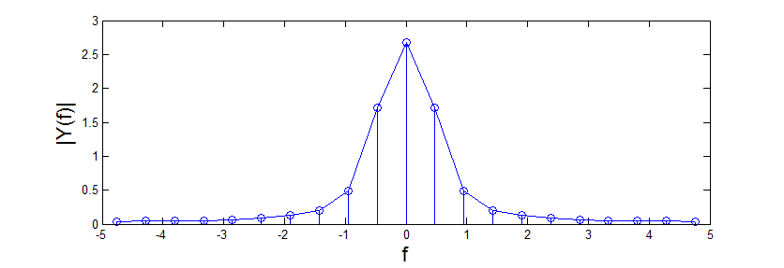
(Step 2-1)
for m ≤ N/2
(Step 2-2)
for m > N/2
In this example,
y(t) 的頻譜

