Slide 1
· 2-L Frequency Sampling Method
假設 designed filter h[n] 的區間為 n ∈ [0 , N−1]
filter 的點數為 N, k = (N − 1)/2
remember:
• Frequency Sampling 基本精神：
H_{d}(f) = H_{d}(f+f_{s})
若 H_{d}(f) 是 desired filter 的 discrete-time Fourier transform
R(f) 是 r[n] = h[n+P] 的 discrete-time Fourier transform
要求
for m = 0, 1, 2, 3, ……, N − 1
f_{s} : sampling frequency
若以 normalized frequency F = f/f_{s}表示
for m = 0, 1, 2, 3, ……, N − 1
(see page 101)

Slide 2
References：
L. R. Rabiner and B. Gold, Theory and Application of Digital Signal Processing, Prentice-Hall, N. J., 1975.
B. Gold and K. Jordan, “A note on digital filter synthesis,” Proc. IEEE, vol. 56, no. 10, pp. 1717-1718, 1969.
L. R. Rabiner and R. W. Schafer, “Recursive and nonrecursive realizations of digital filters designed by frequency sampling techniques,” IEEE Trans. Audio and Electroacoust., vol. 19, no. 3, pp. 200-207. Sept. 1971.

Slide 3
設計方法：
Step 1
n = 0, 1, …., N−1
換句話說，r₁[n] 是 H_{d}(m/N) 的 inverse discrete Fourier transform (IDFT)
Step 2 When N is odd
for n = 0, 1, …., k
k = (N −1)/2
for n = k+1, k+2, …., N−1
注意： r[n] 的區間為 n ∈ [−(N −1)/2, (N −1)/2]
h[n] = r[n − k ]
k = (N −1)/2

Slide 4
證明：
注意，若 R(F)是 r[n] 的 discrete-time Fourier transform
又由於 r₁[n] 是 H_{d}(m/N) 的 inverse discrete Fourier transform (IDFT)
所以

Slide 5
例子：
N = 17
H_{d}(F) = 1 for -0.25 < F < 0.25,
H_{d}(F) = 0 for -0.5 < F < -0.25, 0.25 < F < 0.5
(Step 1)
[ 1 , 1 , 1 , 1 , 1 , 0 , 0 , 0 , 0 , 0 , 0 , 0 , 0 , 1 , 1 , 1 , 1 ]
F=1/N
x
F=2/N

Slide 6
(Step 2)
r₁[n] = ifft([1, 1, 1, 1, 1, 0, 0, 0, 0, 0, 0, 0, 0, 1, 1, 1, 1]
= [0.529 0.319 -0.030 -0.107 0.032 0.066 -0.035 -0.049 0.040
0.040 -0.049 -0.035 0.066 0.032 -0.107 -0.030 0.319]
n = 0 ~ 16
(Step 3)
r [n] = [0.040 -0.049 -0.035 0.066 0.032 -0.107 -0.030 0.319 0.529
0.319 -0.030 -0.107 0.032 0.066 -0.035 -0.049 0.040]
n = −8 ~ 8
(Step 4)
若我們希望所設計出來的 filter h[n] 有值的區域為 n ∈ [0, 16]
h[n] = r[n − 8 ]
= [0.040 -0.049 -0.035 0.066 0.032 -0.107 -0.030 0.319 0.529
0.319 -0.030 -0.107 0.032 0.066 -0.035 -0.049 0.040]
n = 0 ~ 16

Slide 7
(Step 2)
(Step 3)
(Step 4)

Slide 8
R(F)在sample frequency 等於H_{d}(F)
Error 非 equal-ripple
• The approximation error tends to be highest around the transition band
and smaller in the passband and stopband regions.

Slide 9
Error is larger at the edge

Slide 11
討論：
(1) Frequency sampling 的方法頗為簡單且直觀，
但得出來的 filter 不為 optimal
(2) Ripple 大小變化的情形，介於 MSE 和 Minimax 之間
(3) 可以用設定 transition band 的方式，來減少 passband 和 stopband 的 ripple。(In transition band, R(m/N) ≠ H_{d}(m/N)).
然而，如何設定 transition band R(m/N) 的值，讓 passband 和 stopband 的
ripple 變為最小 ……… 需要作 linear programming。
(運算時間不少)

Slide 12
· 2-M 三種 FIR Digital Filter 設計方法的比較
• 以設計方法而論
MSE :
Minimax :
frequency sampling :
• 以方法的限制而論
MSE :
Minimax :
frequency sampling :
• 以效果而論
MSE :
Minimax :
frequency sampling :

Slide 13
The 4th Method for the FIR Filter Design
DFT
IDFT
x[n]
X[m]
Y[m] = X[m]H[m]
y[n]
H[m] = 1 for passband
H[m] = 0 for stopband
Q: Why do we not apply the method?

Slide 14
· 2-N Implementation of the FIR Filter
y[n] = x[n] ∗ h[n]
convolution
(1) 使用 FFT
y[n] = IFFT[ FFT{x[n]}× FFT{h[n]} ]
(2) 直接作 summation 即可
(3) Sectioned FFT

Slide 15
y[n] = x[n] ∗ h[n]
(2) 直接作 summation
假設 h[n] = 0 for n < 0 and n ≥ N
y[n] = h[0]x[n] + h[1]x[n−1] + ….. + h[N −2]x[n−N+2] + h[N −1]x[n−N+1]
• 若 h[n] = h[N−1−n] (even symmetric), N 為odd
y[n] = h[0](x[n] + x[n−N+1]) + h[1](x[n−1] + x[n−N+2])
+ ….. + h[k−1](x[n−k+1] + x[n−N+k]) + h[k] x[n−k]
k = (N − 1)/2

Slide 16
3. Theories about IIR Filters
3-A Minimum-Phase Filter
• FIR filter: The length of the impulse response is finite
usually linear phase (i.e., even or odd impulse response)
always stable
• IIR filter: The length of the impulse response is infinite.
may be unstable
(Question): Is the implementation also a problem?

Slide 17
An IIR Filter May Not be Hard to Implement
Ex : h[n] = (0.9)^{n}
, for n ≧ 0 , h[n] = 0 , otherwise
y[n] = x[n] * h[n]
Z transform

Slide 18
• IIR filter: The length of the impulse response is infinite.
→ try to make the energy concentrating on the region near to n = 0
. → try to make both the forward and the inverse transforms stable
using the minimum phase filter.
(All the poles and all the zeros are within the unit circle.)

Slide 19
Z transform
H(z) can be expressed as
p₁, p₂, p₃, ….. , p_{S} : poles z₁, z₂, z₃, ….. , z_{R} : zeros
• Minimum phase filter: All the poles and all the zeros are within the unit circle. i.e., |p_{s}| ≤ 1 and |z_{r}| ≤ 1
If any pole falls outside the unit circle (|p_{s}| > 1 ), then the impulse response of the filter is not convergent.

Slide 20
Stable filter: All the poles are within the unit circle.
when n < 0
when n ≥ 0
when n < 0 and n > R−S
when 0 ≤ n ≤ R−S

Slide 21
Thus, the minimum phase filter is stable and causal.
The inverse of the minimum phase filter is stable and causal.
Im(z)
poles zeros
unit circle |z| = 1
Re(z)

Slide 22
References
• A. Antoniou, Digital Filters: Analysis and Design, McGraw-Hill, New York, 1979.
• T. W. Parks and C. S. Burrus, Digital Filter Design, John Wiley, New York, 1989.
• O. Herrmann and W. Schussler, ‘Design of nonrecursive digital filters with minimum phase,’ Elec. Lett., vol. 6, no. 11, pp. 329-330, 1970.
• C. M. Rader and B. Gold, ‘Digital filter design techniques in the frequency domain,’ Proc. IEEE, vol. 55, pp. 149-171, Feb. 1967.
R. W. Hamming, Digital Filters, Prentice-Hall, Englewood Cliffs, NJ, 1988.
F. W. Isen, DSP for MATLAB and LabVIEW, Morgan & Claypool Publishers, 2009.

Slide 23
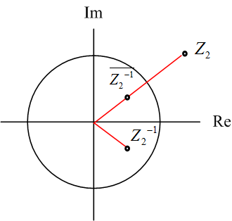
· 3-B Converting an IIR Filter into a Minimum Phase Filter
不影響amplitude
Suppose that z₂ is not within the unit circle, |z₂|> 1
The upper bar means conjugation.

Slide 24
In fact, if (see page 20), H(z) and H₁(z) only differ in phase,
(proof):
when
(單位圓上)
• We call the filter whose amplitude response is always 1 as the all-pass filter.
is an all-pass filter
• One can also use the similar way to move poles from the outside of the unit circle into the inside of the unit circle.

Slide 25
Any stable IIR filter can be expressed as a cascade of the
minimum phase filter and an all-pass filter.
H(z) :IIR filter, H_{mp}(z): minimum phase filter, H_{ap}(z): allpass filter
stable and causal IIR filter
all-pass filter
minimum phase filter
=

Slide 26
Example:
conjugates with
h[n], h₁[n] are the impulse response of the two filters H(z) and H₁(z)
(origin)
(minimum phase)

Slide 27
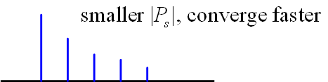
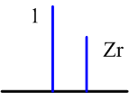
· 3-C The Meaning of Minimum Phase
Another important advantage of the minimum phase filter：
The energy concentrating on the region near to n = 0.
when n < 0
when n ≥ 0
b_{r}[0] = 1, b_{r}[1] = z_{r} ,
b_{r}[0] = 0 otherwise
n=0
n=1

Slide 28
Phase is related to delay
discrete time
Fourier transform
Minimum phase → Minimum delay
The multiplications in the Z domain (frequency domain) are equivalent to the convolutions in the time domain, so we could analyze each term individually in the previous page!!

Slide 29

125
附錄四：查資料的方法
(1) Google 學術搜尋 (不可以不知道)
網址： http://scholar.google.com.tw/
(太重要了，不可以不知道) 只要任何的書籍或論文，在網路上有電子版，都可以用這個功能查得到
再按「搜尋」，就可找到想要的資料
輸入關鍵字，或標題、作者
註：由於版權，大部分的論文必需要在學校上網才可以下載

Slide 30

126
按搜尋之後將出現相關文章
點選後，可找到該學術文章的原始出處和相關的電子檔
可限定要找的文章的刊登時間
若要引用這篇論文，可點選此按鈕，會出現三種不同格式的引用方式

Slide 31
127
(2) 尋找 IEEE 的論文
http://ieeexplore.ieee.org/Xplore/guesthome.jsp
註：除非你是 IEEE Member，否則必需要在學校上網，才可以下載到 IEEE 論文的電子檔
(3) Google
(4) Wikipedia
(5) 數學的百科網站
http://eqworld.ipmnet.ru/index.htm
有多個 tables，以及對數學定理的介紹
(6) 傳統方法：去圖書館找資料
台大圖書館首頁 http://www.lib.ntu.edu.tw/
或者去 http://www.lib.ntu.edu.tw/tulips

Slide 32
128
(7) 查詢其他圖書館有沒有我要找的期刊
台大圖書館首頁
其他聯合目錄
全國期刊聯合目錄資料庫
如果發現其他圖書館有想要找的期刊，可以申請「館際合作」，請台大圖書館幫忙獲取所需要的論文的影印版
台大圖書館首頁
館際合作
(8) 查詢其他圖書館有沒有我要找的書
「台大圖書館首頁」
「其他圖書館」
(9) 找尋電子書
「台大圖書館首頁」
「電子書」
或「免費電子書」

Slide 33
(10) 中文電子學位論文服務
129
http://www.cetd.com.tw/ec/index.aspx
可以查到多個碩博士論文 (尤其是 2006年以後的碩博士論文) 的電子版
(11) 想要對一個東西作入門但較深入的了解:
看書會比看 journal papers 或 Wikipedia 適宜
如果實在沒有適合的書籍，可以看 “review”， “survey” ，或 “tutorial” 性質的論文
(12) 有了相當基礎之後，再閱讀 journal papers
(以 Paper Title， Abstract， 以及其他 Papers 對這篇文章的描述，
來判斷這篇 journal papers 應該詳讀或大略了解即可)

Slide 34
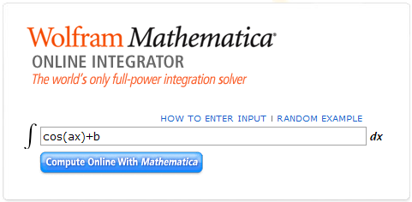
(13) 積分查詢方法
積分不會算或懶的算怎麼辦？
http://integrals.wolfram.com/index.jsp
輸入數學式，就可以查到積分的結果
範例：
(a) 先到integrals.wolfram.com/index.jsp 這個網站
(b) 在右方的空格中輸入數學式，例如
數學式

Slide 35
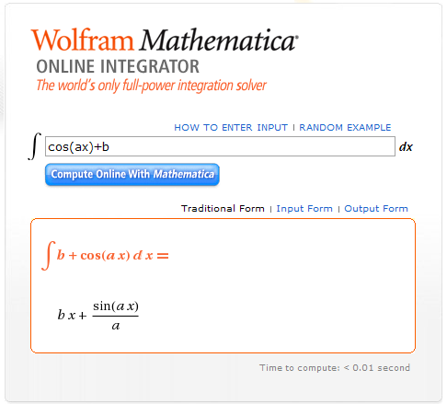
(c) 接著按 “Compute Online with Mathematica”
就可以算出積分的結果
按
結果

Slide 36
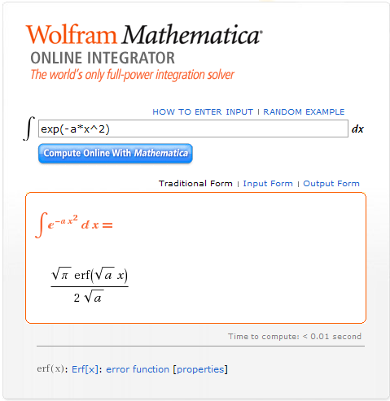
(d) 有時，對於一些較複雜的數學式，下方還有連結，點進去就可以看到
相關的解說
連結

Slide 37
(14) 可以查詢數學公式的工具書 (Handbooks)
M. R. Spiegel, Mathematical Handbook of Formulas and Tables, McGraw-Hill, 3rd Ed., New York, 2009. (已經有電子版)
M. Abramowitz and I. A. Stegun, Handbook of Mathematical Functions, with Formula, Graphs and Mathematical Tables, Dover Publication, New York, 1965.
A. Jeffrey, Handbook of Mathematical Formulas and Integrals, Academic Press, San Diego, 2000.

