Slide 1
4. Some Popular Filters
· 4-A Popular Filters (1): Pass-Stop Band Filters
highpass
bandpass
lowpass
allpass
bandstop
notch filter: 想濾掉 F = F₀ 的 noise，但 stop band 越小越好
F = 0
F₀
F = 0.5
思考: Why the notch filter is hard to design?

Slide 2
References
[1] K. Hirano, S. Nishimura, and S. K. Mitra, “Design of digital notch filters,” IEEE Trans. Commun., vol. 22, no. 7, pp. 964-970, Jul. 1974.
[2] T. H. Yu, S. K. Mitra and H. Babic, “Design of linear phase FIR notch filters,” in Sadhana, Springer, vol. 15, issue 3, pp. 133-155, Nov. 1990.
[3] S. C. D. Roy, S. B. Jain, and B. Kumar, "Design of digital FIR notch filters," Vision, Image and Signal Processing, IEE Proceedings, vol.141, no. 5, pp.334-338, Oct. 1994.
[4] S. C. Pei and C. C. Tseng, “IIR multiple notch filter design based on allpass filter,” IEEE Trans. Circuits Syst. II, vol. 44, no.2, pp. 133-136, Feb. 1997.
[5] C. C. Tseng and S. C. Pei, “Stable IIR notch filter design with optimal pole placement,” IEEE Trans. Signal Processing, vol. 49, issue 11, pp. 2673-2681, Nov. 2001.

Slide 3
· 4-B Popular Filters (2): Smoother (Weighted Average)
最簡單的 smoother:
find the average
近似 low-pass filter
可改寫成
h[n]
h[n] 如右圖
-L
L

Slide 4
一般型態的 smoother
Choose (1) h[n] = h[−n]
(2) |h[n₁]| ≤ |h[n₂]| if | n₁ | > | n₂ |
(3) h[n] ≥ 0 for all n
(4)
τ
任何能量隨著 |n| 遞減的 even function，都可以當成 smoother filter

Slide 5
Example
After applying the smoother filter

Slide 6
Smoother 是一種 lowpass filter (但不為 pass-stop band filter)
思考: smoother 在信號處理上有哪些功用？

Slide 7
· 4-C Popular Filters (3): Family of Odd Symmetric Filters
(a) Differentiation H(f) = j2πf when −f_{s} /2 < f < f_{s} /2,
H(f) = H(f + f_{s})
(b) Difference (一個簡單取代 differentiation 的方法)
1
h[n]
0
n
-1
h[n] = 1 when n = −1, h[n] = −1 when n = 0,
-1
h[n] = 0 otherwise
These two filters are equivalent only at low frequencies

Slide 8
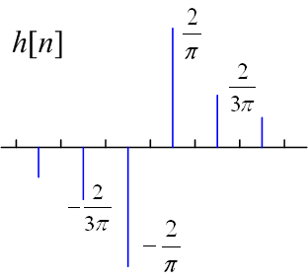
(C) Discrete Hilbert Transform
H(F) = −j
for 0 < F < 0.5
H(F) = j
for -0.5 < F < 0
H(F) = H(F+1)
when n is odd,
h[n] = 0 otherwise
Applications: (1) analytic function, (2) instantaneous frequency, (3) edge detection
Analytic function:
where

Slide 9
(D) Edge Detection
(1) h[n] = − h[−n]
(2) |h[n₁]| ≤ |h[n₂]| if |n₁| > |n₂|
Difference 和 discrete Hilbert transform 都可用作 edge detection
(1) 任何能量隨著 |n| 遞減的 odd function，都可以當成 edge detection filter
(2) The edge detection filter is in fact a matched filter.
Reference
S. C. Pei and J. J. Ding, “Short response Hilbert transform for edge detection,” IEEE Asia Pacific Conference on Circuits and Systems, Macao, China, pp. 340-343, Dec. 2008.

Slide 12
2D Edge Detection Filter
Example: Sobel filter

Slide 13
Sobel Operator
{2A[m, n+1] – 2A[m, n-1]+
A[m+1, n+1] –A[m+1, n-1]+
A[m-1, n+1] –A[m-1, n-1]}/4
A ∗
(horizontal axis)
11 | 10 | 10 | 10 | 12 | 11 | 10 | 9 | 10
10 | 10 | 11 | 10 | 10 | 10 | 10 | 11 | 9
10 | 10 | 9 | 150 | 150 | 150 | 10 | 10 | 10
10 | 10 | 160 | 160 | 155 | 160 | 158 | 10 | 11
10 | 10 | 158 | 160 | 161 | 161 | 160 | 150 | 10
10 | 155 | 160 | 163 | 164 | 165 | 160 | 151 | 10
10 | 148 | 160 | 160 | 162 | 160 | 155 | 10 | 12
8 | 10 | 140 | 150 | 152 | 150 | 10 | 11 | 10
9 | 12 | 10 | 10 | 10 | 10 | 9 | 10 | 10
 | 0 | 35 | 35.25 | 0.25 | -35.5 | -35 | -0.5
 | 37.25 | 107.5 | 69 | 0 | -69.25 | -107.25 | -37
 | 111.75 | 147.5 | 33.5 | 0.25 | -33.75 | -112.75 | -111
 | 149 | 114.5 | 1.25 | 1 | -0.75 | -46.5 | -149.25
 | 149.5 | 44.5 | 3.25 | 1.25 | -4 | -47.25 | -148.25
 | 145.5 | 43 | 5 | 0.5 | -40 | -113.25 | -109
 | 103.75 | 72.5 | 6.5 | 0 | -73 | -107 | -35.5

Slide 14
Sobel Operator
{2A[m+1, n] – 2A[m-1, n]+
A[m+1, n+1] –A[m-1, n+1]+
A[m+1, n-1] –A[m-1, n-1]}/4
A ∗
(vertical axis)
11 | 10 | 10 | 10 | 12 | 11 | 10 | 9 | 10
10 | 10 | 11 | 10 | 10 | 10 | 10 | 11 | 9
10 | 10 | 9 | 150 | 150 | 150 | 10 | 10 | 10
10 | 10 | 160 | 160 | 155 | 160 | 158 | 10 | 11
10 | 10 | 158 | 160 | 161 | 161 | 160 | 150 | 10
10 | 155 | 160 | 163 | 164 | 165 | 160 | 151 | 10
10 | 148 | 160 | 160 | 162 | 160 | 155 | 10 | 12
8 | 10 | 140 | 150 | 152 | 150 | 10 | 11 | 10
9 | 12 | 10 | 10 | 10 | 10 | 9 | 10 | 10
 | -0.5 | 34.5 | 104.25 | 138.75 | 104 | 35 | 0.5
 | 37.25 | 112 | 148.5 | 147.5 | 148.25 | 111.25 | 37
 | 37.25 | 77 | 45 | 10.75 | 45.75 | 112.75 | 107.5
 | 72.5 | 37 | 3.75 | 6.5 | 5.25 | 37.5 | 70.75
 | 69.5 | 35.5 | 0.75 | 0.25 | -1.5 | -37.75 | -70.75
 | -78 | -49.5 | -14.5 | -13 | -48 | -113.75 | -107.5
 | -105.75 | -146.5 | -150.5 | -151 | -149.5 | -110.5 | -37

Slide 15
Sobel Operator
{2A[m-1, n+1] – 2A[m+1, n-1]+
A[m-1, n] –A[m+1, n]+
A[m, n+1] –A[m, n-1]}/4
A ∗
(45°)
n
11 | 10 | 10 | 10 | 12 | 11 | 10 | 9 | 10
10 | 10 | 11 | 10 | 10 | 10 | 10 | 11 | 9
10 | 10 | 9 | 150 | 150 | 150 | 10 | 10 | 10
10 | 10 | 160 | 160 | 155 | 160 | 158 | 10 | 11
10 | 10 | 158 | 160 | 161 | 161 | 160 | 150 | 10
10 | 155 | 160 | 163 | 164 | 165 | 160 | 151 | 10
10 | 148 | 160 | 160 | 162 | 160 | 155 | 10 | 12
8 | 10 | 140 | 150 | 152 | 150 | 10 | 11 | 10
9 | 12 | 10 | 10 | 10 | 10 | 9 | 10 | 10
 | 0.25 | 0.25 | -33.75 | -104 | -104.75 | -70.25 | -0.5
 | 0.25 | -2.25 | -77.25 | -111.25 | -145 | -146.5 | -74.25
 | 37 | 70.25 | -7.75 | -7.75 | -77.5 | -150.5 | -146.75
 | 75.75 | 40 | -2.5 | -3.5 | -4.5 | -80.75 | -147.25
 | 77 | 7.5 | 1.5 | 0.75 | -1.75 | -7.25 | -75
 | 149.75 | 84.5 | 15.75 | 10.5 | 6 | 0.5 | -0.75
 | 142.5 | 146.5 | 116.5 | 113 | 74.5 | 1.75 | 1.5
m

Slide 16
· 4-D Popular Filters (4): Matched Filter
Used for demodulation, similarity measurement, and pattern recognition
“Edge and corner detections” are special cases of pattern recognition.
To detect a pattern h[n], we use its time-reverse and conjugation form as the filter
if h[n] ≠ 0 for τ₁ ≤ n ≤ τ₂
x[n]: input pattern, h[n]: the desired pattern
(correlation)
2-D form:
if h[m, n] ≠ 0 for τ₁ ≤ m ≤ τ₂, ρ₁ ≤ n ≤ ρ ₂,

Slide 17
Example
The result of the convolution should be normalized!

Slide 18
• Normalization Form
when
when
2-D Case
when
when

Slide 19
放大

Slide 20
• Normalization and Offset Form
when
when
where
(local mean)

Slide 21
• Normalization and Offset Form for the 2D Case
when
when
where
(local mean)

Slide 22
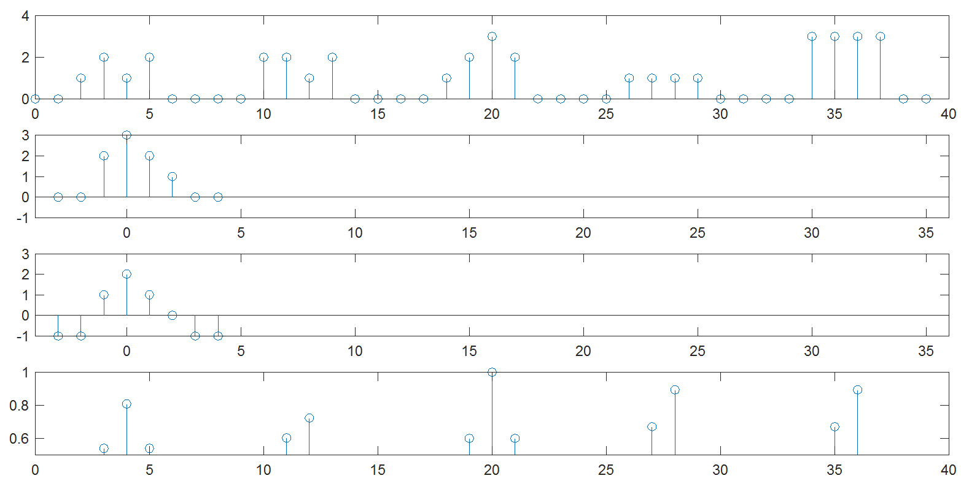
Normalization and Offset Form
x[n]
h[n]
h₁[n]
y[n]

Slide 23
· 4-E Popular Filters (5): Particle Filter and Kalman Filter
Particle filter:
f( ) is some mapping function and m[n] is the noise
The goal of the particle filter is not to remove the noise.
It is used for system modeling or prediction.
When (i) f( ) is a linear function and (ii) m[n] is a Gaussian noise, it becomes the Kalman filter.
Example:

Slide 24
· 4-F Popular Filters (5): Wiener Filter
(Nobert Wiener 維納, AD 1949)
No specific passband and stop band
It is related to random process.
The filter is designed based on the statistics of signal and noise

Slide 25
Suppose that
(a) the cross-correlation between the original signal x_{i}[n] and the received signal y_{i}[n] (i = 1, 2, 3, ….) is R_{xy}[n, σ],
(b) the auto-correlation of the received signal (denoted by R_{yy}[n, σ]),
then the transfer function of the optimal filter can be designed as

Slide 26
References
[1] N. Wiener, Extrapolation, Interpolation, and Smoothing of Stationary Time Series, M.I.T. Press, Cambridge, Mass. , 1964.
[2] S. S. Haykin, Adaptive Filter Theory, Prentice Hall, N.J., 2002.
[3] M. R. Banham and A. K. Katsaggelos, "Digital image restoration," IEEE Signal Processing Magazine, vol.14, no. 2, pp. 24-41, Mar. 1997

Slide 27
· 4-G Popular Filters (6): Equalizer
Used for compensation (such as the multiple path problem)
x[n]: original signal, y[n]: received signal
k[n]: effect of the system
Equalizer:
或者用 Z transform 表示

Slide 28
Equalizer:
Problem: If the system is interfered by noise m[n]
If K(F) is near to 0, the effect of the noise is magnified.

Slide 29
Combined with the concept of the Wiener filter, the equalizer is modified as:
E: mean
c is large when the SNR is small
c is small when the SNR is large

Slide 30
• Equalizer for the Multiple Path Problem
Equalizer:
delay = τ₁
x[n]
delay = τ₂
y[n]
delay = τ₃
delay = τ₄

Slide 31
• 缺點: (1) H(z)可能unstable
(2) H(z) is usually a dynamic response
• 可以用 homomorphic signal processing 來取代 equalizer 處理 multiple path problem.
References
S. S. Haykin, Communication Systems, John Wiley, N.J., 2010
W. D. Chang, J. J. Ding, Y. Chen, C. W. Chang, and C. C. Chang, “Edge-membership based blurred image reconstruction algorithm,” APSIPA Annual Summit and Conference, Hollywood, USA, Dec. 2012

Slide 32
165
附錄五 讀論文的方法 (個人心得)
為了做研究和工作的需要，同學們將來都要經常閱讀論文，甚至於，有的時候可能要一週要閱讀三篇以上的論文，而且大部分的論文說得都沒有像大學課本那麼有條理。用大學以前的讀書習慣，恐怕將難以應付。
要如何在短時間之內讀懂那麼多的論文，甚至於發現論文所提的方法可以改良的地方，是上了研究所之後必需學會的能力。
以下是幾點原則 (根據我個人的經驗)：
(A) 先判斷這篇論文是否應該被詳讀
(1) 越是核心，越是最早提出某個理論的論文，越是應該被詳讀
(2) 和自己目前研究密切相關的論文，當然有詳讀的必要
(3) Citation rate (引用次數) 較高的論文，可能也比較重要 (雖然不完全相 關)。
至於比較支節的論文，大略讀過即可

Slide 33
166
(B) 自己動手算
對於該「詳讀」的論文，可以自己動手來計算當中的幾個重要公式。
不是每篇論文都對論文中的理論和公式的來源有清楚的說明。在這個時候，還不如自己拿起筆來，親手證明論文當中的公式和理論。
自己動手算，不只能幫助自己了解論文當中的理論，而且，有時還可以「意外」的發現論文當中的理論可以進一步改良的地方，進而寫出新的論文出來。
(C) 讀過論文之後，問自己一些問題
(1) 這篇論文所提的概念 (Concepts) 是什麼？
(2) 方法的優點何在 (Advantages)？
(3) 可能的應用 (Applications) 在何處？
若能回答這三個問題，表現你大致讀通了這篇論文
若回答不出來，可能要再把論文當中遺漏的地方，再好好看 一看

Slide 34
167
(D) 進一步的分析
如果你不以讀懂一篇論文為滿足，想要進一步的發明創造之外，可以再問自己幾個問題
(1) Analysis for Advantages: 是什麼原因，造成這個方法有這樣的優點？
類似的概念，是否可以延伸、用在其他地方？
(2) Analysis for Disadvantages: 這方法有什麼問題？
是什麼原因，造成這些問題？
有什麼方法，可以改良這些問題？
(3) Innovations: 綜合以上的分析，再加上個人的靈感，想想這篇論文是否 有可以再進一步發明創新的地方？
(E) 註解
我經常看過一篇論文之後，會寫上幾行的文字，來描述這篇論文要點，以及在這個領域當中所扮演的角色。一方面有助於釐清概念，一方面也可以避免日後還要花時間來回憶這篇論文的內容是什麼

Slide 35
168
(F) 做個整理
可以將多篇論文所提的許多種方法，做一個有系統的整理和比較。
總共有多少種方法被提出來處理這個問題？這些方法的優缺點和適用的地方是什麼？它們之間是否可以歸納成幾大類？這些方法的相似和相異之處是什麼？
有時，把各種不同的方法做個綜合，拮取各方法的優點，將有助出創造出效能更好的新方法

