Slide 1
V. Homomorphic Signal Processing
· 5-A Homomorphism
Homomorphism is a way of “carrying over” operations from one algebra system into another.
Ex. convulution multiplication addition
把複雜的運算，變成效能相同但較簡單的運算

Slide 2
170
· 5-B Cepstrum
For the process of cepstrum (denoted by D*[．] )
convolution
product
addition
addition
*
×
＋
＋
x[n]
FT[．]
Log[ ]
FT⁻¹[．]
X(F)
FT: discrete-time Fourier transform

Slide 3

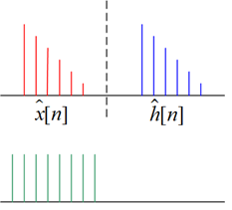
• 由 y[n]= x [n]*h[n] 重建 x[n]
y[n]= x [n]*h[n]
x[n]
*
D*[ ]
＋
＋
Lifter
＋
＋
D⁻¹*[ ]
*
For the inverse cepstrum D⁻¹*[．]
• 有趣的名詞
n
cepstrum
lifter
quefrency
n
lifter

Slide 4
· 5-C Methods for Computing the Cepstrum
• Method 1: Compute the inverse discrete time Fourier transform:
ambiguity for phase
Problems: (1)
(2)
Actually, the COMPLEX Cepstrum is REAL for real input

Slide 5
173
實際上計算cepstrum的方法
• Method 2 (From Poles and Zeros of the Z Transform)
time delay
where
Poles & zeros
inside unite circle
Poles & zeros
outside unite circle

Slide 6
174
Taylor series
Z⁻¹
(inverse Z transform)
?

Slide 7
175
Taylor series expansion
Z⁻¹
(Suppose that r = 0)
Poles & zeros inside unit circle, right-sided sequence
Poles & zeros outside unit circle, left-sided sequence
Note:
(1) 在 complex cepstrum domain
Minimum phase 及 maximum phase 之貢獻以 n = 0 為分界切開
(2) For FIR case, c_{k} = 0, d_{k} = 0
(3) The complex cepstrum is unique and of infinite duration for both positive & negative n, even though x[n] is causal & of finite durations

Slide 8
• Method 3
Z⁻¹

Slide 9
177
Suppose that x[n] is causal and has minimum phase, i.e. x[n] = = 0, n < 0
For a minimum phase sequence x[n]
recursive method
Determining
from

Slide 10
178
For anti-causal and maximum phase sequence, x[n] = = 0, n > 0
For maximum phase sequence,

Slide 11
· 5-D Properties
P.1 ) The complex cepstrum decays at least as fast as
P.2 ) If X(Z) has no poles and zeros outside the unit circle, i.e. x[n] is minimum phase, then
   
because of no b_{k}, d_{k}
P.3 ) If X(Z) has no poles and zeros inside the unit circle, i.e. x[n] is maximum phase, then
because of no a_{k}, c_{k}

Slide 12
180
P.4 ) If x[n] is of finite duration, then
has infinite duration

Slide 13
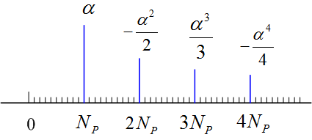
181
· 5-E Application of Homomorphic Deconvolution
(1) Equalization for Echo
s[n]
x[n]
delay N_{p}
Let p[n] be p[n] =δ[n] +αδ[n-N_{p}]
x[n] =s[n] +α s[n-N_{p}] =s[n] * p[n]
Z⁻¹
n

Slide 14
182
Filtering out the echo by the following “lifter”:
(2) Representation of acoustic engineering
x[n] = s[n] * h[n]
N_{p}
2N_{p}
3N_{p}
n
Signal
Synthesized music
music
building effect：e.g. 羅馬大教堂的impulse response

Slide 15
183
(3) Speech analysis
(4) Seismic Signals
(5) Multiple-path problem analysis
Speech
wave
Global wave shape
Pitch
Vocal tract impulse
They can be separated by filtering in the complex Cepstrum Domain

Slide 16
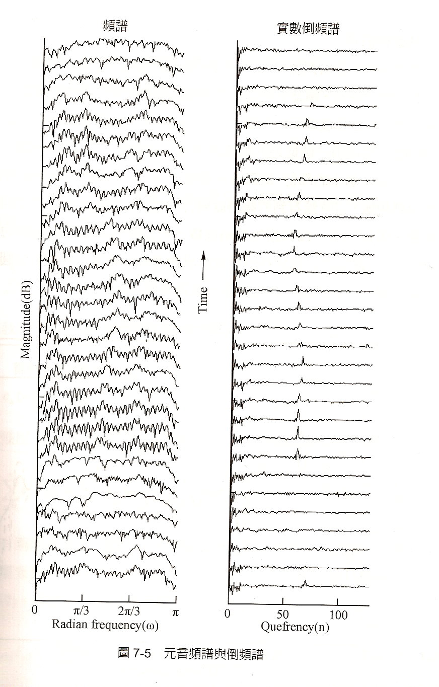
184
用 cepstrum 將 multipath的影響去除
From 王小川， “語音訊號處理”，全華出版，台北，民國94年。

Slide 17
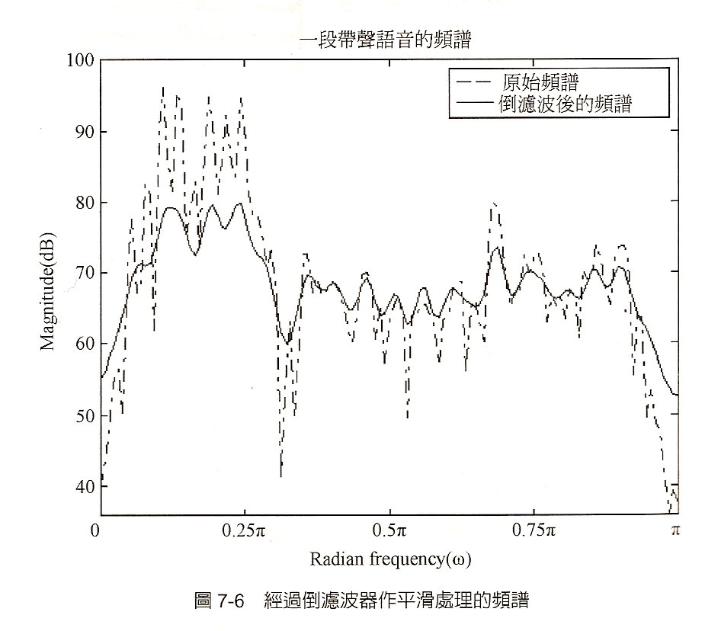
185
From 王小川， “語音訊號處理”，全華出版，台北，民國94年。

Slide 18
186
· 5-F Problems of Cepstrum
(1) | log(X(Z))|
(2) Phase
(3) Delay Z^{-k}
(4) Only suitable for the multiple-path-like problem

Slide 19
· 5-G Differential Cepstrum
或
inverse Z transform
Note:
If
Advantages: no phase ambiguity
able to deal with the delay problem

Slide 20
• Properties of Differential Cepstrum
(1) The differential Cepstrum is shift & scaling invariant
不只適用於 multi-path-like problem
也適用於 pattern recognition
If y[n] = A X[n - r]
(Proof):

Slide 21
(2) The complex cepstrum is closely related to its differential cepstrum and the signal original sequence x[n]
 
Complex cepstrum 做得到的事情, differential cepstrum 也做得到！

Slide 22
190
(3) If x[n] is minimum phase (no poles & zeros outside the unit circle), then = 0 for n ≤ 0
(4) If x[n] is maximum phase (no poles & zeros inside the unit circle) , then = 0 for n ≥ 2
delay
max phase
min phase
0
1
2
(5) If x(n) is of finite duration, has infinite duration
Complex cepstrum decay rate
Differential Cepstrum decay rate 變慢了,

Slide 23
191
· 5-H Mel-Frequency Cepstrum (梅爾頻率倒頻譜)
Take log in the frequency mask
B_{m}[k] = 0 for f < f_{m−1} and f > f_{m+1}
for f_{m−1} ≤ f ≤ f_{m}
for f_{m} ≤ f ≤ f_{m+1}
f = k*f_{s} /N
gain
mask of Mel-frequency cepstrum
f₁ , f₂ , f₃…… 以等比級數增加
frequency
f_{m-1}
f_{m}
f_{m+1}
f_{m+2}
f_{m+3}

Slide 24
192
Process of the Mel-Cepstrum
summation of the effect inside the m^{th} mask
x[n] X[k]
Q: What are the difference between the Mel-cepstrum and the original cepstrum?
Mel-frequency cepstrum 更接近人耳對語音的區別性
用 c_{x}[1], c_{x}[2], c_{x}[3], ……., c_{x}[13] 即足以描述語音特徵
FT
Advantages :

Slide 25
193
· 5-I References
• R. B. Randall and J. Hee, “Cepstrum analysis,” Wireless World, vol. 88, pp. 77-80. Feb. 1982
• 王小川， “語音訊號處理”，全華出版，台北，民國94年。
• A. V. Oppenheim and R. W. Schafer, Discrete-Time Signal Processing, London: Prentice-Hall, 3rd ed., 2010.
• S. C. Pei and S. T. Lu, “Design of minimum phase and FIR digital filters by differential cepstrum,” IEEE Trans. Circuits Syst. I, vol. 33, no. 5, pp. 570-576, May 1986.
• S. Imai, “Cepstrum analysis synthesis on the Mel-frequency scale,” ICASSP, vol. 8, pp. 93-96, Apr. 1983.

Slide 26
附錄六：聲音檔和影像檔的處理 (by Matlab)
194
A. 讀取聲音檔
電腦中，沒有經過壓縮的聲音檔都是 *.wav 的型態
讀取： wavread 或 audioread
例： [x, fs] = wavread('C:\WINDOWS\Media\ringin.wav');
可以將 ringin.wav 以數字向量 x 來呈現。 fs: sampling frequency
這個例子當中 size(x) = 9981 1 fs = 11025
思考: 所以，取樣間隔多大?
這個聲音檔有多少秒？
註：2015版本以後的 Matlab，wavread 將改為 audioread

Slide 27
195
畫出聲音的波型
time = [0:length(x)-1]/fs; % x 是前頁用 wavread 所讀出的向量
plot(time, x)
注意： *.wav 檔中所讀取的資料，值都在 −1 和 +1 之間

Slide 28
196
一個聲音檔如果太大，我們也可以只讀取它部分的點
[x, fs]=wavread('C:\WINDOWS\Media\ringin.wav', [4001 5000]);
% 讀取第4001至5000點
[x, fs, nbits] = wavread('C:\WINDOWS\Media\ringin.wav');
nbits: x(n) 的bit 數
第一個bit : 正負號，第二個bit : 2⁻¹，第三個bit : 2⁻²， …..，
第 n 個bit : 2^{−nbits +1}， 所以 x 乘上2^{nbits −1} 是一個整數
以鈴聲的例子， nbits = 8，所以 x 乘上 128是個整數

Slide 29
197
有些聲音檔是 雙聲道 （Stereo）的型態 (俗稱立體聲)
例： [x, fs]=wavread('C:\WINDOWS\Media\notify.wav');
size(x) = 29823 2 fs = 22050

Slide 30
198
B. 繪出頻譜 (請參考附錄四)
X = fft(x); plot(abs(X))
fft 橫軸 轉換的方法
(1) Using normalized frequency F: F = m / N.
(2) Using frequency f, f = F × f_{s} = m × (f_{s} / N).

Slide 31
199

Slide 32
200
C. 聲音的播放
(1) wavplay(x): 將 x 以 11025Hz 的頻率播放
(時間間隔 = 1/11025 = 9.07 × 10⁻⁵ 秒)
(2) sound(x): 將 x 以 8192Hz 的頻率播放
(3) wavplay(x, fs) 或 sound(x, fs): 將 x 以 fs Hz 的頻率播放
Note: (1)~(3) 中 x 必需是1 個column (或2個 columns)，且 x 的值應該 介於 −1 和 +1 之間
(4) soundsc(x, fs): 自動把 x 的值調到 −1 和 +1 之間 再播放

Slide 33
201
D. 用 Matlab 製作 *.wav 檔： wavwrite
wavwrite(x, fs, waveFile)
將數據 x 變成一個 *.wav 檔，取樣速率為 fs Hz
① x 必需是1 個column (或2個 columns) ② x 值應該 介於 −1 和 +1 之間
③ 若沒有設定fs，則預設的fs 為 8000Hz

Slide 34
202
E. 用 Matlab 錄音的方法
錄音之前，要先將電腦接上麥克風，且確定電腦有音效卡
(部分的 notebooks 不需裝麥克風即可錄音)
範例程式：
Sec = 3;
Fs = 8000;
recorder = audiorecorder(Fs, 16, 1);
recordblocking(recorder, Sec);
audioarray = getaudiodata(recorder);
執行以上的程式，即可錄音。
錄音的時間為三秒，sampling frequency 為 8000 Hz
錄音結果為 audioarray，是一個 column vector (如果是雙聲道，則是兩個 column vectors)

Slide 35
203
範例程式 (續)：
wavplay(audioarray, Fs); % 播放錄音的結果
t = [0:length(audioarray)-1]./Fs;
plot (t, audioarray‘); % 將錄音的結果用圖畫出來
xlabel('sec','FontSize',16);
wavwrite(audioarray, Fs, ‘test.wav’) % 將錄音的結果存成 *.wav 檔

Slide 36
204
指令說明：
recorder = audiorecorder(Fs, nb, nch);
(提供錄音相關的參數)
Fs: sampling frequency,
nb: using nb bits to record each data
nch: number of channels (1 or 2)
recordblocking(recorder, Sec);
(錄音的指令)
recorder: the parameters obtained by the command “audiorecorder”
Sec: the time length for recording
audioarray = getaudiodata(recorder);
(將錄音的結果，變成 audioarray 這個 column vector，如果是雙聲道，則 audioarray 是兩個 column vectors)
以上這三個指令，要並用，才可以錄音

Slide 37
F、MP3 檔的讀和寫
要先去這個網站下載 mp3read.m, mp3write.m 的程式
http://www.mathworks.com/matlabcentral/fileexchange/13852-mp3read-and-mp3write
程式原作者：Dan Ellis
mp3read.m : 讀取 mp3 的檔案
mp3write.m : 製作 mp3 的檔案
不同於 *.wav 檔 (未壓縮過的聲音檔)，*.mp3 是經過 MPEG-2 Audio Layer III的技術壓縮過的聲音檔

Slide 38
範例：
%% Write an MP3 file by Matlab
fs=8000; % sampling frequency
t = [1:fs*3]/3;
filename = ‘test’;
Nbit=32; % number of bits per sample
x= 0.2*cos(2*pi*(500*t+300*(t-1.5).^3));
mp3write(x, fs, Nbit, filename); % make an MP3 file test.mp3
%% Read an MP3 file by Matlab
[x1, fs1]=mp3read('phase33.mp3');
x2=x1(577:end); % delete the head
sound(x2, fs1)

Slide 39
207
F：影像檔的處理
Image 檔讀取: imread
Image 檔顯示: imshow, image, imagesc
Image 檔製作: imwrite
基本概念：灰階影像在 Matlab 當中是一個矩陣
彩色影像在 Matlab 當中是三個矩陣，分別代表 Red, Green, Blue
*.bmp: 沒有經過任何壓縮處理的圖檔
*.jpg: 有經過 JPEG 壓縮的圖檔
Video 檔讀取: aviread

Slide 40
範例一： (黑白影像)
208
im=imread('C:\Program Files\MATLAB\pic\Pepper.bmp');
(注意，如果 Pepper.bmp 是個灰階圖，im 將是一個矩陣)
size(im)
ans =
256 256
(用 size 這個指令來看 im 這個矩陣的大小)
image(im);
colormap(gray(256))
範例二：(彩色影像)
im2=imread('C:\Program Files\MATLAB\pic\Pepper512c.bmp');
size(im2)
ans =
512 512 3
(注意，由於這個圖檔是個彩色的，所以 im2 將由三個矩陣複合而成)
imshow(im);

Slide 41
209
注意：要對影像做運算時，要先變成 double 的格式
否則電腦會預設影像為 integer 的格式，在做浮點運算時會產生誤差
例如，若要對影像做 2D Discrete Fourier transform
im=imread('C:\Program Files\MATLAB\pic\Pepper.bmp');
im=double(im);
Imf=fft2(im);

