Slide 1
Data Science Homework 3
Shih-Hong Tsai and Yu-Heng Hsieh

Slide 2
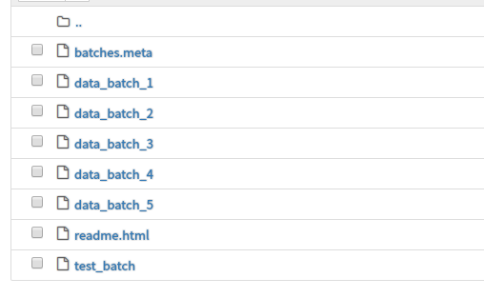
Goal: Train a model of which performance exceeds 75%
1. Download the dataset CIFAR-10 in https://www.cs.toronto.edu/~kriz/cifar.html
2. Split your training set into training and validation data, and construct a well-designed model to perform better then 75% on testing set
Training set: data_batch_1,2,3...
Testing set: test_batch

Slide 3
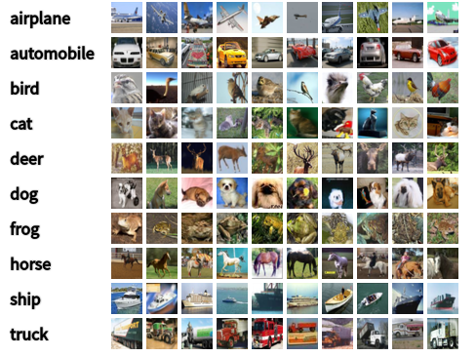
CIFAR 10 dataset
The CIFAR-10 dataset consists of 60000 32x32 colour images in 10 classes, with 6000 images per class. There are 50000 training images and 10000 test images.

Slide 4
Submission
hw3.zip
1. report.pdf:
1. Describe how you preprocess your data and the model architecture. (30%)
2. Compare different architectures or parameters and record their
performance (30%)
2. screenshot.png: A screenshot of the best testing set accuracy on
terminal. (20%)
3. hw3.py: A script that you train and test your model (20%)

